Slide 1
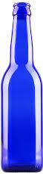
Blue Beer
Expansion Project

Slide 2
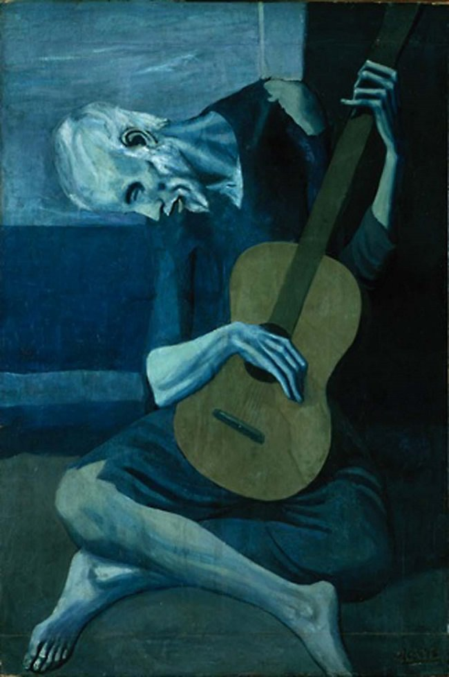
INTRODUCTION
Market research has shown that Millennials and iGen (>=21) prefer locally crafted beers, that have a high alcohol content but are not drawn to highly bitter beers.
To meet this demand we are introducing a new beer into the market.
Picasso
Blue Beer’s Picasso has a higher than typical alcohol content (ABV= 0.06) while having a lower than typical bitterness rating (IBU = 30).
We are looking to launch our initial production in an area with as few craft breweries as possible in the state, has a supporting demographic, and prefers beers with Picasso’s ABV and IBU characteristics.
PICASSO

Slide 3
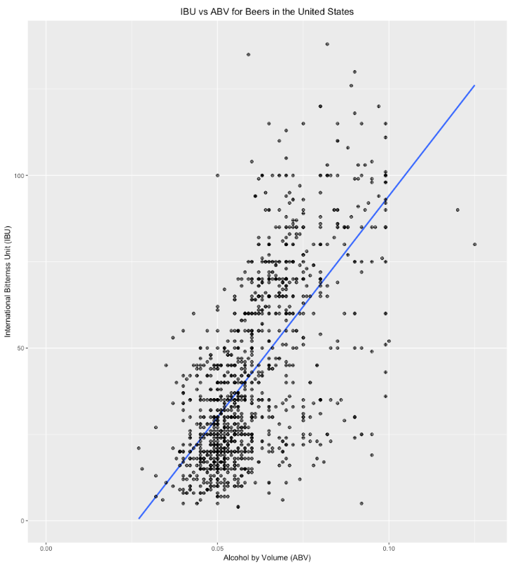
INTRODUCTION
PICASSO

Slide 4
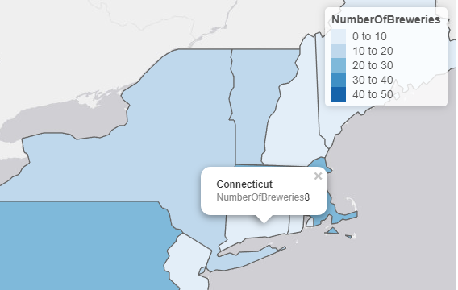
PILOT STATE
Connecticut
Reasons for Selection:
7th Highest Median Alcohol By Volume (ABV) – 0.06
9th Lowest Median International Bitterness Unit (IBU) – 29.0
In-state craft breweries: 8
PICASSO

Slide 5
PILOT STATE
Connecticut Drinking Age Population¹
Generation | Percentage | Count
iGen* (>=21) | 4.7% | ~160,000
Millennials | 18.2% | ~630,000
GenX | 23.9% | ~825,000
Boomers | 19.9% | ~690,000
PICASSO

Slide 6
Pilot Market
New Haven
Reasons for selection:
Second largest city²
Population: ~130,000
Universities³
Yale
Albertus Magnus College
Southern Connecticut State University
No craft brewers headquarters
PICASSO

Slide 7
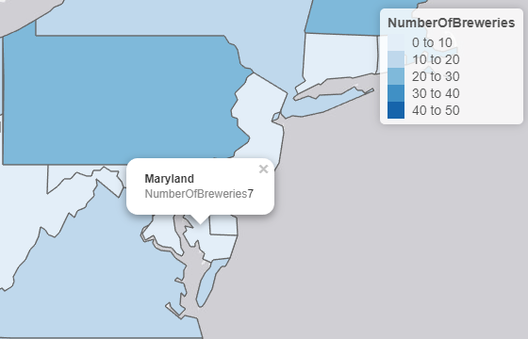
Second Test State
Maryland
Reasons for Selection:
12th Highest Median Alcohol By Volume (ABV) – 0.058
10th Lowest Median International Bitterness Unit (IBU) – 29.0
In-state craft breweries: 7
PICASSO

Slide 8
SECOND TEST STATE
Maryland Drinking Age Population⁴
Generation | Percentage | Count
iGen* (>=21) | 5.2% | ~290,000
Millennials | 19.8% | ~1,120,000
GenX | 23.1% | ~1,300,000
Boomers | 19.0% | ~1,070,000
PICASSO

Slide 9
SECOND TEST MARKET: Baltimore
Baltimore
Reasons for selection:
Largest city⁵
Population: ~650,000⁵
Universities⁶
Coppin State University
Johns Hopkins University
Morgan State University
Loyola University Maryland
University of Baltimore
Plus four (4) other major institutions
Three (3) craft brewers are headquartered in Baltimore
PICASSO

Slide 10
Final Test Market: Indiana / Illinois
Indiana / Illinois
Indiana
In-state craft breweries: 22
14th Highest Median Alcohol By Volume (ABV) – 0.058
18th Lowest Median International Bitterness Unit (IBU) – 33.0
Illinois
In-state craft breweries: 18
13th Highest Median Alcohol By Volume (ABV) – 0.058
11th Lowest Median International Bitterness Unit (IBU) – 30.0
PICASSO

Slide 11
Final Test Market: Indiana / Illinois
Indiana / Illinois
Brewery Location: South Bend, IN
Reasons for selection:
96 Miles from Chicago
South Bend-Chicago Population: ~2.8 million^{7,8}
Universities^{9,10}
DePaul University
Elmhurst College
Holy Cross College
Loyola University Chicago
University of Notre Dame
Plus 40 other institutions
One (1) brewer headquartered in South Bend
Nine (9) brewers headquartered in Chicago
PICASSO

Slide 12
Mass Production Locations
REGION | CITY
Northeast | Newark
Midwest | Chicago
Southeast | Atlanta
Northwest | Boise
Rocky Mountain | Denver
Southwest | Dallas
PICASSO

Slide 13
Summary
Introduce our newest beer, Picasso, that is high in alcohol content but low in bitterness
Release as a local craft beer in test markets
Initial: New Haven, Connecticut
Follow-on:
Baltimore Maryland
South Bend, Indiana
Chicago, Illinois
Expand nationwide placing major breweries in large distribution centers
Chicago
Newark
Atlanta
Boise
Dallas
Denver
PICASSO

Slide 14
SOURCES
https://suburbanstats.org/population/how-many-people-live-in-connecticut
https://en.wikipedia.org/wiki/List_of_cities_in_Connecticut
https://en.wikipedia.org/wiki/List_of_colleges_and_universities_in_Connecticut
https://suburbanstats.org/population/how-many-people-live-in-maryland
https://en.wikipedia.org/wiki/List_of_municipalities_in_Maryland
https://en.wikipedia.org/wiki/List_of_colleges_and_universities_in_Maryland
https://www.google.com/search?q=population+of+chicago+2017&rlz=1C1CHFX_enUS749US749&oq=population+of+chicago+2017&aqs=chrome.0.69i59j69i60l3j0l2.2727j1j7&sourceid=chrome&ie=UTF-8
https://en.wikipedia.org/wiki/List_of_cities_in_Indiana
https://en.wikipedia.org/wiki/List_of_colleges_and_universities_in_Indiana
https://en.wikipedia.org/wiki/List_of_colleges_and_universities_in_Chicago
PICASSO

