Slide 1
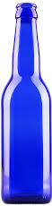

Blue Beer’s
Picasso
Expansion Project
PICASSO

Slide 2
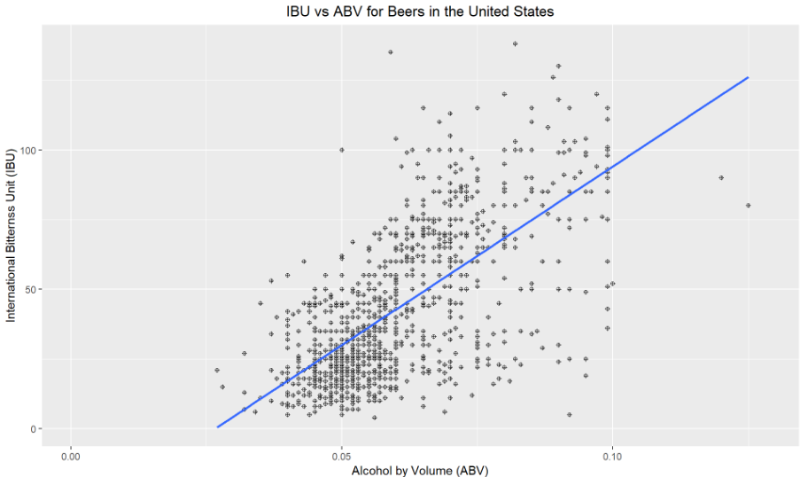
ISSUE
Beers follow the general rule:
Higher alcohol requires
More bitterness
PICASSO

Slide 3
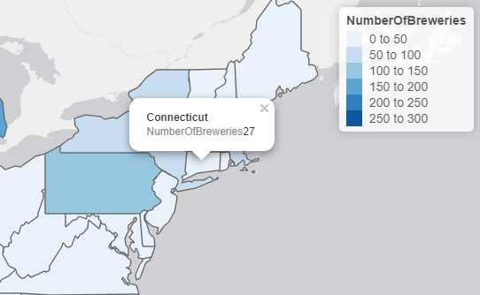
INITIAL TEST MARKET
Connecticut
Selection Criteria:
In-state breweries: 8
7th Highest Median Alcohol By Volume (ABV) – 0.06
9th Lowest Median International Bitterness Unit (IBU) – 29.0
PICASSO

Slide 4
INITIAL TEST MARKET
Connecticut Drinking Age Population¹
Generation | Percentage | Count
iGen* (>=21) | 4.7% | ~160,000
Millenials | 18.2% | ~630,000
GenX | 23.9% | ~825,000
Boomers | 19.9% | ~690,000
PICASSO

Slide 5
Initial Test Market
Connecticut
Location for Brewery: New Haven
Selection Criteria:
Second largest city²
Population: ~130,000
Universities³
Yale
Albertus Magnus College
Southern Connecticut State University
No Connecticut brewers are headquartered in New Haven
PICASSO

Slide 6
Expansion Test Markets
Maryland
Brewery Location: Baltimore
Indiana / Illinois
Brewery Location: South Bend
96 Miles from Chicago
PICASSO

Slide 7
Mass Production Locations
REGION | CITY
Northeast | Newark
Midwest | Chicago
Southeast | Atlanta
Northwest | Boise
Rocky Mountain | Denver
Southwest | Dallas
PICASSO

Slide 8
Summary
Introduce our newest beer that is high in alcohol content but low in bitterness
Release as a local craft beer in test markets
Initial: New Haven, Connecticut
Follow-on:
South Bend, Indiana
Chicago, Illinois
Baltimore Maryland
Expand nationwide placing major breweries in large distribution centers
Chicago
Newark
Atlanta
Boise
Dallas
Denver
PICASSO

Slide 9
Footnotes
https://suburbanstats.org/population/how-many-people-live-in-connecticut
https://en.wikipedia.org/wiki/List_of_cities_in_Connecticut
https://en.wikipedia.org/wiki/List_of_colleges_and_universities_in_Connecticut
PICASSO

