Slide 1
A secure environment for conducting examinations on personal devices
Bachelor thesis by Kjell Viaene

Slide 2
Introduction
Why?
For who?
What?
Notes:
Spieken bij digitale examens wordt te frequent geaccepteerd
Schools, teachers and students
DNS whitelisting, router acl, firewall, SEB

Slide 3
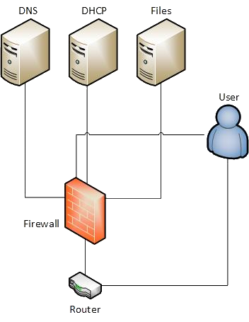
Test environment

Slide 4
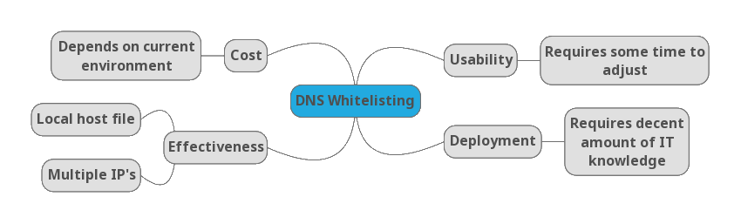
DNS whitelisting

Slide 5
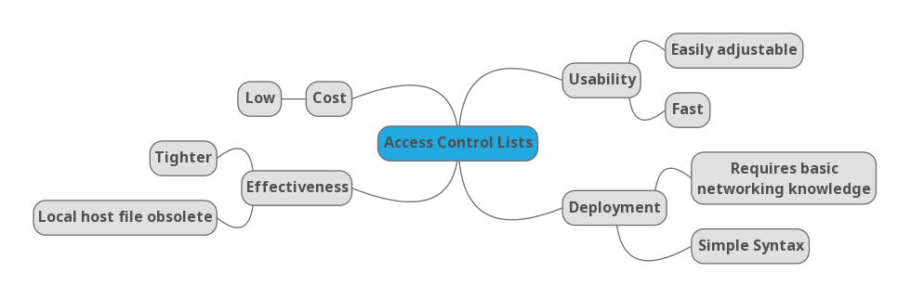
Access control lists

Slide 6
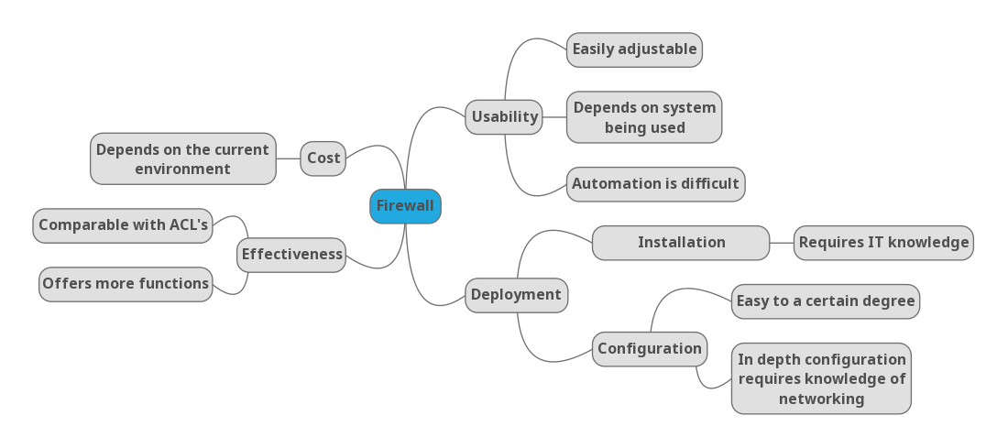
PFSense Firewall

Slide 7
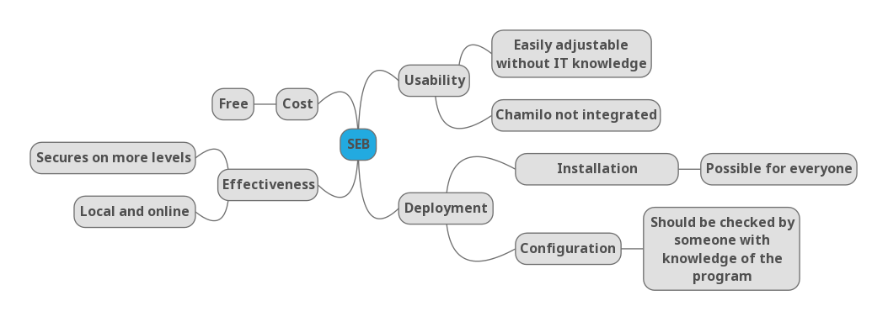
Safe Exam Browser

Slide 8
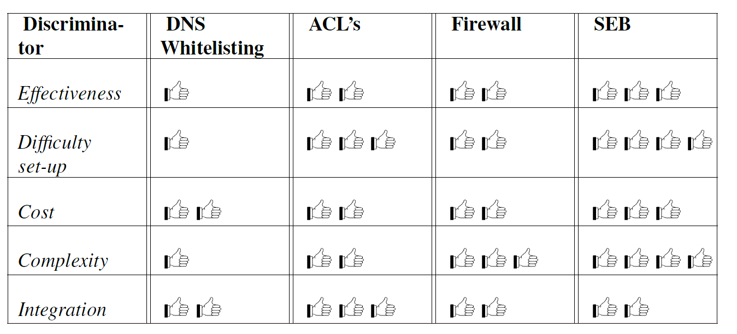
Final comparison

Slide 9
Conclusion
Safe Exam Browser
Remaining danger
Further research

