Slide 1









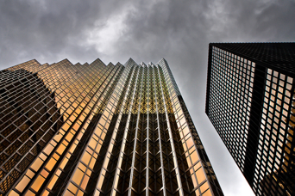






















$×$1.5
$×$1.5
$×$2
$×$2
$×$2.5
$×$2.5
$×$3
$×$3
$×$3.5
$×$3.5
$×$4
$×$4

