Slide 1
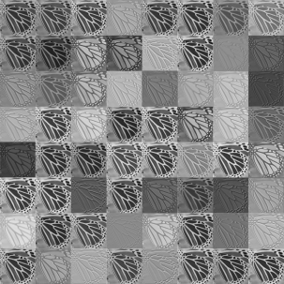
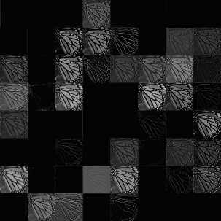



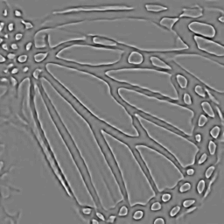

ILR
Conv.1
ReLu.1
Conv.D-1
ReLu.D-1
Conv.D (Output)
HR

Slide 2




ILR
Conv.1
ReLu.1
Conv.D-1
ReLu.D-1
Conv.D (Output)
HR
x
e
y

