Slide 1

REFERENCES
[1] M. Poostchi, K. Silamut, R. J. Maude, S. Jaeger, G. Thoma. (2018). Image analysis and machine learning for detecting malaria [Online]. Available: https://www.ncbi.nlm.nih.gov/pmc/articles/PMC5840030/
[2] WHO. (2019, Dec. 4). The "World malaria report 2019" at a glance [Online]. Available: https://www.who.int/news- room/feature-stories/detail/world-malaria-report-2019
[3] S. Rajaraman​, S. K. Antani, M. Poostchi, K. Silamut, Md. A. Hossain, R. J. Maude, S. Jaeger, G. R. Thoma1. (2018, Apr. 16). Pre-trained convolutional neural networks as feature extractors toward improved malaria parasite detection in thin blood smear images [Online]. Available: https://peerj.com/articles/4568/
[4] Expert System Team. (2020, May. 6). What is Machine Learning? A definition [Online]. Available: https://expertsystem.com/machine-learning-definition/
[5] A. Deshpande. (2016, Jul. 20). A Beginner's Guide to Understanding Convolutional Neural Networks [Online]. Available: https://adeshpande3.github.io/A-Beginner%27s-Guide-To-Understanding-Convolutional-Neural- Networks/
[6] H. Pokharna. (2016, Jul. 28). The best explanation of Convolutional Neural Networks on the Internet [Online]. Available: https://medium.com/technologymadeeasy/the-best-explanation-of-convolutional-neural-networks- on-the-internet- fbb8b1ad5df8
[7] Stanford University (n.d.). CS231n Convolutional Neural Networks for Visual Recognition [Online]. Available: https://cs231n.github.io/convolutional-networks/
[8] Worldometer (2017). GDP per Capita [Online]. Available: https://www.worldometers.info/gdp/gdp-per-capita/

Slide 2

ASSESSING MALARIA BLOOD SAMPLES USING DEEP LEARNING

Slide 3
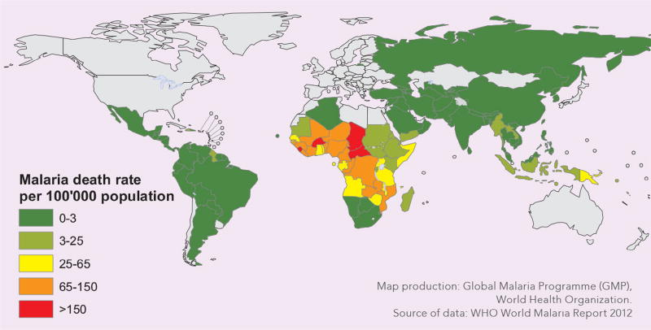
MALARIA
Major impact on global health
2018: estimated 228 million cases worldwide & 405,000 deaths [2]
Only 6 countries account for more than 50% of all cases [2]
Nigeria accounts for 25% of all cases [2] and has 34% of the world average GDP (per Capita 2017) [8]
[1]

Slide 4
WHY USE AI?
Yearly hundreds of millions of blood films examined by a trained microscopist
This involves manual counting of parasites in red blood cells, which is timely
Microscopists in poorer areas may have low quality training
Low-resource areas and poor-quality control setting
Lead to incorrect diagnosis
False positives and False negatives
Standardise using AI
Faster testing
Reduced workload
More reliable (with an accurate model)

Slide 5
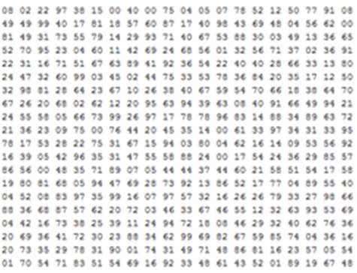
MACHINE LEARNING
Allow a system to automatically learn without being explicitly programmed
Computer sees images differently to us, so we need a way to aid its ‘learning’
Computers see images as arrays of numbers
Each pixel has 3 values to create an RGB colour e.g. 180, 50, 200 creates pink
Convolutional Neural Networks…
[5]

Slide 6
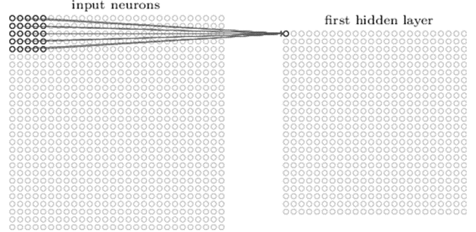
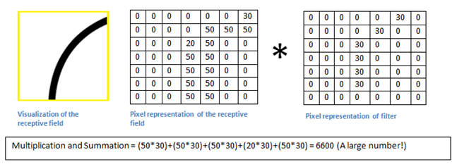
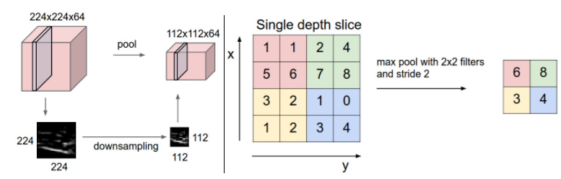
CNNs AS IMAGE CLASSIFIERS
[5]
CNNs are based on the visual cortex (1962 D. Hubel & T. Wiesel)
CNNs essentially take an image and pass it through a multiple layer network and identify features that overtime become more abstract e.g. edges
Pre-processing
Convolutional layers
Filters, feature maps, convolving
Rectified Linear Activation Function or Rectified Linear Unit (ReLU)
Pooling layers
Fully connected layers

Slide 7
CNNs – TRAINING AND TESTING
Good rule of thumb for splitting the dataset – 70/30 or 80/20
What makes the algorithm actually ‘work’
Training process – backpropagation
Gradient descent - technique for minimising loss
½ (desired output – real output) ²
Caches values on forward pass
Backwards pass determines which inputs contributed to the overall loss
Adjusts weights accordingly (weight update) via a parameter called learning rate
Test by comparing outputs to ground truth

Slide 8

USEFUL LIBRARIES
TensorFlow
Keras
Pandas
NumPy

Slide 9

FRONT END UI
Simple
Very accessible
Requires smallest number of resources possible
Internet capable device
Internet connection
Bootstrap for device compatibility
PC and mobile
Brand

Slide 10
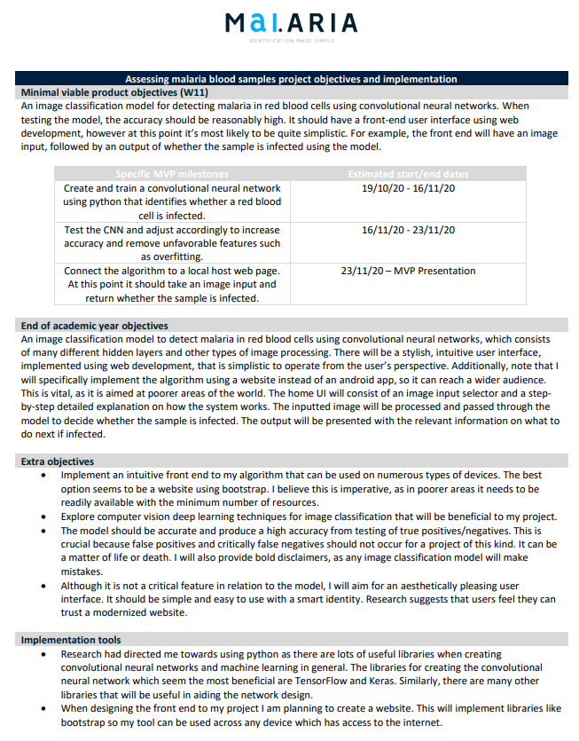
MVP OBJECTIVES/IMPLEMENTATION
Image classification model for detecting malaria in red blood cells using convolutional neural networks
Relatively high accuracy model
Link algorithm to front end user interface
Simple front end UI that takes an image input and outputs whether sample is infected

Slide 11
SUBMISSION OBJECTIVES/IMPLEMENTATION
Already including the previous goals
Increase accuracy so tool is reliable
Stylish, intuitive user interface, implemented using web development
Add brand
Provide model disclaimers
Guide on how to take a test
Guide on what to do next if infected

Slide 12
MVP ESTIMATED DEADLINES
Specific MVP milestones | Estimated start/end dates
Create and train a convolutional neural network using python that identifies whether a red blood cell is infected. | 19/10/20 - 16/11/20
Test the CNN and adjust accordingly to increase accuracy and remove unfavorable features such as overfitting. | 16/11/20 - 23/11/20
Connect the algorithm to a local host web page. At this point it should take an image input and return whether the sample is infected. | 23/11/20 – MVP Presentation

Slide 13
IMPLEMENTATION TOOLS
Python
Tensorflow
Keras
Many other useful libraries that are open source
Web development
Bootstrap

Slide 14
SUMMARY
Researched and understood how images are classified
Researched my problem in thorough detail
Researched how I want to implement the user interface
Created a detailed plan of what I want to achieve and how I want to implement it
Clear objectives and goals
Timetabled key deadlines up to MVP
Implementation details
Implementation tools
Examined a image classifiers Google AI course on how to implement CNNs in code
Created an example project brand to use

Slide 15
INITIAL NEXT STEPS
Look at more tutorials on how to implement CNNs in code
Implement a convolutional neural network using python libraries like TensorFlow and Keras
Research more on CNNs while writing the code
Increase my knowledge
Improve model

Slide 16
THANK YOU, QUESTIONS?

