Slide 1


ASSESSING MALARIA BLOOD SAMPLES USING MACHINE LEARNING
KIERNAN HARDING

Slide 2

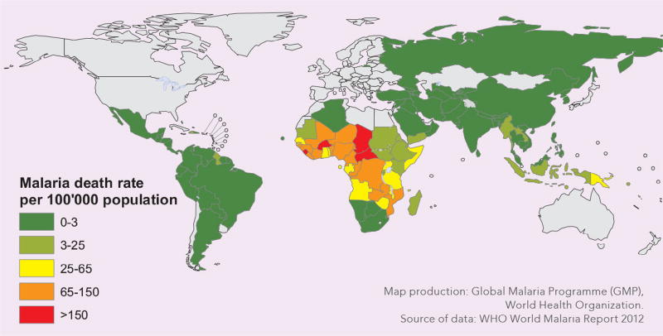
WHY?
Malaria has a major impact on global health
2018: estimated 228 million cases worldwide & 405,000 deaths [2]
Only 6 countries account for more than 50% of all cases [2]
Nigeria accounts for 25% of all cases [2] and has 34% of the world average GDP (per Capita 2017) [8]
Microscopists are required for testing and this can lead to many problems…
[1]

Slide 3
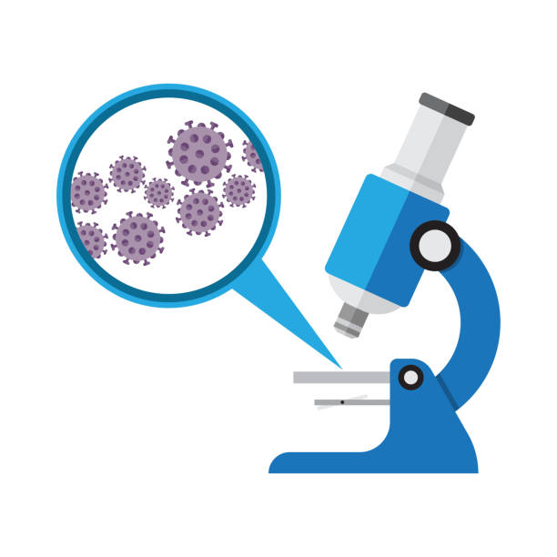
WHY USE AI?
Yearly hundreds of millions of blood films examined by a trained microscopist
This involves manual counting of parasites in red blood cells = timely
Microscopists in poorer areas may have low quality training
Low-resource areas and poor-quality control setting
Lead to incorrect diagnosis
False positives and False negatives
Standardise using AI
Faster testing
Reduced workload
More reliable (with an accurate model)

Slide 4
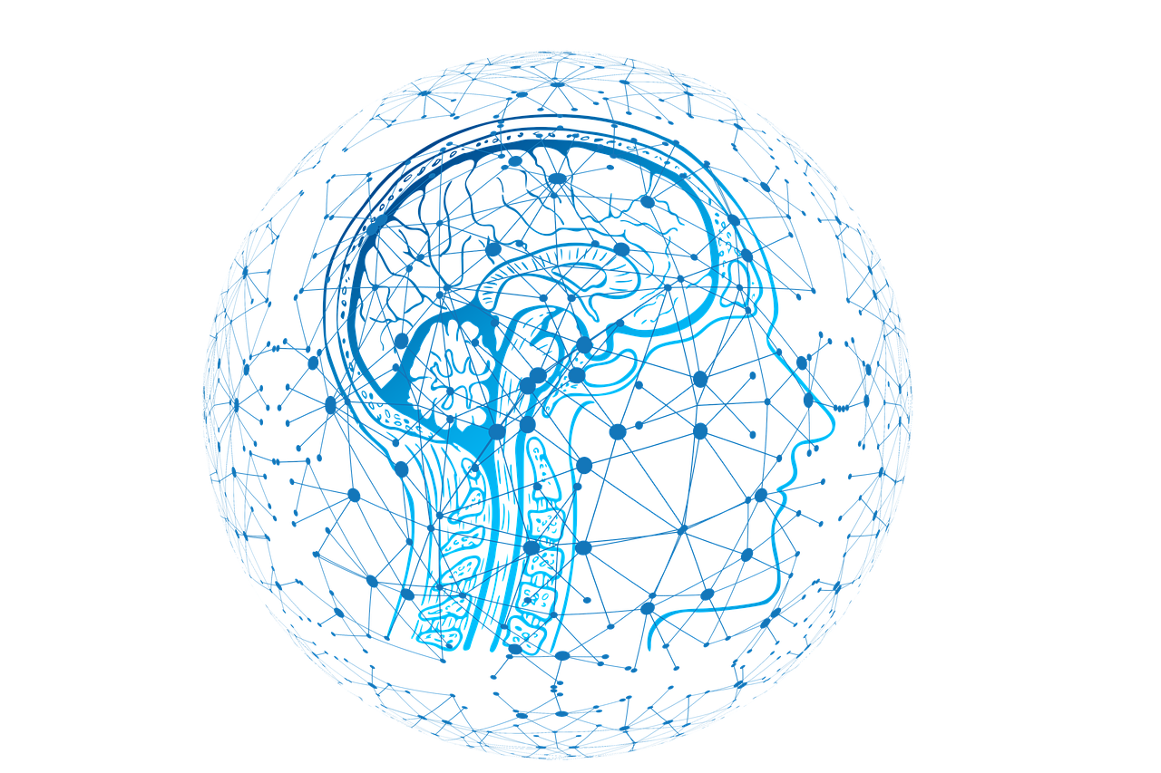
RESEARCH TOPICS
Effects of malaria on world health and why the testing process would benefit from AI
Using deep learning for image classifiers: specifically convolutional neural networks
How to use TensorFlow and Keras to create a convolutional neural network (dogs and cats tutorial)
How to implement a CNN model into a website (using python with an interactive website)

Slide 5
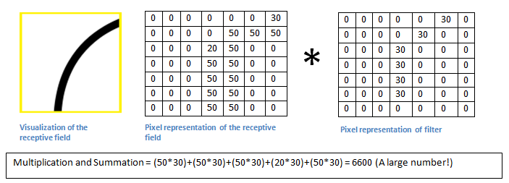
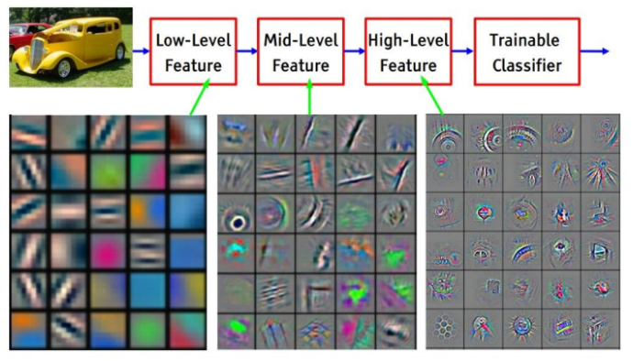
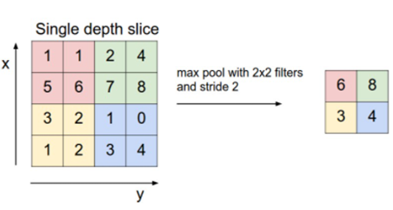
WHAT IS A CNN? (ML)
Short for ‘convolutional neural network’
Class of deep learning neural networks
Learns similarly to a child - inspired by the human brain
Trained through backpropagation:
Forward pass - pass input data through network as normal as caches values
Backwards pass - go back through network and alter loss (similar to telling a child they’re incorrect, which they then learn from)
Different types of layers:
Convolutional – identifies features in images, such as straight lines and curves, aids learning process (becoming less abstract over time)
Activation (e.g. ReLU) – aids the network to learn complex patterns in the data - increase non-linearity (ReLU: returns 0 if negative and value x if positive)
Pooling (e.g. max pooling) – reduces sample size and thus speeds up processing
Fully connected – essentially the output layer (provides probabilistic values)
Applying filters to an image [5]
Convolutional Layer [10]
Convolved feature maps [9]
Max pooling [7]

Slide 6
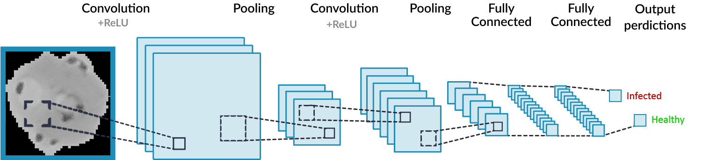
CREATING MY CNN MODEL
Splitting the dataset into training and testing (80/20)
Preparing the dataset for training – resizing, greyscale…
Created a convolutional neural network in python using TensorFlow and Keras
3 main layers and out output layer (the fully connected layer)
These layers include: convolutional, activation (ReLU), pooling and fully connected
Created a script and tested the models prediction accuracy: 71.4% (3,936/5,512) - overfitting
Incredibly bias towards infected samples: parasitized = 91.1%, healthy = 51.7%
Created a windows batch file which automatically installs the required libraries for running any project related code

Slide 7

UI - WEB APPLICATION
Use of web development to increase the applications accessibility in poorer areas
Microscope, camera, ideally an internet connection
No specific requirements (e.g. android application = limits reach)
Uses the Flask library to connect the python script to a website
Simple as possible
Takes an image input of a blood sample
Classifies and outputs whether the sample is infected

Slide 8
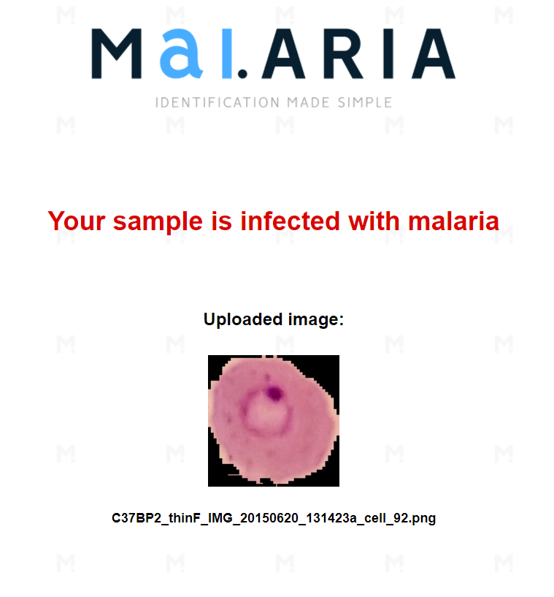
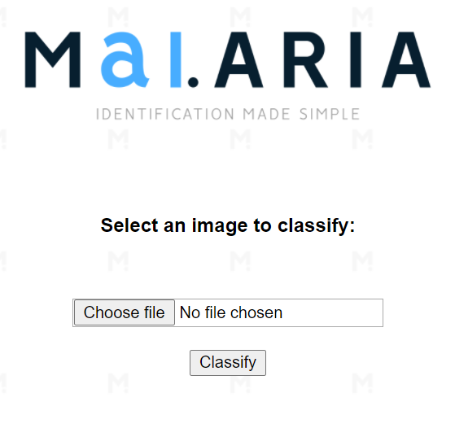
LIVE DEMO
Back-up example:
A web application that includes a back-end machine learning classifying model
Examples of infected blood cells being classified
Examples of healthy blood cells being classified
>>

Slide 9

MAIN ISSUES ENCOUNTERED
Installation of the required local environment – e.g. libraries such as TensorFlow
Issues with array types between libraries – Occurred whilst creating a working convolutional neural network using tutorials (using the Kaggle dogs and cats dataset)
Trying to save, use and classify the input image whilst designing the web application

Slide 10
MAIN INTERIM GOALS – HOW DID IT GO?
What was adjusted and achieved?
Specific MVP milestones | Estimated start/end dates
Create and train a convolutional neural network using python that identifies whether a red blood cell is infected. | 19/10/20 - 16/11/20
Test the CNN and adjust accordingly to increase accuracy and remove unfavorable features such as overfitting. | 16/11/20 - 23/11/20
Connect the algorithm to a local host web page. At this point it should take an image input and return whether the sample is infected. | 23/11/20 – MVP Presentation

Slide 11
TIMELINE OF FUTURE OBJECTIVES
Improve my convolutional neural network model through research and structured testing (e.g. add colour) 8/2/21 | Implement bootstrap into my website to improve usability across all devices 22/2/21 | Improve the visual styling of the user interface 8/3/21 | Slack for any issues encountered before the submissions 17/3/21
Now
17/3/21 – Open Day Submissions

Slide 12
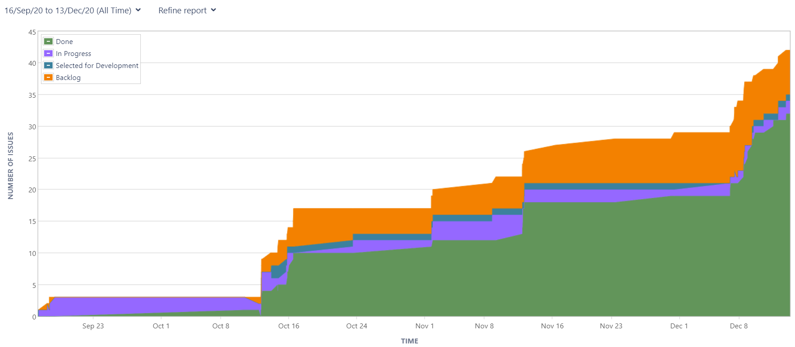
USE OF JIRA
Consistent use of Jira
Use of tasks, sub-tasks, comments to document updates/plan future tasks
Releases
Cumulative flow diagram since the start of September

Slide 13
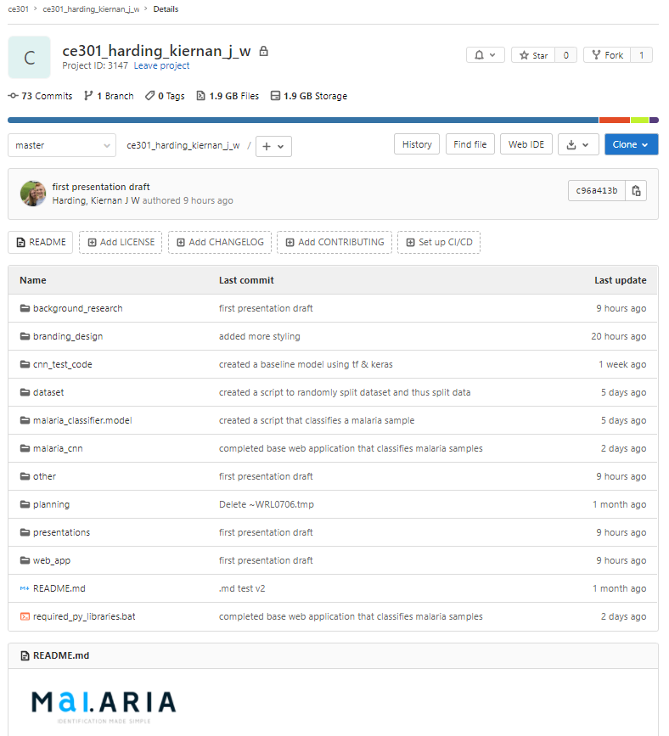
USE OF GIT
Consistent use of Git
Regular commits to Git for:
Significant changes
Keep important work backed-up!
Small required alterations: deletions
Short, meaningful commit messages
Snapshot of Git 14/12/20

Slide 14
THANK YOU, I HOPE YOU ENJOYED. ANY QUESTIONS?

Slide 15
REFERENCES
[1] M. Poostchi, K. Silamut, R. J. Maude, S. Jaeger, G. Thoma. (2018). Image analysis and machine learning for detecting malaria [Online]. Available: https://www.ncbi.nlm.nih.gov/pmc/articles/PMC5840030/
[2] WHO. (2019, Dec. 4). The "World malaria report 2019" at a glance [Online]. Available: https://www.who.int/news-room/feature- stories/detail/world-malaria-report-2019
[3] S. Rajaraman​, S. K. Antani, M. Poostchi, K. Silamut, Md. A. Hossain, R. J. Maude, S. Jaeger, G. R. Thoma1. (2018, Apr. 16). Pre-trained convolutional neural networks as feature extractors toward improved malaria parasite detection in thin blood smear images [Online]. Available: https://peerj.com/articles/4568/
[4] Expert System Team. (2020, May. 6). What is Machine Learning? A definition [Online]. Available: https://expertsystem.com/machine-learning- definition/
[5] A. Deshpande. (2016, Jul. 20). A Beginner's Guide to Understanding Convolutional Neural Networks [Online]. Available: https://adeshpande3.github.io/A-Beginner%27s-Guide-To-Understanding-Convolutional-Neural- Networks/
[6] H. Pokharna. (2016, Jul. 28). The best explanation of Convolutional Neural Networks on the Internet [Online]. Available: https://medium.com/technologymadeeasy/the-best-explanation-of-convolutional-neural-networks-on-the-internet-fbb8b1ad5df8
[7] Stanford University (n.d.). CS231n Convolutional Neural Networks for Visual Recognition [Online]. Available: https://cs231n.github.io/convolutional-networks/
[8] Worldometer (2017). GDP per Capita [Online]. Available: https://www.worldometers.info/gdp/gdp-per-capita/
[9] Rohith Gandhi (May. 2018). An introduction to CNN and code [Online]. Available: https://towardsdatascience.com/build-your-own- convolution-neural-network-in-5-mins-4217c2cf964f
[10] Sumit Saha (Dec. 2018). A Comprehensive Guide to Convolutional Neural Networks [Online]. Available: https://towardsdatascience.com/a- comprehensive-guide-to-convolutional-neural-networks-the-eli5-way-3bd2b1164a53

