Slide 1
USA Philanthropy Data Analysis
Team: Sphinx
Kristen Wunderlich, Matthew Tabaka
Zingha Siel, Keisha McCallum

Slide 2

Agenda
Research Questions
Data Analysis
Learnings
Conclusion
Resources

Slide 3
Research Question
We chose to analyze information on US charities from 2015 to 2018 for gifts a $1M or more.
What is the correlation between donor source of wealth and amount of money given over the course of recent years?
What are the geographic concentrations of where money is going to and where money is coming from for major donations?
What types of charity causes receive the most money?
How have total amount of donations changed in the last 4 years?

Slide 4
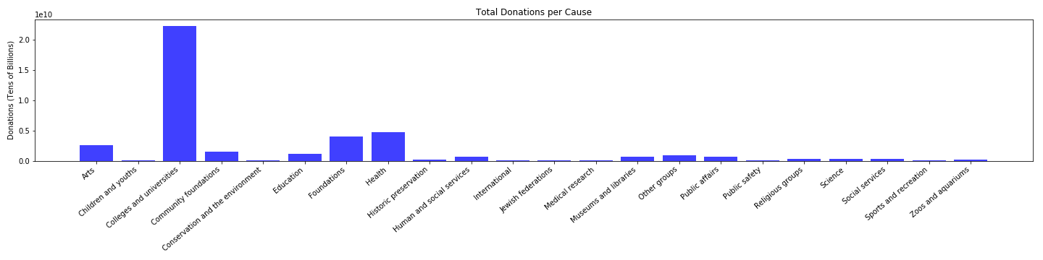
What types of charity causes receive the most money?

Slide 5
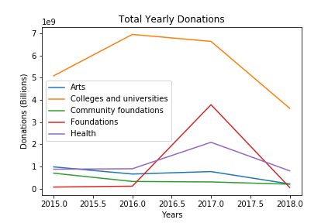
What types of charity causes receive the most money?
Notes:
Total yearly donations

Slide 6
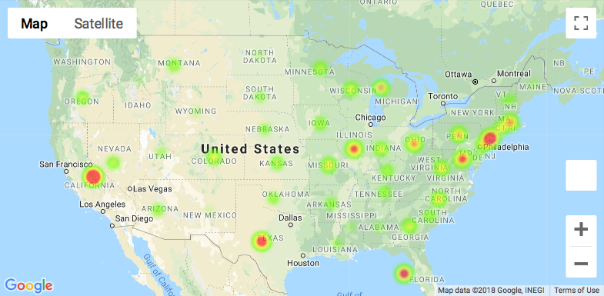
What are the geographic concentrations of where money is going to and where money is coming from for major donations?
Notes:
Recipient map

Slide 7
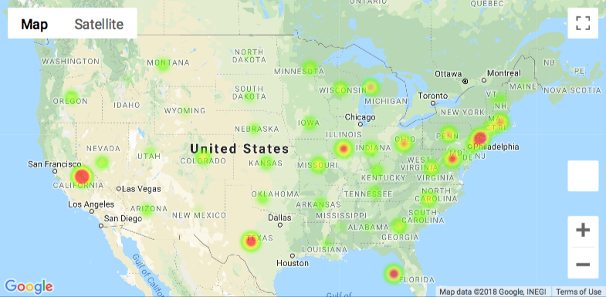
What are the geographic concentrations of where money is going to and where money is coming from for major donations?
Notes:
Donor locations map

Slide 8
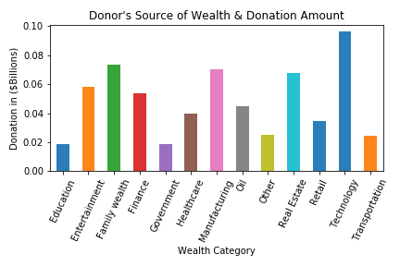
What is the correlation between donor source of wealth and amount of money given over the course of recent years?
Notes:
Donations by wealth category or source of wealth.

Slide 9
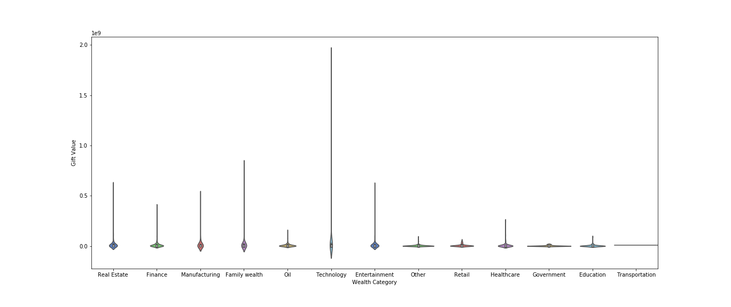
What is the correlation between donor source of wealth and amount of money given over the course of recent years?

Slide 10
How have total amount of donations changed in the last 4 years?

Slide 11
How have total amount of donations changed in the last 4 years?

Slide 12
Learnings
The data was pulled from the Chronicle of Philanthropy, put into four separate csv files and read into the notebook for analysis. It revealed that the top five recent highest earning causes are:
NOTE: 2018 donation numbers will be lower than final numbers as the year has not ended yet.
Colleges and universities Health Foundations Arts Community foundations
Colleges and universities is by far the highest earning cause, with a four year total of over $20 billion. There was also an interesting uptick in the donations to foundations in 2017, with a massive uptick from roughly half a billion in 2016 to 4 billion in 2017 and then a return to about half a billion in 2018. Health also saw an uptick in donations in 2017, growing from 1 to 2 billion from 2016 - 2017.

Slide 13
Conclusion

Slide 14
Resources

