Slide 1

USA Philanthropy Data Analysis
Team: Sphinx
Kristen Wunderlich, Matthew Tabaka
Zingha Siel, Keisha McCallum

Slide 2
Agenda
Research Questions
Data Analysis
Conclusion
Learnings
Resources

Slide 3
Research Questions
We chose to analyze donation information in the US from 2015 to 2018 valued at $1 million or more.
What is the correlation between donor source of wealth and amount of money given over the course of recent years?
What are the geographic concentrations of where money is going to and where money is coming from?
What types of charity causes receive the most money?
How have total amount of donations changed in the last 4 years?

Slide 4
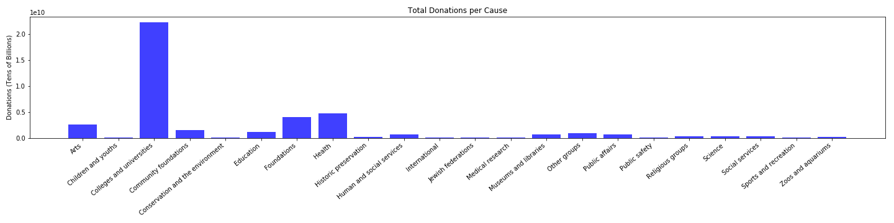
What types of charity causes receive the most money?

Slide 5
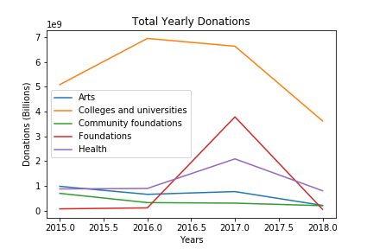
What types of charity causes receive the most money?
Notes:
Total yearly donations

Slide 6
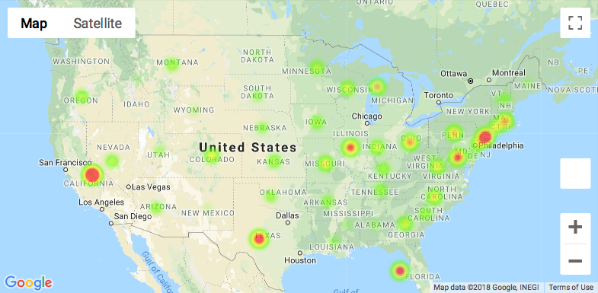
What are the geographic concentrations of where money is going to?
Notes:
Recipient map

Slide 7
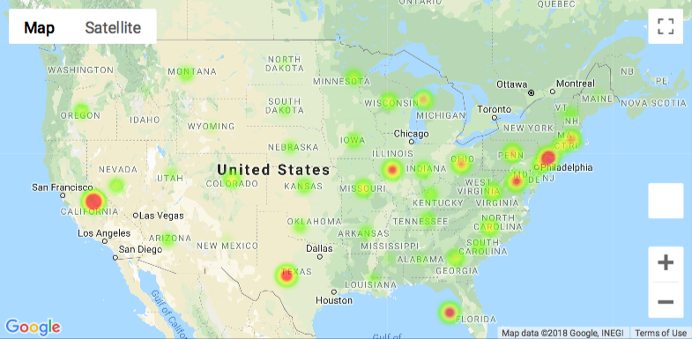
What are the geographic concentrations of where money is coming from?
Notes:
Donor locations map

Slide 8
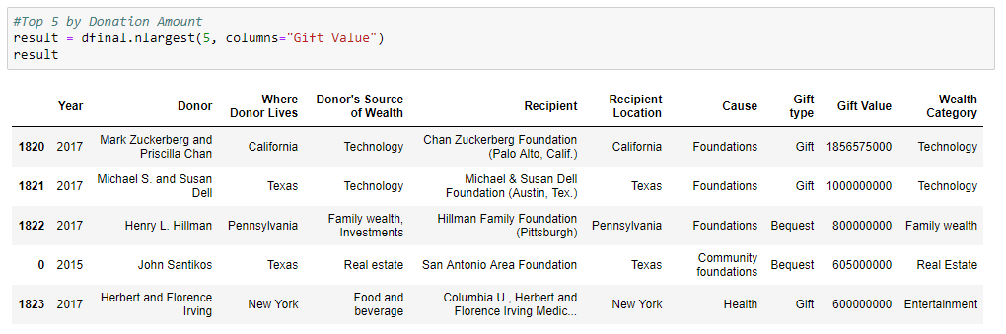
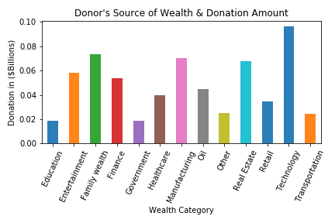
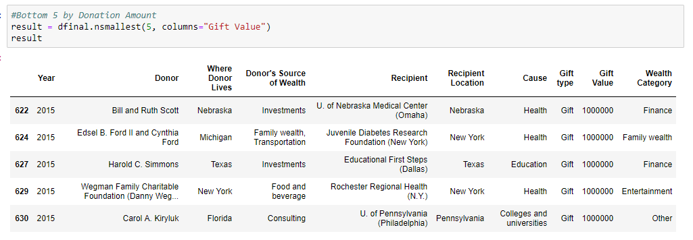
What is the correlation between donor source of wealth and amount of money given over the course of recent years?
Notes:
Donations by wealth category or source of wealth.
The largest donation of $1.8 billion was made to a Chan Zuckerberg Foundation from Mark Zuckerberg and Priscilla Chan in 2017. Their source of wealth was in Technology. Notably their residence of California is of no surprise.
The wealth category groupings were bucketed to allow for distinction among 192 unique strings of 2 or more sources of wealth. This created 13 distinct categories and these were used to identify wealth source. A separate csv cross reference file was created and saved to the master repository.
Overall 95% of all donations came from Technology followed by Manufacturing, Family Wealth and Real Estate.
There was a relatinship found with a donors source of wealth and their donation amount. Wealth categories that command more value in the market yielded higher donations. Healthcare and Retail sources of wealth yeilded nearly identical amounts of donations over the 4 years with Transportation and Education being the lowest.

Slide 9
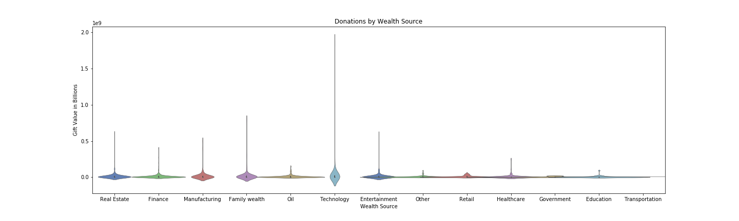
What is the correlation between donor source of wealth and amount of money given over the course of recent years?
The largest donations came from donors who earned their wealth in Technology. This represented $2Billion in donations 2015 to 2018.
Family wealth represents the second largest source of wealth with just under $1Billion.
Real Estate and Entertainment have similar overall donations with the lowest category being Transportation.

Slide 10
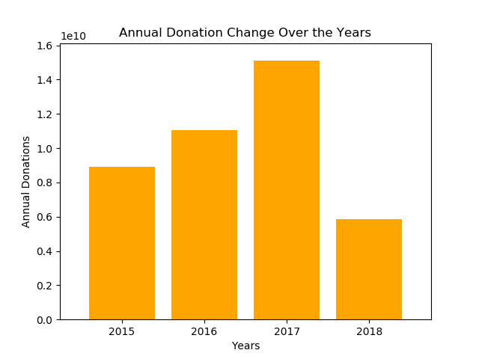
How have total amount of donations changed in the last 4 years?

Slide 11
Conclusion
The data was pulled from the Chronicle of Philanthropy website, scraped into csv files and read into the notebook for analysis. It revealed that the top five highest earning causes are:
Colleges and universities
Health
Foundations
Arts
Community foundations
Colleges and universities total – over $20 billion
Interesting uptick in donations to foundations in 2017, with a big increase from roughly half a billion in 2016 to 4 billion in 2017
Health also saw an uptick in donations in 2017, growing from 1 to 2 billion from 2016 - 2017.
NOTE: 2018 donation numbers are incomplete.

Slide 12
Conclusion
With regard to the correlation between donor source of wealth and amount of money given over the course the four years 2015 to 2018:
The largest donation of $1.8 billion was made to a Chan Zuckerberg Foundation from Mark Zuckerberg and Priscilla Chan in 2017. Their source of wealth was in Technology. Notably their residence of California is of no surprise.
The wealth category groupings were bucketed to allow for distinction among 192 unique strings of 2 or more sources of wealth. This created 13 distinct categories and these were used to identify wealth source. A separate csv cross reference file was created and saved to the master repository.
Overall 95% of all donations came from Technology followed by Manufacturing, Family Wealth and Real Estate.
There was a relationship found with a donors source of wealth and their donation amount. Wealth categories that command more value in the market yielded higher donations. Healthcare and Retail sources of wealth yield nearly identical amounts of donations over the 4 years with Transportation and Education being the lowest.

Slide 13
Learnings
In real world situations the receipt of data can be in varied forms. We had to do a numbers of cleaning step to the data before we could even begin our analysis.
It is good practice to determine treatment of null values.
Other sources may be additive to the analysis such as, geo locations (Latitude, Longitude).
Additional descriptors to further categorize data may also prove useful.
It is best to divide work equally among a team. We took this approach and it worked well. This allows for many analytical questions to be answered over a short period.
Ask more questions and ask the same question in different ways.

Slide 14

Resources
https://www.philanthropy.com/factfile/gifts/
https://github.com/kjwunderlich/project-one---sphinx

