Slide 1
USA Philanthropy Data Analysis
Team: Sphinx
Kristen Wunderlich, Matthew Tabaka
Zingha Siel, Keisha McCallum

Slide 2

Agenda
Research Questions
Data Analysis
Learnings
Conclusion
Resources

Slide 3
Research Questions
We chose to analyze donation information in the US from 2015 to 2018 valued at $1 million or more.
What is the correlation between donor source of wealth and amount of money given over the course of recent years?
What are the geographic concentrations of where money is going to and where money is coming from?
What types of charity causes receive the most money?
How have total amount of donations changed in the last 4 years?

Slide 4
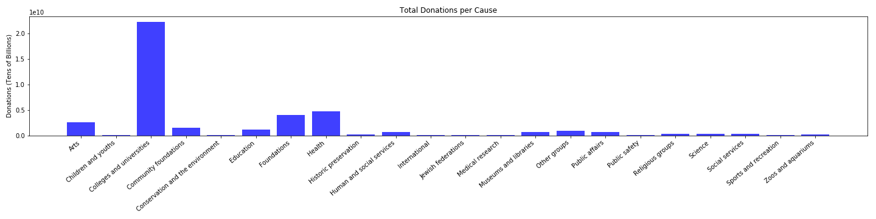
What types of charity causes receive the most money?

Slide 5
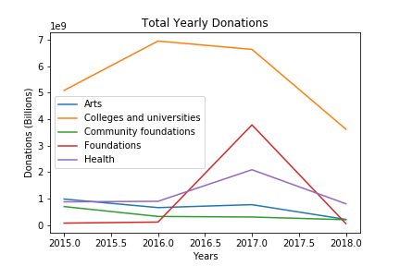
What types of charity causes receive the most money?
Notes:
Total yearly donations

Slide 6
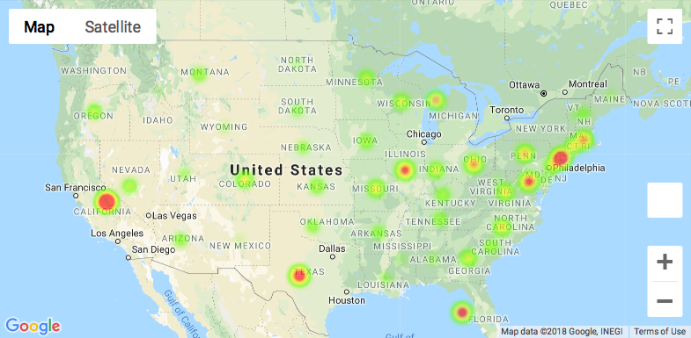
What are the geographic concentrations of where money is going to?
Notes:
Recipient map

Slide 7
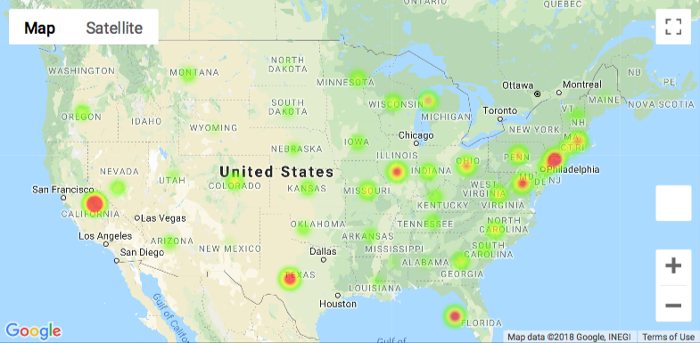
What are the geographic concentrations of where money is coming from?
Notes:
Donor locations map

Slide 8
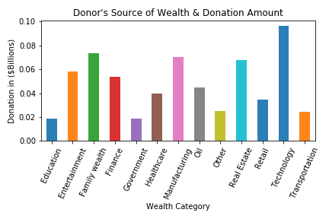
What is the correlation between donor source of wealth and amount of money given over the course of recent years?
Notes:
Donations by wealth category or source of wealth.

Slide 9
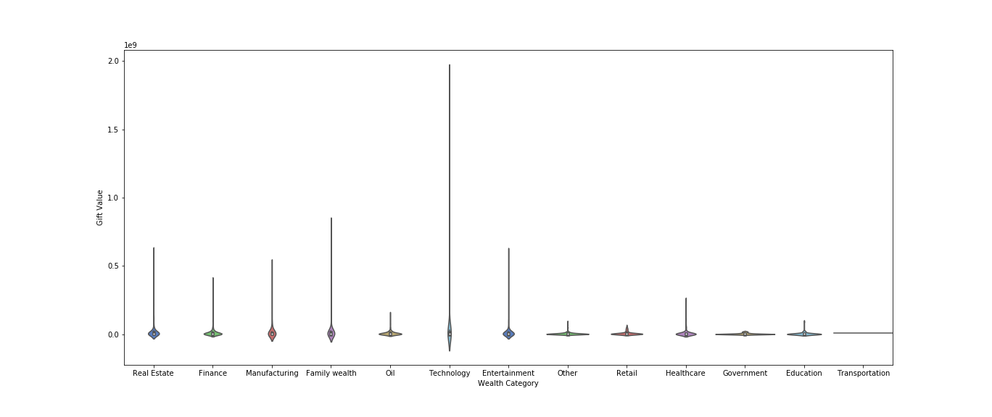
What is the correlation between donor source of wealth and amount of money given over the course of recent years?

Slide 10
How have total amount of donations changed in the last 4 years?

Slide 11
How have total amount of donations changed in the last 4 years?

Slide 12
Learnings
The data was pulled from the Chronicle of Philanthropy website, scraped into csv files and read into the notebook for analysis. It revealed that the top five highest earning causes are:
Colleges and universities
Health
Foundations
Arts
Community foundations
Colleges and universities total – over $20 billion
Interesting uptick in donations to foundations in 2017, with a big increase from roughly half a billion in 2016 to 4 billion in 2017
Health also saw an uptick in donations in 2017, growing from 1 to 2 billion from 2016 - 2017.
NOTE: 2018 donation numbers are incomplete.

Slide 13
Conclusion

Slide 14
Resources

