Slide 1
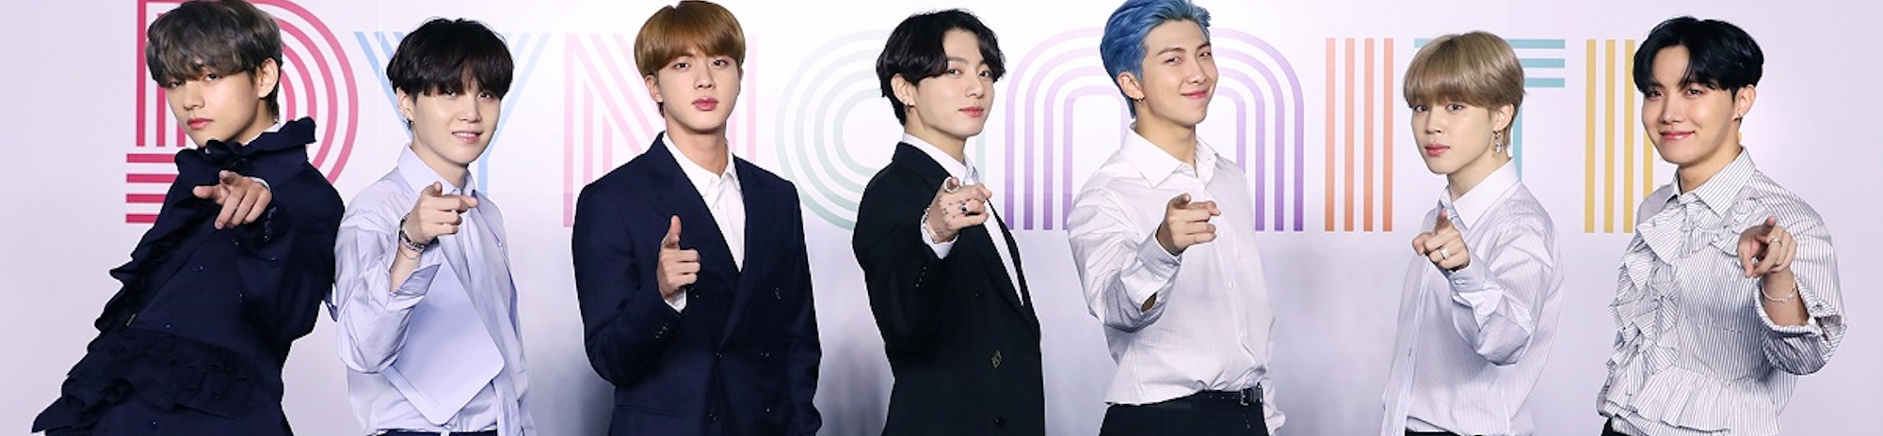
hey, have you heard of bts?
Dianne kim
Plsc 31101 final project

Slide 2



Soft power
Using the powers of attraction through culture and ideology rather than coercion or “hard power” – Joseph Nye, 1990
Is K-pop an effective soft power strategy?

Slide 3
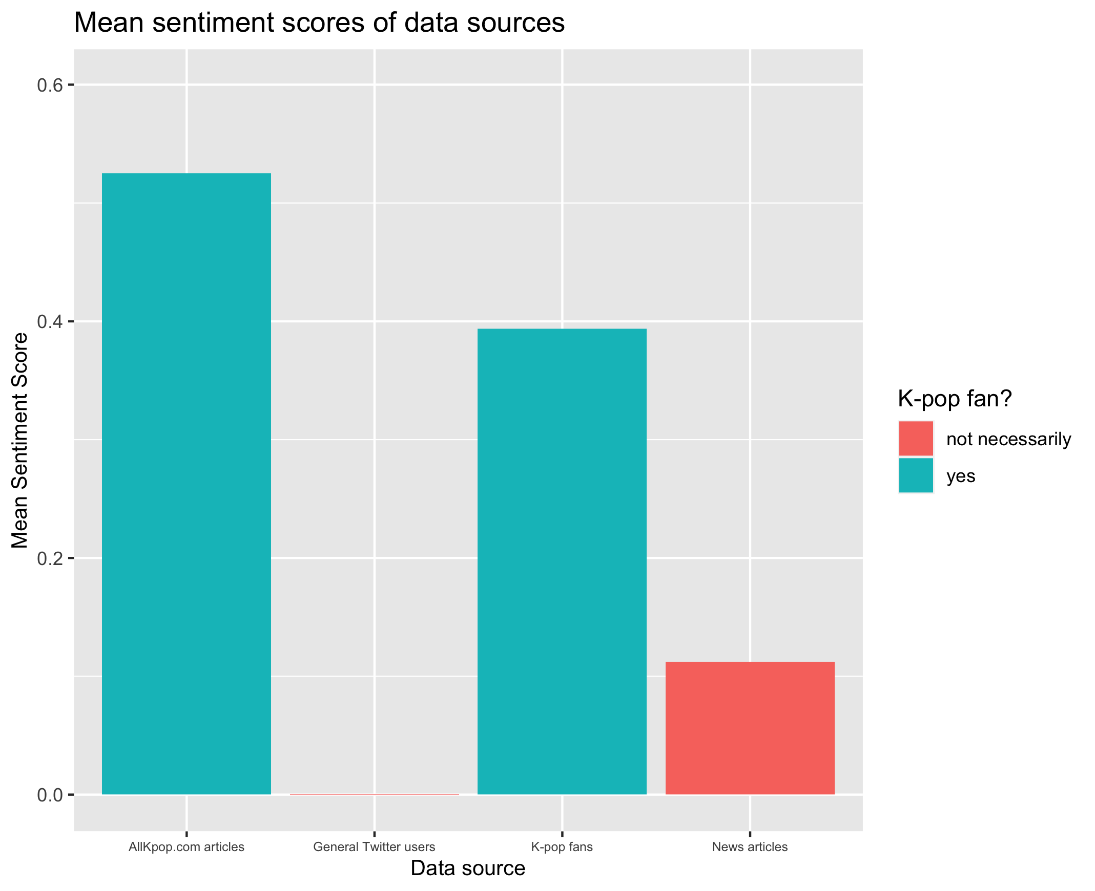

Slide 4
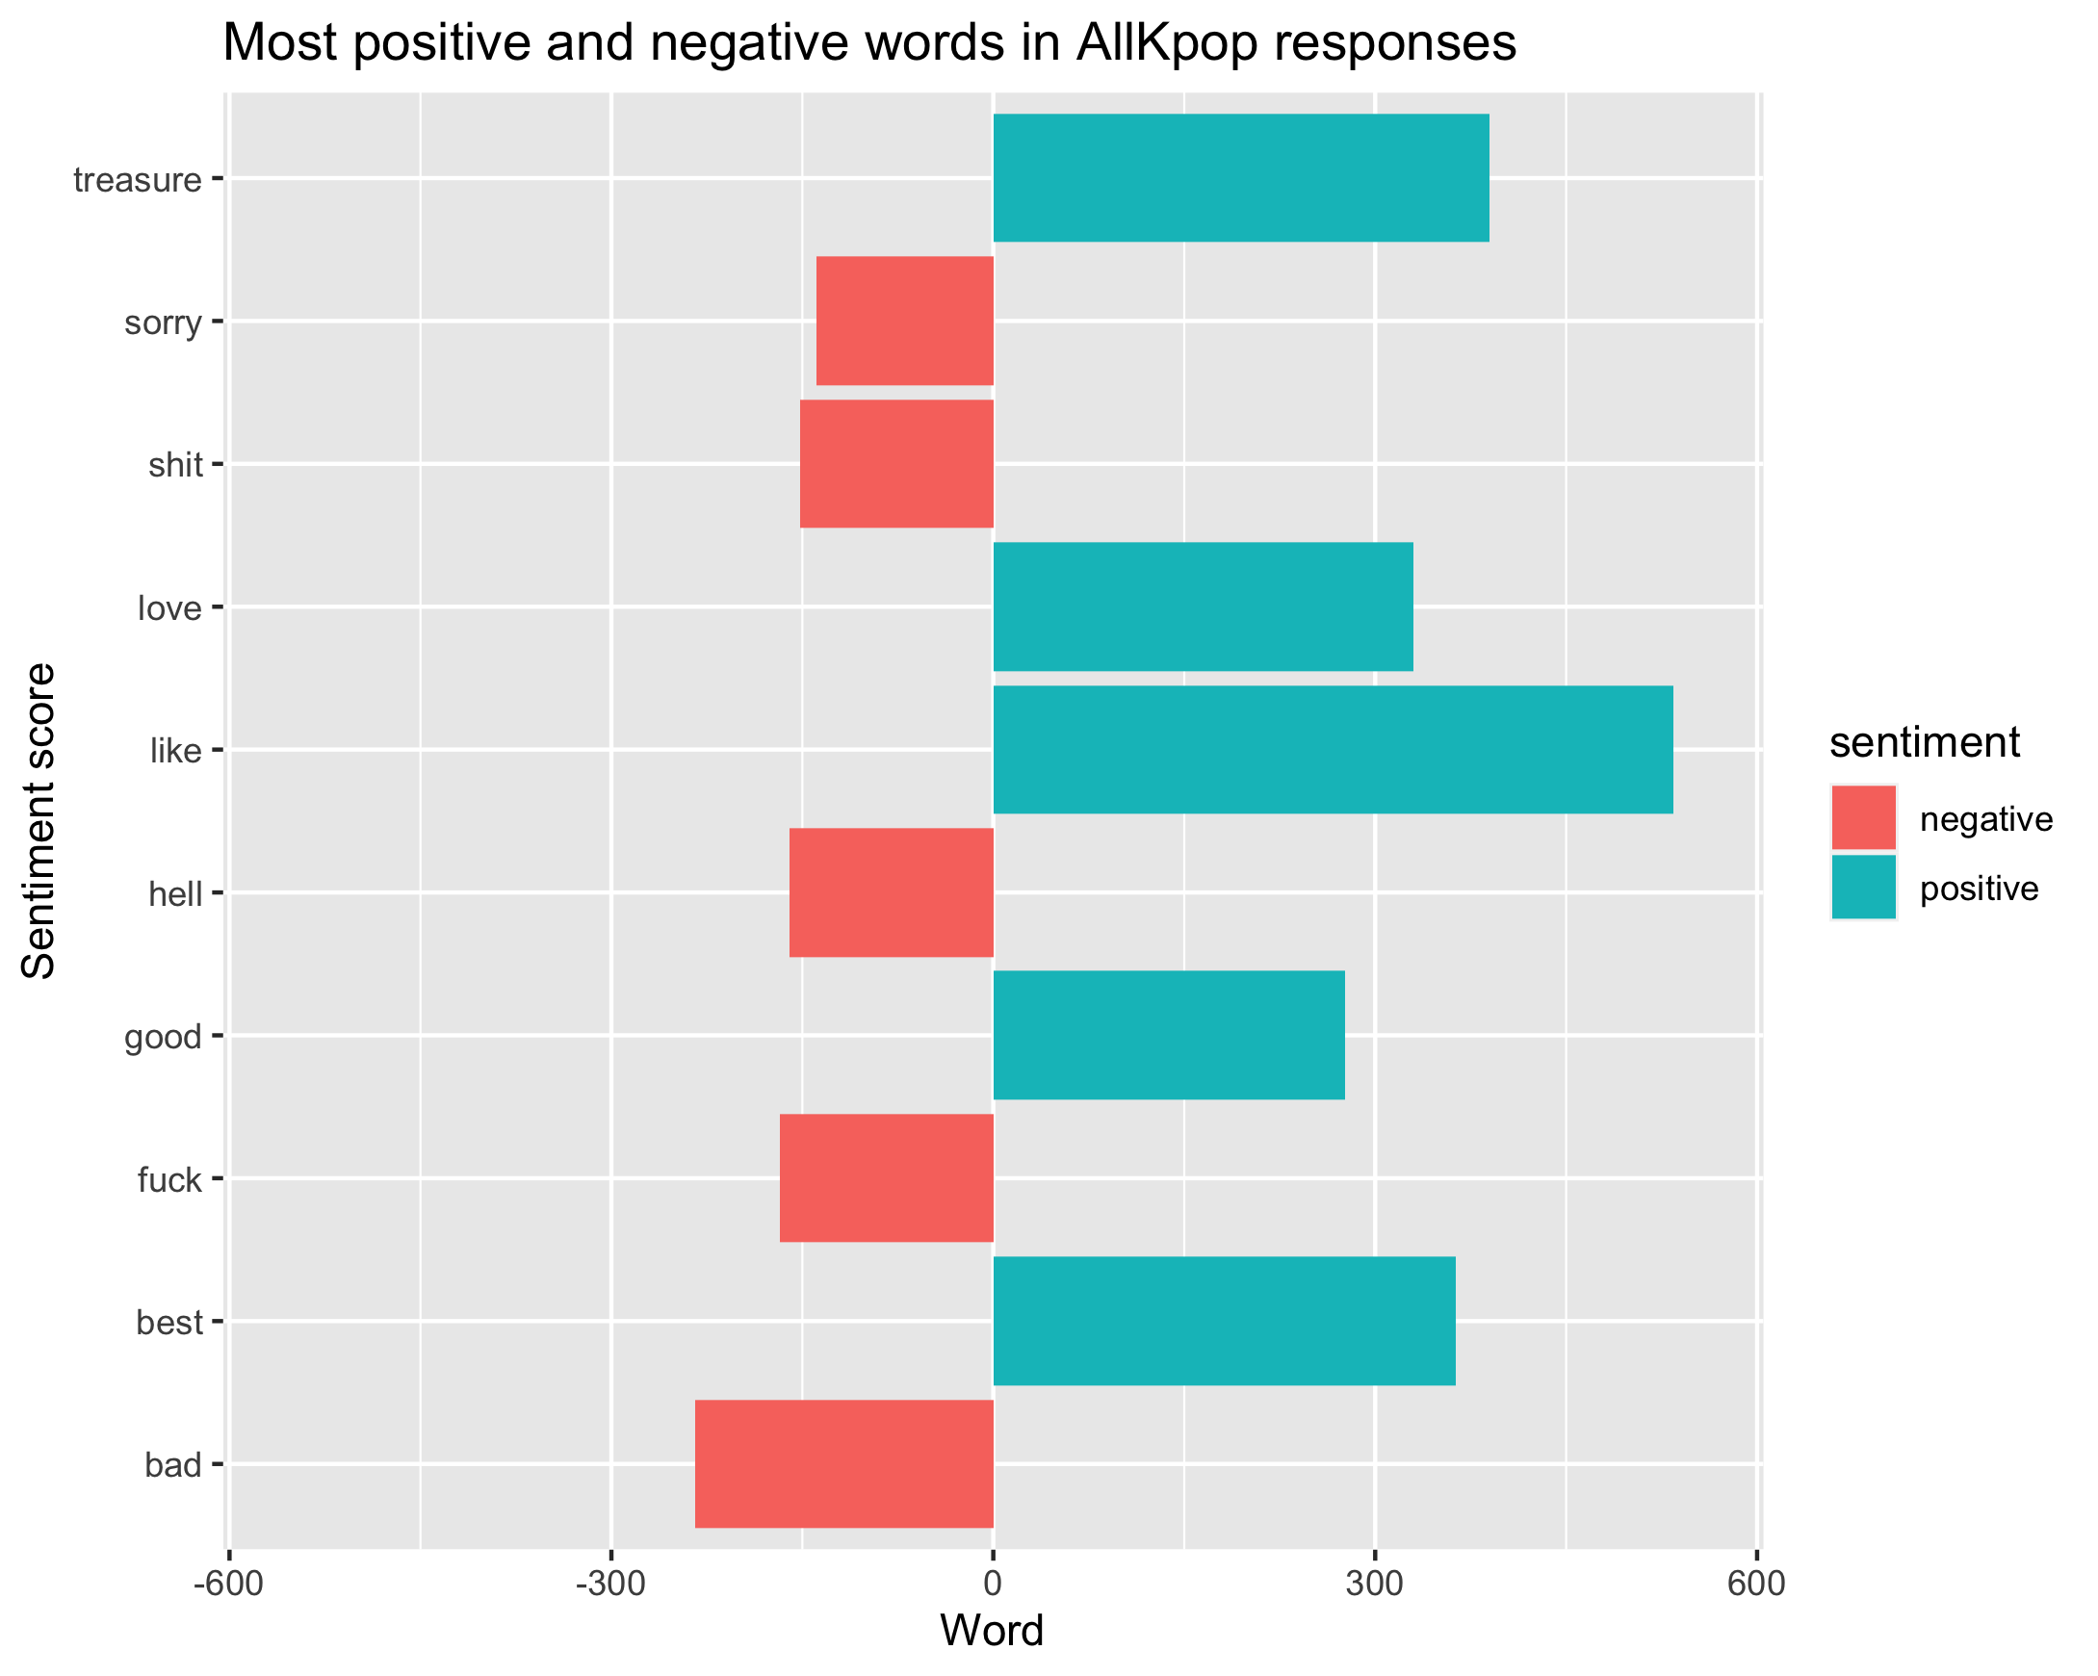
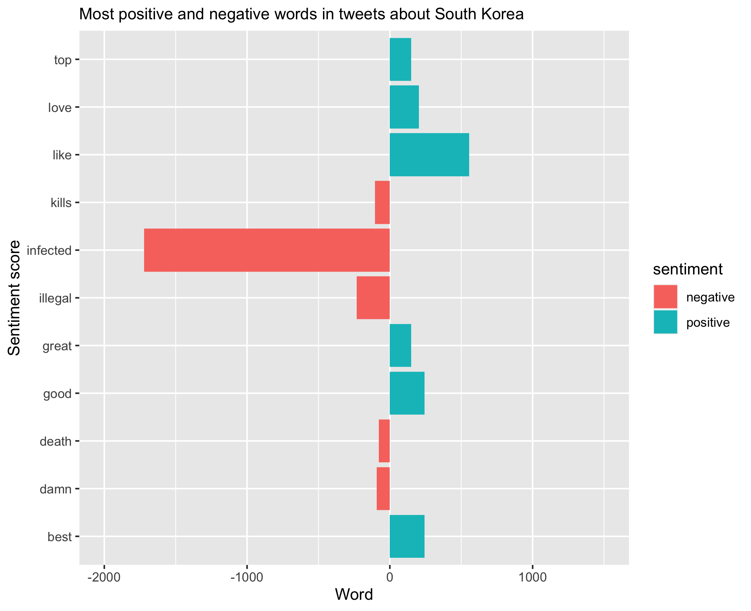
Polarized responses
Thanks, COVID

Slide 5
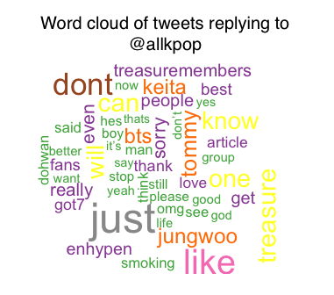
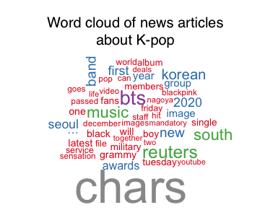
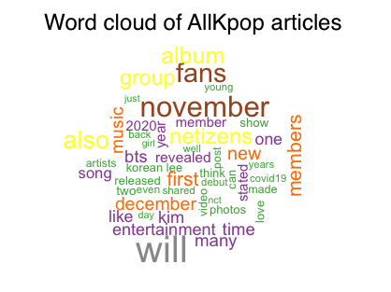

Slide 6
challenges
Websites with infinite scroll are pretty, but not the best for webscraping
Rselenium
Shoutout to Nan Wen for saving my life (https://github.com/NanWen-CU/Web-Scraping-Scrolling-Website-Using-R)
Existing lexicons do not account for Internet & fandom lingo
What is the sentiment score of the following? Lmao go off king sksksksksk stan bts
API request limits and not planning ahead

