Slide 1
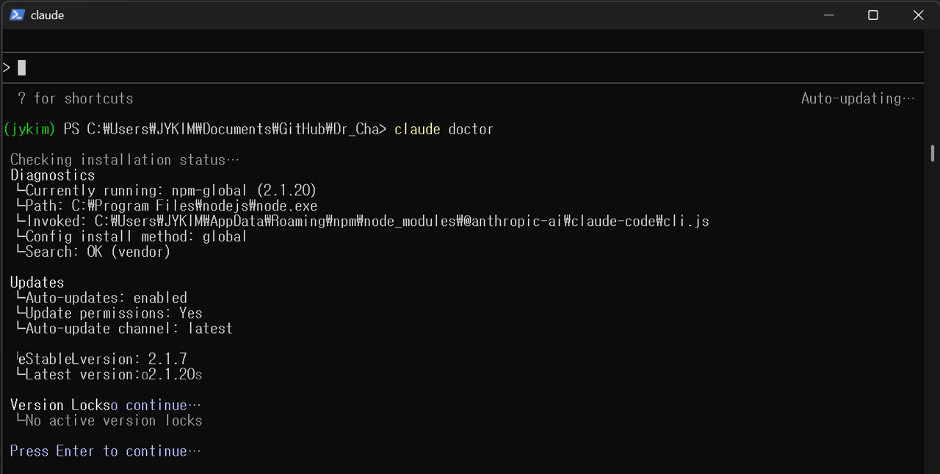

Slide 2

https://github.com/kjy4194/Dr_Cha_Seminar

Slide 3
