Slide 1
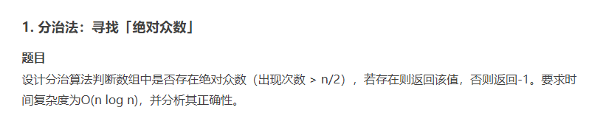

Slide 2
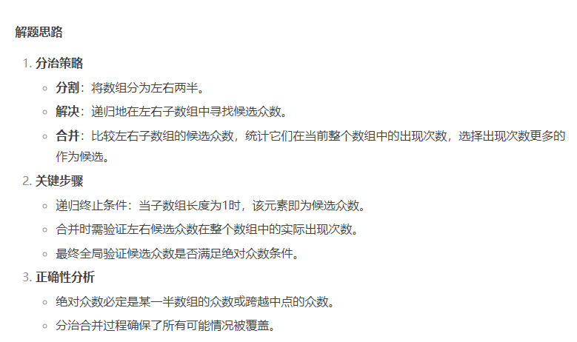

Slide 3
def majority_element(nums):
def helper(left, right):
if left == right:
return nums[left]
mid = (left + right) // 2
left_maj = helper(left, mid)
right_maj = helper(mid+1, right)
if left_maj == right_maj:
return left_maj
count_left = sum(1 for i in range(left, right+1) if nums[i] == left_maj)
count_right = sum(1 for i in range(left, right+1) if nums[i] == right_maj)
return left_maj if count_left > count_right else right_maj
candidate = helper(0, len(nums)-1)
return candidate if nums.count(candidate) > len(nums)//2 else -1

Slide 4
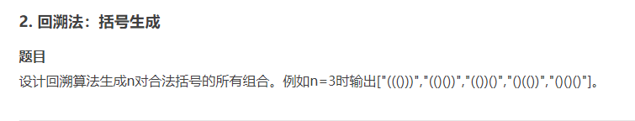

Slide 5
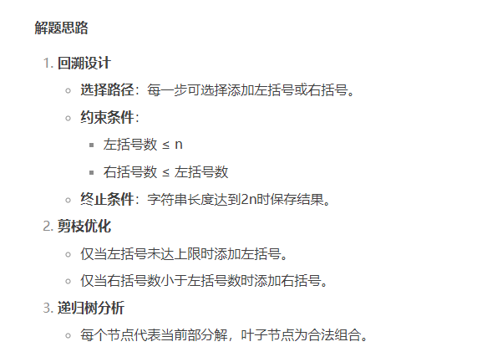

Slide 6
def generateParenthesis(n):
res = []
def backtrack(s, left, right):
if len(s) == 2*n:
res.append(s)
return
if left < n:
backtrack(s+'(', left+1, right)
if right < left:
backtrack(s+')', left, right+1)
backtrack('', 0, 0)
return res

Slide 7
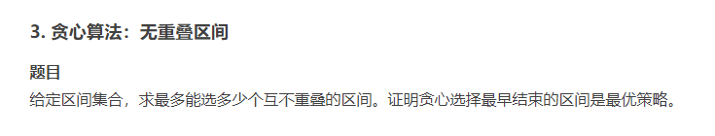

Slide 8
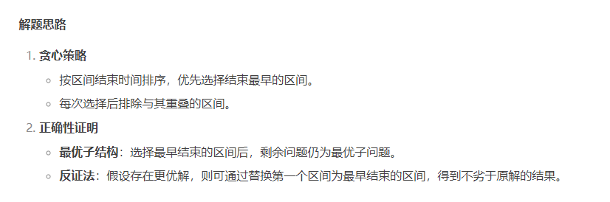

Slide 9
def eraseOverlapIntervals(intervals):
if not intervals: return 0
intervals.sort(key=lambda x: x[1])
count = 1
end = intervals[0][1]
for interval in intervals[1:]:
if interval[0] >= end:
count += 1
end = interval[1]
return len(intervals) - count

Slide 10
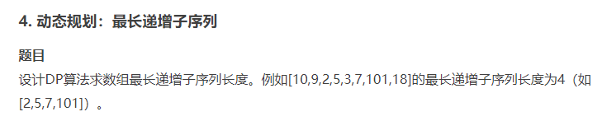

Slide 11
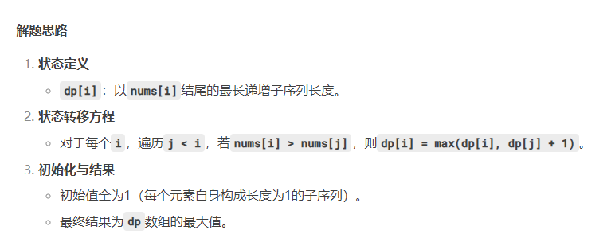

Slide 12
def lengthOfLIS(nums):
dp = [1] * len(nums)
for i in range(1, len(nums)):
for j in range(i):
if nums[i] > nums[j]:
dp[i] = max(dp[i], dp[j]+1)
return max(dp)

Slide 13


Slide 14


Slide 15
import random
def quick_select(arr, k):
pivot = random.choice(arr)
less = [x for x in arr if x < pivot]
eq = [x for x in arr if x == pivot]
great = [x for x in arr if x > pivot]
if k <= len(less):
return quick_select(less, k)
elif k <= len(less)+len(eq):
return pivot
else:
return quick_select(great, k-len(less)-len(eq))

Slide 16
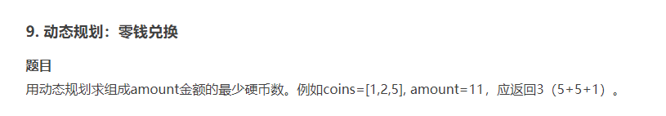

Slide 17
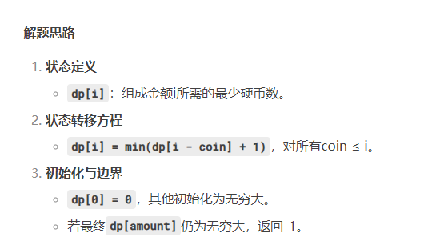

Slide 18
def coinChange(coins, amount):
dp = [float('inf')] * (amount+1)
dp[0] = 0
for i in range(1, amount+1):
for coin in coins:
if i >= coin:
dp[i] = min(dp[i], dp[i-coin]+1)
return dp[amount] if dp[amount] != float('inf') else -1

Slide 19


Slide 20
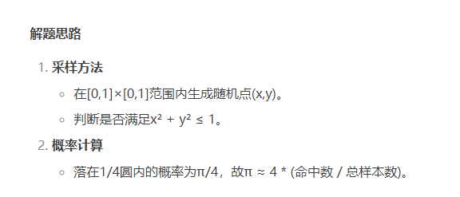

Slide 21
import random
def estimate_pi(n):
count = 0
for _ in range(n):
x, y = random.random(), random.random()
if x**2 + y**2 <= 1:
count +=1
return 4 * count / n

Slide 22


Slide 23


Slide 24
def max_activities(activities):
activities.sort(key=lambda x: x[1])
count = 0
end = -float('inf')
for s, e in activities:
if s >= end:
count += 1
end = e
return count

Slide 25


Slide 26
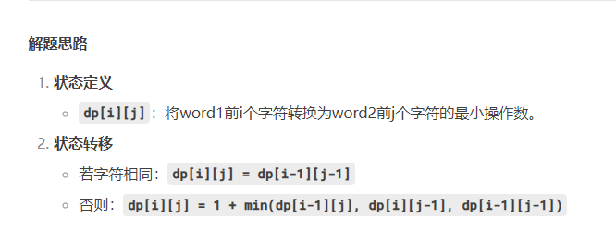

Slide 27
def minDistance(word1, word2):
m, n = len(word1), len(word2)
dp = [[0]*(n+1) for _ in range(m+1)]
for i in range(m+1):
dp[i][0] = i
for j in range(n+1):
dp[0][j] = j
for i in range(1, m+1):
for j in range(1, n+1):
if word1[i-1] == word2[j-1]:
dp[i][j] = dp[i-1][j-1]
else:
dp[i][j] = 1 + min(dp[i-1][j], dp[i][j-1], dp[i-1][j-1])
return dp[m][n]

Slide 28


Slide 29


Slide 30
import random
def quicksort(arr):
if len(arr) <= 1:
return arr
pivot = random.choice(arr)
less = [x for x in arr if x < pivot]
eq = [x for x in arr if x == pivot]
great = [x for x in arr if x > pivot]
return quicksort(less) + eq + quicksort(great)

Slide 31


Slide 32
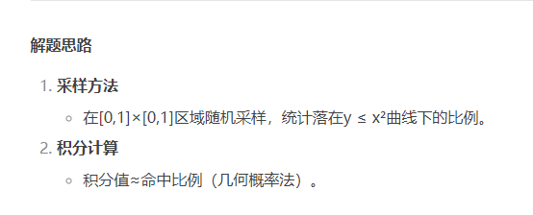

Slide 33
import random
def estimate_integral(n):
count = 0
for _ in range(n):
x = random.uniform(0, 1)
y = random.uniform(0, 1)
if y <= x**2:
count += 1
return count / n

Slide 34


Slide 35
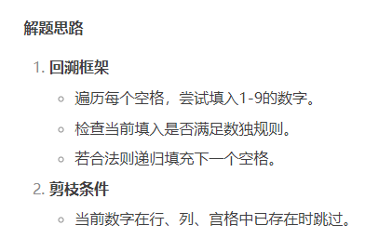

Slide 36
def solveSudoku(board):
def is_valid(row, col, num):
for i in range(9):
if board[row][i] == num or board[i][col] == num:
return False
start_row, start_col = 3*(row//3), 3*(col//3)
for i in range(3):
for j in range(3):
if board[start_row+i][start_col+j] == num:
return False
return True
def backtrack():
for i in range(9):
for j in range(9):
if board[i][j] == '.':
for num in '123456789':
if is_valid(i, j, num):
board[i][j] = num
if backtrack():
return True
board[i][j] = '.'
return False
return True
backtrack()

