Slide 1
Assignment-1 POS Tagging Using HMM
Suvvari Jaswanth : 200050140
T.Krishna Kamal : 200050142
Ashish Patel : 200260011
Date : 4th September 2022

Slide 2
Problem Statement
Given a sequence of words, produce the POS tag sequence
Technique to be used: HMM-Viterbi
Use Universal Tag Set (12 in number)
5-fold cross validation
"VERB","NOUN","PRON","ADJ","ADV","ADP","CONJ","DET","NUM","PRT","X","."

Slide 3
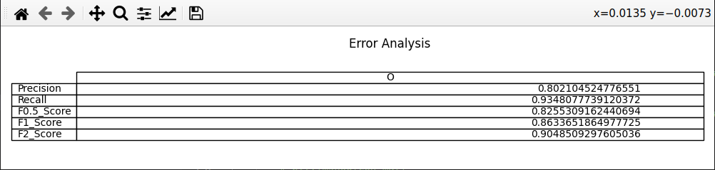
Overall performance

Slide 4
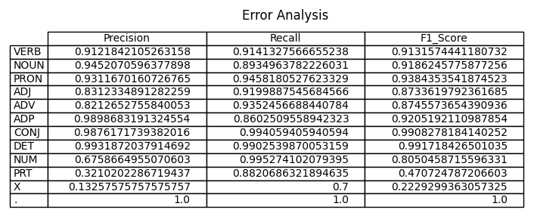
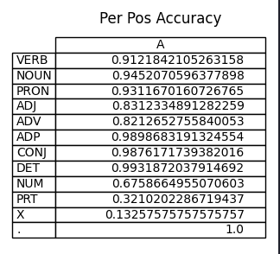
Per POS performance

Slide 5
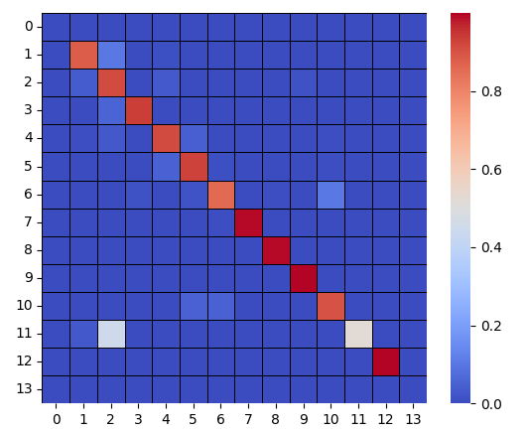
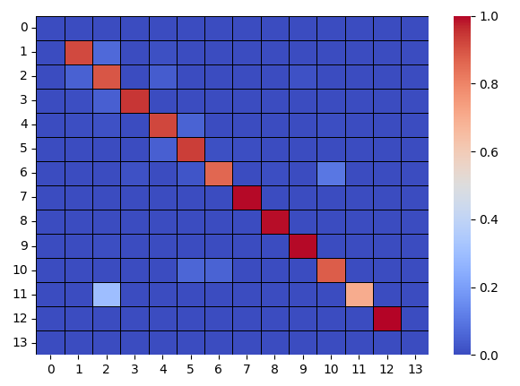
Confusion Matrix (12 X 12) (can give heat map)
FOLD : 1
FOLD : 2

Slide 6
Interpretation of confusion (error analysis)
Most confused tags are “X” and “PRT”
“X” is the worst of it because “ other/’X’ ” need more occurences of it and is not includable in unknown words.
While “PRT” is not as worse as “X” but it has it down fall in fold-1 due to unique domain sentences from 1st test part.
But in subsequent folds both their confusion is reduced and is in a range of 0.7-0.9 which is huge given their less probability in transition and occurence.

Slide 7
Data Processing Info (Pre-processing)
Data was first loaded from “NLTK” module which returns a list of sentences(list of tuples(word,tag)).
Data was split into 5 parts and sent to 5-Fold CV.
“nltk” take more time to load data so we decided to store the data in a json file and retrive it as same as before.
Before prediction/training a word, the word gets converted to lower case for more reliability and avoid the unknown word case due to capitalization.
Each tag was represented by a unique index ranging from 1-12 and for usage we added two additional tags namely “START” and “END”.

Slide 8
Inferencing/Decoding Info
A model named “hmm()” is created from scratch.
It requires a transition table, an emmision dictionary and test data.
As we surf through each sentences and get the word and true tag retrieved, we predict the tag for the word and use this to update corresponding error analysis and return them from the model.
Produced a heatmap for better view of confusion matrix retrived from the error analysis of hmm() model.
Plotted tables for per-pos-accuracy, F-Scores, precision and recall.

Slide 9
Marking Scheme
1. Demo working- 10/10 (if not, 0)
2. Implemented Viterbi and Clarity on Viterbi- 5/5
3. Transition and Lexical tables clearly described- 5/5
4. Confusion matrix drawn and error analysed- 5/5
5. Overall F-score > 90- 10/10, >80 & <=90- 8/10, else 6/10
6. Unknown word handling- done (5/5; else 0)

Slide 10
Any thoughts on generative vs. discriminative POS tagging
A generative model trains with data under the bayes theorem of updating beliefs where a discriminative is a fixed conditional probability based tagging which doesn’ t update with the size of data supplied to it.
Mathematically a generative model uses a P(x,y) where a discriminative model uses P(x|y).

