Slide 1
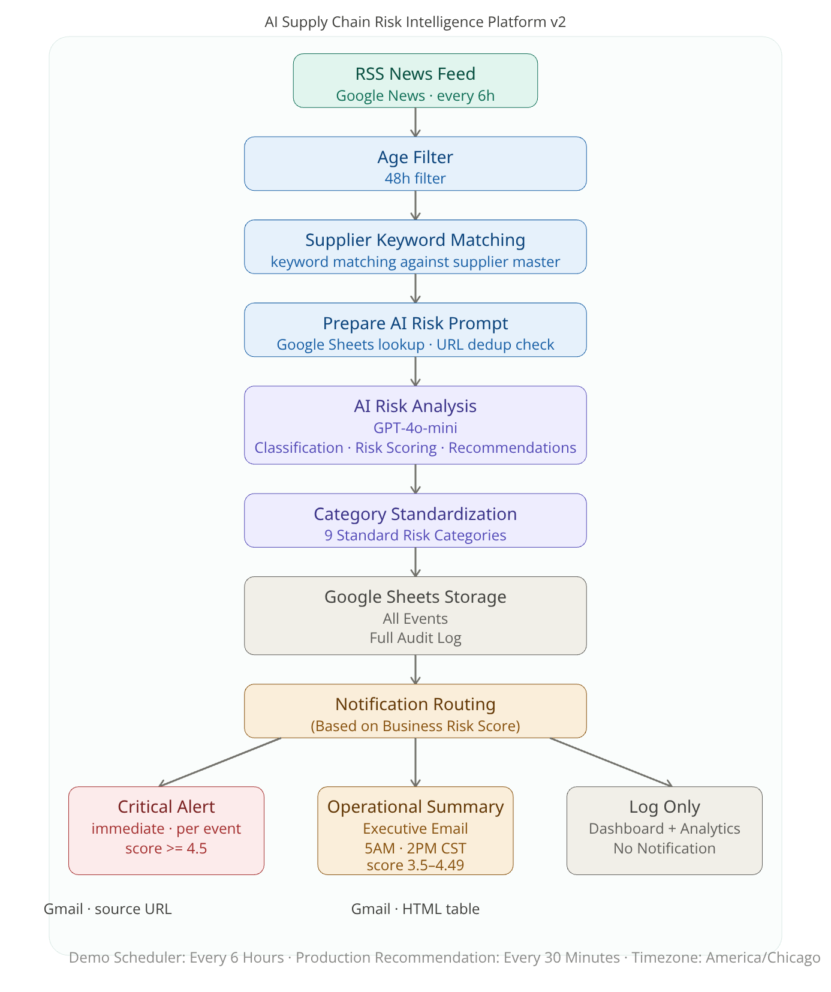
AI Supply Chain Risk Intelligence Platform v2
AI-assisted workflow automation for supply chain risk monitoring, executive alerting, and operational intelligence — turning hours of manual effort into minutes of decisive action.

Slide 2





The Business Problem
Supply chain risk moves faster than email threads. By the time a critical supplier disruption surfaces through manual monitoring, the window for early response has often already closed.
Manual Monitoring Overload
Delayed Leadership Escalation
Teams juggle scattered news sources, spreadsheets, and ad-hoc alerts with no consistent framework for triage or escalation.
Critical events reach decision-makers too late — often after disruptions have already impacted production or logistics schedules.
Alert Fatigue & Noise
No Centralized Visibility
Without intelligent scoring, every event feels equally urgent — causing teams to tune out alerts entirely, missing the ones that matter most.
Risk data lives in inboxes, tabs, and silos. There is no single source of truth for supply chain risk status across the organization.
The cost of late response is measured in production delays, missed SLAs, and critical events that could have been avoided.

Slide 3






Solution Overview
From news to action in minutes, not days.
RSS News Feed
Demo : every 6 hours
Production : 30 minutes
Age Filter
48 hours only · stale news blocked
URL Deduplication
Same article never processed twice
AI Risk Analysis
GPT-4o-mini · scoring · categorization
Google Sheets Logging
All events · full audit log
Risk Score Threshold
Routes to one of three outcomes
Score ≥ 4.5
Score 3.5–4.49
Score < 3.5
CRITICAL ALERT
Immediate email per event
SCHEDULED SUMMARY
5AM / 2PM CST
LOG ONLY
Logged for audit only

Slide 4





Enterprise Technology Architecture
Layered enterprise architecture enables scalable, maintainable, and technology-independent business solutions.
Business Experience Layer
Workflow Automation Layer
AI Intelligence Layer
Data Layer
AI-assisted business reasoning
Enterprise operational data
Executive dashboards, business notifications, and reporting
Executive Notifications
Business process orchestration
OpenAI GPT-4o-mini
Risk Classification
Risk Scoring
Executive Summary Generation
AI Recommendations
Google Sheets (Demo)
SQL Server
Azure SQL
Production-ready Schema
Audit Logging
Event History
n8n Cloud (Demo)
n8n Enterprise
Azure Logic Apps
Microsoft Power Automate
Camunda
Gmail Alerts (Demo)
Executive Dashboards
GitHub Pages Dashboard (Demo)
Executive Web Portal
HTML Dashboard (Demo)
Analytics Platforms
Power BI
Tableau
Looker
Qlik Sense
Layered Enterprise Technology Architecture decouples Business Experience, Workflow Automation, AI Intelligence, and Data into independently evolvable architectural layers, improving scalability, maintainability, governance, and long-term technology flexibility.

Slide 5
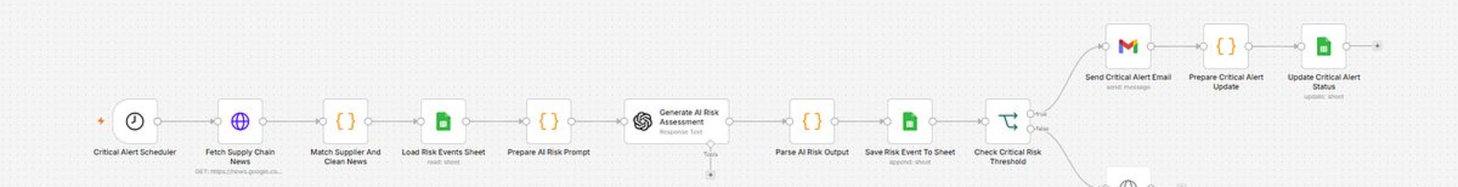





Critical Alert Workflow
High-risk events are escalated immediately and automatically — no human triage required to trigger an alert to leadership.
RSS Ingest
Feeds polled every 30 min in production (every 6 hrs in demo)
Filter & Dedupe
48-hour age filter applied; duplicate URLs suppressed before analysis
AI Scoring
GPT-4o-mini evaluates severity, operational impact, and urgency
Immediate Alert
Score ≥ 4.5 triggers instant email with source link and AI summary
Every critical alert includes the source article as evidence — giving leadership the context to act, not just the notification to react.

Slide 6
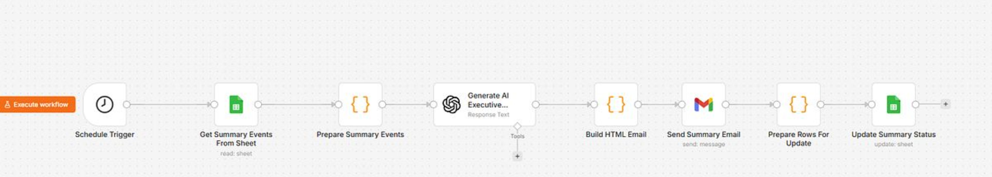
Operational Summary Workflow
One email. Full operational picture. Twice a day. The summary workflow consolidates mid-tier risk events into structured digest emails designed for leadership consumption — not inbox overload.
🕔 5:00 AM CST
🕑 2:00 PM CST
Morning digest covering overnight events — optimized for Eastern time zone executives starting their day with situational awareness.
Afternoon digest for Pacific time zone coverage — ensuring no region misses a consolidated risk summary before end of business.
Each summary email contains an AI-generated Executive Summary, top-ranked risks with scores and supplier names, recommended actions, and a full source events table with clickable article links — everything a leader needs to make an informed call.

Slide 7




Risk Scoring Methodology
Scores reflect business impact — not keyword frequency. The weighted formula ensures that operational consequence drives prioritization, not just media volume.
40%
35%
Severity
Operational Impact
Magnitude of potential harm
Disruption to production and logistics
25%
0–5
Urgency
Overall Score
Response time requirement
Combined weighted result
🚨 Score ≥ 4.5
📋 Score 3.5–4.49
📁 Score < 3.5
CRITICAL — Immediate email alert sent per event. No delay, no batching.
SUMMARY — Included in next scheduled daily digest at 5AM or 2PM CST.
LOG ONLY — Stored silently for audit and trend analysis. No notification generated.

Slide 8



Data Quality & Governance
Clean data. Auditable operations. Every event that enters the system is subject to quality controls before analysis — ensuring the AI never scores stale, duplicate, or irrelevant content.
1
2
3
Age Filter
URL Deduplication
Status Tracking
Only articles published within the last 48 hours are processed. Stale news cannot trigger alerts or inflate risk scores.
Each article URL is hashed and checked before processing. The same story is never scored twice — preventing duplicate emails and inflated event counts.
Every event records: processed_at · alert_level · summary_status · critical_alert_status · dedupe_key
A complete audit trail is maintained in Google Sheets — reviewable by any stakeholder without requiring access to the n8n workflow environment.

Slide 9





AI Capabilities
AI interprets risk. Humans decide. For every qualifying news event, the AI engine generates a structured, actionable intelligence package — not just a raw article link.
Risk Category
Composite Score
Classified into one of 9 standardized supply chain risk categories for consistent reporting.
Severity, Operational Impact, and Urgency scores generated independently, then combined via weighted formula.
Executive Summary
Recommended Action
AI-drafted, leadership-ready narrative explaining the risk in plain business language — no translation required.
Suggested next step for procurement or operations — flagged as AI-assisted, not autonomous.
Confidence scores (0–100) accompany every AI output. Human review remains essential for all high-impact supply chain decisions.

Slide 10
Operational Data Layer
Every event logged. Every alert tracked. The data layer is designed for transparency today and enterprise migration tomorrow.
Why Google Sheets (Demo)
23 Fields Tracked Per Event
Zero infrastructure setup — operational immediately
Full transparency for stakeholder review
Direct Power BI connectivity for dashboard integration
SQL-ready schema — migration is designed and ready
Each logged event captures the full intelligence record including:
Risk scores (Severity, Operational Impact, Urgency, Overall)
Alert routing status and timestamps
Deduplication key and source URL
AI-generated summary, category, and recommended action
Confidence score and processing metadata
Future migration to SQL Server is architecturally complete — the schema, field mapping, and query patterns are already designed for a seamless transition when production deployment begins.

Slide 11

Production Design Thinking
Designed for production. Deployed as a demo. Every architectural decision — from scheduling intervals to schema design — was made with enterprise-grade production requirements in mind, not demo convenience.
Component
Demo
Production
Scheduler
Every 6 hours
Every 30 minutes
Storage
Google Sheets
Enterprise Relational Database (SQL Server/Azure SQL)
Supplier Data
Fictional scenarios
ERP/Supplier Master Integration
Notifications
Gmail
Role-based Notifications (Email/Microsoft Teams/Slack)
Analytics
HTML prototype dashboard
Enterprise BI Platform (Power BI, Tableau, Looker, Qlik Sense)
Orchestration
n8n Cloud
Enterprise Workflow Platform
(n8n Enterprise, Azure Logic Apps, Power Automate, Camunda)
Core architecture, workflow design, and governance are production-ready.

Slide 12





Business Benefits
Operational value. Not just automation. The platform delivers measurable intelligence improvements across every layer of the supply chain risk function.
Reduced Manual Monitoring Effort
Automated ingestion and scoring replaces hours of daily manual news review across scattered sources.
Faster Critical Escalation
High-risk events reach leadership within minutes of publication — not hours or days after manual triage.
Reduced Alert Fatigue
Score-based routing ensures only genuinely critical events generate immediate notifications — quieting the noise without losing the signal.
Evidence-Based Decisions
Every alert includes source links, AI summaries, and confidence scores — giving leaders context, not just notifications.
PROCUREMENT
OPERATIONS
EXECUTIVE LEADERSHIP
SUPPLY CHAIN ANALYSTS

Slide 13
Future Roadmap
Each phase delivers independent business value while expanding automation, governance, and AI-driven intelligence.
In Progress
1
Foundation Platform
SQL Server / Azure SQL migration
Dashboard modernization
Data model & schema finalization
2
Near Term
Business focus: Production-ready data foundation.
Enterprise Integration
ERP / Supplier Master integration
Enterprise BI Platform connectivity
Teams / Slack notifications
Mid Term
3
Enterprise Operations
Business focus: Connect systems, improve visibility.
Role-based alert routing & workflows
Data quality monitoring
Multi-source intelligence feeds
4
Future AI
Business focus: Governance, control, scalability.
Intelligent Operations
AI Copilot for procurement analysts
Predictive forecasting & root cause
Recommendation engine
Business focus: AI-assisted decision support.
Each phase delivers standalone business value while progressively increasing enterprise automation, governance, and operational intelligence.

Slide 14

About the Developer
Enterprise operations experience meets AI workflow automation. This platform was built by a practitioner who has spent 20+ years at the intersection of enterprise systems and operational process design.
Enterprise Systems
Business & IT Bridge
ERP, EDI, manufacturing, and logistics operations — implementation, integration, and day-to-day operational support.
Data exchange operations, cross-functional stakeholder alignment, and translating business requirements into technical solutions.
Operational Intelligence
Workflow automation, process improvement, and operational intelligence design — Now focused on Enterprise AI Automation Workflow Architecture Operational Intelligence Business Systems Analysis
Now focused on: AI-powered workflow automation · Business process automation architecture · Enterprise operational intelligence
Kaori Kashiwagi | GitHub: github.com/kk-2050

Slide 15



Design Philosophy
"The system separates event persistence, dashboard visibility, and human notification. All events are logged. Dashboards remain available for self-service monitoring. Only critical or summarized risks are pushed to users."
Separation of Concerns
Human-in-the-Loop
Enterprise-Grade Reliability
Logging, alerting, and dashboarding are independent layers. Each serves a distinct purpose and audience — preventing coupling that creates fragility at scale.
AI recommends. Humans decide. The platform amplifies human judgment — it does not replace it. Especially for high-impact supply chain actions.
Every design decision — from deduplication to audit tracking to schema design — is made for production-grade reliability, not demo convenience.
Designed for enterprise-grade reliability — not just automation.

