Slide 1
Healthcare AI Forward Deployment Lab
Prior Authorization Workflow Support — Phase 1 Portfolio Prototype
Project Owner & Solution Designer - K. Kashiwagi
Checks requests using deterministic rules first
Uses AI assistance only for appropriate language tasks
Routes unresolved cases to Human Review
Records key workflow events for traceability
Synthetic healthcare data only — no autonomous clinical approval or denial
Notes:
Today I will introduce my Healthcare AI Forward Deployment Lab, a Phase 1 portfolio prototype for prior authorization workflow support. Prior authorization is an administrative process where a request and its supporting information are checked before a coverage review. The purpose here is to help with repetitive checks, not to make medical decisions. The system uses fixed rules first, asks for human review when something is unresolved, and records important workflow events. It uses synthetic healthcare data only. I will show what actually worked in a local demonstration, and I will separate that evidence from AI capabilities tested offline and features planned for later.

Slide 2
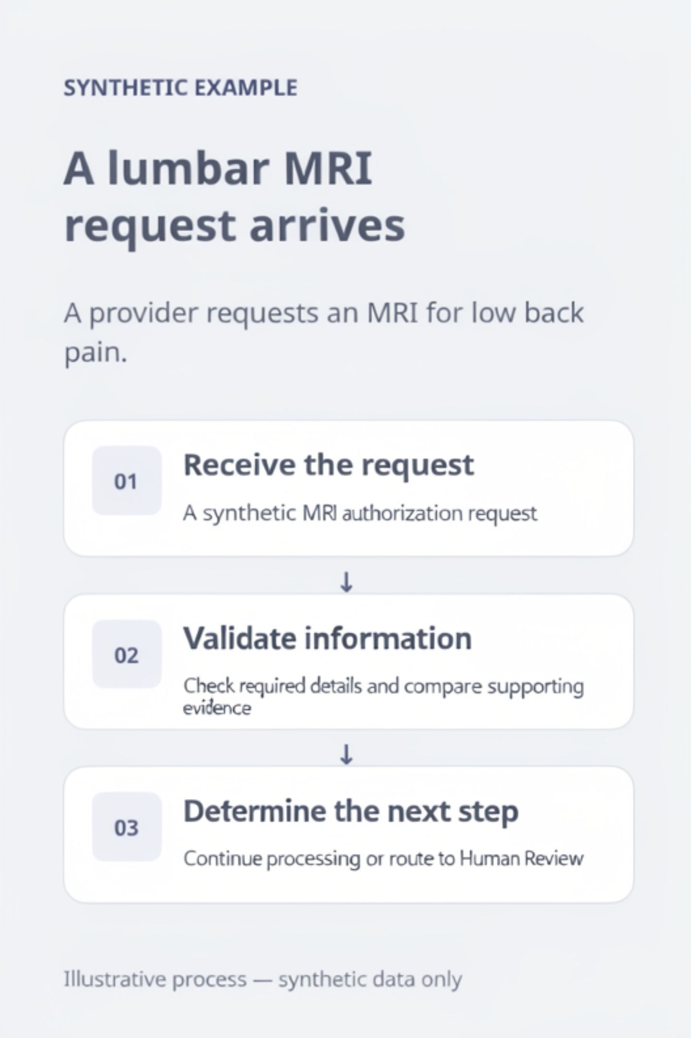
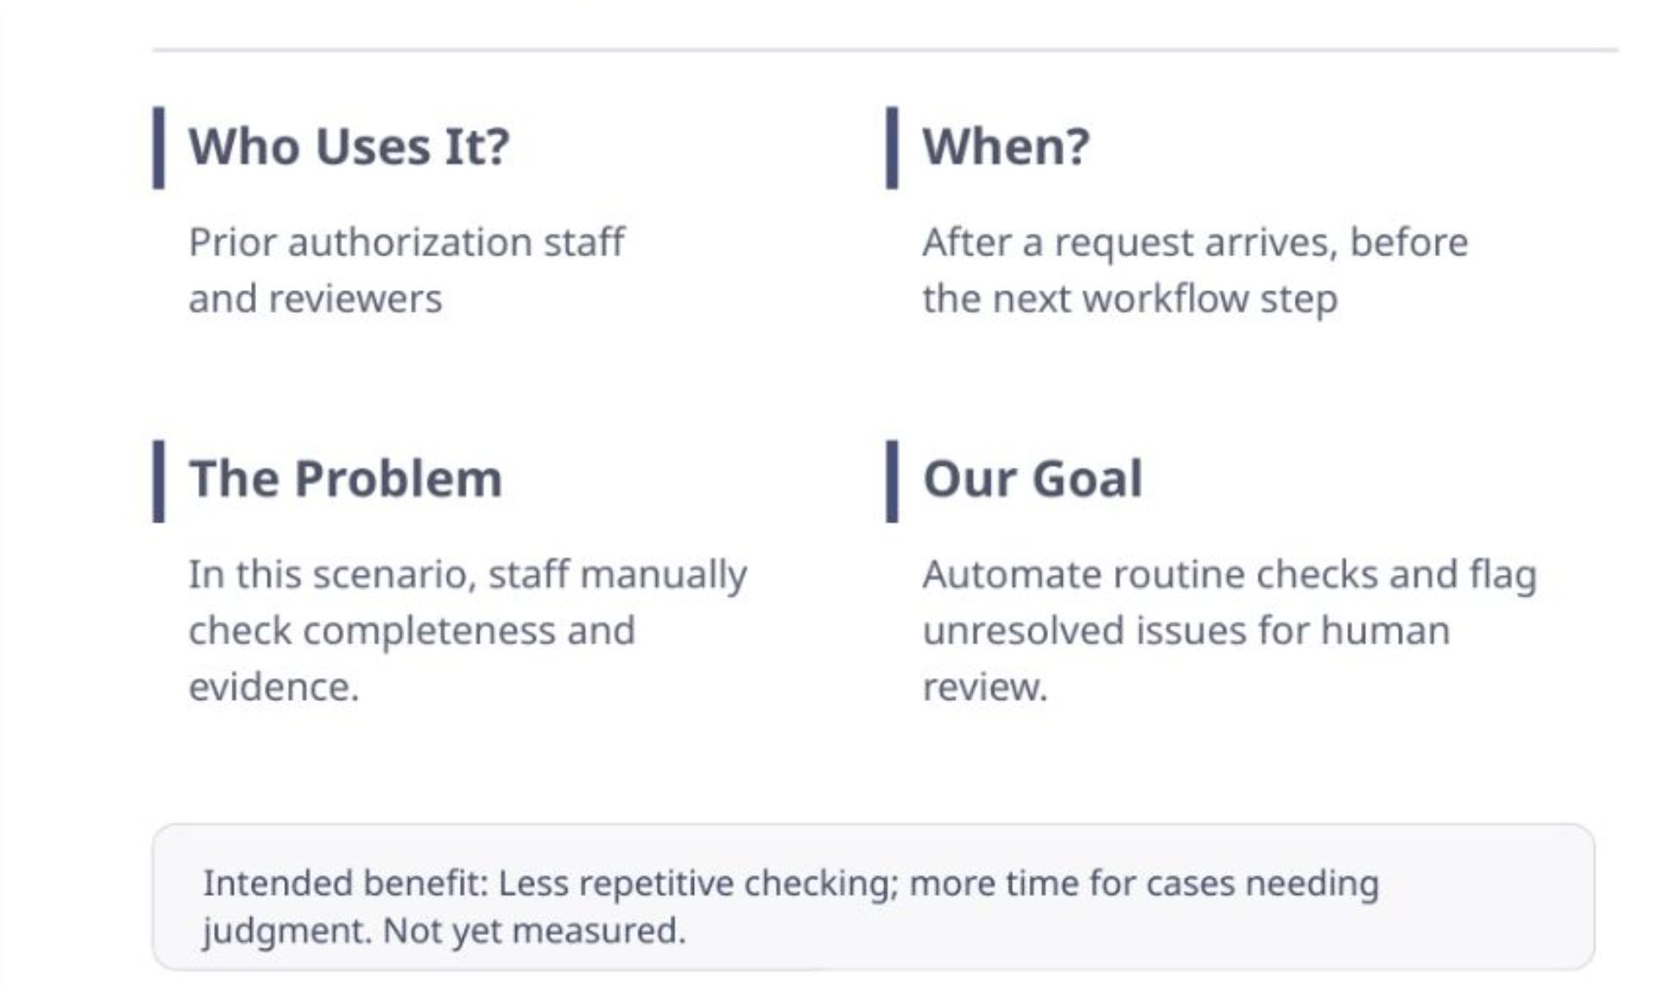
The Business Problem: Who, When, and Why?
Support the checking work before further review.
Notes:
Imagine a healthcare provider requests an MRI scan for someone with lower back pain. Before the case moves forward, staff may need to check whether required information is present and whether the request agrees with its supporting evidence. Those routine checks can take time and are easy to repeat inconsistently. The people who would use this support are prior authorization operations staff and reviewers. My prototype aims to automate the predictable checks and send unresolved cases to a person. The intended benefit is more time for cases that really need human judgment. I have not measured time savings or clinical outcomes, so I present this as a goal, not a proven result.

Slide 3

From Business Need to Traceable Requirements
Requirements Defined
Functional Trace
Capture business, functional, technical needs.
Document 28 functions linked to tests.
Business Problem
Status Tracking
Identify stakeholders and goals.
Track validated versus planned items.
Structured Requirement Layers
Linked and Tracked
Business requirements: stakeholder goals and compliance needs
Functional requirements: 28 documented capabilities
Technical requirements: architecture, data, and API contracts
Each requirement is linked to its implementation, test coverage, and audit-event plan. Actual status — validated vs. planned — is tracked explicitly, ensuring no capability is overclaimed.
Notes:
A Forward Deployment Engineer needs to start with the business problem, not the technology. I first identify who uses the workflow, what they need, and which questions are still unanswered. Those needs become business requirements, functional requirements, and technical requirements. In this project, 28 functional requirements are documented. Traceability means being able to follow a requirement toward its implementation, relevant tests, and planned audit evidence. Importantly, that does not mean every requirement has already been implemented or validated. Tracking 'working now' separately from 'planned' keeps both the technical work and the stakeholder conversation honest.

Slide 4

How the System Works: Four Main Components
Streamlit
FastAPI
The user-facing web interface. Staff submit requests, view status, and complete Human Review actions here.
The backend service layer. Receives requests from Streamlit, coordinates workflow execution, and returns results.
LangGraph / Python
SQL Server
Orchestrates the step-by-step workflow logic. Applies deterministic rules; optionally calls Azure OpenAI for language tasks only.
Stores cases, workflow runs, Human Review records, and audit events. Pydantic models validate data; synthetic FHIR-style structures represent clinical evidence.
Azure OpenAI is configured as an optional external language support component. It was not called live during Task 26D validation.
Notes:
The architecture has four main parts. Streamlit is the screen where a staff member submits a synthetic request and reviews results. FastAPI is the application's request-handling layer; the screen communicates with it through a REST API using JSON, which is a common text format for data. Within the backend, LangGraph and Python organize the workflow steps and apply the rules. SQL Server stores case information, reviews, workflow states, and audit events. Pydantic checks that incoming data has the expected structure. The healthcare evidence follows a synthetic FHIR-style format; it is not a connection to a real healthcare system. Azure OpenAI is optional language assistance and was not called during the local demonstration.

Slide 5
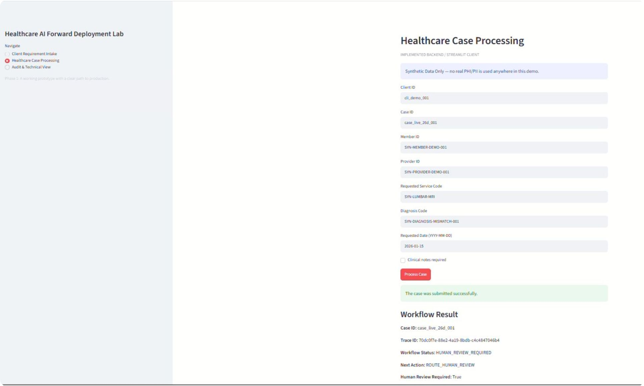
Rules First, AI Only When Appropriate
Missing Information
Check required fields and supporting documents using deterministic rules.
Evidence Mismatch
Compare the request's diagnosis code with supporting healthcare evidence.
Unresolved → Human Review
An unresolved evidence mismatch routes directly to Human Review without an AI call.
Real local validation: Evidence mismatch detected → HUMAN_REVIEW_REQUIRED. No live AI call.
Notes:
My main design choice is 'rules first.' A deterministic rule means that the same verified input leads to the same defined result. For example, the system checks required fields and compares the diagnosis code in a request against its supporting healthcare evidence. If those facts disagree and the mismatch remains unresolved, there is no reason to ask AI to guess which one is correct. The system routes the case to Human Review instead. This screen comes from the actual local workflow validation and shows HUMAN_REVIEW_REQUIRED. That route was reached without a live AI call. The reviewer handles the next administrative step, not an automated clinical approval or denial.

Slide 6
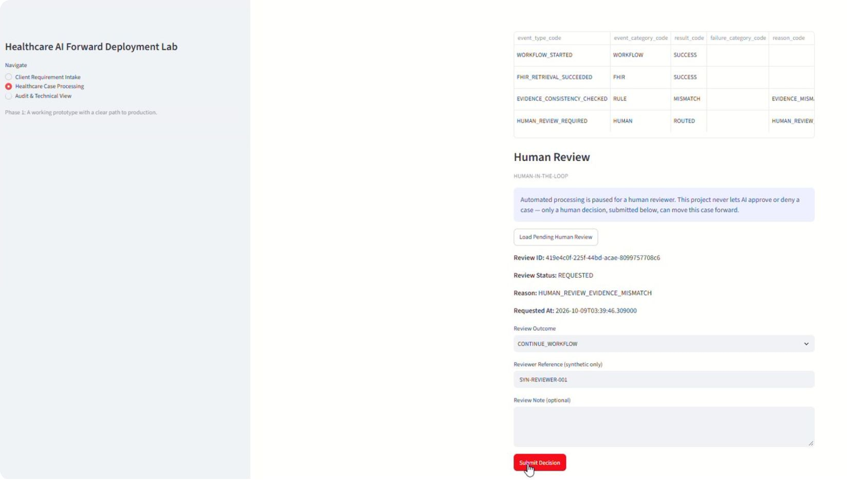
AI Assists. Humans Review.
What AI May Do
Summarize request text
Identify ambiguous language
Suggest clarifying questions
Human Review Actions
Continue processing (CONTINUE_WORKFLOW)
Request more information (REQUEST_MORE_INFORMATION)
Escalate (ESCALATE)
Close case (CLOSE_CASE)
Real Human Review form — synthetic data. Workflow decision control shown.
AI does not approve or deny care. Human reviewers select workflow actions, not clinical decisions.
Notes:
AI has a limited role in this design. It can support language-related tasks, such as summarizing text, identifying unclear wording, or suggesting a question for a reviewer. Those behaviors were tested offline; the local workflow demonstration did not make a live AI call. Important workflow decisions stay with a person. The Human Review interface supports four process actions: continue processing, request more information, escalate, or close the case. These are administrative workflow actions, not controls for approving or denying medical care. The real screenshot shows the review form with the dropdown collapsed, so the picture alone does not display all four options.

Slide 7
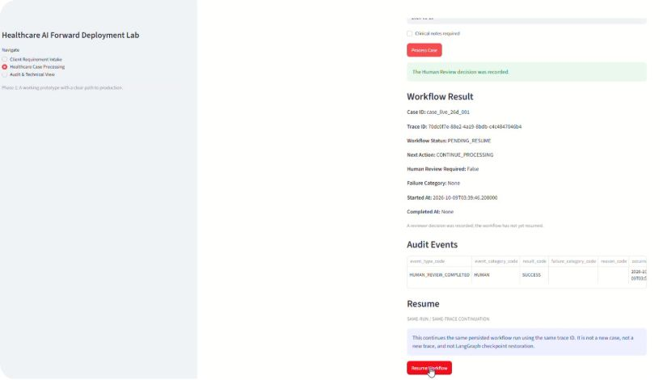
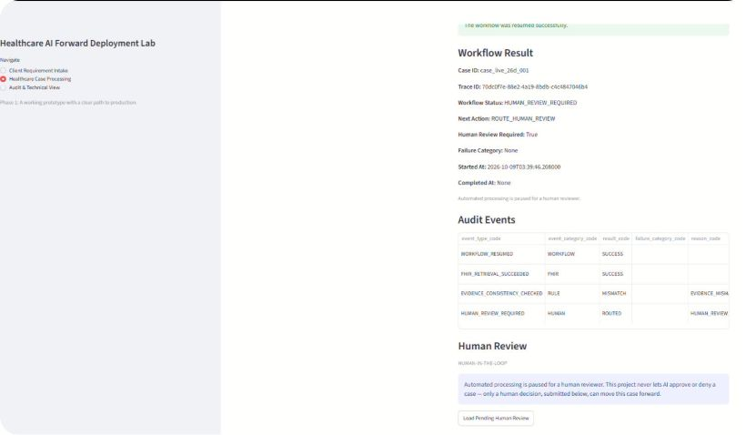
Real Local Run: Review, Resume, Revalidate
Mismatch
Human Review
Record Action
Pending Resume
Revalidate → Human Review
Before Resume — PENDING_RESUME
After Resume — HUMAN_REVIEW_REQUIRED
Same trace ID. Evidence checked again. Unresolved mismatch returns to Human Review.
Notes:
This slide follows one real local workflow example. The system found a mismatch and routed the case to Human Review. A reviewer recorded an action to continue, which left the workflow in PENDING_RESUME. When Resume was triggered, the application reused the SAME trace ID and ran the appropriate checks again. Because the underlying evidence mismatch was still unresolved, the workflow returned to HUMAN_REVIEW_REQUIRED. This is application-level re-invocation, not restoration from a LangGraph checkpoint. That difference matters: continuing a workflow must not silently treat an unresolved problem as solved. These two screenshots show the before-and-after states of that specific local example.

Slide 8
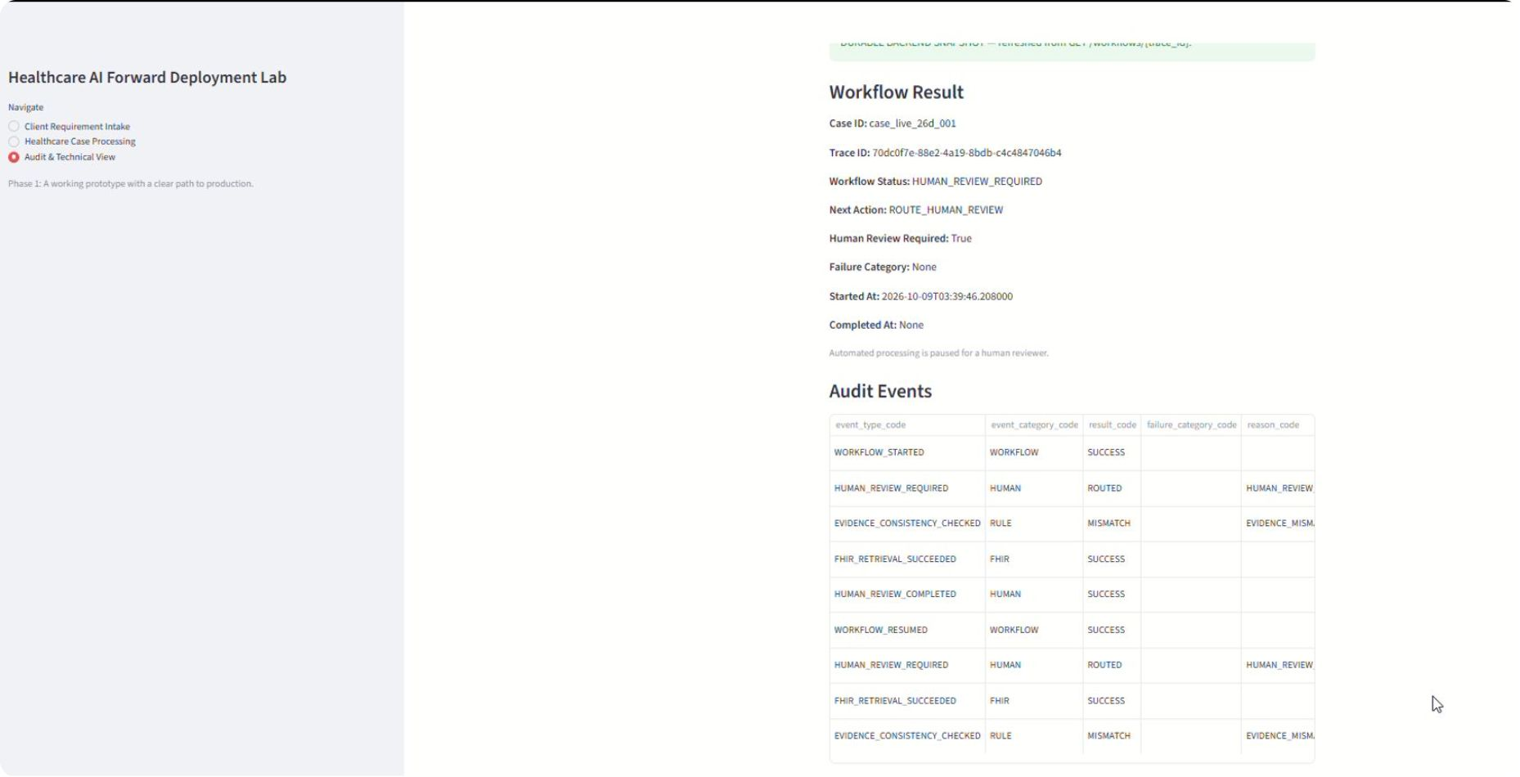
Traceable Workflow Events — Application View
What Gets Recorded
Application View — Audit Events
case_id
trace_id
Identifies the prior authorization case and links its related records through case_id and trace_id.
Identifies one workflow run. A case may have multiple runs.
Audit Events
Application inserts a record at each key workflow transition. Database-enforced immutability has not been verified in Phase 1.
Notes:
Traceability means being able to explain what happened to a case and why. The case_id identifies the authorization case; the trace_id identifies a particular workflow run associated with that case. A case can have more than one run, while a run can have several events and Human Review records. The application view displays important workflow events, such as starting the workflow, checking evidence, requesting human review, and resuming. The application inserts audit records for these events, but database-enforced immutability has not been independently verified. Also, this screenshot alone does not prove that a particular HTTP refresh request succeeded. It shows the application's audit information, not every possible system event.

Slide 9
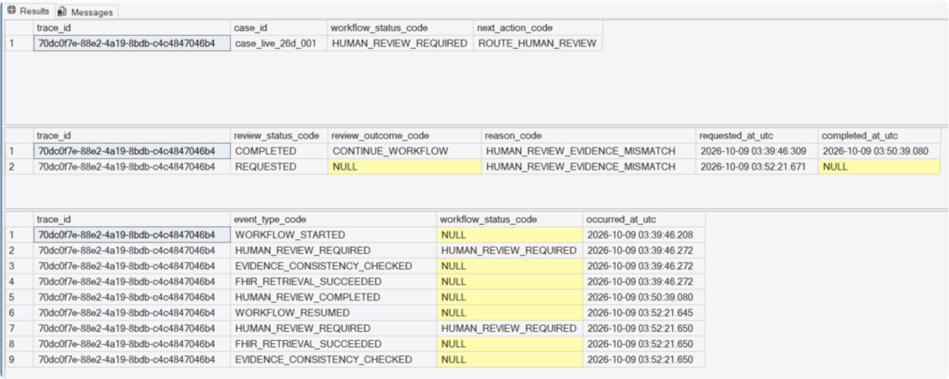

SQL Server — Direct Database Verification
Database View — Direct SQL Verification
SQL persistence confirms that data was saved. It does not by itself prove that a specific HTTP refresh request succeeded.
Notes:
Here I checked the database directly rather than relying only on the application's screen. The SQL Server results show a workflow-run record, two Human Review records, and nine recorded audit events for the same trace ID. One review was completed with CONTINUE_WORKFLOW; a later review was requested again after revalidation. This supports the claim that the workflow state, review information, and important events were actually saved in the local database. It is a different kind of evidence from a user-interface screenshot. However, a SQL query cannot by itself prove that a specific HTTP refresh request succeeded, and this was not a production database or production-security validation.

Slide 10

Automated Tests and Real Local Validation
Prior Automated Test Baseline
650
4
0
Tests Passed
Tests Skipped
Tests Failed
Covering implemented scenarios
Not executed in that test run
Clean baseline at time of review
Automated tests verify expected behavior in covered scenarios. They are a separate measure from live local validation.
Task 26D — Local End-to-End Validation
Streamlit UI
FastAPI Backend
SQL Server
Staff submitted a synthetic FHIR-style evidence request through the browser interface.
Request received, workflow triggered, deterministic mismatch detected.
Case, workflow run, and audit event persisted to the real local database.
No live AI call. No production FHIR connection. One complete workflow demonstrated end-to-end.
Notes:
There are two separate kinds of evidence on this slide. First, an earlier automated test baseline reported 650 passed, four skipped, and zero failed. This baseline was not rerun just for the presentation, and the individual reasons for the four skipped tests still need to be checked in the original test report. Automated tests tell us how the software behaves in the scenarios covered by those tests; they cannot prove every possible case is correct. Second, Task 26D was a real LOCAL end-to-end validation through Streamlit, FastAPI, and SQL Server using synthetic evidence. It demonstrated one complete workflow path. It did not test a live AI call, production FHIR integration, or production authentication.

Slide 11
What Works Today — and What Comes Next
Phase 1 Prototype — Working Now
Production Roadmap — Not Yet Implemented
Deterministic Checks
Human Review
Production authentication and secrets management
Real FHIR / payer system integration
Broader clinical policy enforcement
Automatic retry controls and error escalation
CI/CD pipeline and compliance monitoring
Rule-based mismatch and completeness validation
Reviewer workflow actions with key audit events recorded
Application Resume
SQL Persistence
Re-invocation using trace ID with revalidation
Cases, runs, reviews, and audit events recorded
A working prototype with a clear path to production — not a clinical decision system.
Notes:
This is a working Phase 1 prototype, not a hospital-ready product. Today it supports defined deterministic checks, Human Review workflow actions, same-trace application-level Resume, and persistence of cases, runs, reviews, and important audit events in SQL Server. It does not claim to record every possible action in a complete or database-immutable audit trail. The production roadmap still includes authentication, managed secrets, real FHIR and payer integrations, wider security-policy enforcement, retry controls, deployment automation, and monitoring. Separating implemented capabilities from future work is part of the engineering deliverable. The objective is a clear path to production, not an autonomous clinical decision system.

Slide 12

Appendix A1: One Real Deterministic Routing Decision
What This Function Does
Key Concepts — Plain Language
After the evidence-consistency check runs, one routing function reads the check result and decides the next workflow step. This is one of several decision points in the graph — not the only one.
state
A shared data object that passes information between workflow steps.
def route_after_evidence_consistency(state):
result = state["evidence_consistency_result"]
if result is not None and result.is_consistent:
return "evaluate_completeness"
return "human_review_required"
evidence_consistency_result
A structured result containing the evidence-consistency check outcome.
return value
A text label telling LangGraph which node to visit next — The function returns a route label; it does not execute the destination node itself.
No AI is called here. The function reads the result of an earlier rule-based evidence check and returns a label for the next workflow step. LangGraph uses that label to route the case.
Notes:
This is one small routing function from the actual workflow source, with type information and the docstring omitted for slide space. A function is a reusable piece of Python code. Here, state holds information shared between workflow steps. The function reads the evidence_consistency_result produced by an earlier check. If a result exists and the evidence is consistent, it returns the label evaluate_completeness. Otherwise it returns human_review_required. LangGraph uses that label to choose the next workflow node. The routing function does not make the evidence comparison itself, does not execute the destination node, and does not call AI. It is one of several routing decisions in the workflow.

Slide 13
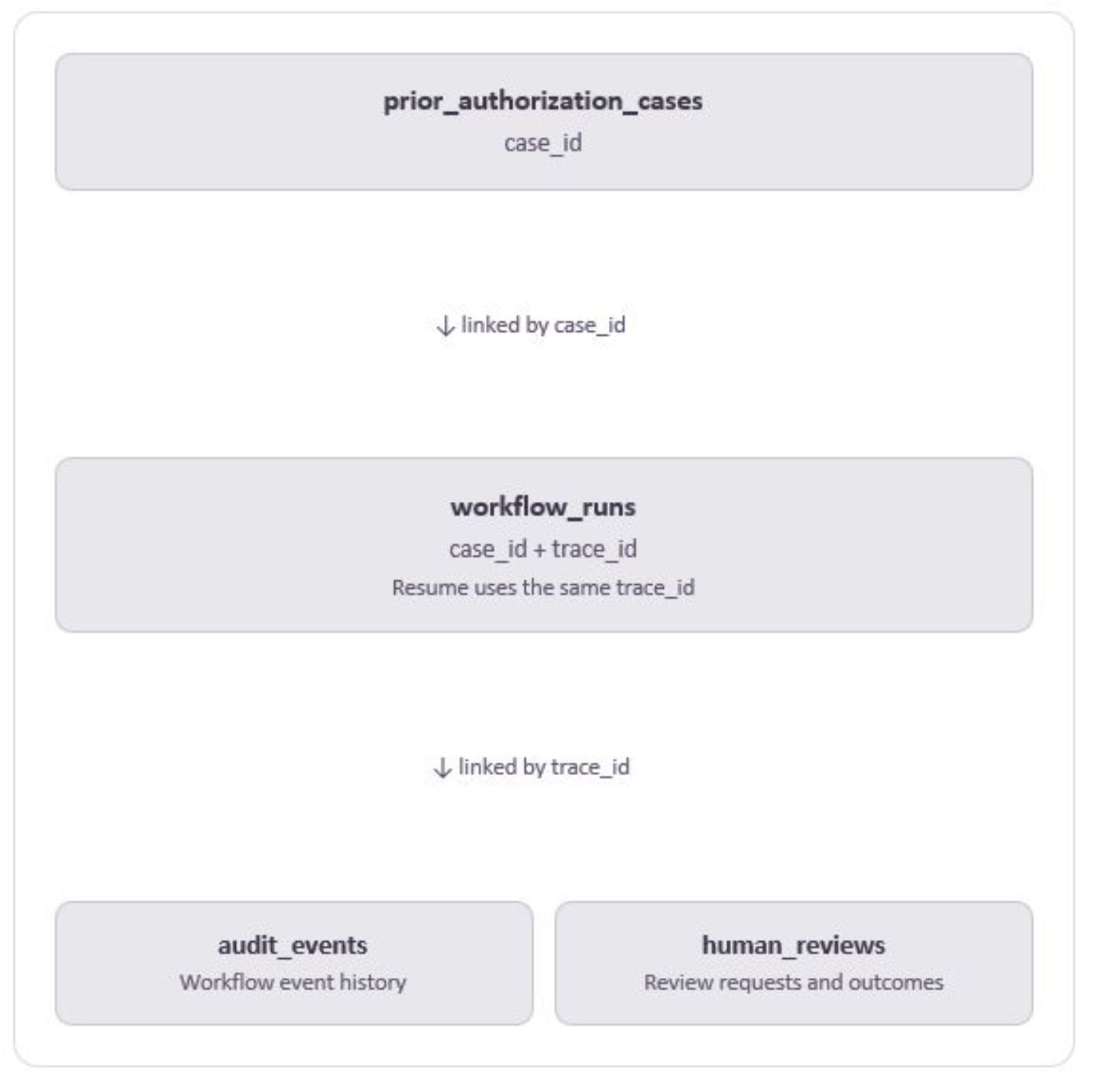
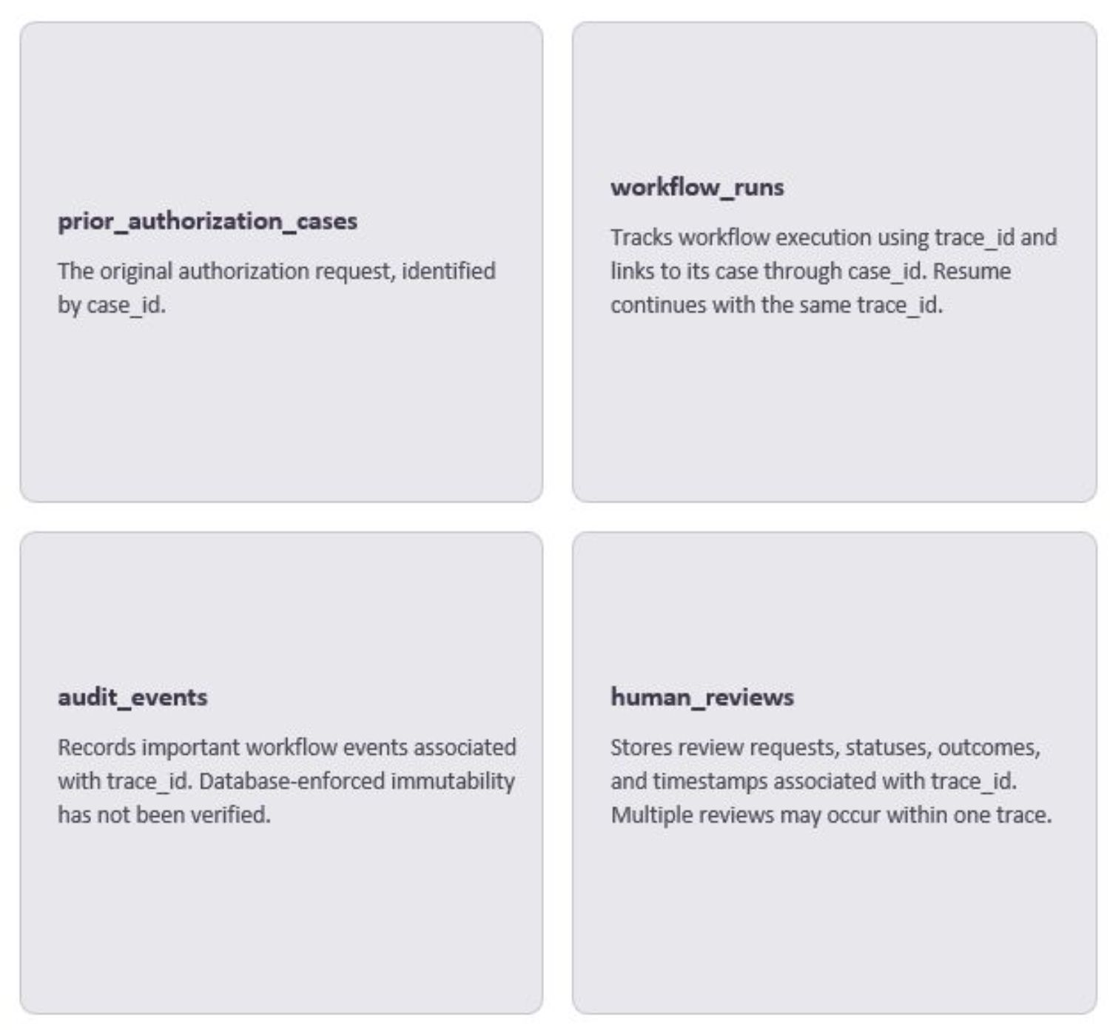
Appendix A2: How the Database Records Connect
Conceptual relationship diagram — not a full physical ER diagram.
Notes:
Think of these as four connected record books. The prior_authorization_cases table identifies the original request using case_id. The workflow_runs table connects a run to its case and identifies the run using trace_id. Audit events and Human Review records are associated with that run. A single case may have multiple runs, and one trace may contain multiple review records. In the demonstrated Resume, the application kept the same trace ID while rechecking the evidence. This is a simplified conceptual diagram to explain the identifiers, not a complete physical database relationship diagram. Audit rows are inserted by the application; database-enforced immutability has not been verified.

Slide 14
Appendix A3: Tested Failure Paths and Planned Safeguards
Implemented and Tested Offline
Designed — Not Yet Implemented
Malformed AI Output
AI Provider Failure
Security Policy Enforcement
Automatic Retry Controls
Azure OpenAI unavailable or timeout → routed to Human Review
Unparseable or invalid AI response → routed to Human Review
Broader violation detection and automatic escalation paths are designed but not yet active in Phase 1.
Configured retry logic for transient failures is planned for a future phase.
Evidence Lookup Failure
Healthcare evidence retrieval fails → routed to Human Review
Not every failure path routes to Human Review. Some failures may terminate the run or trigger a different escalation path depending on the error type.
Notes:
A reliable workflow needs safe behavior when something goes wrong. In the offline tests, three specific failure patterns route to Human Review: an AI response that cannot be validated, an AI provider failure or timeout, and a healthcare evidence lookup failure. This is not a claim that every error follows the same route. Some failures may require a different escalation or may prevent a safe workflow state from being established. Broader security-policy enforcement and configured automatic retry controls remain design or roadmap items, not completed Phase 1 features. No real AI provider call was part of the local validation shown earlier. This slide is about tested boundaries and clearly labeled remaining work.

Slide 15



Appendix A4: Human-Led, AI-Assisted Collaborative Engineering
K. Kashiwagi — Project Owner & Solution Designer
ChatGPT — Design & Review Partner
Claude Code — Implementation Partner
Architecture direction, core principles, requirements, final decisions, and validation oversight.
Collaborative solution design, requirements, planning, technical analysis, and quality reviews.
Scoped development, automated tests, debugging, documentation, and approved Git operations.
Collaborative Development
K coordinated iterative design, implementation, testing, and review with ChatGPT and Claude Code.
Human-led decisions · AI-assisted execution · Evidence-based validation
Notes:
I want to be transparent about how I developed this portfolio project. I set the architecture direction, deterministic-first principle, human-review boundary, requirements, and final approval criteria. I worked with ChatGPT as a design and review partner to refine requirements, examine tradeoffs, plan tasks, and review technical results. I used Claude Code as an implementation partner for focused coding, tests, debugging, documentation, and approved Git operations. These were iterative collaborations under human oversight; the AI tools did not independently own the architecture or approve the work. The result demonstrates both hands-on technical delivery and the judgment needed to keep AI-assisted engineering explainable, testable, and accountable.

