Slide 1


INTERNATIONAL CONFERENCE ON CURRENT TRENDS IN INFORMATION TECHNOLOGY (ICCTIT-2025) Organized by School of Information Technology, St. Joseph’s University, Bangalore
ST JOSEPH’S UNIVERSITY
A Public-Private-Partnership University under RUSA 2.0 of MHRD (Government of India),
established by the Karnataka Govt. Act No. 24 of 2021
Knowledge Partner
Exploring the Usage of Generative AI by The Bengaluru Urban Upper Middle Class Presented by Krithika Kannan
Paper ID: ICCTIT25069
Date:
10th MARCH, 2025

Slide 2
INTRODUCTION
Generative AI and its usage are rapidly growing in popularity, and we have barely scratched the surface in terms of its applications.
In light of GenAI’s fast-increasing relevance, it is important to examine the attitudes of users towards this new technology.
This paper explores attitudes and usage patterns of generative AI by the urban upper middle class Bengaluru citizen, namely with respect to:
UTAUT2 [2][3] (unified theory of acceptance and use of technology).
Factors such as trust, ease of use, ethical considerations, perceived social impact and efficiency.
Demographics, namely gender and age group.
Date:
10th MARCH, 2025
Notes:
In light of… UTAUT2, factors, demographics

Slide 3
BACKGROUND & CONTEXT
Key Definition: Generative Artificial Intelligence
Generative AI, sometimes called gen AI, is artificial intelligence (AI) that can create original content—such as text, images, video, audio or software code—in response to a user’s prompt or request.
Assessment of attitude towards gen AI tools is important for a multitude of reasons:
Evaluation of ethical concern.
Assessment of adoption level of the technology.
Identification of potential areas of further development.
Date:
10th MARCH, 2025

Slide 4
PROBLEM STATEMENT
Any task that takes input in words and produces output in either words, images or other multimedia can now be automated by any person with an internet connection and a browser.
In light of this, this research paper seeks to examine how such tools are used as well as what opinions people hold, with respect to the urban upper middle-class residents of Bengaluru, India.
This paper also seeks to understand the awareness about and opinions regarding the environmental impact of AI and biases that arise during training of AI models.
Date:
10th MARCH, 2025
Notes:
So, how do we use GenAI tools? What do we think of them and what opinions do we have about its ethics and impact? That is what this paper seeks to uncover.

Slide 5
METHODOLOGY
A qualitative survey was created and sent to urban upper middle class Bengaluru residents. A total of 76 responses were received, and 74 responses were used after data cleaning.
The questionnaire obtained demographic information, and ratings on a 5-point likert scale to obtain data on attitudes of the respondents.
Information was obtained about Effort Expectancy, Performance Expectancy, Social Influence, Perceived Social Impact, Ease of Use, Trust, Ethical Considerations and Efficiency.
Ethical Considerations: combination of bias awareness and environmental impact.
Date:
10th MARCH, 2025
Notes:
Effort: time saving, performance: quality, efficiency: productivity

Slide 6
METHODOLOGY
After exploratory data analysis, study was done on three primary verticals:
Factors under study against gender (independent t-test)
Factors under study against age group (one-way ANOVA)
Logistic regression model using factors under study to predict frequency of usage of gen AI tools by a user.
Hypotheses and factor-specific p-values have been excluded from this presentation for conciseness.
Date:
10th MARCH, 2025

Slide 7
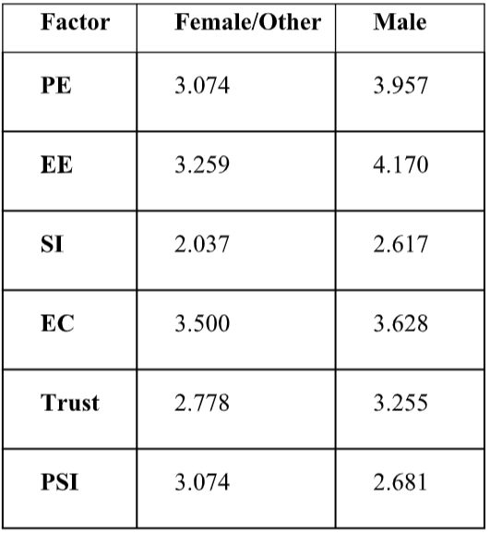
RESULTS AND DISCUSSION
There is a significant difference in mean performance expectancy, effort expectancy and trust with respect to gender, at a level of significance 0.05.
All genders seem neutral about perceived social impact, and about ethical concerns.
Males tend to trust gen AI tools more than other genders.
Gender-wise Means: Factors Under Study
Date:
10th MARCH, 2025

Slide 8
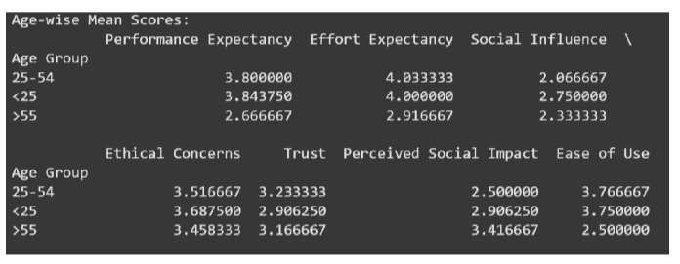
RESULTS AND DISCUSSION
Mean attitude towards ease of use, perceived social impact and performance expectancy differ significantly across age groups.
Age-wise Means: Factors Under Study
Respondents across age groups are neutral about ethical concerns.
Date:
10th MARCH, 2025

Slide 9
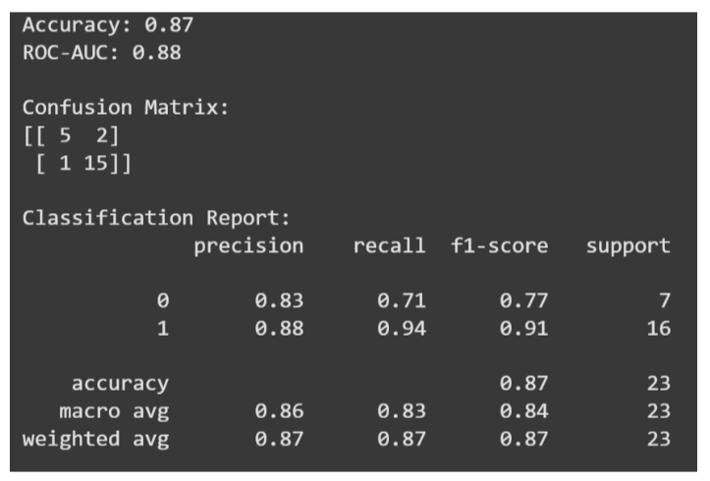
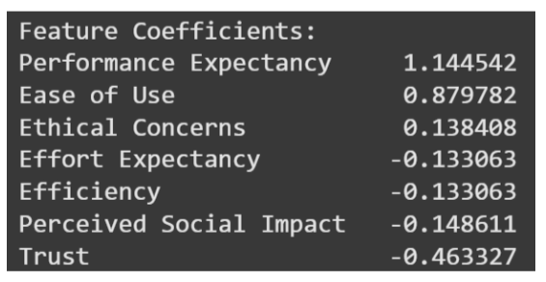
RESULTS AND DISCUSSION
Logistic Regression Feature Coefficients
Target Variable: Frequency of usage, where class 1 is “Frequent User” and class 0 is “Infrequent User”.
Logistic Regression Metrics
Date:
10th MARCH, 2025

Slide 10
KEY TAKEAWAY: ETHICS
A primary and important takeaway from the study is that the general attitude of respondents to the topics of environmental effects of AI and the racial and gender-based biases that may arise at the time of training AI models is neutral.
In light of this, it is even more important for researchers in the gen AI field to be conscious of these and other ethical issues, and to actively work towards solutions to these issues while furthering progress in the field, even if user attitudes do not demand it.
40 of the 74 respondents also expressed willingness to switch to more environmentally friendly AI tools if they had the opportunity.
Date:
10th MARCH, 2025

Slide 11
CHALLENGES & LIMITATIONS
This survey was done with an extremely small sample size, namely 76 respondents. After processing, only 74 samples could be used.
The studies done on the data obtained are all inferential, and the results cannot be spoken about without acknowledging that a small sample size decreases the representative power of the inferences.
The survey also consists primarily of respondents who use gen AI tools, and while this might be due to similar underlying proportions in the population, small sample size prevents us from making that assumption.
Date:
10th MARCH, 2025

Slide 12
FUTURE ENHANCEMENT
Further enhancement of this research can be done by collecting a larger sample of respondents to verify the inferences made by this paper and to make more valid, actionable conclusions.
While this study targets urban upper-middle-class respondents, a broader survey may be useful in capturing the accessibility of AI tools by measuring ease of use and general attitude of respondents.
Studies such as the one conducted in this paper are important to assess the attitudes of users towards new technology, especially when conducted in lesser-privileged groups to understand where further research in the field should be directed.
Date:
10th MARCH, 2025

Slide 13
CONCLUSION
The study finds most respondents to be GenAI users, and most GenAI users to be frequent users.
However, demographic factors such as gender and age group have some connection with the respondents’ opinions on GenAI.
Interestingly, we find that trust in AI generated responses does not have any positive effect on usage of GenAI tools.
We also find that respondents above 55 years of age tend to find AI less easy to use, and also are more likely to believe that AI negatively impacts society.
Date:
10th MARCH, 2025

Slide 14
REFERENCES
[1] Davis, F. D. (1989). Perceived usefulness, perceived ease of use, and user acceptance of information technology. MIS Quarterly, 13(3), 319-340.
[2] Venkatesh, V., Morris, M. G., Davis, G. B., & Davis, F. D. (2003). User acceptance of information technology: Toward a unified view. MIS Quarterly, 27(3), 425-478.
[3] Venkatesh, V., Thong, J. Y. L., & Xu, X. (2012). Consumer acceptance and use of information technology: Extending the unified theory of acceptance and use of technology. MIS Quarterly, 36(1),157-178.
[4] Goodhue, D. L., & Thompson, R. L. (1995). Task-technology fit and individual performance. MIS Quarterly, 19(2), 213-236.
Date:
10th MARCH, 2025

Slide 15
QUESTIONS AND ANSWERS
Thank You!
Audience questions are welcome ☺
Contact Information:
Krithika Kannan
Mobile No. : 9902115877
Email: krithika.kannan.13@gmail.com
Date:
10th MARCH, 2025

