Slide 1
Executed Evictions In New York City Building-level Analysis
Kingsum Kong
DC 37 Data Analytics Academy FALL 2025

Slide 2
BACKGROUND
Motivation
Working at NYCHA gave me a closer look at housing issues in New York City, how they affect low-income communities. What eviction patterns look like at a citywide level, and whether they are connected to the type of housing people live in.
Goal
To Better Understand How Eviction Is Actually Distributed Across The City, And Whether It Is Linked To The Type Of Buildings People Live In, Rather Than Happening Randomly.
Research questions
whether evictions are linked to certain building type
whether evictions are spread evenly or concentrated in specific kinds of housing

Slide 3
DATASOURCE
Evictions| NYC Open Data
executed evictions within the 5 boroughs.
Time range: 2017-present. Last updated 5/7/26
Agency: Department of Investigation (DOI). data is compiled from NYC marshals.
Size: 127,559 rows, 20 columns
Key variables : executed date , borough, bbl
PRIMARY LAND USE TAX LOT (PLUTO) | NYC Open Data
land use and geographic data at the tax lot level in NYC.
Range: Created 2/23/2020. Last updated 2/20/2026
Agency: Department of City Planning (DCP)
Size: 859k rows, 101 columns
Key variables: bbl, buildingclass, number of residential unit, built year of building

Slide 4
methodology
Data cleaning/transformations
Remove missing values
Change datatype of variables to integer/string
Deleted 97 columns in total(PLUTO)
Rename variable 'BBL’ to ’bbl’ for merging
Left join: Merge building data into eviction data
Python - Google Colab
Panda – data cleaning and data analysis
Matplotlib/Seaborn – Visualization
Bar Charts:
Building types: building class, number of residential unit
Building age: built year of building
Eviction distribution: ’bbl’

Slide 5
FINDINGS

Slide 6

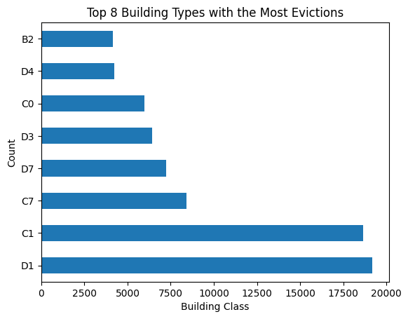
Building TYPES
Distributed unevenly
multi-family buildings (elevator and walk-up)
top 5 building types account for 52.26% of all evictions
certain types of housing are more exposed to eviction risk
D1: Multi-Family Elevator apts; Semi-fireproof (no stores)
C1: Multi-Family Walk-Up Buildings, no store (7+ units)
C7: Mixed Residential & Commercial Buildings(7+ units)
D7: Mixed Residential & Commercial Buildings, Semi-Fireproof
D3: Multi-Family Elevator Buildings.
D4:Elevator Cooperatives, residents own shares.
C0: 3-Family Walk-Up Buildings
B2: One & Two Family Buildings
Source: NYC Building Classifications - DOF. https://www.nyc.gov/assets/finance/jump/hlpbldgcode.html

Slide 7
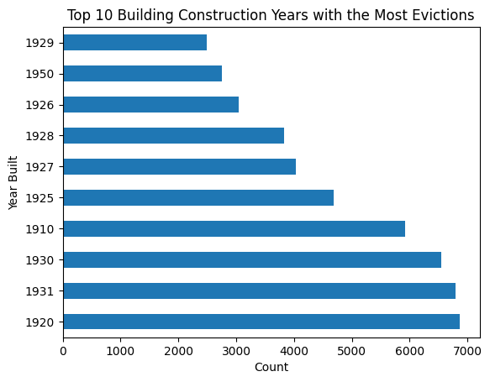
Building age
Top 10 building age are all before 1950
Top 8 building age account for 36.39% of all evictions
older housing stock being more vulnerable

Slide 8
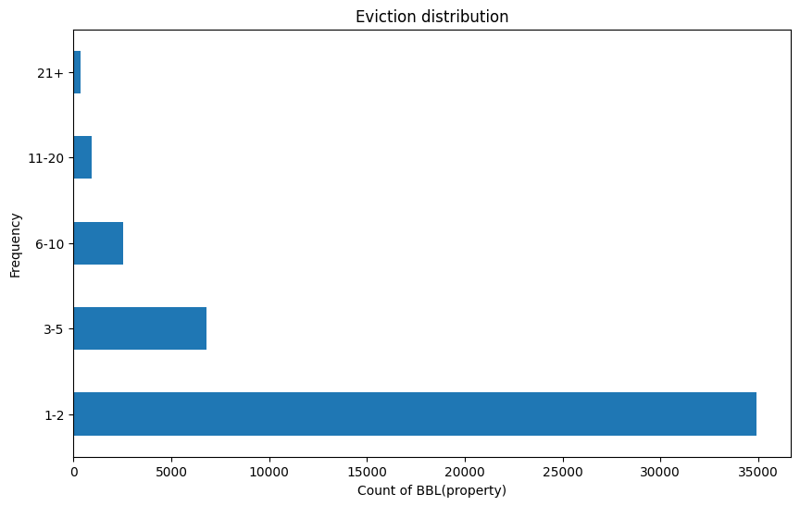
Eviction distribution
eviction frequency per property
small number of properties experience repeated evictions (e.g multifamily buildings, development)
Evictions concentrated in a smaller group of buildings.

Slide 9
Conclusion
Evictions are more heavily concentrated in certain types of buildings and are repeatedly occurring in a small number of properties.
Eviction is closely linked to housing type and building conditions.
Understanding these patterns helps identify which parts of the housing system are more vulnerable and where policy attention may be needed.

Slide 10
Reference
Evictions | NYC Open Data https://data.cityofnewyork.us/city-government/evictions/6z8x-wfk4/about_data
Primary Land Use Tax Lot Output (PLUTO) | NYC Open Data https://data.cityofnewyork.us/city-government/primary-land-use-tax-lot-output-pluto-/64uk-42ks/about_data

