Slide 1
How to Make great Cookies?
Let our models tell you

Slide 2
Team members:
Mariana
Lucy
Kexin

Slide 3
What we see from the data?

Slide 4

Missing Values?
Duplicates?
Bad Values?
Outliers?
Data Types?
Target?

Slide 5
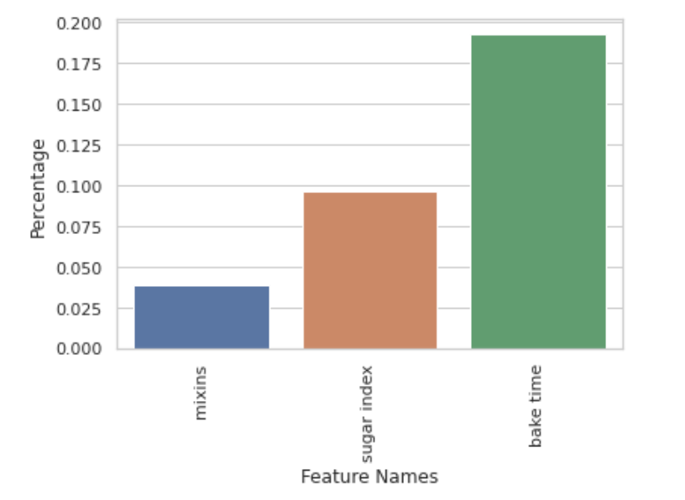
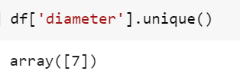
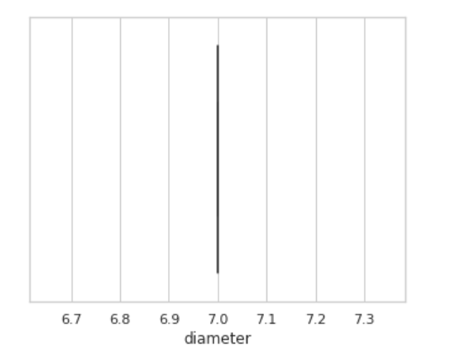
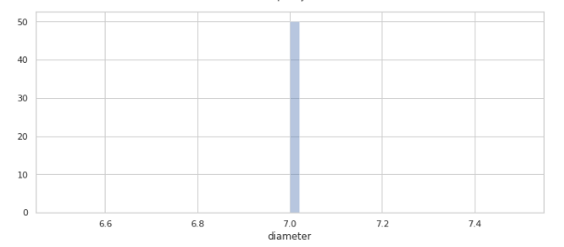
Missing Values? - DROP!
Duplicates? -DROP!

Slide 6
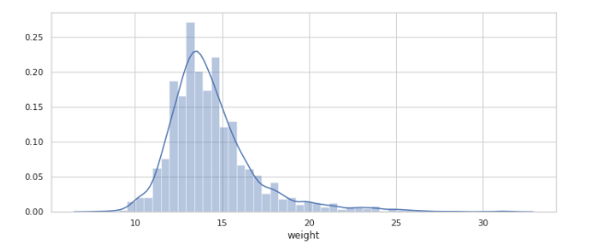
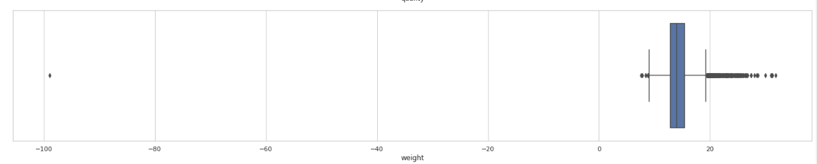


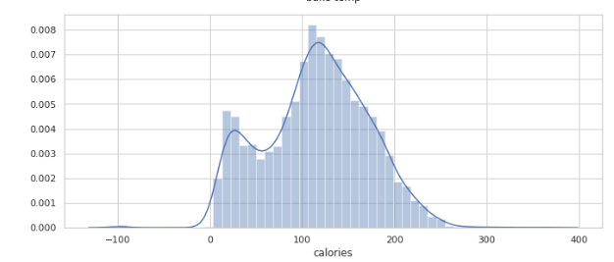
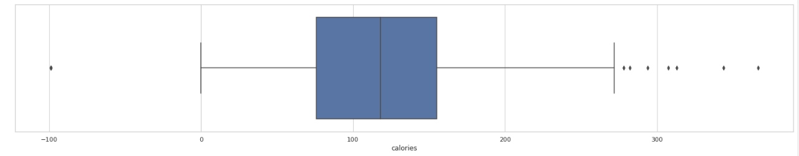
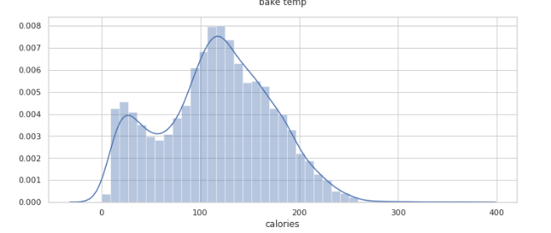

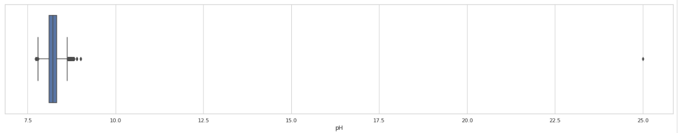
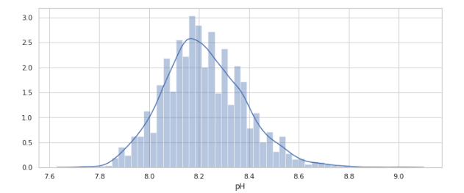


Num Features Bad Values? - REPLACE BY MEAN!

Slide 7


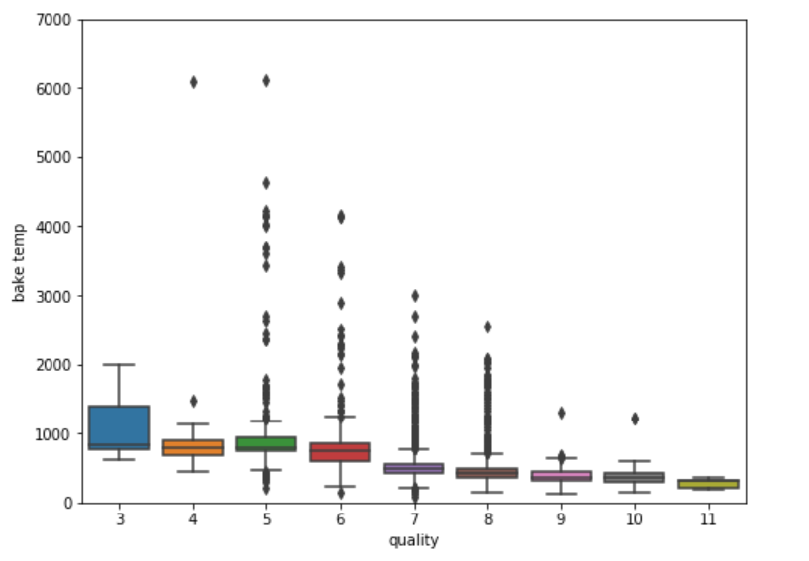
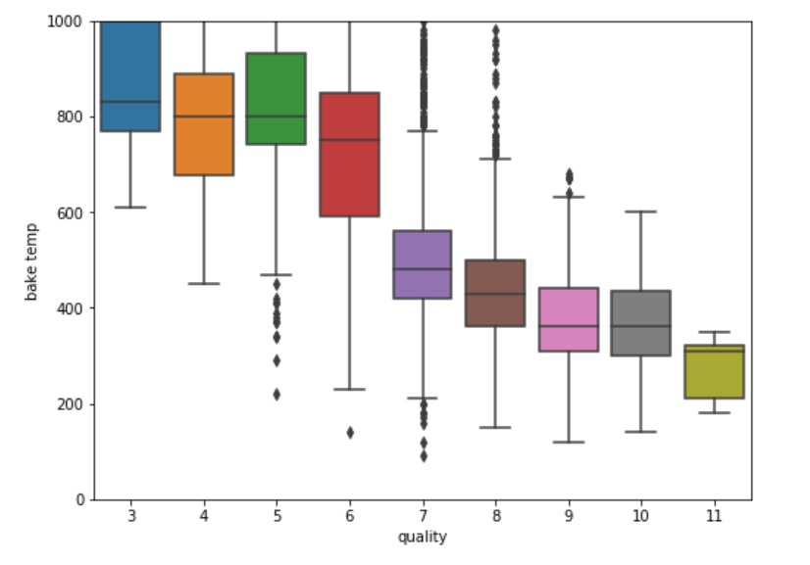
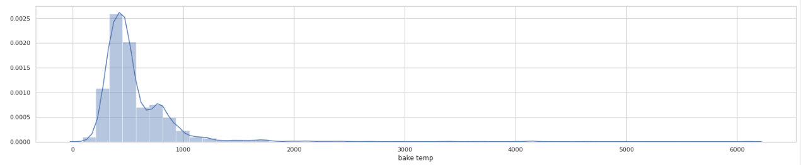
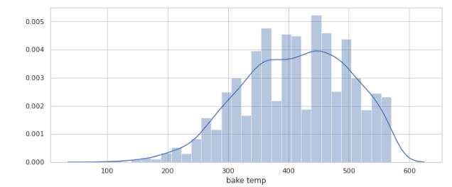
Num Features Bad Values?
Max temp 500
40% row with bad temp
Corr 0.4 with
Before
After

Slide 8
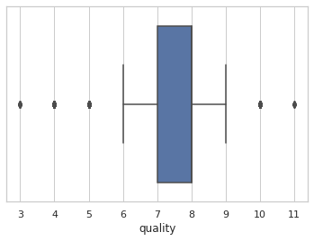
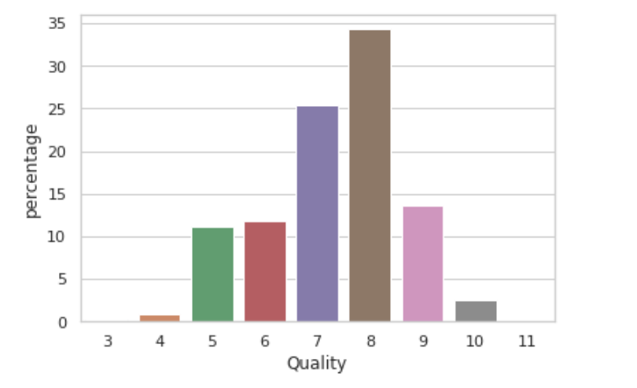
Original Target?
The Average Quality Level is between 6-9
Quality Level 7-8 represents more in the whole dataset

Slide 9
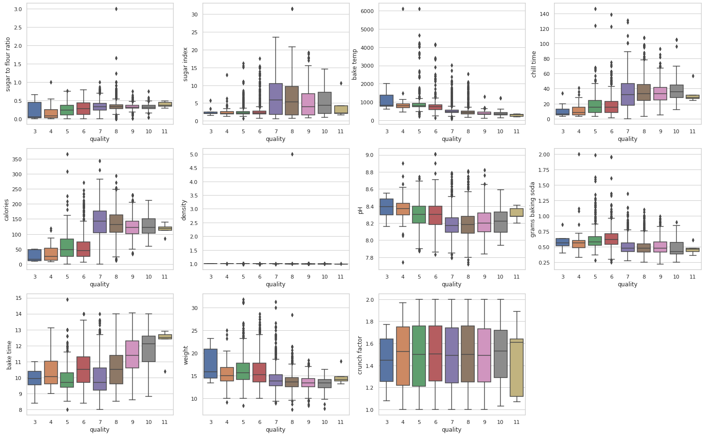
Num Features vs Original Target
Density has no impact on Quality
Good cookies have higher Calories
Good cookies with low Bake Temp
Good cookies have longer Chill Time

Slide 10
Num Features vs Original Target
From BoxPlots, we see three different behaviors for Target variable
Considering logic reality
We decide to try either with Two Classes for Three Classes
Two Classes: Good Cookies vs Bad Cookies
Three Classes: Due to Boxplots

Slide 11
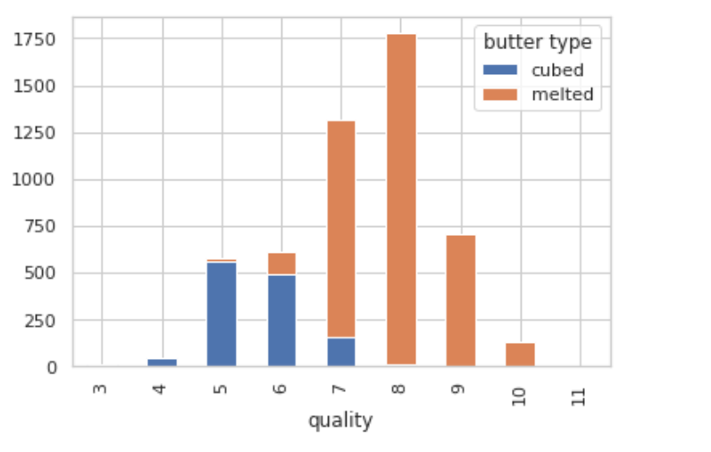
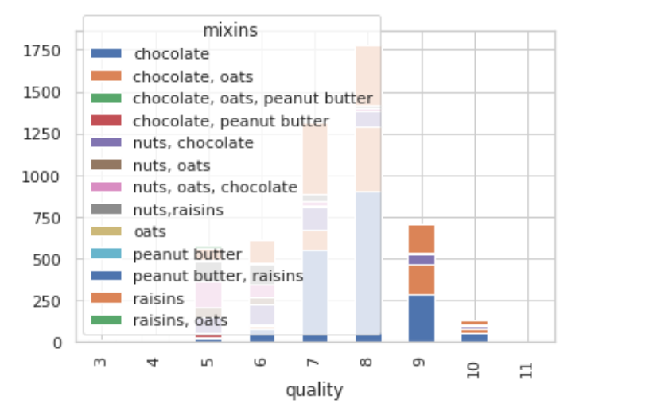
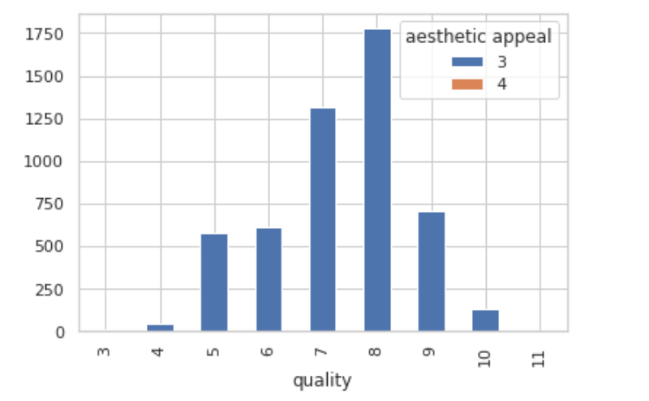
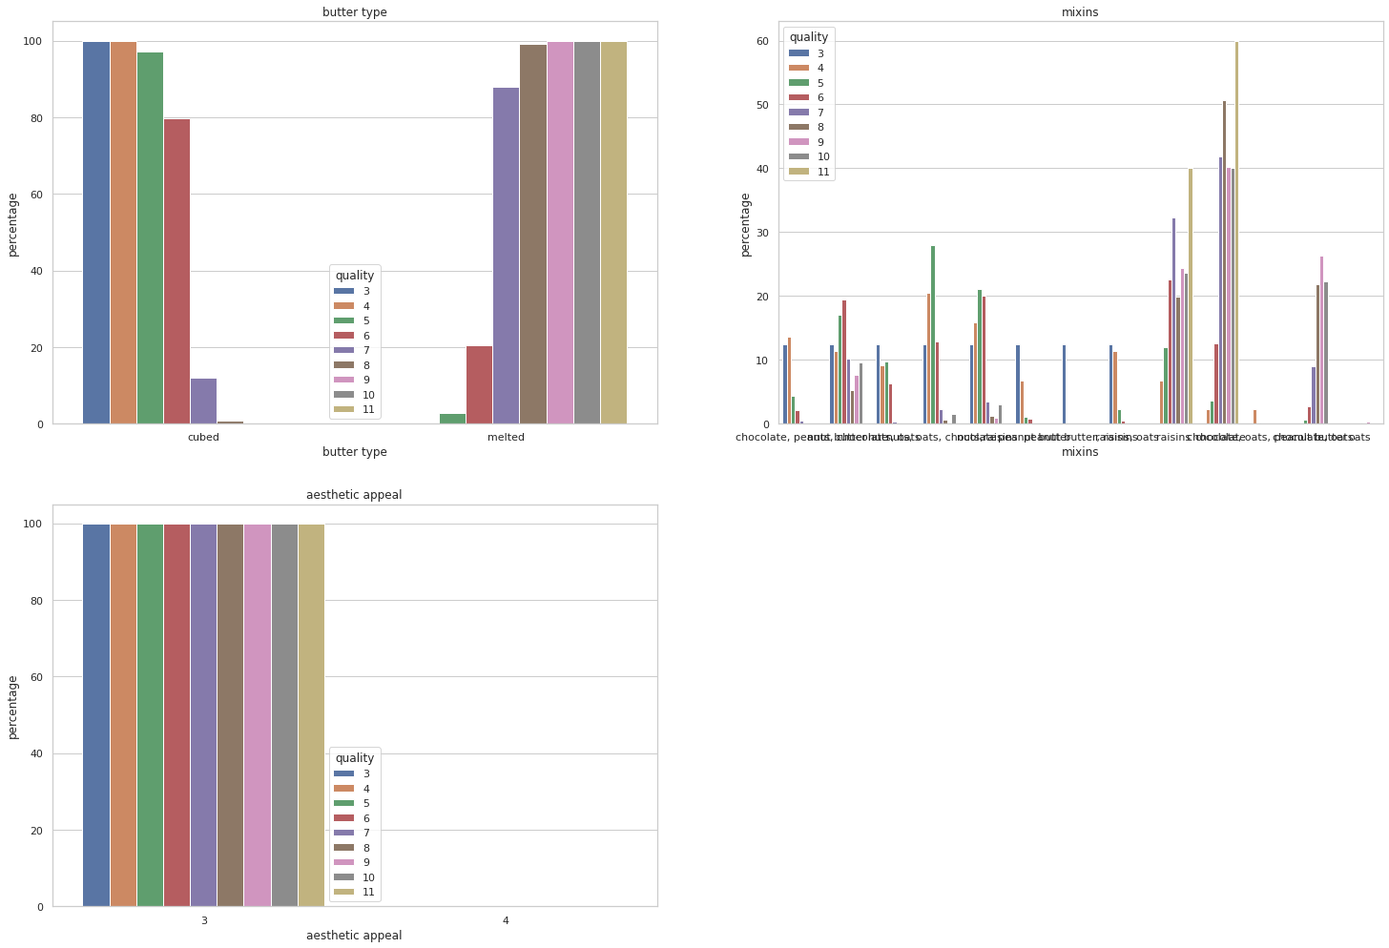
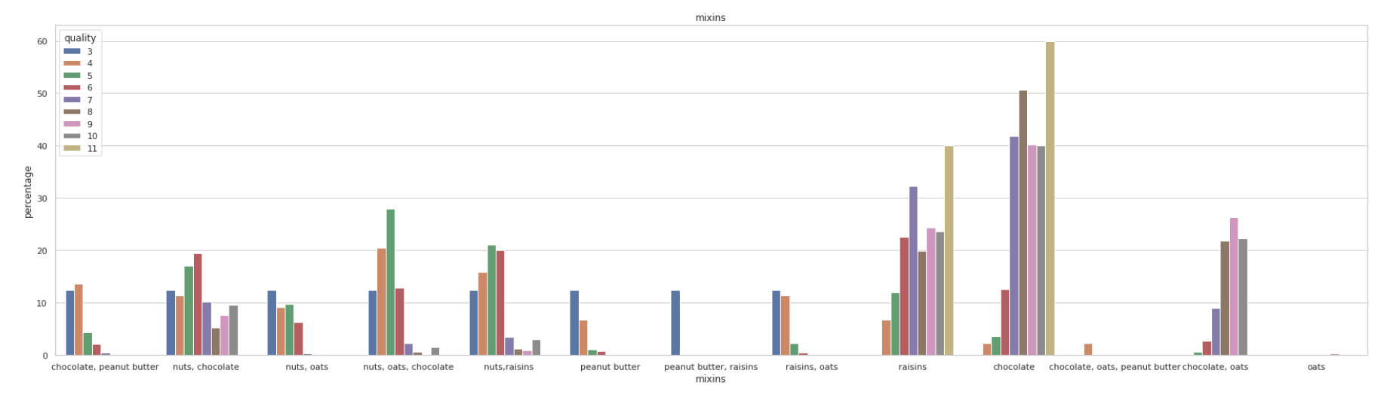
Cat Features vs Original Target
Good cookies are using more Melted Butter
Bad cookies are using more Cubed Butter
Aesthetic Appeal has no impact on Quality
With more Chocolate and Raisins as Mixins tends to have better cookies

Slide 12
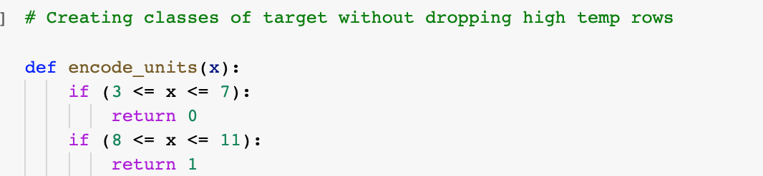
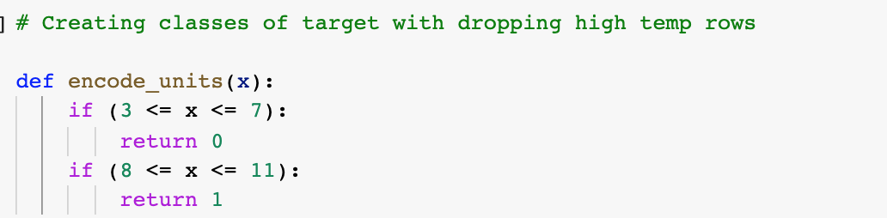
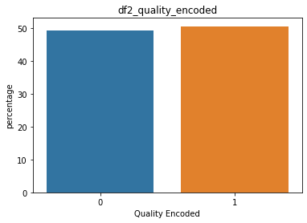
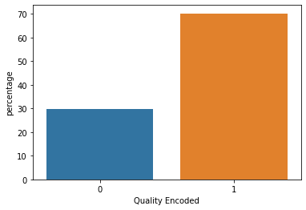
Target? - Two Classes: Bad vs Good
Dropping has impact on target
Encoded Bake Temp
Affects the imbalance of classes when we drop those rows
Keep

Slide 13
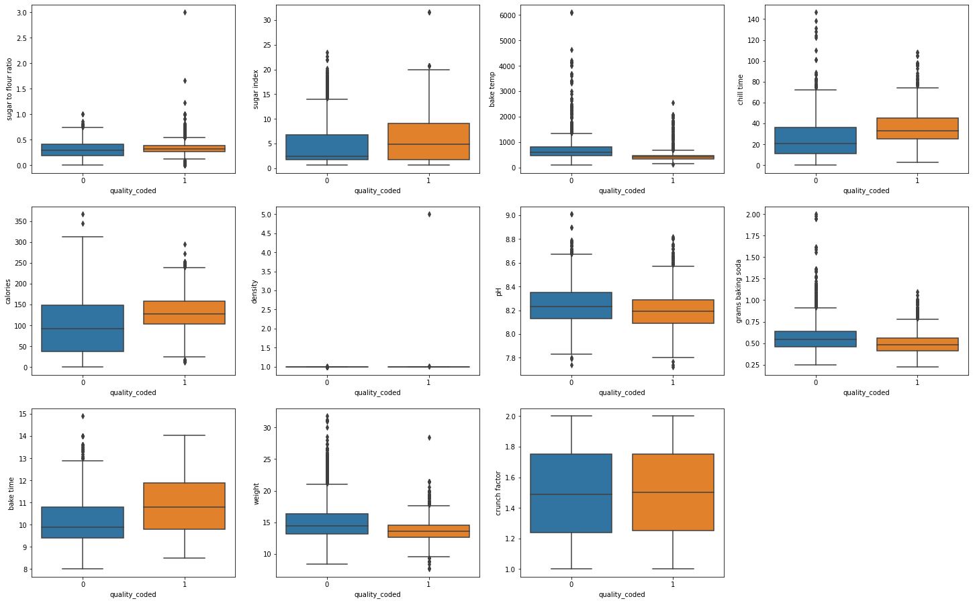
Num Features vs Target：Two Classes
Density has no impact on Quality
Crunch Factor has no impact on Quality
Notes:
After categorize quality, density actually shows the impact for the two classes

Slide 14
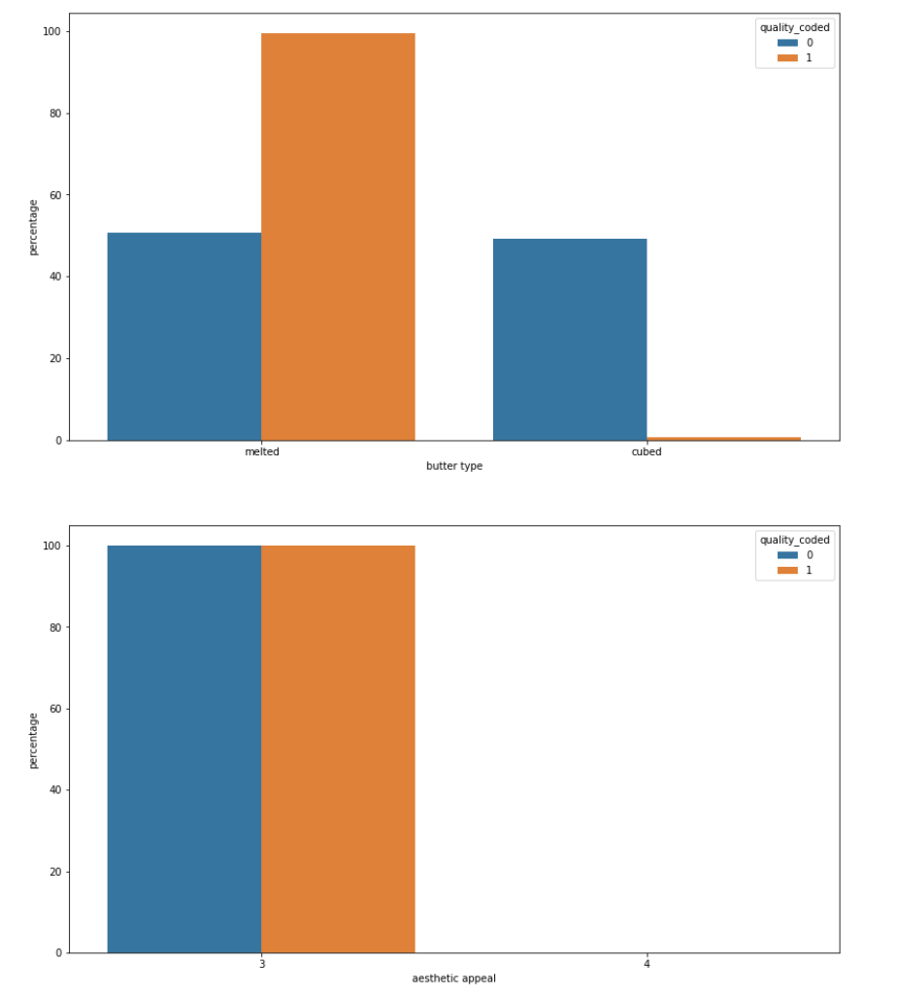
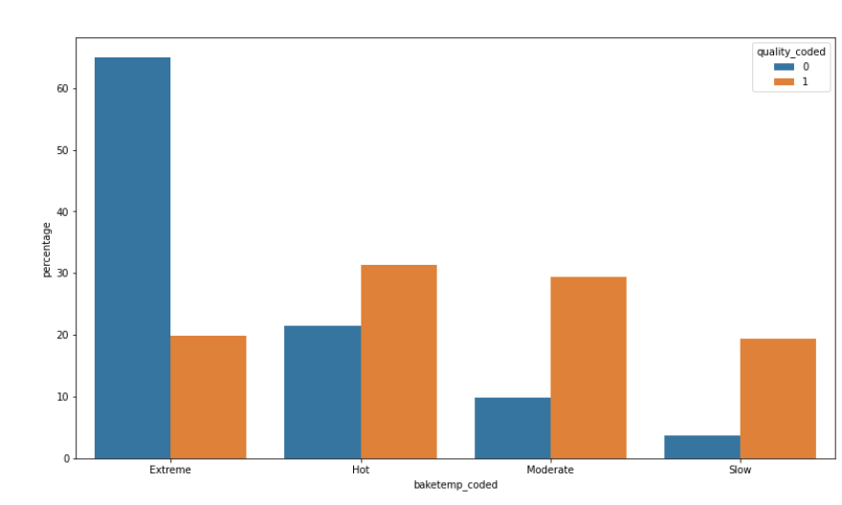
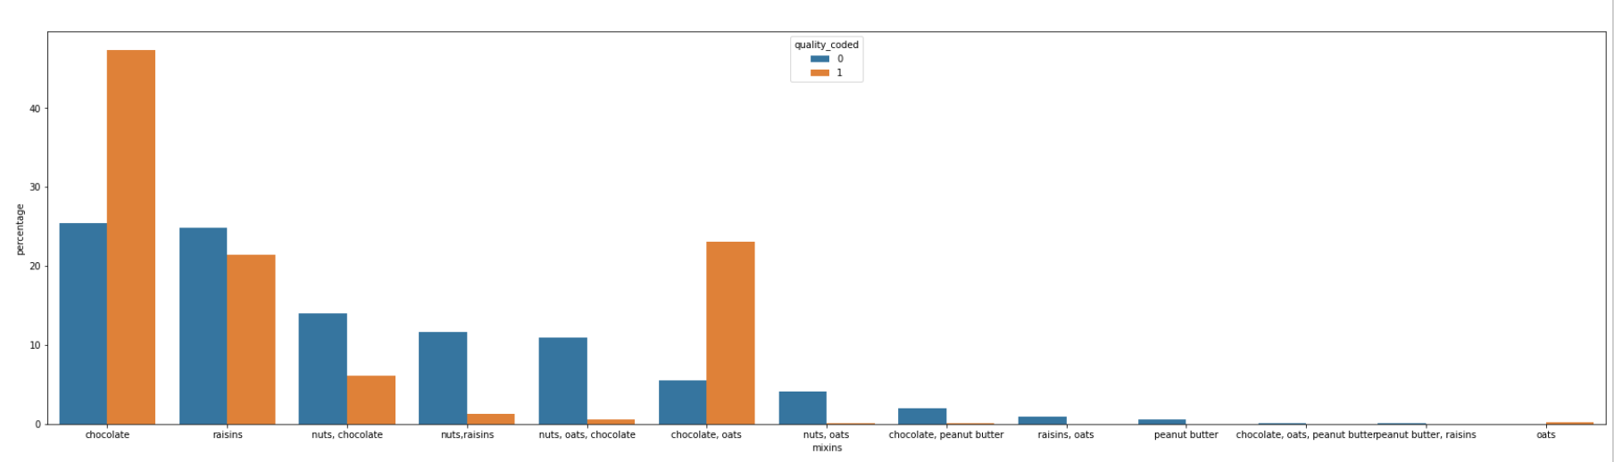
% Cat Features vs Target：Two Classes
Aesthetic Appeal has no impact on Quality
With chocolate, we can make better cookies

Slide 15
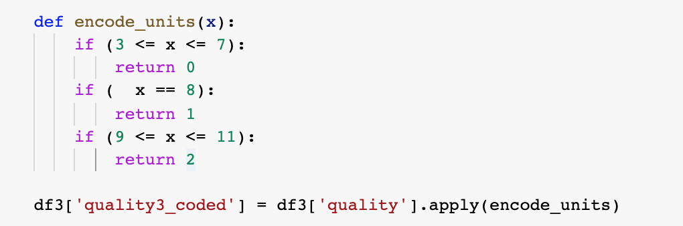
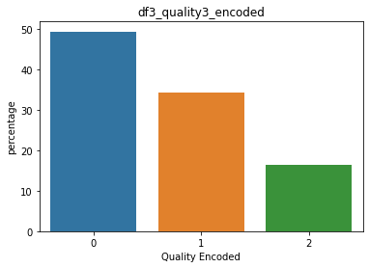
Target? - Three Classes
Over Sampling

Slide 16
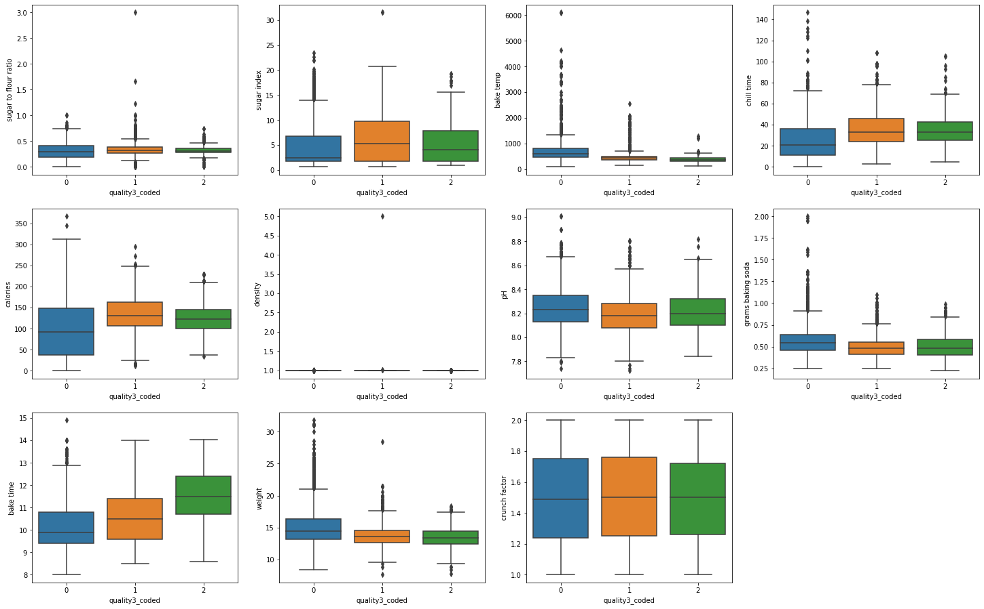
Num Features vs Target：Three Classes
Density has no impact on Quality
Crunch Factor has no impact on Quality
Notes:
After categorize quality, density actually shows the impact for the two classes

Slide 17
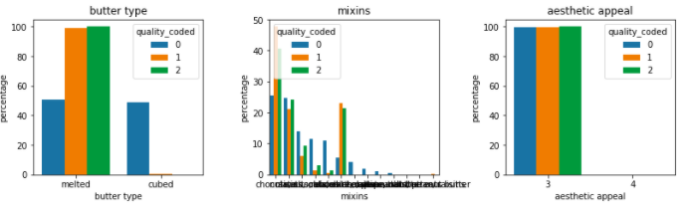
% Cat Features vs Target : Three Classes

Slide 18
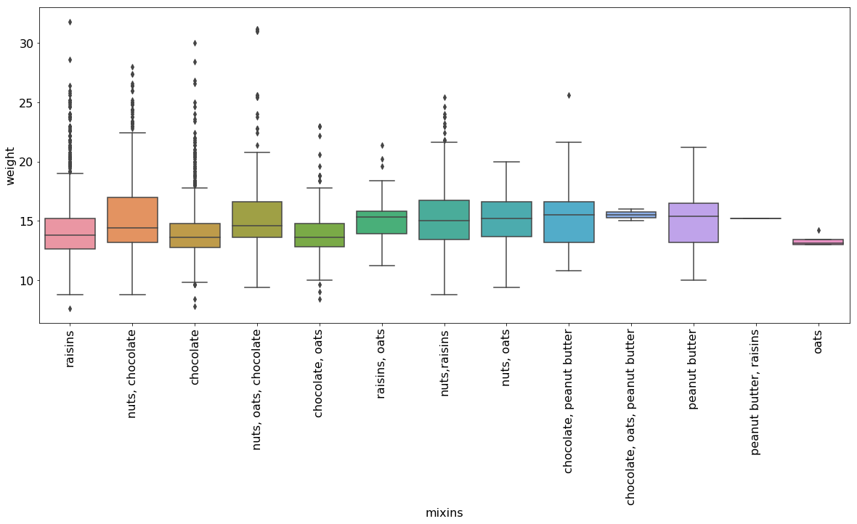
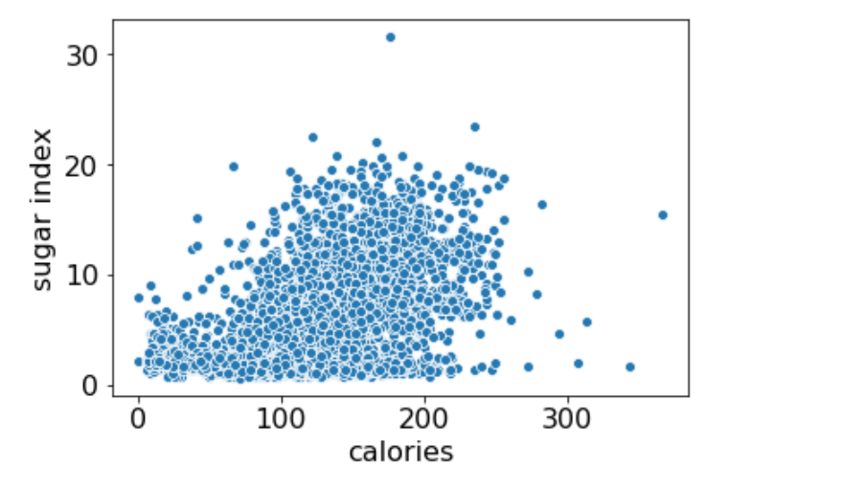
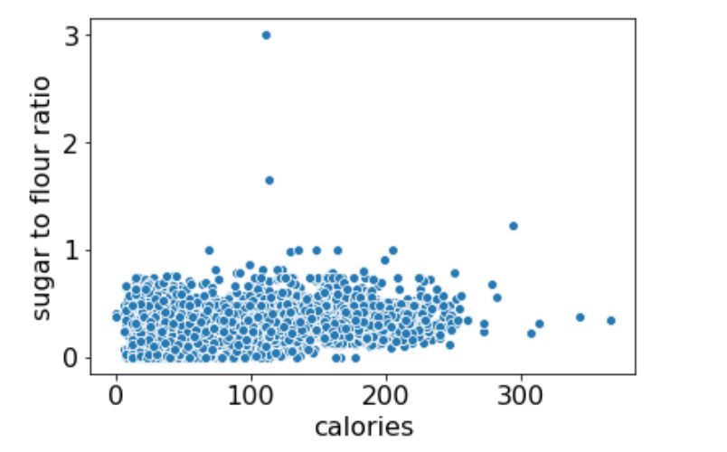
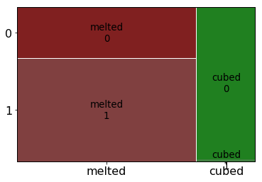
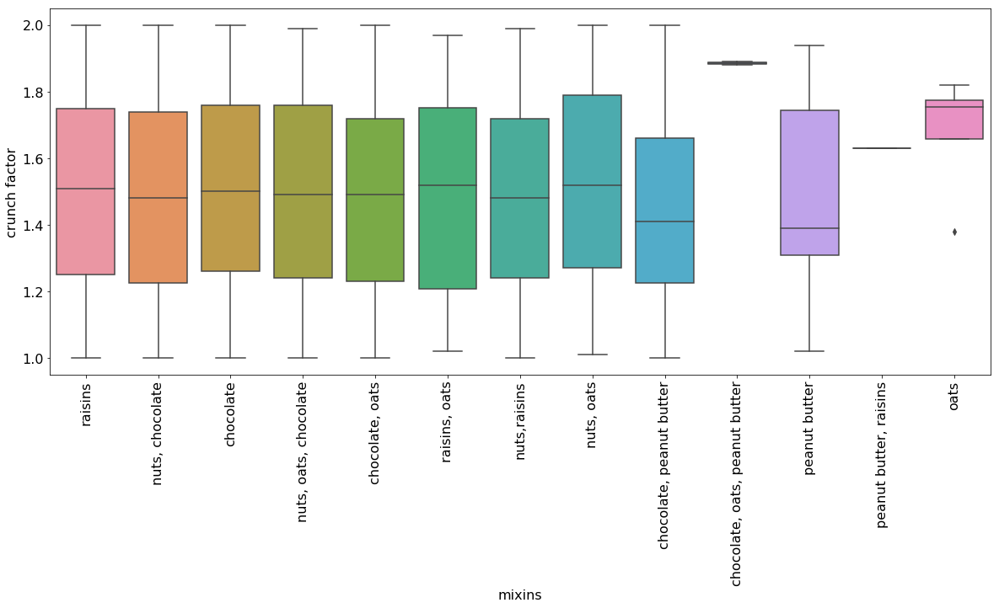
Questions?
Weight vs Mixins
Sugar vs Calories
Butter Type impact Quality
Crunch Factors vs Mixins

Slide 19
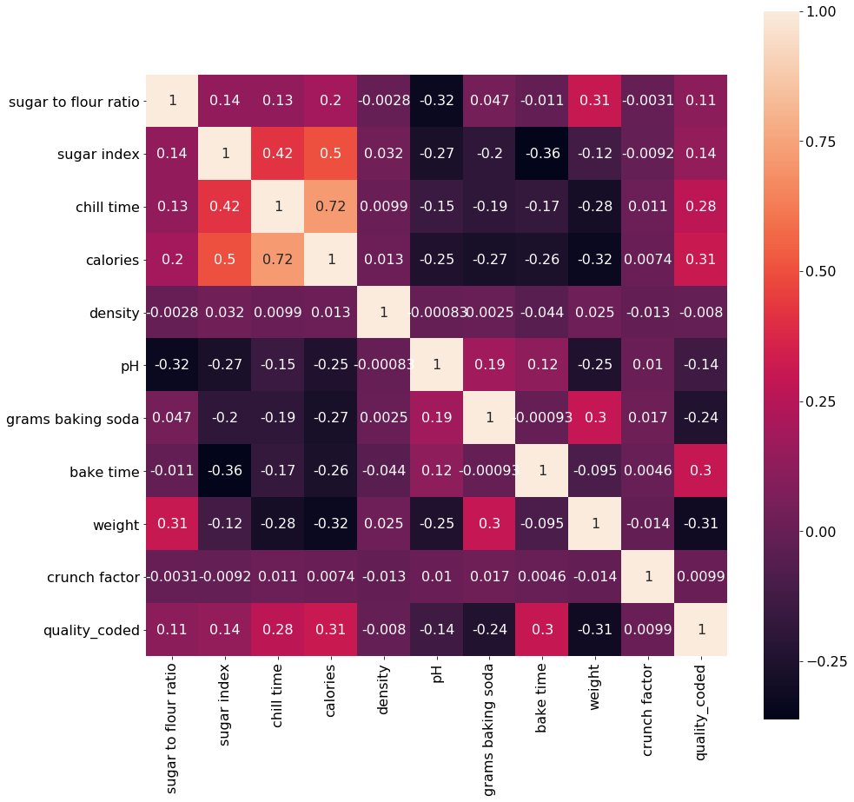
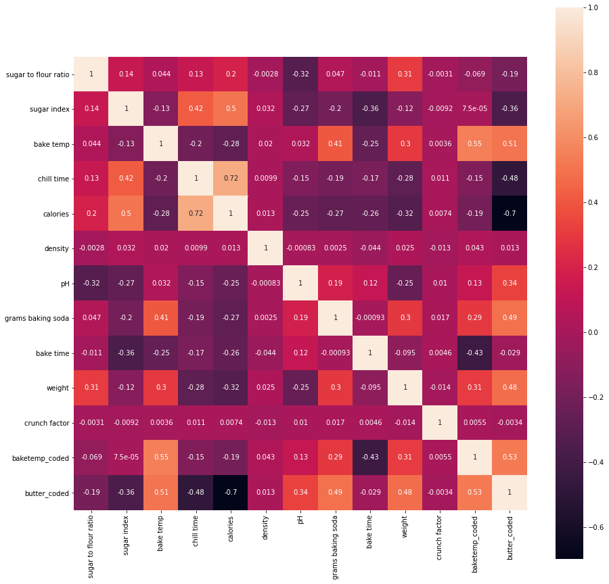
Corr?
Chill Time and Calories are highly correlated
Butter Coded and Calories are highly correlated
Chill Time and Calories are highly correlated
Before
After

Slide 20
What we do for the data?

Slide 21
Encoding Features
Ordinal Encoder
Get Dummies
Butter Type
Bake Temp
Mixins

Slide 22
We select something!

Slide 23
Dropped Features
Crunch Factor
Density
Aesthetic Appeal

Slide 24
Let’s play with the models!

Slide 25
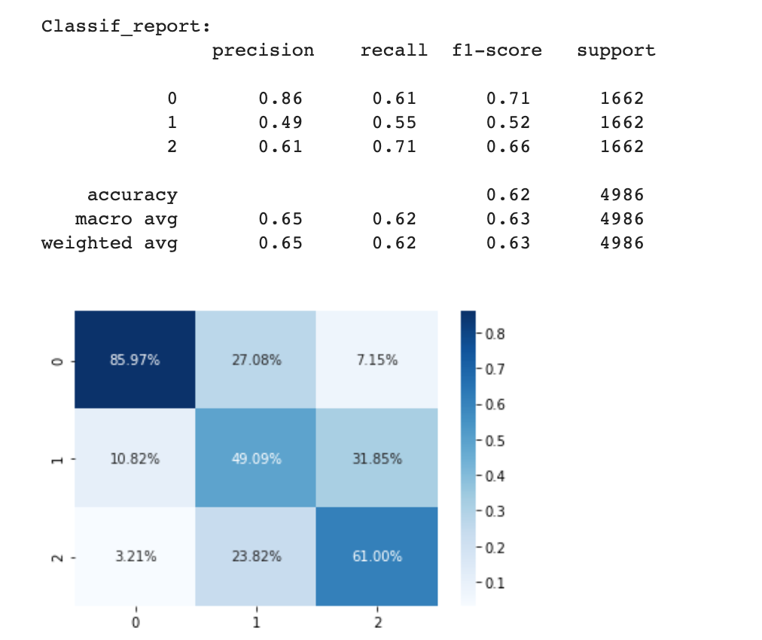
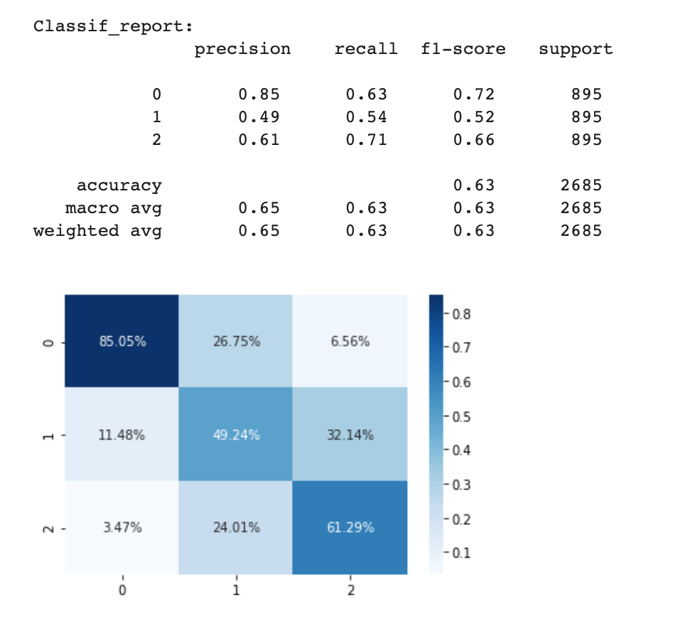
SVG
Target - 3 classes
Bad - Moderate- Good
Train
Test
No overfitting 0.63 but the accuracy for class 1 is very low 0.52

Slide 26
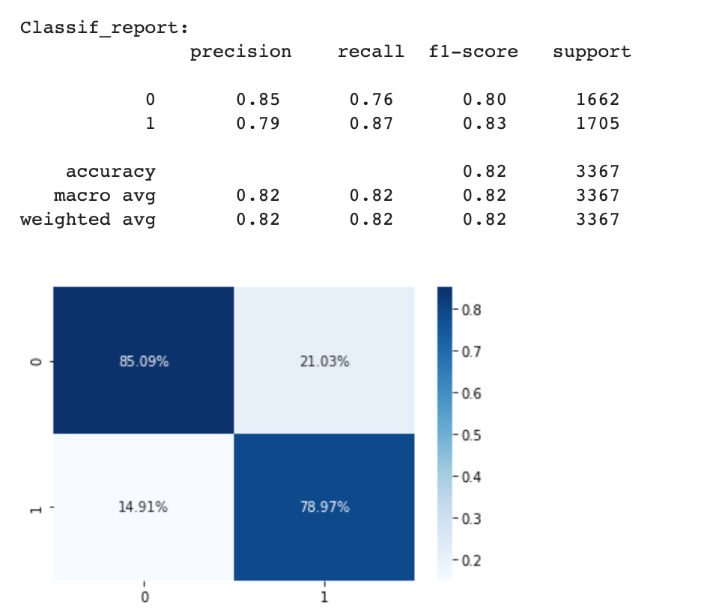
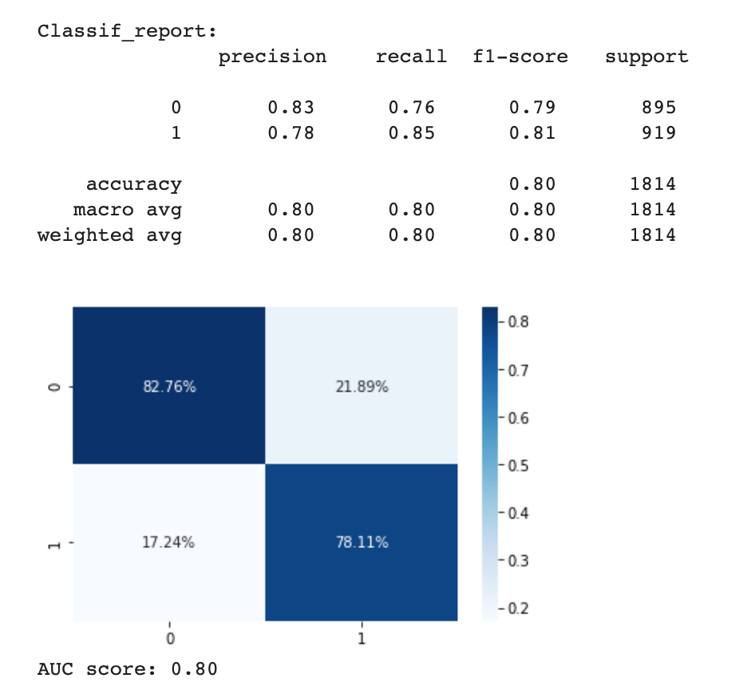
Logistic Regression
Target - 2 classes
Good vs Bad
Train
Test
Slightly Overfitting 0.82 vs 0.80
Class 1 is better than Class 0

Slide 27
Target
Original
Showing Error
Scaled dataset
Encoding ‘bake temp’
Selected features

