Slide 1



RECOMMENDATION SYSTEM - RS
USERS’ SECRETS

Slide 2
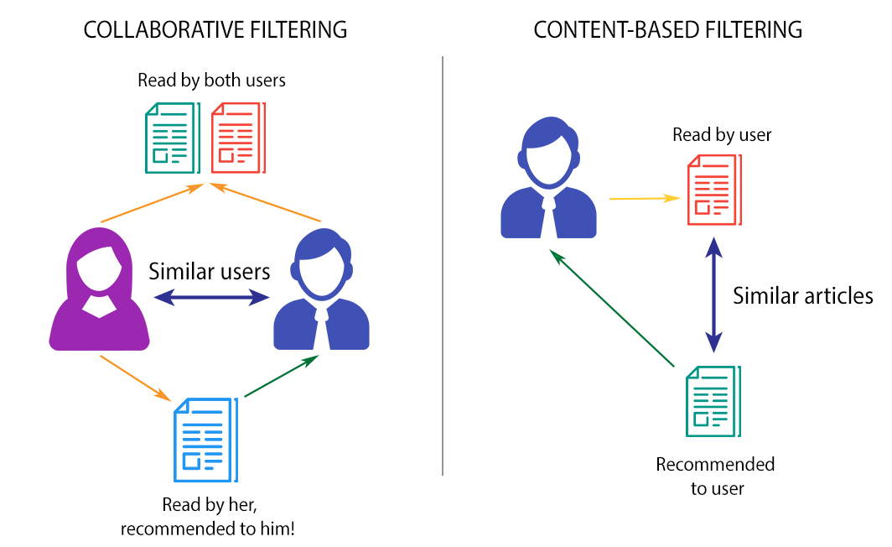
Content-based RS
https://medium.com/analytics-vidhya/city-recommender-system-with-python-part-3-3-deployment-finding-my-schitts-creek-2019971e2c4d

Slide 3
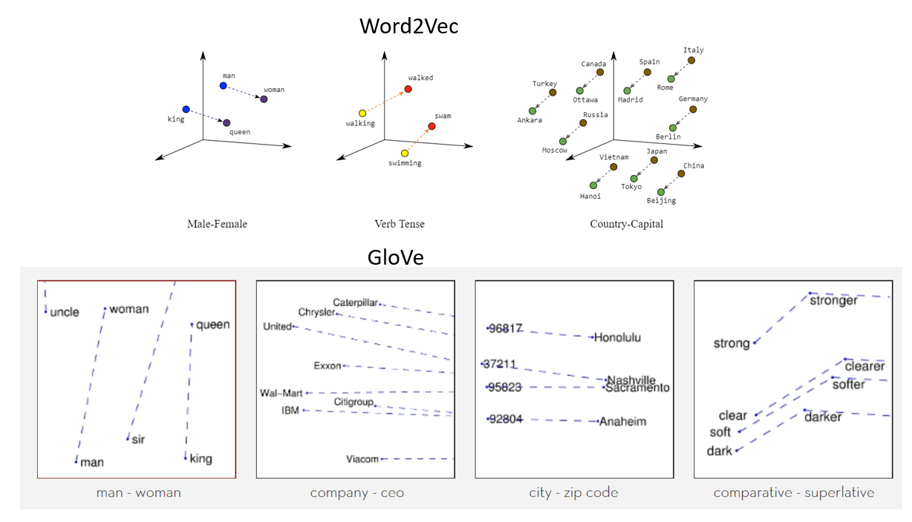
TEXT PROCESSING
NLP: MACHINE VS HUMAN
TOPIC MODELING
WORD EMBEDDING
0 1
0 1
0 3
0 3
WEB - SCRAPING
FEATURE SELECTION
0 2
0 2
NEW LIBRARY
JSON
FOR LOOP
SCORES
IAP
REVIEWS
VIDEO ADS
GENRES
https://medium.com/analytics-vidhya/city-recommender-system-with-python-part-3-3-deployment-finding-my-schitts-creek-2019971e2c4d

Slide 4
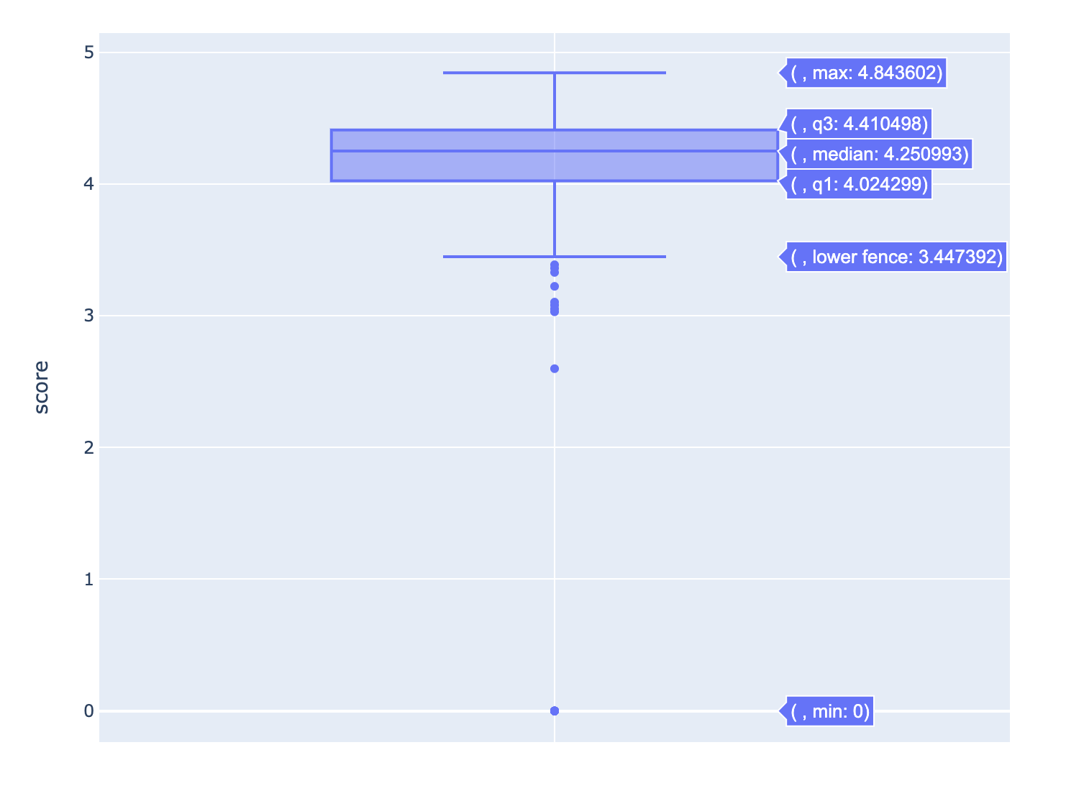
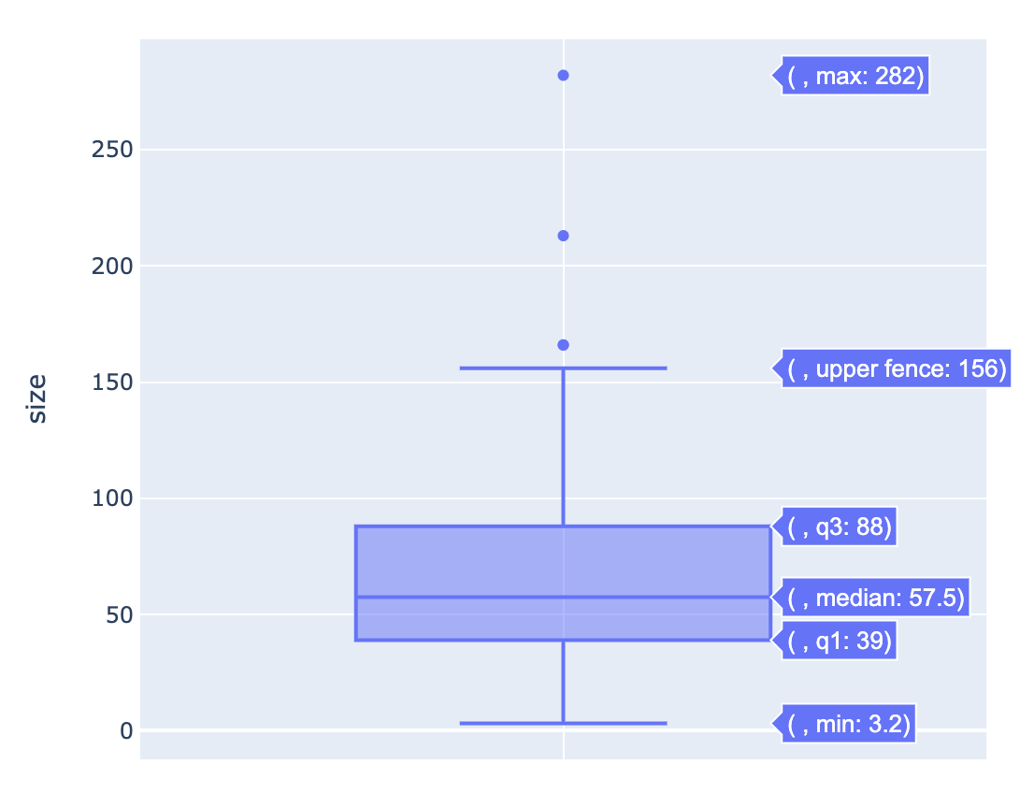
SIZES<100M
SCORES >4

Slide 5
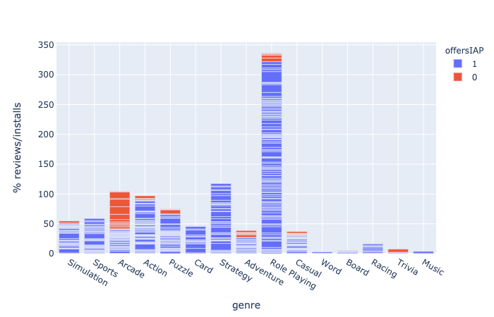
IN APP PURCHASE

Slide 6
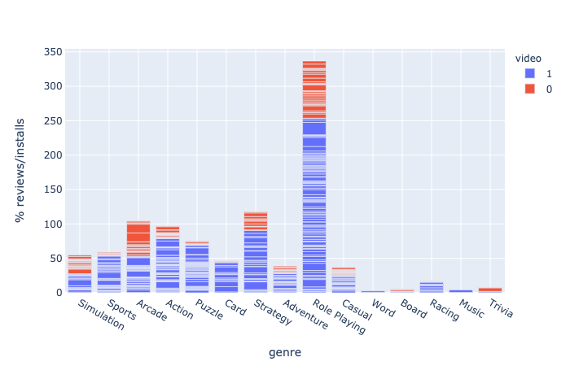
VIDEO ADS

Slide 7
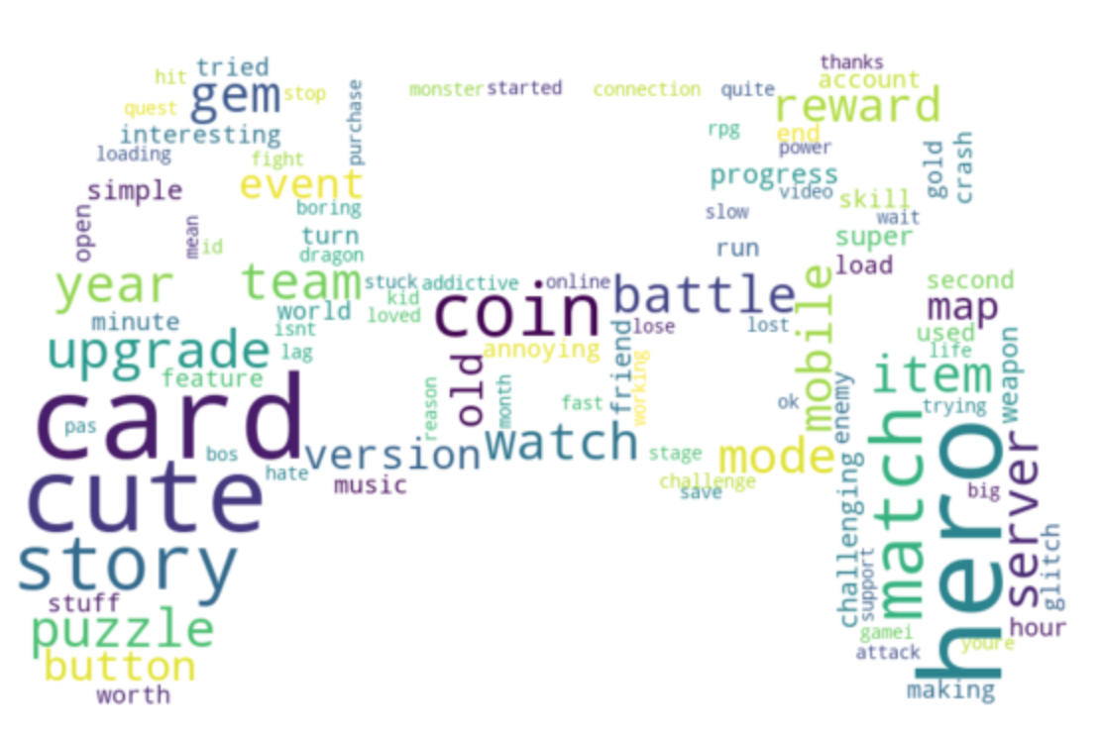
GENERAL REVIEWS

Slide 10
Content-based RS
Content-based RS

Slide 11
SAMPLES:

Slide 13





liu.kexin22@gmail.com
https://www.linkedin.com/in/liukexin22/
WendyLKX

