Slide 1
Project – Srgan
December, 14th, 2018

Slide 2
overview
Executive Summary
Product Motivation
Product Description
Demo

Slide 3
Executive summary
Build web application which can increase photo’s resolution
Using deep learning
Some of original planned features are not successfully working

Slide 4
Product motivation
Idea
Small size and low resolution images become bad
Even with good camera, shaky pictures can come out
Goal
User who needs to
Use downloaded images
Change shaky or old pictures

Slide 5






Product Description
Front-end
HTML
Flask
CSS
JS
Back-end
Python
Pytorch

Slide 6
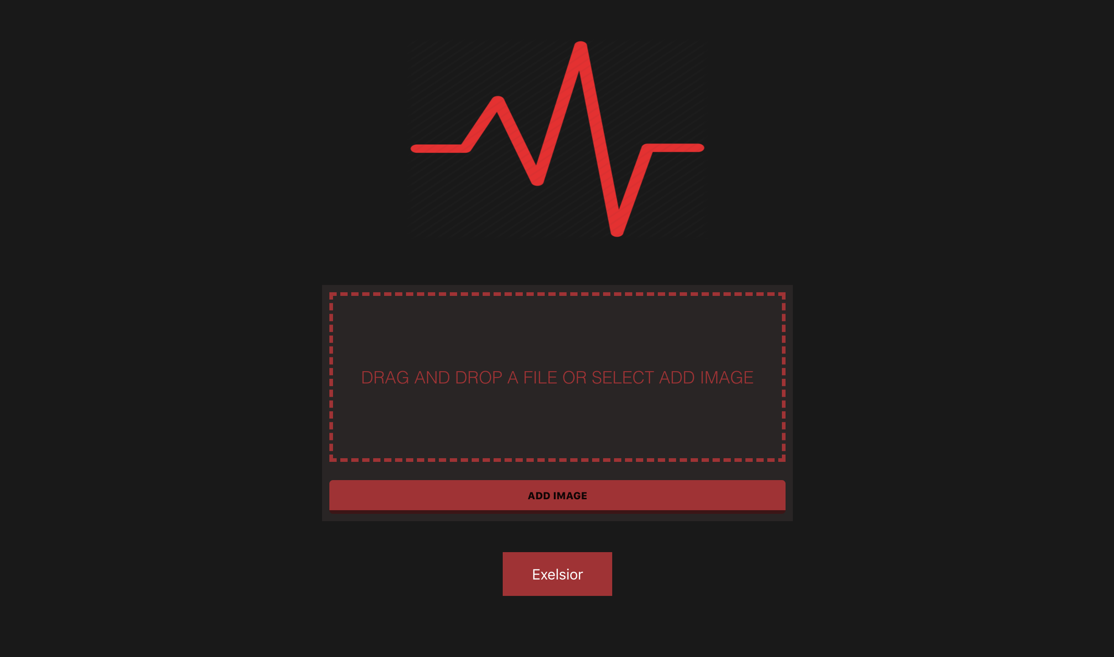
demo
http://127.0.0.1:5001/

Slide 7
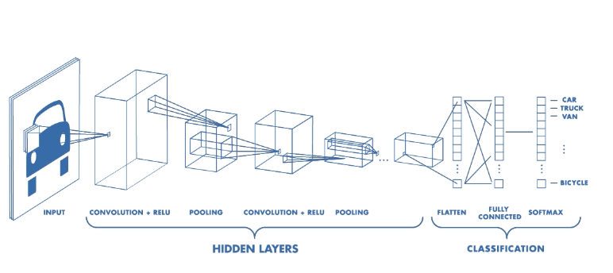
Product Description
Convolutional Neural Network(CNN)

Slide 8
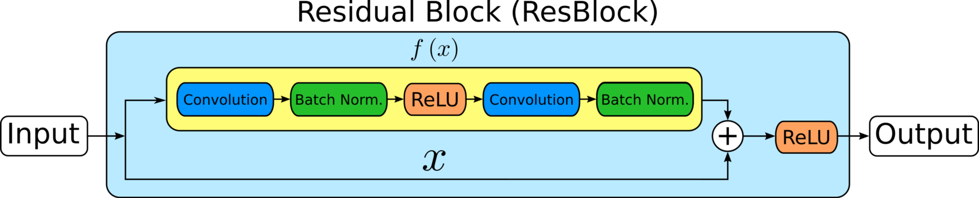
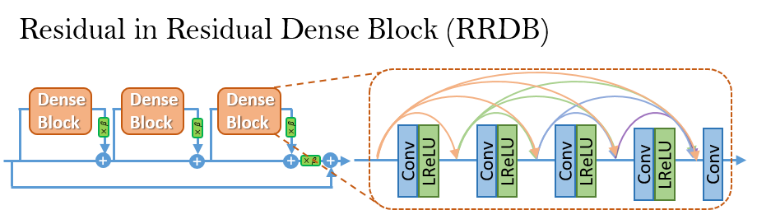
Product Description
RRDB

