Slide 1
Project – Srgan
December, 14th, 2018

Slide 2
overview
Executive Summary
Product Motivation
Product Description
Demo
Difficulty
Future works
Notes:
Here is overview for today’s presentation.

Slide 3
Executive summary
Build web application which can increase photo’s resolution
Using deep learning
Deep learning – a subset of machine learning where artificial neural networks, algorithms inspired by the human brain, learn from large amounts of data.
Notes:
This project is to build a web application that can enhance images’ resolution.
The theory behind is to have deep learning model which has capable of doing image enhancement job.
Deep learning is basically a human brain that has specifically taught in one special ability.

Slide 4
Product motivation
Idea
Small size and low resolution images become bad
Even with good camera, shaky pictures can come out
Goal
User who needs to
Use downloaded images
Change shaky or old pictures
Notes:
Where do I get this idea
There are problems with using small size and low-resolution images which people get those from online or old pictures, images that were never been high-resolution
and another problem even with good camera, people can ended up having shaky pictures
Therefore the goal to fix this is make a web application that can automatically switch to high-resolution images. And there will be users who want to use it.

Slide 5






Product Description
Front-end
HTML
Flask
CSS
JS
Back-end
Python
Pytorch

Slide 6
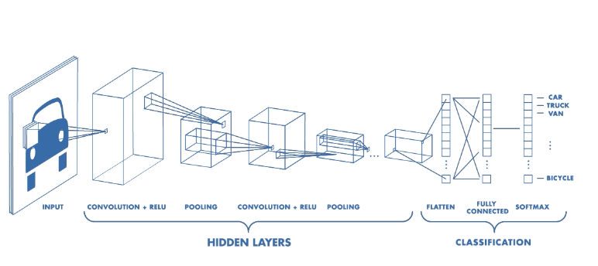
Product Description
Convolutional Neural Network(CNN)
Notes:
So I will briefly go over on CNN.
Most of image related works on Neural network are using cnn,
What cnn does is as you can see from the image
Computer will look through pixel by pixel of image and and eventually it will have matrix of numbers which each number is representaing a color.

Slide 7
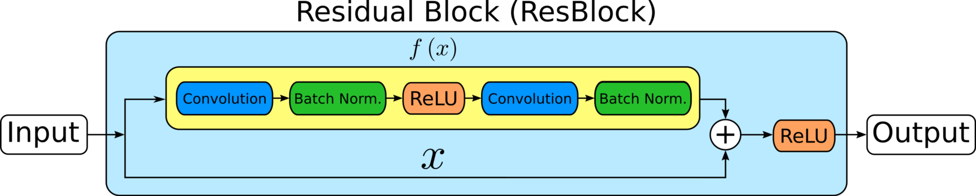
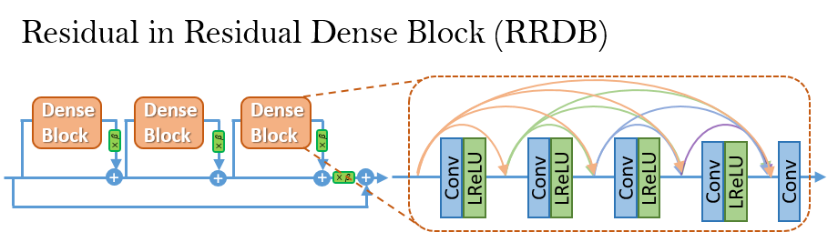
Product Description
RRDB
Notes:
From CNN
For my model I used residual dense block
Batch norm – what is does is like for example lets say you feed model in black cat pictures then eventually the model will think that cat is black.
Batch norm will prevent that and try to normalize that cat can be any color
Relu is like a node in python to connect each other and also confirms to go to next step
eventually what model does is have one pixel make 3x3 nine pixels which means magnifying or make it into high-resolution

Slide 8
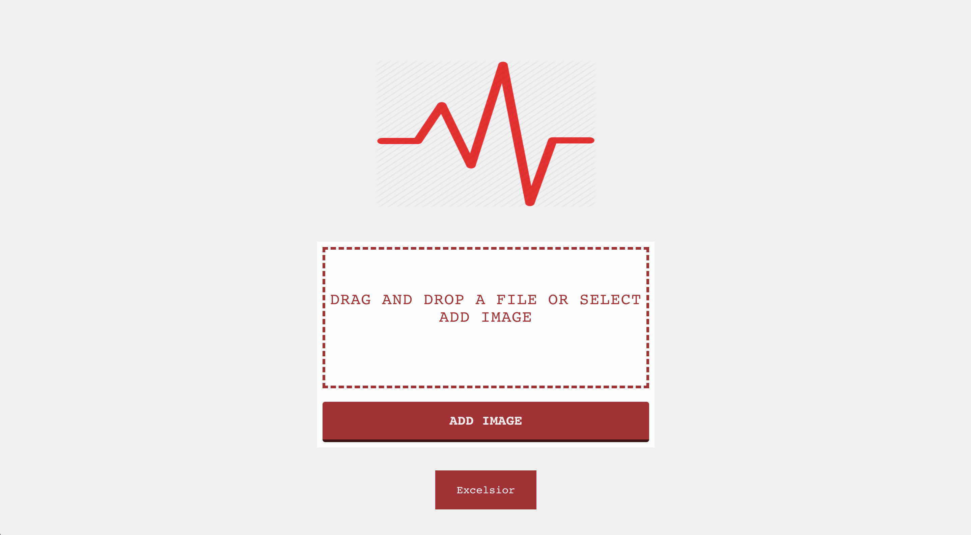
demo
http://127.0.0.1:5001/

Slide 9
Future works
More accuracy on detail
Search engine
Can download super-resolution images directly
Notes:
i want to have some kind of search engine for images like google image where people can download high-resolution images directly from my website.

