Slide 1
Group Project Text summarization
Team member – Kenny kim, Jashan singh
December, 14th, 2018

Slide 2
Product motivation
Idea
Jason is too lazy to read long text
We have a lot of information in todays world and it would take too long to read it all.
Goal
Have a model that creates abstractive summaries
Notes:
where and why we start this project
of course first Jason is too lazy to read long text
there are a lot of interesting articles, and books in this world

Slide 3






Product Description
Front-end
HTML
CSS
Flask
Back-end
Python
TensorFlow
Keras
GloVe
Notes:
Keras and Tensorflow which are AI library

Slide 4
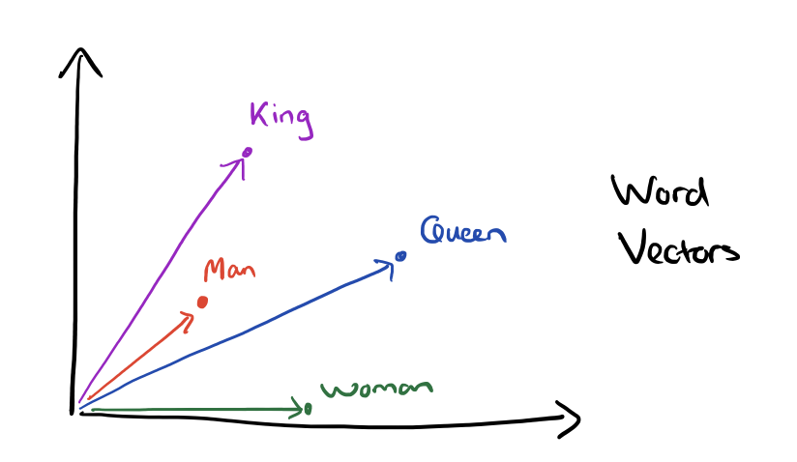
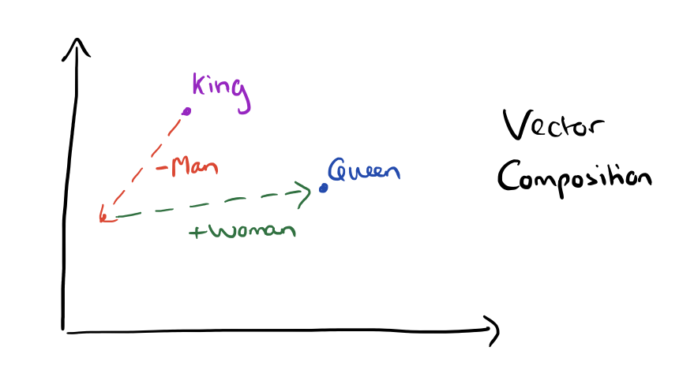
Product Description(cont.)
GloVe
Notes:
King minus man plus woman equal to queen

Slide 5
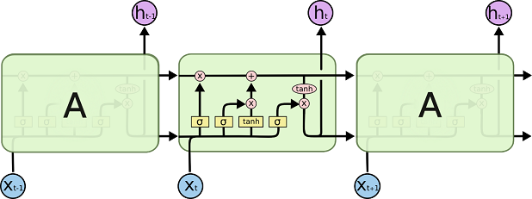
Product Description(cont.)
LSTM model(special RNN)
“I”
“I” + “like”
“I” + “like” + “dogs”

Slide 6
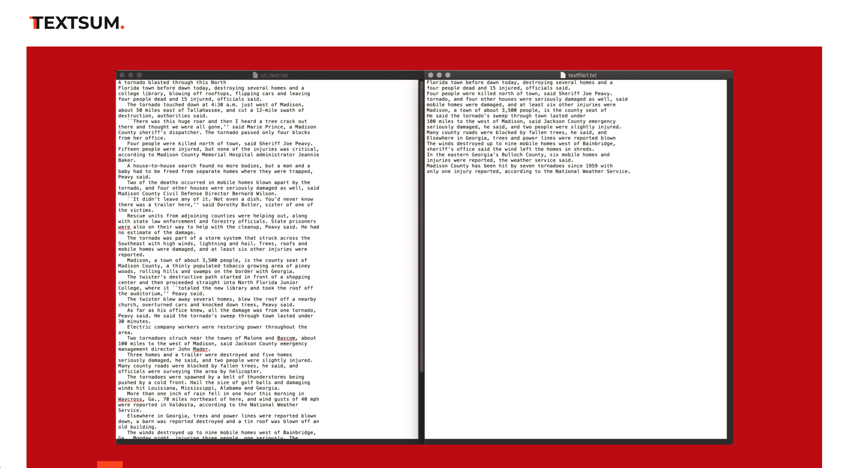
demo
http://127.0.0.1:5000/

Slide 7
Difficulty
Understanding deep learning terminology
Implementing Keras and Tensorflow
Getting model to run on gpu
Notes:
We had few difficulty which we eventually overcame
Studying all the terminology and deeper concepts was tough
Keras and Tensorflow which are AI library it was like learning another language and we needed that to imply on our model
Greatfully Kenso let us to use gpu server which wasn’t also easy and there were few obstacles to go through

Slide 8
Next step
Improve vocabulary size and accuracy
Able to summarize the whole book
Scrap website for text to summarize
Notes:
We need to have larger vocab size which will increase accuracy
We eventually want to summarize the whole book which need bigger model and probably hardwares to hold
Lastly, we want to have a function where people can just write url and it will just go through and summarize the content in that url

