Slide 1
Group Project Text summarization
Team member – Kenny kim, Jashan singh
December, 14th, 2018

Slide 2
Product motivation
Idea
Jason is too lazy to read long text
We have a lot of information in todays world and it would take too long to read it all.
Goal
Have a model that creates abstractive summaries

Slide 3






Product Description
Front-end
HTML
CSS
Flask
Back-end
Python
TensorFlow
Keras
GloVe

Slide 4
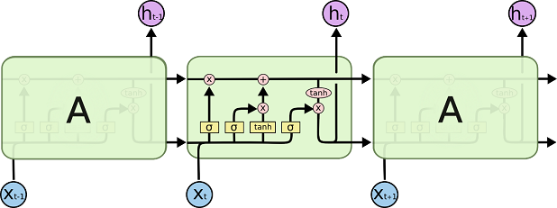
Product Description(cont.)
LSTM model
“I”
“I” + “like”
“I” + “like” + “dogs”

Slide 5
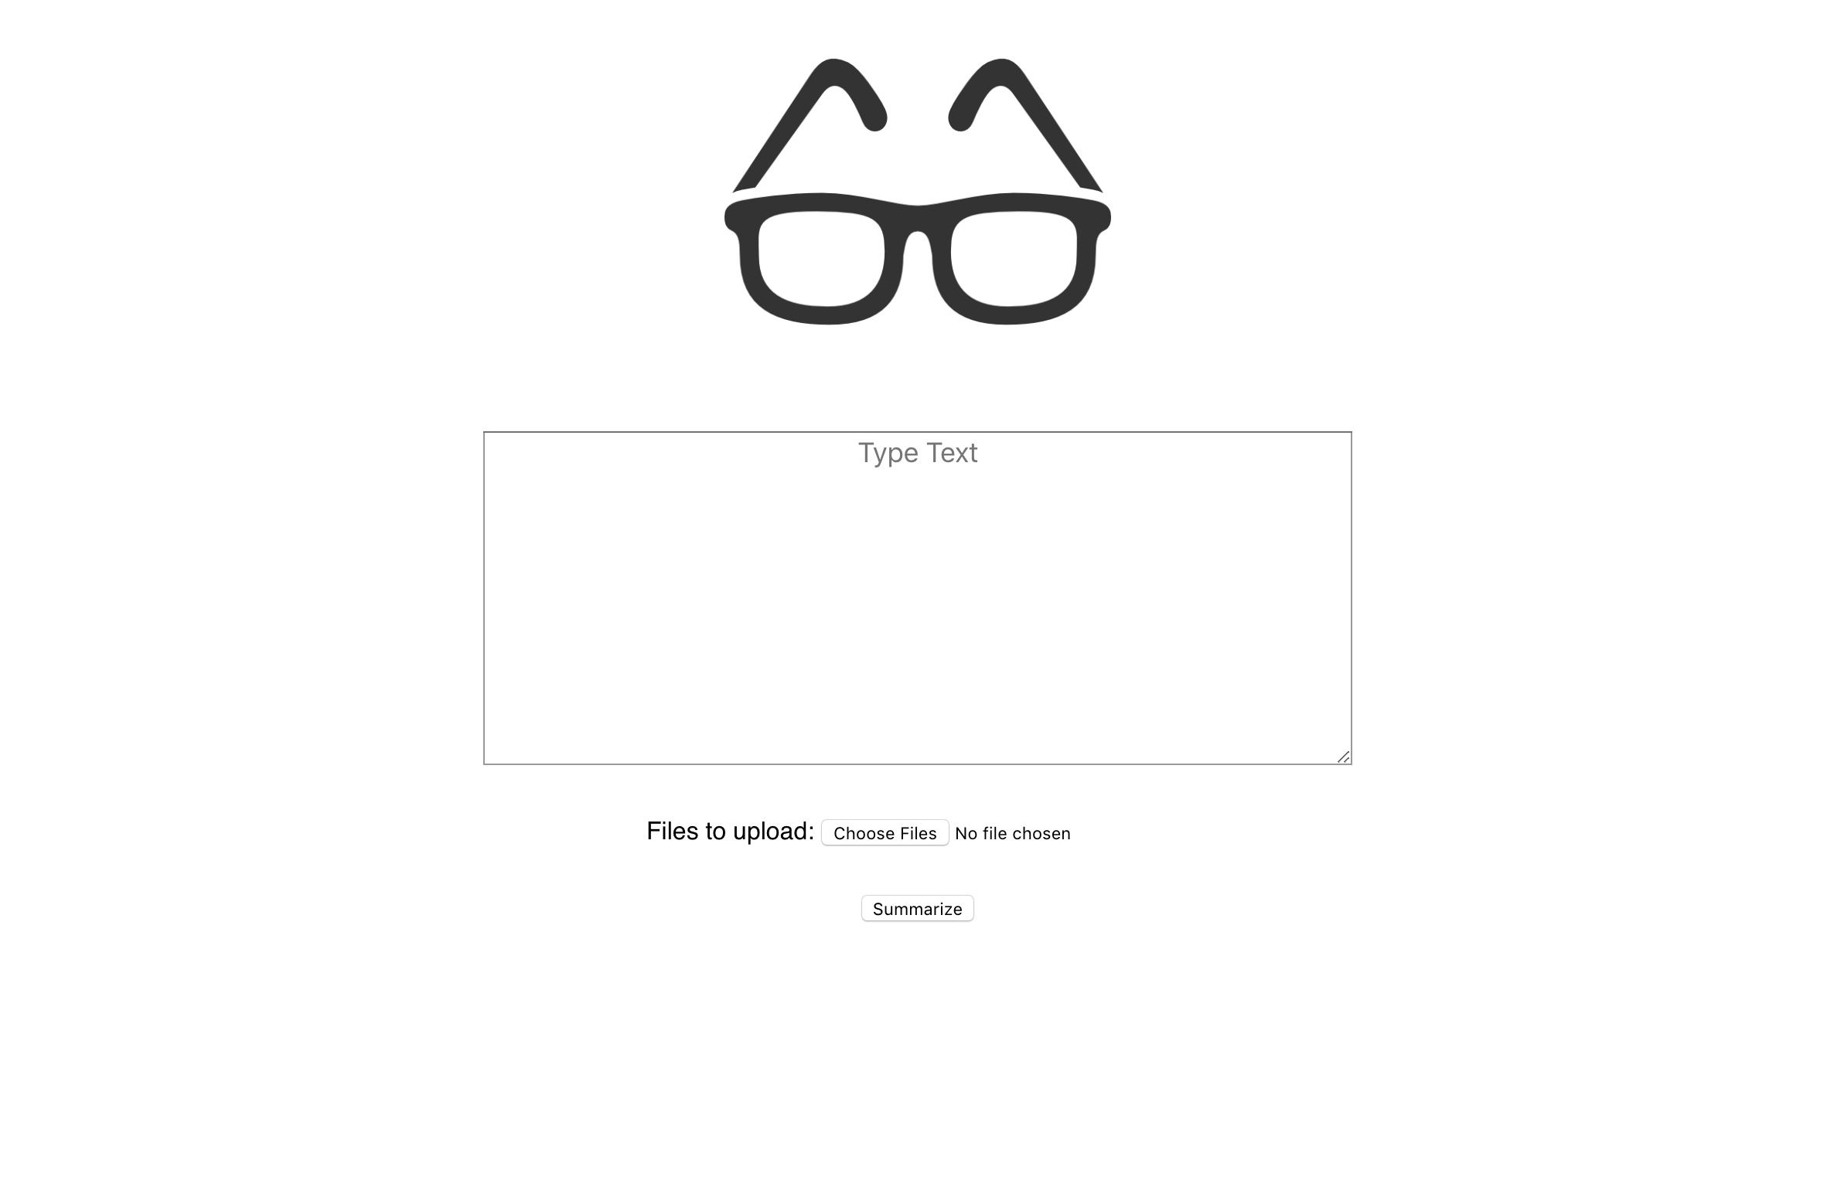
demo
http://127.0.0.1:5000/

Slide 6
Next step
Improve vocabulary size and accuracy
Add a page that takes in articles from a website, for example yahoo finance,

