Slide 1
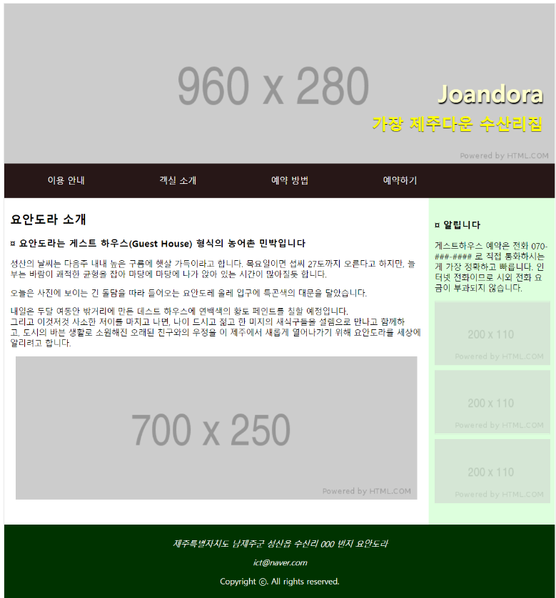
header
nav
h2
h2
detail
P
section
aside
img
image
img
img
p
p
p

