Slide 1
MLDS INDUSTRY PRACTICUM · PROGRESS PRESENTATION
KAVI GLOBAL
intelligence delivered℠
Multi-Platform Marketing
Intelligence Dashboard
Leo McKenna · Keming Zhang
March 2026

Slide 2
PROBLEM STATEMENT
Fragmented Data, Missed Opportunities
The Challenge
Our Solution
Kavi Global runs campaigns across 7+ platforms: YouTube, Mailchimp, Facebook, LinkedIn, Twitter/X, Dripify, and GA4.
Each platform stores data in isolation — no single view of cross-channel performance.
Reporting requires manual exports from every platform, which is slow and error-prone.
Without unified data, it is impossible to identify which channels are driving ROI.
Automated API data extraction from all 7 platforms
Centralized storage in an Azure SQL database
Platform-specific Power BI dashboards with live data
Cross-channel visibility to support data-driven decisions

Slide 3
BUSINESS VALUE & ECONOMIC IMPACT
Why This Matters for Kavi Global
⏱
📊
💡
Time Savings
Faster Decisions
Campaign ROI
~15 hrs/wk
Real-Time
Unified View
Eliminate manual exports across 7 platforms. Automated pipelines free analysts to act on insights rather than gather data.
Replace end-of-month static reports with live dashboards. Detect underperforming campaigns instantly and pivot.
Attribute performance across all channels. Identify top-converting content types and the platforms delivering most value.
7 data sources · 1 automated pipeline · Always-on intelligence

Slide 4
DATA OVERVIEW
7 Platforms, 1 Pipeline
Dashboard Live
In Progress
YouTube
Mailchimp
Facebook
LinkedIn
✓ Live
✓ Live
⏳ In Progress
⏳ In Progress
Views · Watch time
Subscribers · Engagement rate
Open/click rates
Campaigns · Subscriber growth
Reach · Post engagement
Ad performance metrics
Impressions · Followers
Content analytics
Twitter / X
Dripify
Google Analytics 4
⏳ In Progress
⏳ In Progress
⏳ In Progress
Impressions · Reach
Profile visits & engagement
LinkedIn automation
Connection & reply rates
Website traffic
Conversions & user behavior
Notes:
This slide shows the overall data sources used in our marketing intelligence pipeline.
Our system will integrate data from seven different platforms.
Currently, the YouTube and Mailchimp pipelines are fully operational. The remaining platforms are still in progress. At this stage, the company is requesting API access and platform permissions, while we continue building the extraction scripts and designing the corresponding dashboards.
Each platform provides different types of KPI measurements and marketing insights. For example, YouTube focuses on video performance metrics such as views, watch time, subscriber growth, and engagement rate, which help evaluate content effectiveness. Mailchimp, on the other hand, provides email campaign metrics such as open rate, click rate, click-to-open rate, unsubscribe rate, and subscriber growth, which help measure email marketing performance.
By integrating these data sources into a single automated pipeline, we aim to create a unified and centralized view of cross-platform marketing performance.

Slide 5
TECHNICAL ARCHITECTURE
End-to-End Automated Pipeline
Platform
APIs
Python
Scripts
Azure SQL
Database
Power BI
Dashboards
YouTube Data API v3
Mailchimp API v3
Facebook Graph API
LinkedIn API
GA4 Reporting API
Data extraction
Cleaning & transforms
Type enforcement
Scheduled runs
Centralized storage
Relational schema
Historical tracking
Cloud hosted
Live DB connection
Interactive filters
Per-platform views
KPI tracking
▶
▶
▶
Python scripts extract from each platform API on schedule → loaded to Azure SQL → Power BI connects live
Notes:
This slide illustrates the technical architecture of our automated data pipeline.
Out first step is to collect data from various platform APIs.
Next, we use Python scripts to extract and process the data. The preprocessing tasks mainly include data cleaning, transformation, type enforcement, and scheduled data extraction.
The processed data is then stored in an Azure SQL database, which provides centralized storage with a relational schema and supports historical data tracking.
Finally, Power BI dashboards connect directly to the database, allowing users to explore the data through interactive filters, monitor KPIs, and analyze performance for each platform.

Slide 6
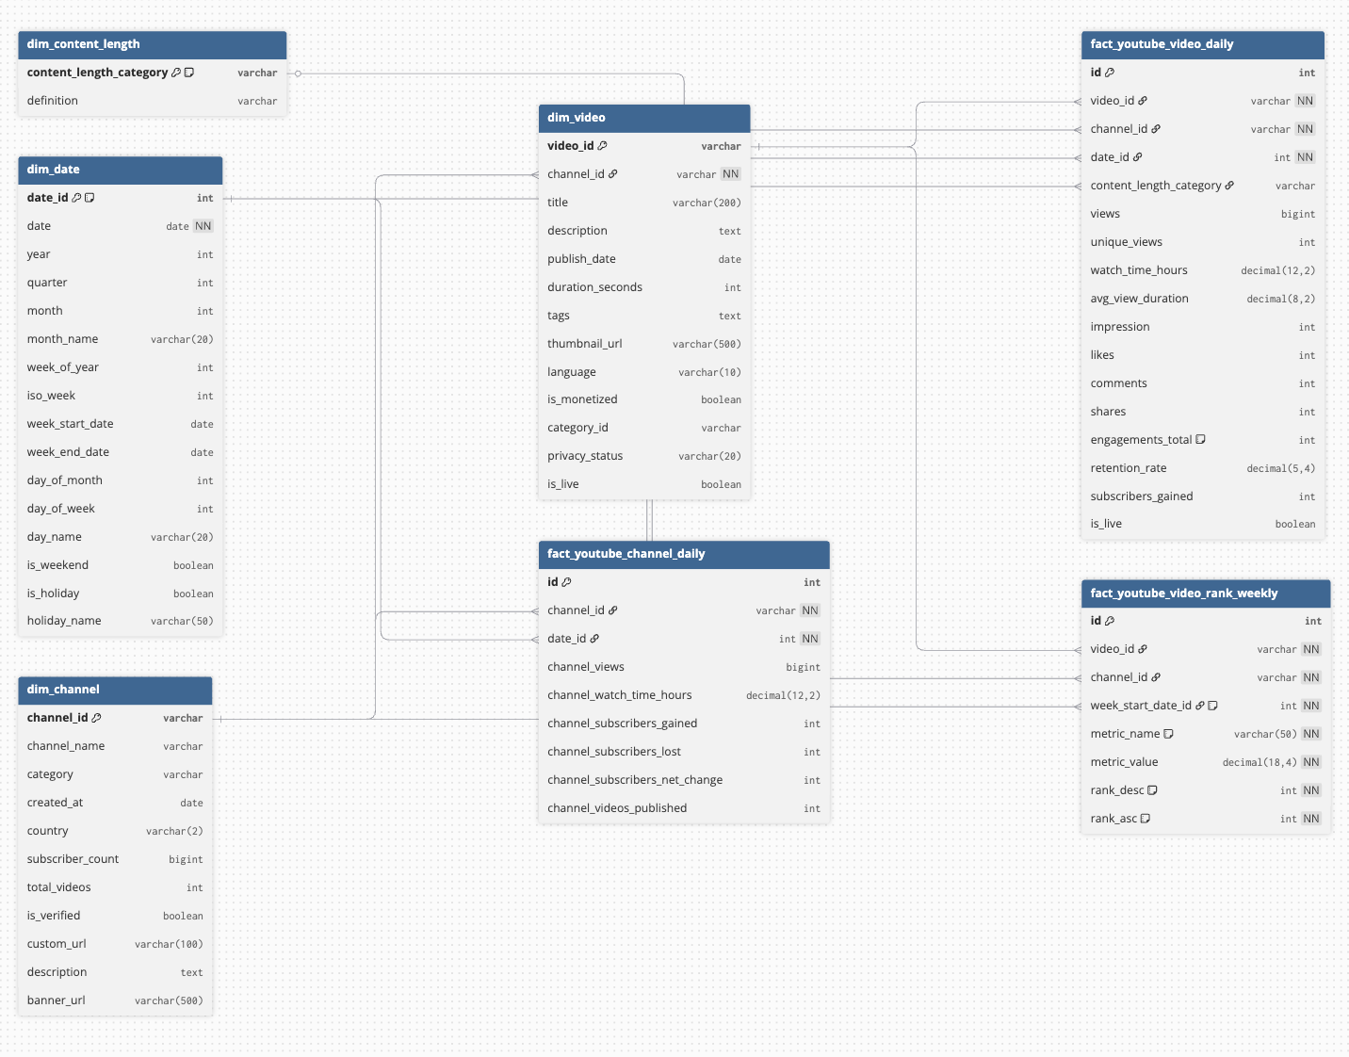
RESULTS — YOUTUBE
YouTube Star Schema
At the center are fact tables that store measurable metrics such as views, watch time, engagement, and subscriber changes.
These fact tables are connected to several dimension tables, including:
dim_video – video metadata such as title, publish date, duration, and category
dim_channel – channel-level information including subscriber count and country
dim_date – calendar attributes used for time-based analysis
dim_content_length – categorizes videos based on duration
This structure enables fast aggregation and flexible analysis, allowing us to track performance across videos, channels, and time.
Additionally, the schema includes:
Daily fact tables to monitor detailed performance metrics
Weekly ranking tables to identify top-performing videos across key KPIs

Slide 7
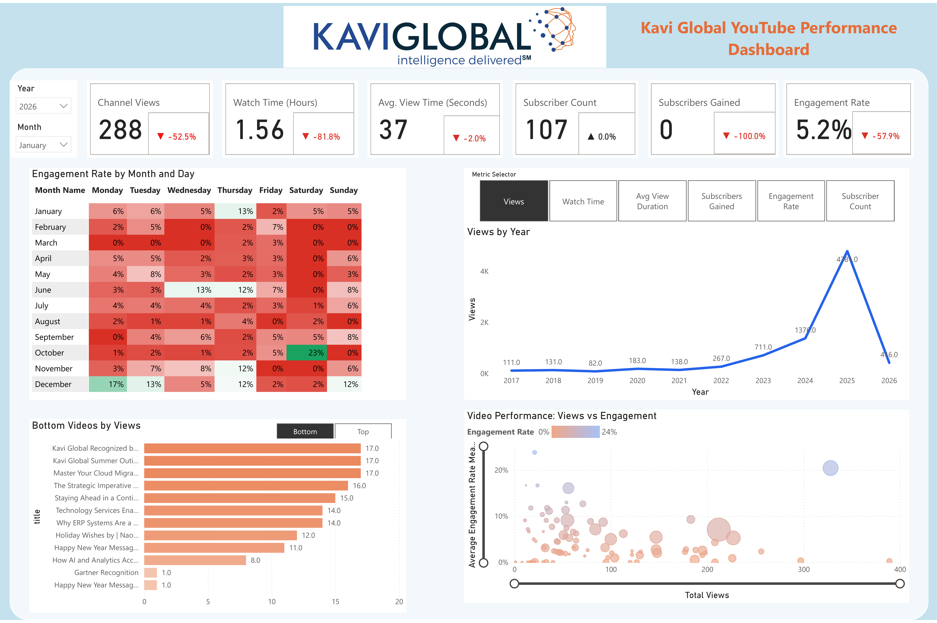
RESULTS — YOUTUBE
YouTube Analytics Dashboard

Slide 8
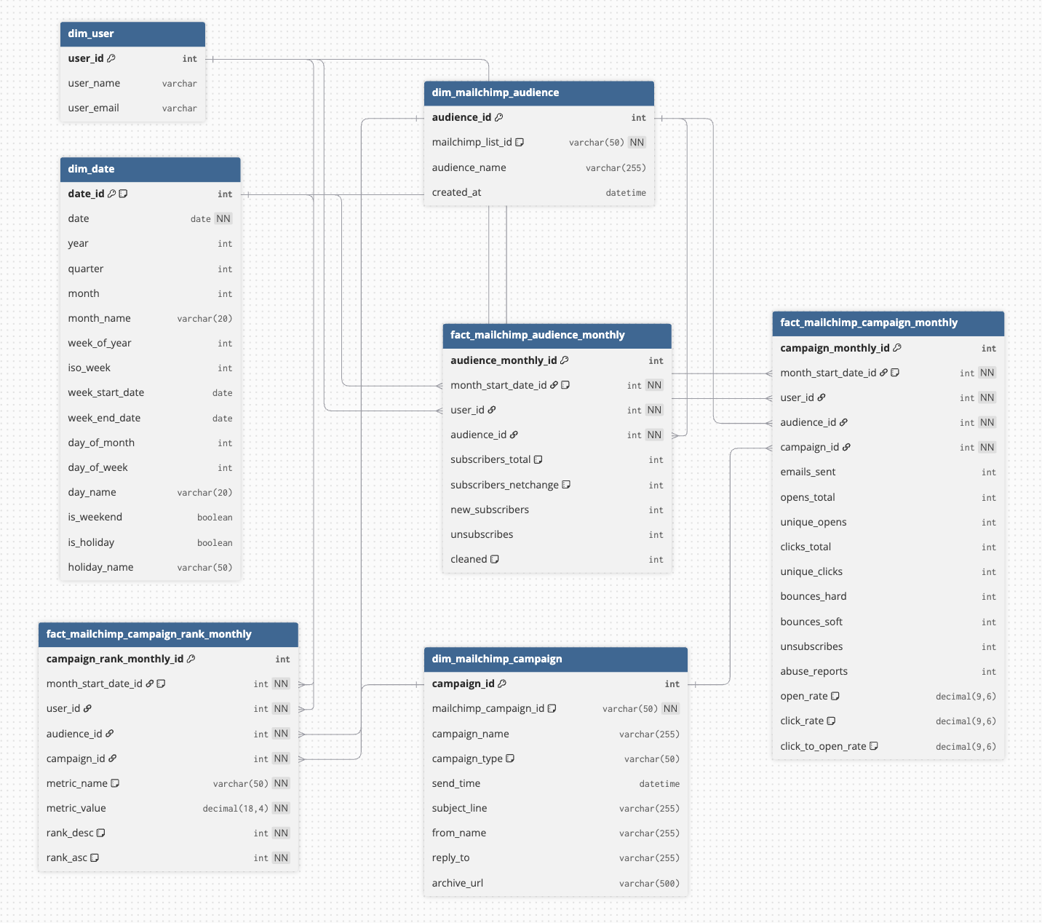
RESULTS — YOUTUBE
Mailchimp Star Schema
The core fact tables capture key marketing metrics:
fact_mailchimp_campaigns_monthly – tracks campaign performance
fact_marketing_audience_monthly – records audience growth metrics
These fact tables are connected to several dimension tables that provide descriptive context:
dim_date – enables time-based analysis such as monthly trends and campaign performance over time
dim_marketing_campaign – contains campaign metadata
dim_marketing_audience – stores audience information
dim_user – tracks account users responsible for managing campaigns
This structure allows us to efficiently analyze email marketing KPIs, monitor audience growth, and evaluate campaign engagement performance across time.

Slide 9
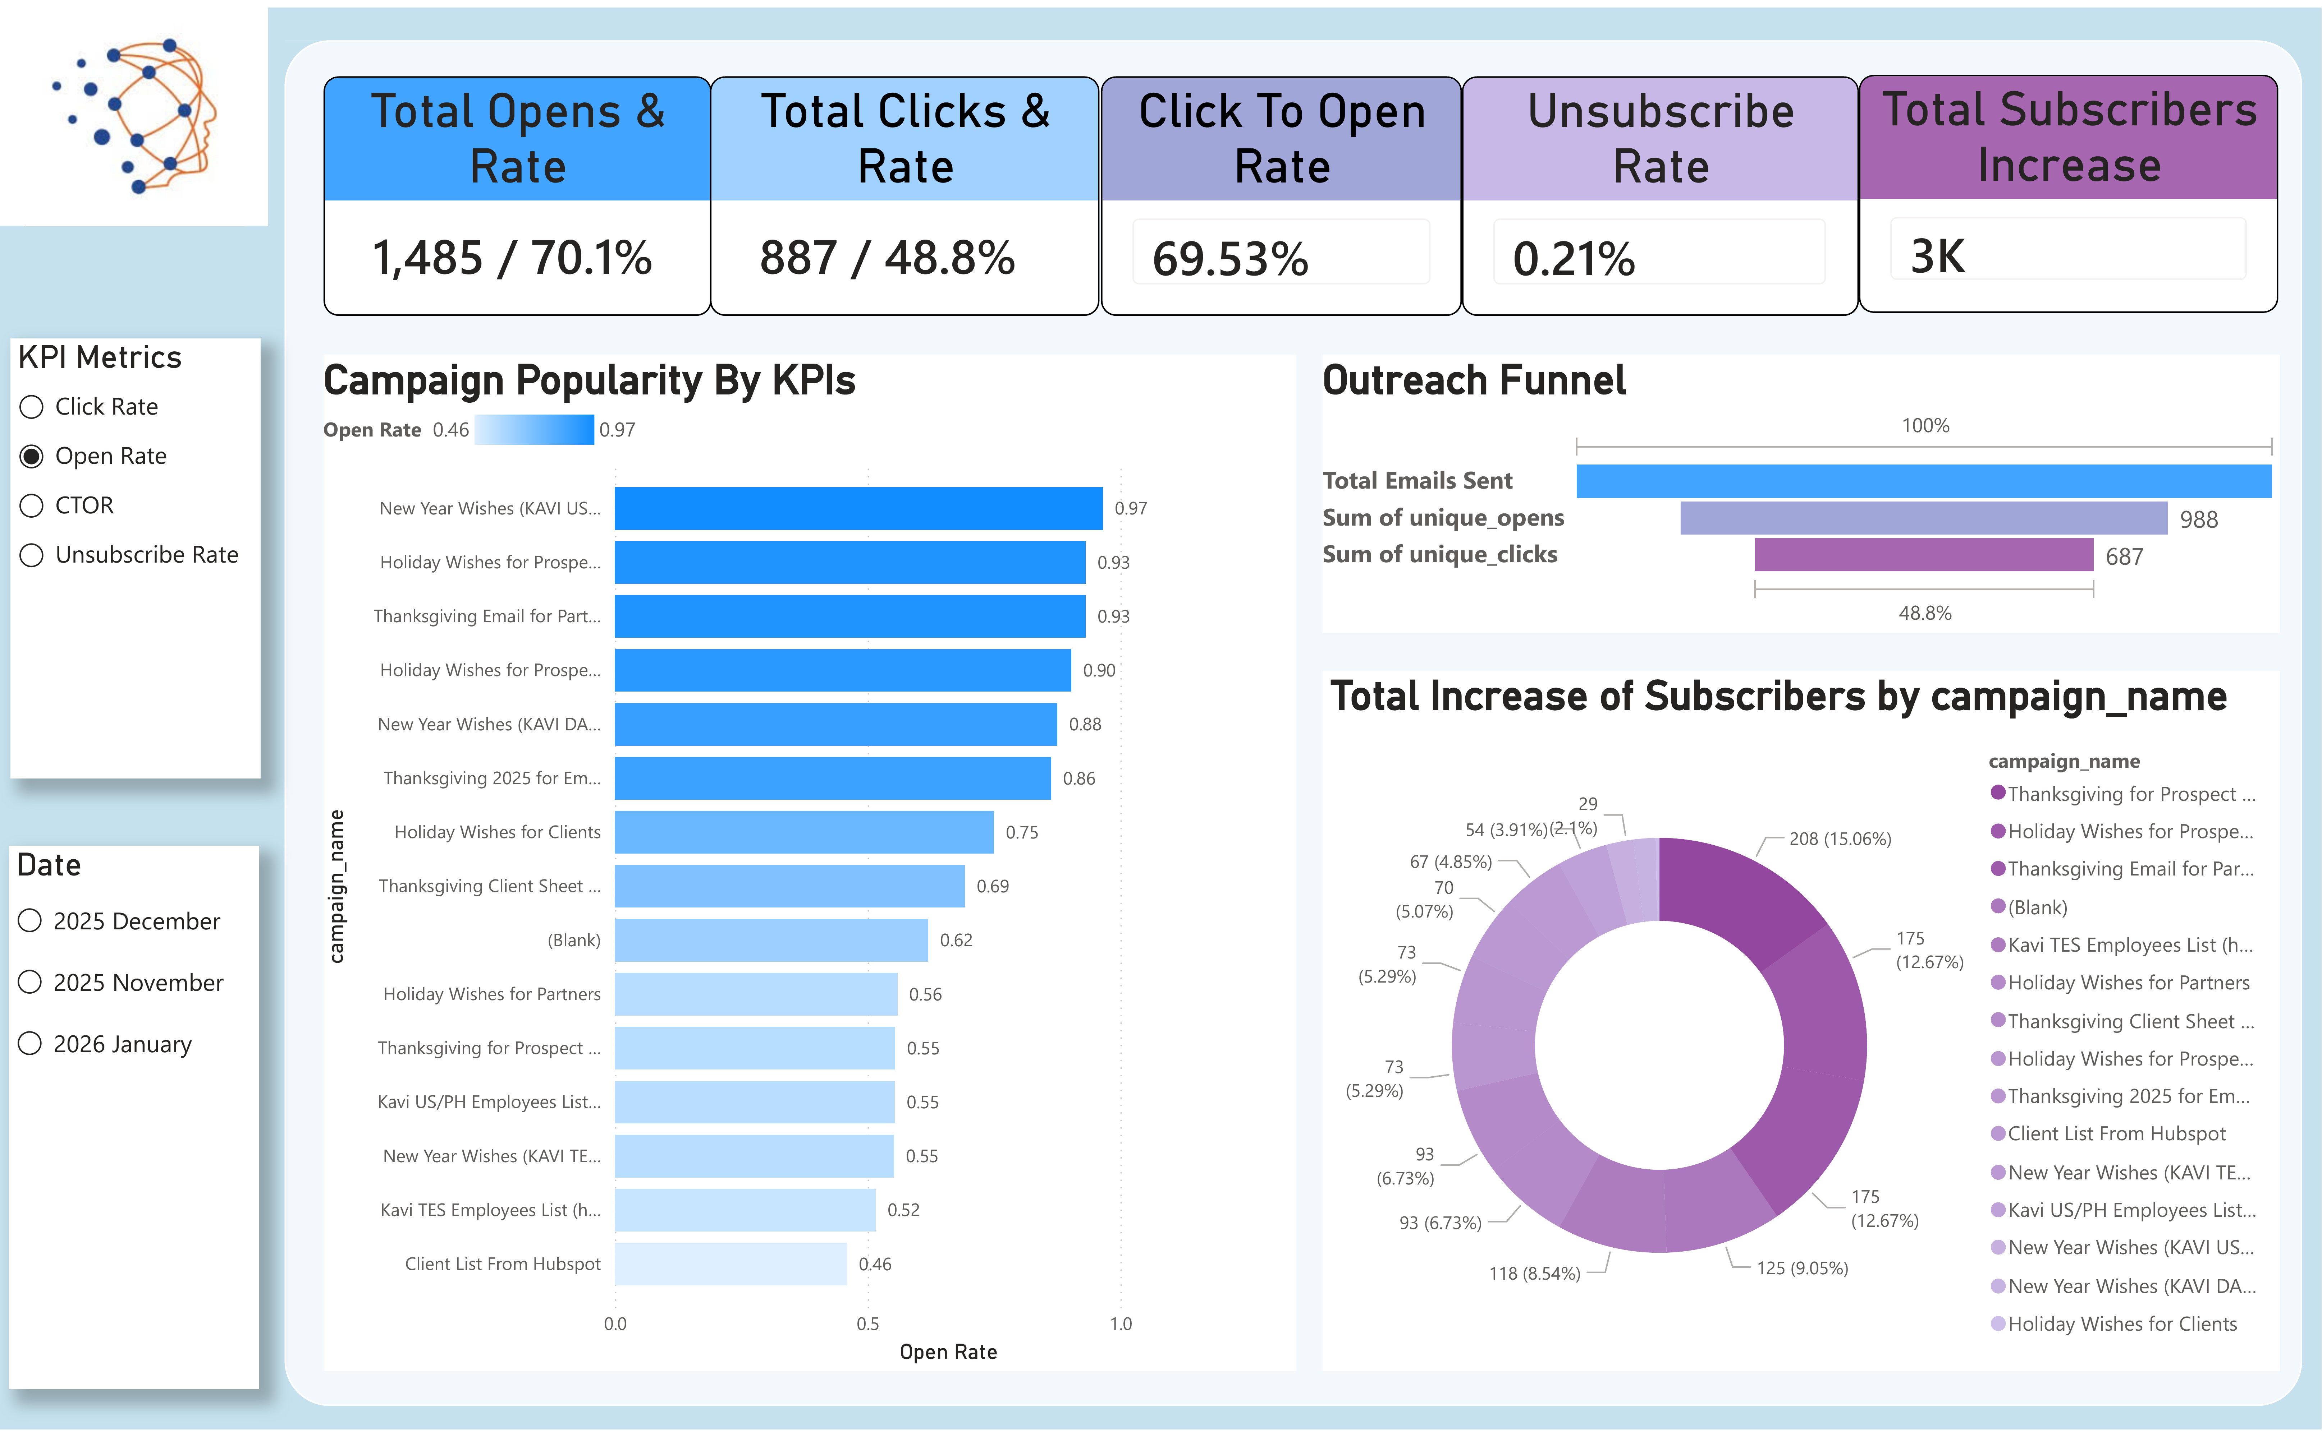
RESULTS — MAILCHIMP
Email Campaign Analytics Dashboard
Notes:
This slide shows the Mailchimp email campaign analytics dashboard built in Power BI.
At the top, we display key performance indicators, including total opens, click rates, click-to-open rate, unsubscribe rate, and subscriber growth. These metrics provide a quick overview of campaign performance.
The dashboard also includes visualizations such as campaign popularity by KPIs, which helps identify the most effective campaigns based on engagement metrics.
I also visualize the email outreach funnel, showing how many users move from email delivery to opening and clicking.
Additionally, the dashboard tracks subscriber growth by campaign, allowing the marketing team to see which campaigns contribute most to audience expansion.
With interactive filters for dates, the dashboard enables marketers to quickly explore campaign performance across time and identify opportunities for optimization.

Slide 10
CONCLUSION & NEXT STEPS
Progress Summary & Roadmap
Completed
Upcoming
YouTube API pipeline & data extraction
Mailchimp API pipeline & data extraction
Azure SQL database schema & ingestion scripts
Interactive YouTube Power BI dashboard
Interactive Mailchimp Power BI dashboard
Facebook: API extraction + Power BI dashboard
LinkedIn: engagement & follower analytics
Twitter/X: impressions & reach dashboard
Dripify: LinkedIn automation metrics
GA4: website traffic & conversion funnel
Unified cross-platform combined dashboard

