Slide 1

Data Preparation for Machine
Learning (M1)
Analysis of the Heart Disease Dataset
Jakub Jakubowicz (2025121082)
Gracjan Jasnos (2025109276)
November 2025
Notes:
Hello. we present our Milestone 1 project.
The goal of this stage was to explore, clean, and prepare a real-world dataset for machine learning — in our case, the Heart Disease dataset from Kaggle.
we’ll show how we analyzed the data, verified its quality, built a preprocessing pipeline, and evaluated a baseline model.
All results are reproducible and ready for further model development in Milestone 2.

Slide 2
Project Objectives
Understand the dataset structure and medical context
Ensure data quality and integrity
Build a reproducible preprocessing pipeline
Notes:
Our main objectives were divided into three parts.
First, to understand the dataset — what the attributes mean and how they relate to heart disease.
Second, to ensure data quality by detecting and handling missing values, duplicates, and inconsistencies.
And finally, to design a complete preprocessing pipeline that automatically performs encoding, scaling, and model training.
This way, the entire process can be reproduced exactly the same way in the next stages.

Slide 3
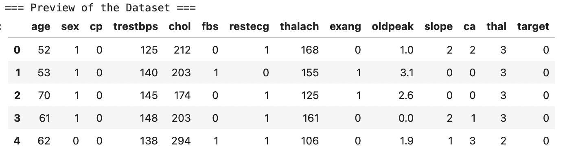
Dataset Overview
14 features
Binary target (0 = No disease | 1 = Disease)
Mixed types: numerical + categorical + ordinal
Notes:
The dataset contains 14 features describing patient demographics and medical measurements.
Each row represents one patient, and the target column indicates whether the patient has heart disease or not.
It’s a classic binary classification problem used in many medical AI studies.
The attributes cover key factors such as age, sex, blood pressure, cholesterol, ECG results, and exercise outcomes.
This diversity makes it ideal for testing both data preprocessing and classification methods.

Slide 4
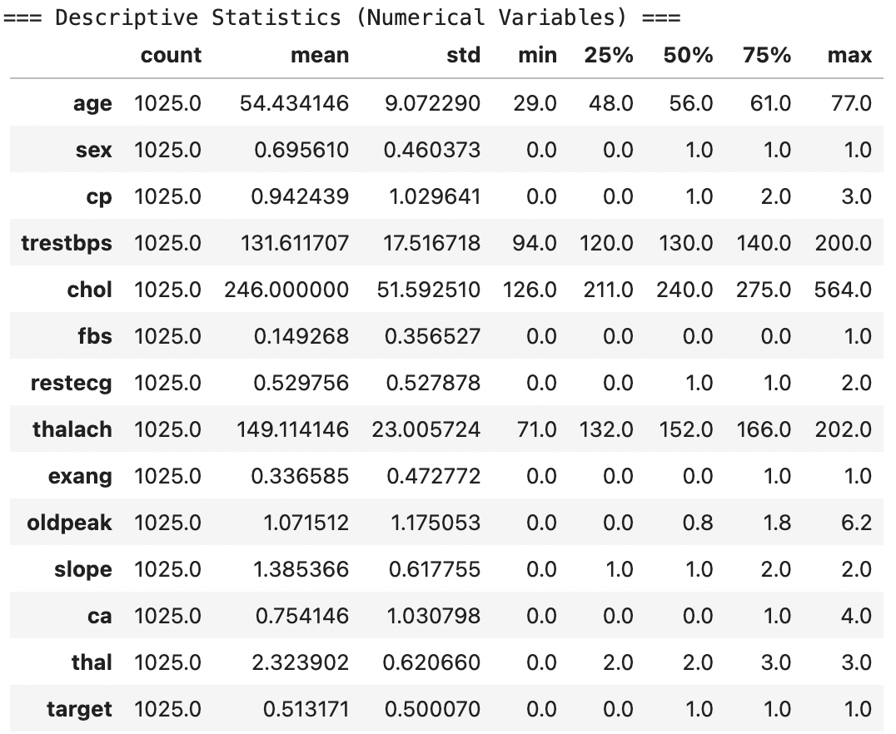
Descriptive Statistics
Notes:
Here we can see the descriptive statistics for the numerical variables.
The average age of patients is around 54, with values ranging from 29 to 77 years old.
The average cholesterol level is about 246 milligrams per deciliter, which fits typical clinical ranges.
All features show reasonable variation and no extreme errors or unrealistic outliers.
Additionally, all columns are complete — there are no missing values in the entire dataset.
This is important because it means we can focus directly on transformation rather than data imputation.

Slide 5
Feature Types & Encoding Plan
Feature | Type | Encoding
sex | Categorical | One-Hot
cp | Ordinal | One-Hot
fbs | Binary | None
thalach | Numerical | StandardScaler
oldpeak | Numerical | StandardScaler
Notes:
We grouped features according to their type.
Categorical variables like sex or chest pain type were One-Hot encoded, because we wanted to avoid implying any artificial order between categories.
Ordinal and binary variables were treated carefully to preserve their medical meaning.
Numerical variables such as cholesterol and maximum heart rate were standardized to make all features comparable in scale.
This structured approach allows the model to interpret medical attributes correctly.

Slide 6
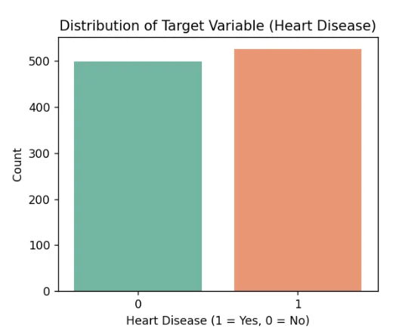
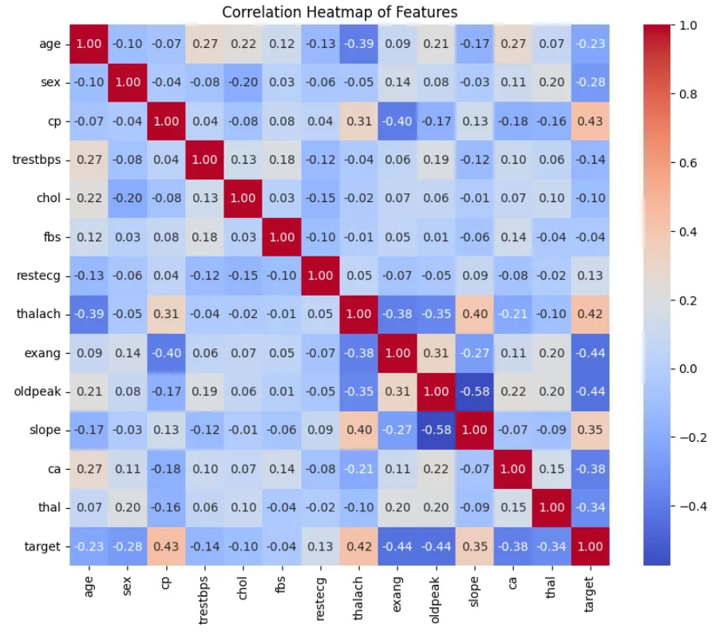
Exploratory Data Analysis (Target & Correlations)
Notes:
The bar chart shows that our target variable is nearly balanced — around half of the patients have heart disease, and half do not.
The correlation heatmap on the right shows how features relate to each other and to the target variable.
We found that maximum heart rate and chest pain type have strong positive correlations with the target, meaning higher values often indicate disease presence.
On the other hand, ST depression and exercise-induced angina are negatively correlated, suggesting healthier patients tend to have lower values of these indicators.
This confirms that the dataset behaves as expected medically.

Slide 7
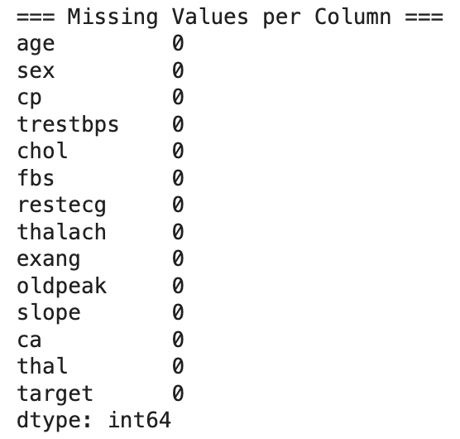
Data Quality Validation
No missing value
Consistent data types
Duplicates handled internally
Dataset ready for feature preprocessing.
Notes:
Before applying machine learning, we verified data quality.
There were no missing values and all columns had consistent data types.
We also checked for duplicate records and handled them automatically.
After validation, the dataset was clean, reliable, and ready for the preprocessing pipeline.
Ensuring data integrity at this stage is essential to prevent bias and training errors later on.

Slide 8
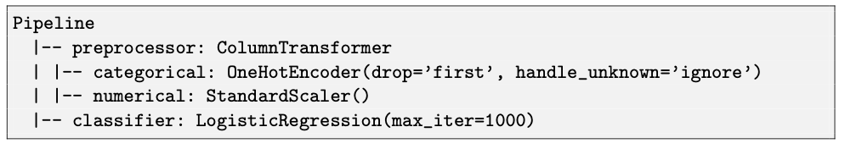
Pipeline Structure & Implementation
Raw Data → [Encoder + Scaler] → Model
Notes:
Here you can see the main component of our project — the preprocessing pipeline.
Using a ColumnTransformer, we applied different transformations to categorical and numerical features in one consistent workflow.
Then, we attached a Logistic Regression model as our baseline classifier.
This approach ensures that all preprocessing steps are applied automatically and in the correct order, both for training and testing datasets.
The entire pipeline can be exported and reused, which improves reproducibility and saves time.

Slide 9
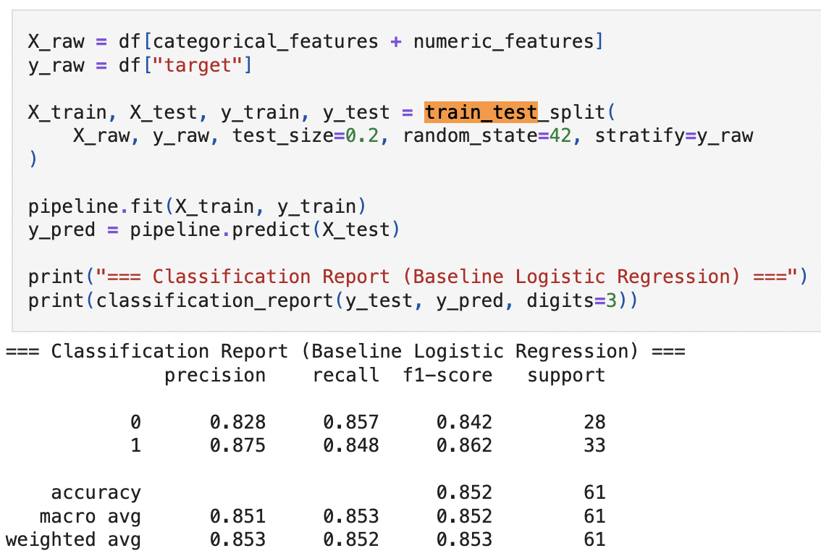
Train–test Split & Model Training
dataset → 80% train / 20% test
Notes:
We divided the data into training and testing sets using an 80 to 20 ratio.
Stratification ensured that both sets had the same proportion of positive and negative cases.
We trained the pipeline on the training data and then evaluated it on the test data to check generalization performance.
Random seeds were fixed for full reproducibility.

Slide 10
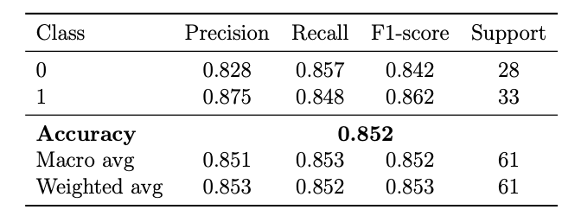
Baseline Results
Notes:
The baseline Logistic Regression achieved an accuracy of about 85 percent.
Precision, recall, and F1-scores are balanced across both classes, which indicates that the model doesn’t favor one class over the other.
These results confirm that our preprocessing steps worked correctly and produced meaningful input for the classifier.
This performance will serve as our baseline for future model tuning and comparison in Milestone 2.

Slide 11
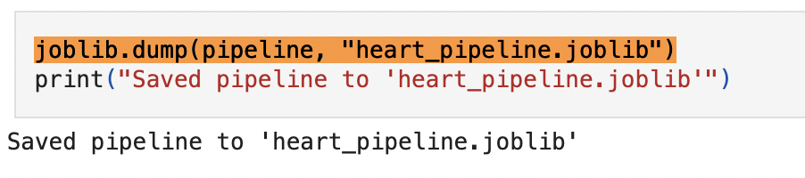
Pipeline Export & Reproducibility
Full preprocessing + model saved for future reuse.
Notes:
Once the model and preprocessing pipeline were validated, we exported them as a single joblib file.
This file includes all preprocessing steps and model parameters.
By saving this artifact, we ensure that our entire process is reproducible — we can load it anytime and apply it to new data or additional models in the next milestone.
Reproducibility is a key requirement for scientific and machine learning projects.

Slide 12
Summary & Next Steps
Data understood
Clean and validated dataset
Pipeline ready for ML
Baseline accuracy: 85%
Notes:
To conclude, we completed the full preparation of the Heart Disease dataset.
We explored and understood the data, confirmed its quality, and implemented a fully automated preprocessing pipeline.
Our baseline model achieved 85 percent accuracy, which is a solid result for Logistic Regression.
In Milestone 2, we plan to test more advanced models like Random Forests or Gradient Boosting,
and to apply unsupervised techniques such as clustering and dimensionality reduction.
The strong foundation built in this milestone allows us to focus entirely on model optimization in the next stage.

Slide 13
Thank you

