Slide 1


BrainTumorDeMoSeg Instructions
Kaixiang Yang, Wenqi Shan, Qiang Li, Zhiwei Wang
Wuhan National Laboratory for Optoelectronics and with MoE Key Laboratory for
Biomedical Photonics
College of Life Science and Technology, Huazhong University of Science and Technology,
Wuhan, China
2024.4.11

Slide 2
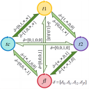
1.Introduction
BrainTumorDeMoSeg version 1.0.0
BrainTumorDeMoSeg is based on the DeMoSeg and integrated into 3d Slicer.
It is an automatic segmenting tools for incomplete brain tumors segmentation, T1, T1ce, T2 and FLAIR MRI are valid modalities.
MRI images should be skull-stripped and co-registered.
Originally developed by Kaixiang Yang, Wenqi Shan, Qiang Li, Zhiwei Wang and etc.

Slide 3
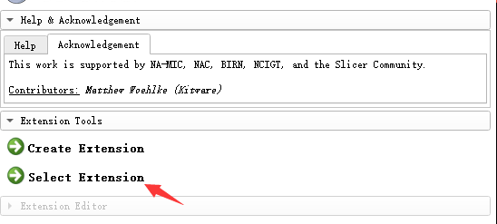
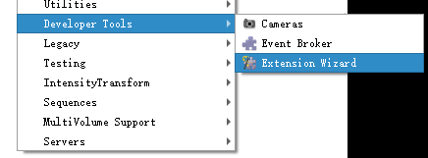

2.Install
Step1: Downloading BrainTumorDeMoSeg
Step2: It is recommended to place the folder in the slicer directory, e.g.,
D:/3D Slicer/Slicer 5.6.2/Extensions
Step3: Load from 3D Slicer, Modules→Developer Tools→Extension Wizard
→Select Extension
Step4: Use it at, Modules→Segmentation→BrainTumorDeMoSeg

Slide 4
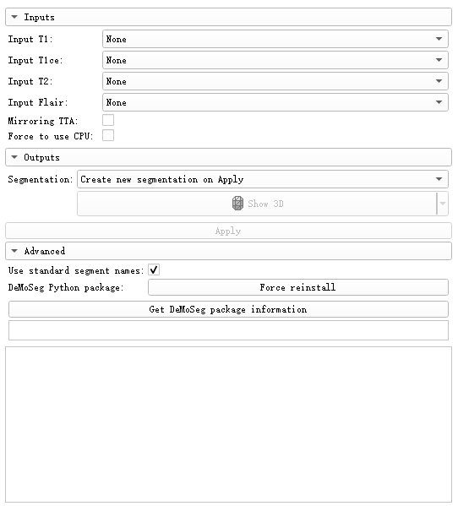
3.Interface Introduction
Input Volume
Output Volume
Package Install

Slide 5
4.1 Application-Package Install
First-time use of BTD requires installation of packages like torch：
1.click: Force reinstall
2.restart: 3D Slicer

Slide 6
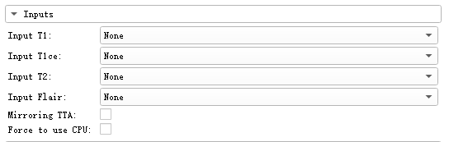
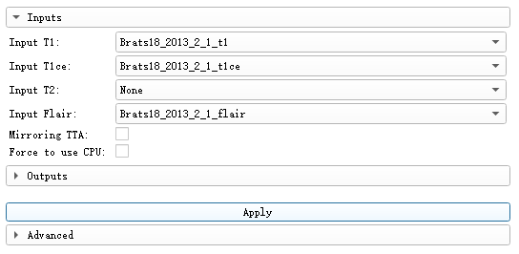
4.2 Application-DeMoSeg
If any modalities are missing, set as None
Testing Time Augmentation
Force to use CPU
If T1, T1ce and FLAIR are present, T2 is missing:
1.set each modality
2.click Apply button

Slide 7
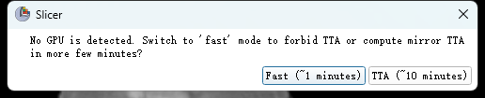
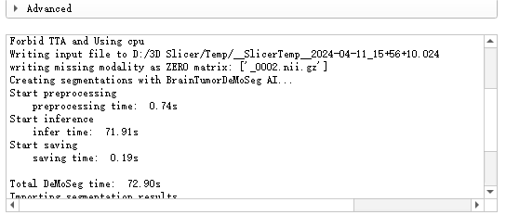
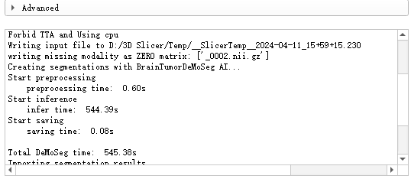
4.2 Application-DeMoSeg
If require TTA but CUDA is unavailable:
1.Forbid TTA
2.Still TTA
Forbid TTA
Still TTA

Slide 8
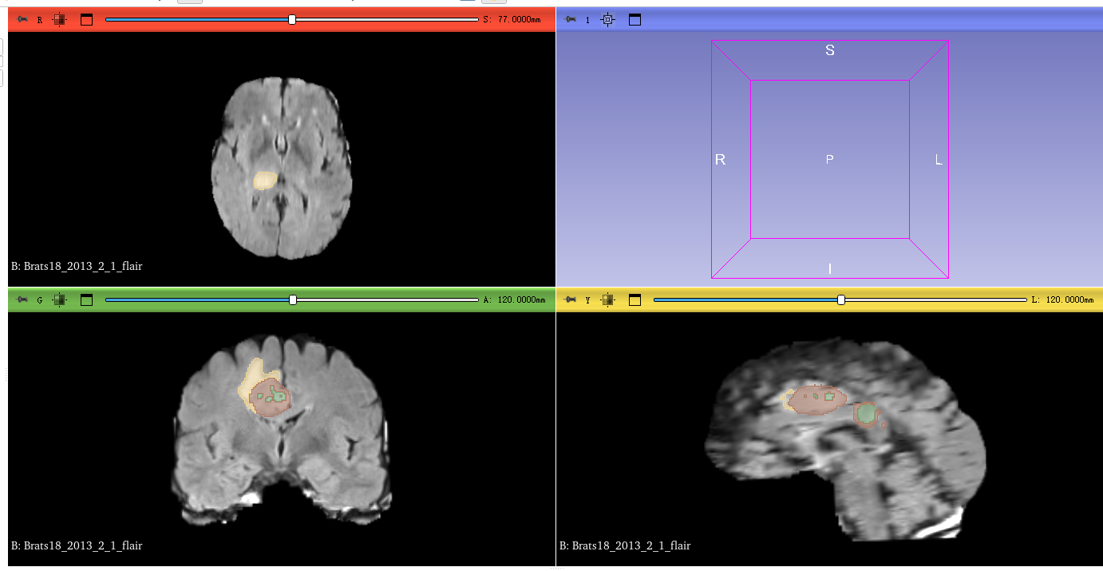
4.3 Application-Postprocess
Use Segmentation and other Tools in 3D Slicer to postprocess and save segmentation.

