Slide 1
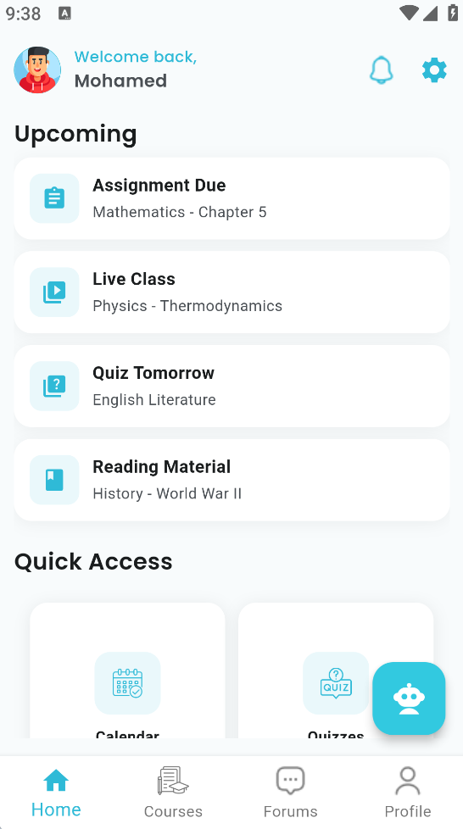
BNU LEARNING
MANAGEMENT SYSTEM
CampusConnect is a cutting-edge mobile-first Learning Management System designed to streamline academic processes for both students and instructors, offering a seamless and intuitive experience.
CampusConnect aims to set a new standard for academic platforms by focusing on user-centric design and robust software principles through:
• Prioritizing accessibility and functionality on handheld devices.
• Integrating all academic functions into one solution.
• Delivering timely and relevant alerts to keep users informed of any changes.

