Slide 1
N-Body Simulation
Kuan Chen, Yisi Lu, Qingqing Li
Advisor: Prof. Martin Herbordt

Slide 2

I Want to see how the stars move
We have N-Body Simulation!
It simulates a dynamic system of particles under forces such as gravity

Slide 3
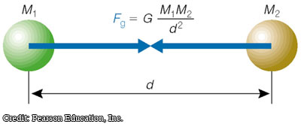
Usage of N-Body Simulation
Investigate the evolution of few-body systems such as Earth-Moon-Sun system
Study the dynamic evolution of star clusters
Force Calculation:

Slide 4
Methods for N-Body Simulation
Brute Force
Calculate every forces among bodies
O(n^2)
Barnes-Hut Simulation
Create a Quad Tree
Calculate Mass, Force and Position
O(nlogn)

Slide 5
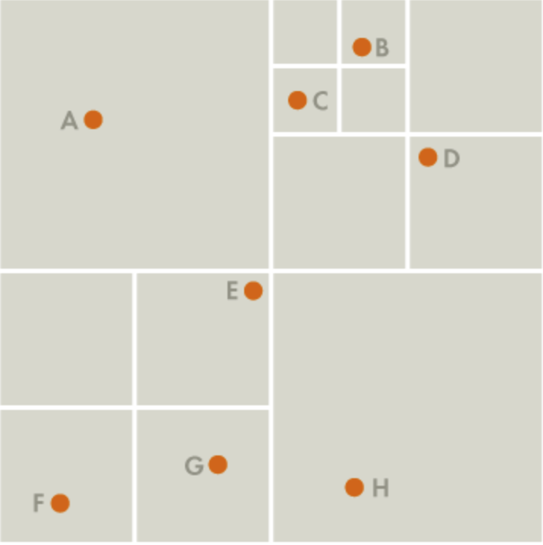
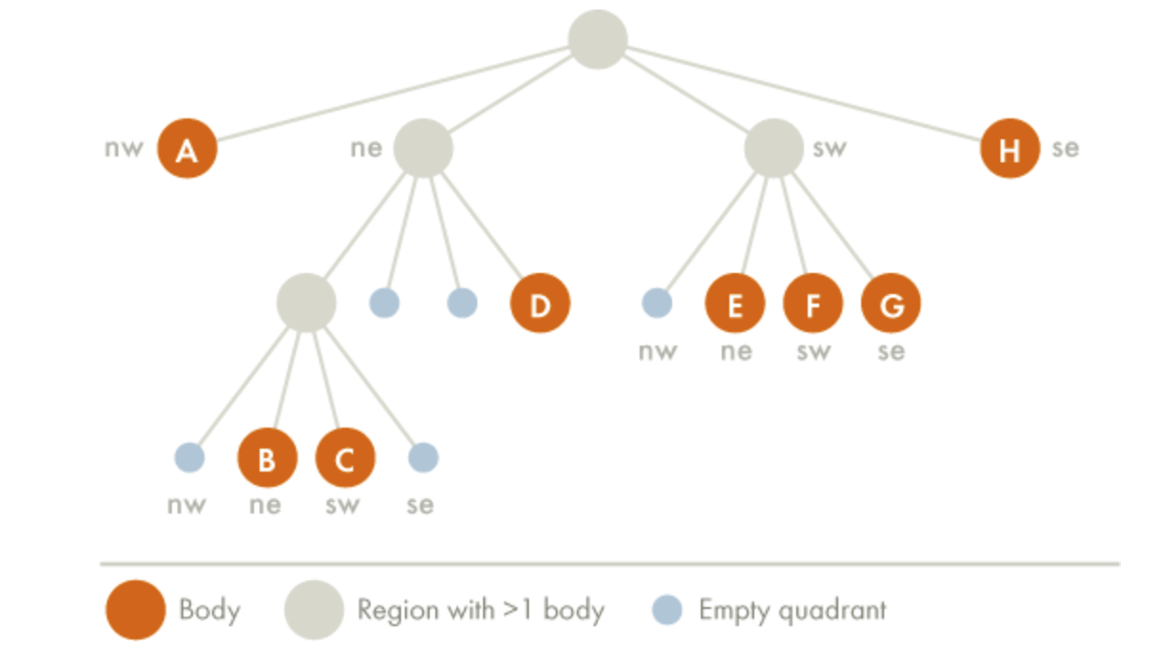
Quad Tree Creation

Slide 6
Simulation Time
Preliminary Results:
Future Work:
GPU Implementation of this algorithm

Slide 8
Thank You!
Any Questions?

