Slide 1

Steelcase Practicum – Midterm Report
Project 1 – Group 2 (Answer Group 1)
Maryam Rahmanpour
Krishna Kumar Ganesh
Chhavi Kadian

Slide 2
Problem Statement
Project 1 - Answer Components Value Stream out of Athens Plant, Alabama
Build a model which predicts the likelihood of certain quality defects in Answer Components value stream to help improve our quality performance.

Slide 3
Expected Outcome
Identify which manufacturing related defects to focus on​
Identify which product lines from this value stream can be targeted​
Determine factors that have a detrimental impact on quality​
Develop a predictive model to detect high risk orders​
Develop execution strategy for Operations​
Provide feedback on what can be changed in how we collect data to better facilitate data science projects​

Slide 4

Project Approach
Analyze the given data
Establish CTQs
Develop the predictive model
Identify top defects
Identify key product lines from the value stream

Slide 5

Project Approach
Analyzing the given data
Identify top defects to focus on
Finding the defects with most frequency
Exploring any possible seasonal trend overall and for each defect type
Using Explanatory Data Analysis (EDA) tools to have a better understanding of each feature.
Correlation analysis between defects and other features
Finding most costly defects using any other possible data

Slide 6

Project Approach
Finding the product line with highest defect frequency (ratio) through EDA
Find top 3 cause code for each product line to focus on
Applying feature selection methods to find factors with most detrimental impact on quality
Develop the predictive model
Find the best model to predict high risk orders, Some candidate models are binary classification, Logistic regression
Further digging into additional models like one class classification(anomaly detection), Autoencoder, down sampling or grouping data into subgroups
Identify key product line
Establish CTQs
Conducting correlation analysis

Slide 7
Datasets Provided
Datasets were provided primarily in parquet and csv format, except for the Defects Report file which is an Excel document.
Dataset1 – This dataset contains all sales order details for the last 3 years. (Volume - around 7.5 million rows).
Dataset2 – This dataset contains some extended columns not already available on the Dataset1. (Volume - around 3.3 million rows)
Dataset3 – This dataset contains information about materials used for the sales orders. This dataset is mostly metadata about materials and not an order-to-material mapping. (Volume – around 2.5 million rows)
Dataset4 – This dataset contains information about parcels and related metadata around parceling. (Volume – around 3 million rows)
Defects Report – This is the primary driver file for this project. This file is in excel format and has multiple attributes associated with a defect that has been reported on a sales order.

Slide 8

Progress so far…
Performed exploratory data analysis on all the files.
Derived some insights to be used in modeling efforts.
Shortlisted few features from the defect dataset which can be filtered by the sales order (eg: product line can be used to filter all sales orders which fall within a specific product line). More features to be identified.
An active feedback loop was in place between our team and the Steelcase team through Microsoft Teams, providing us a platform to bring up questions and have our doubts clarified.
Wrap up additional data analysis tasks as newer information about the dataset is made available from the Steelcase team last week.
Tools Used – Spyder, Jupyter, Heat map using Cramer’s V association, Word cloud on text data from customer comments, Sweetviz visualizations, Ad-hoc analysis

Slide 9

Findings
The following slides share some insights on certain attributes and subsets of orders which might be more susceptible to defects.

Slide 10
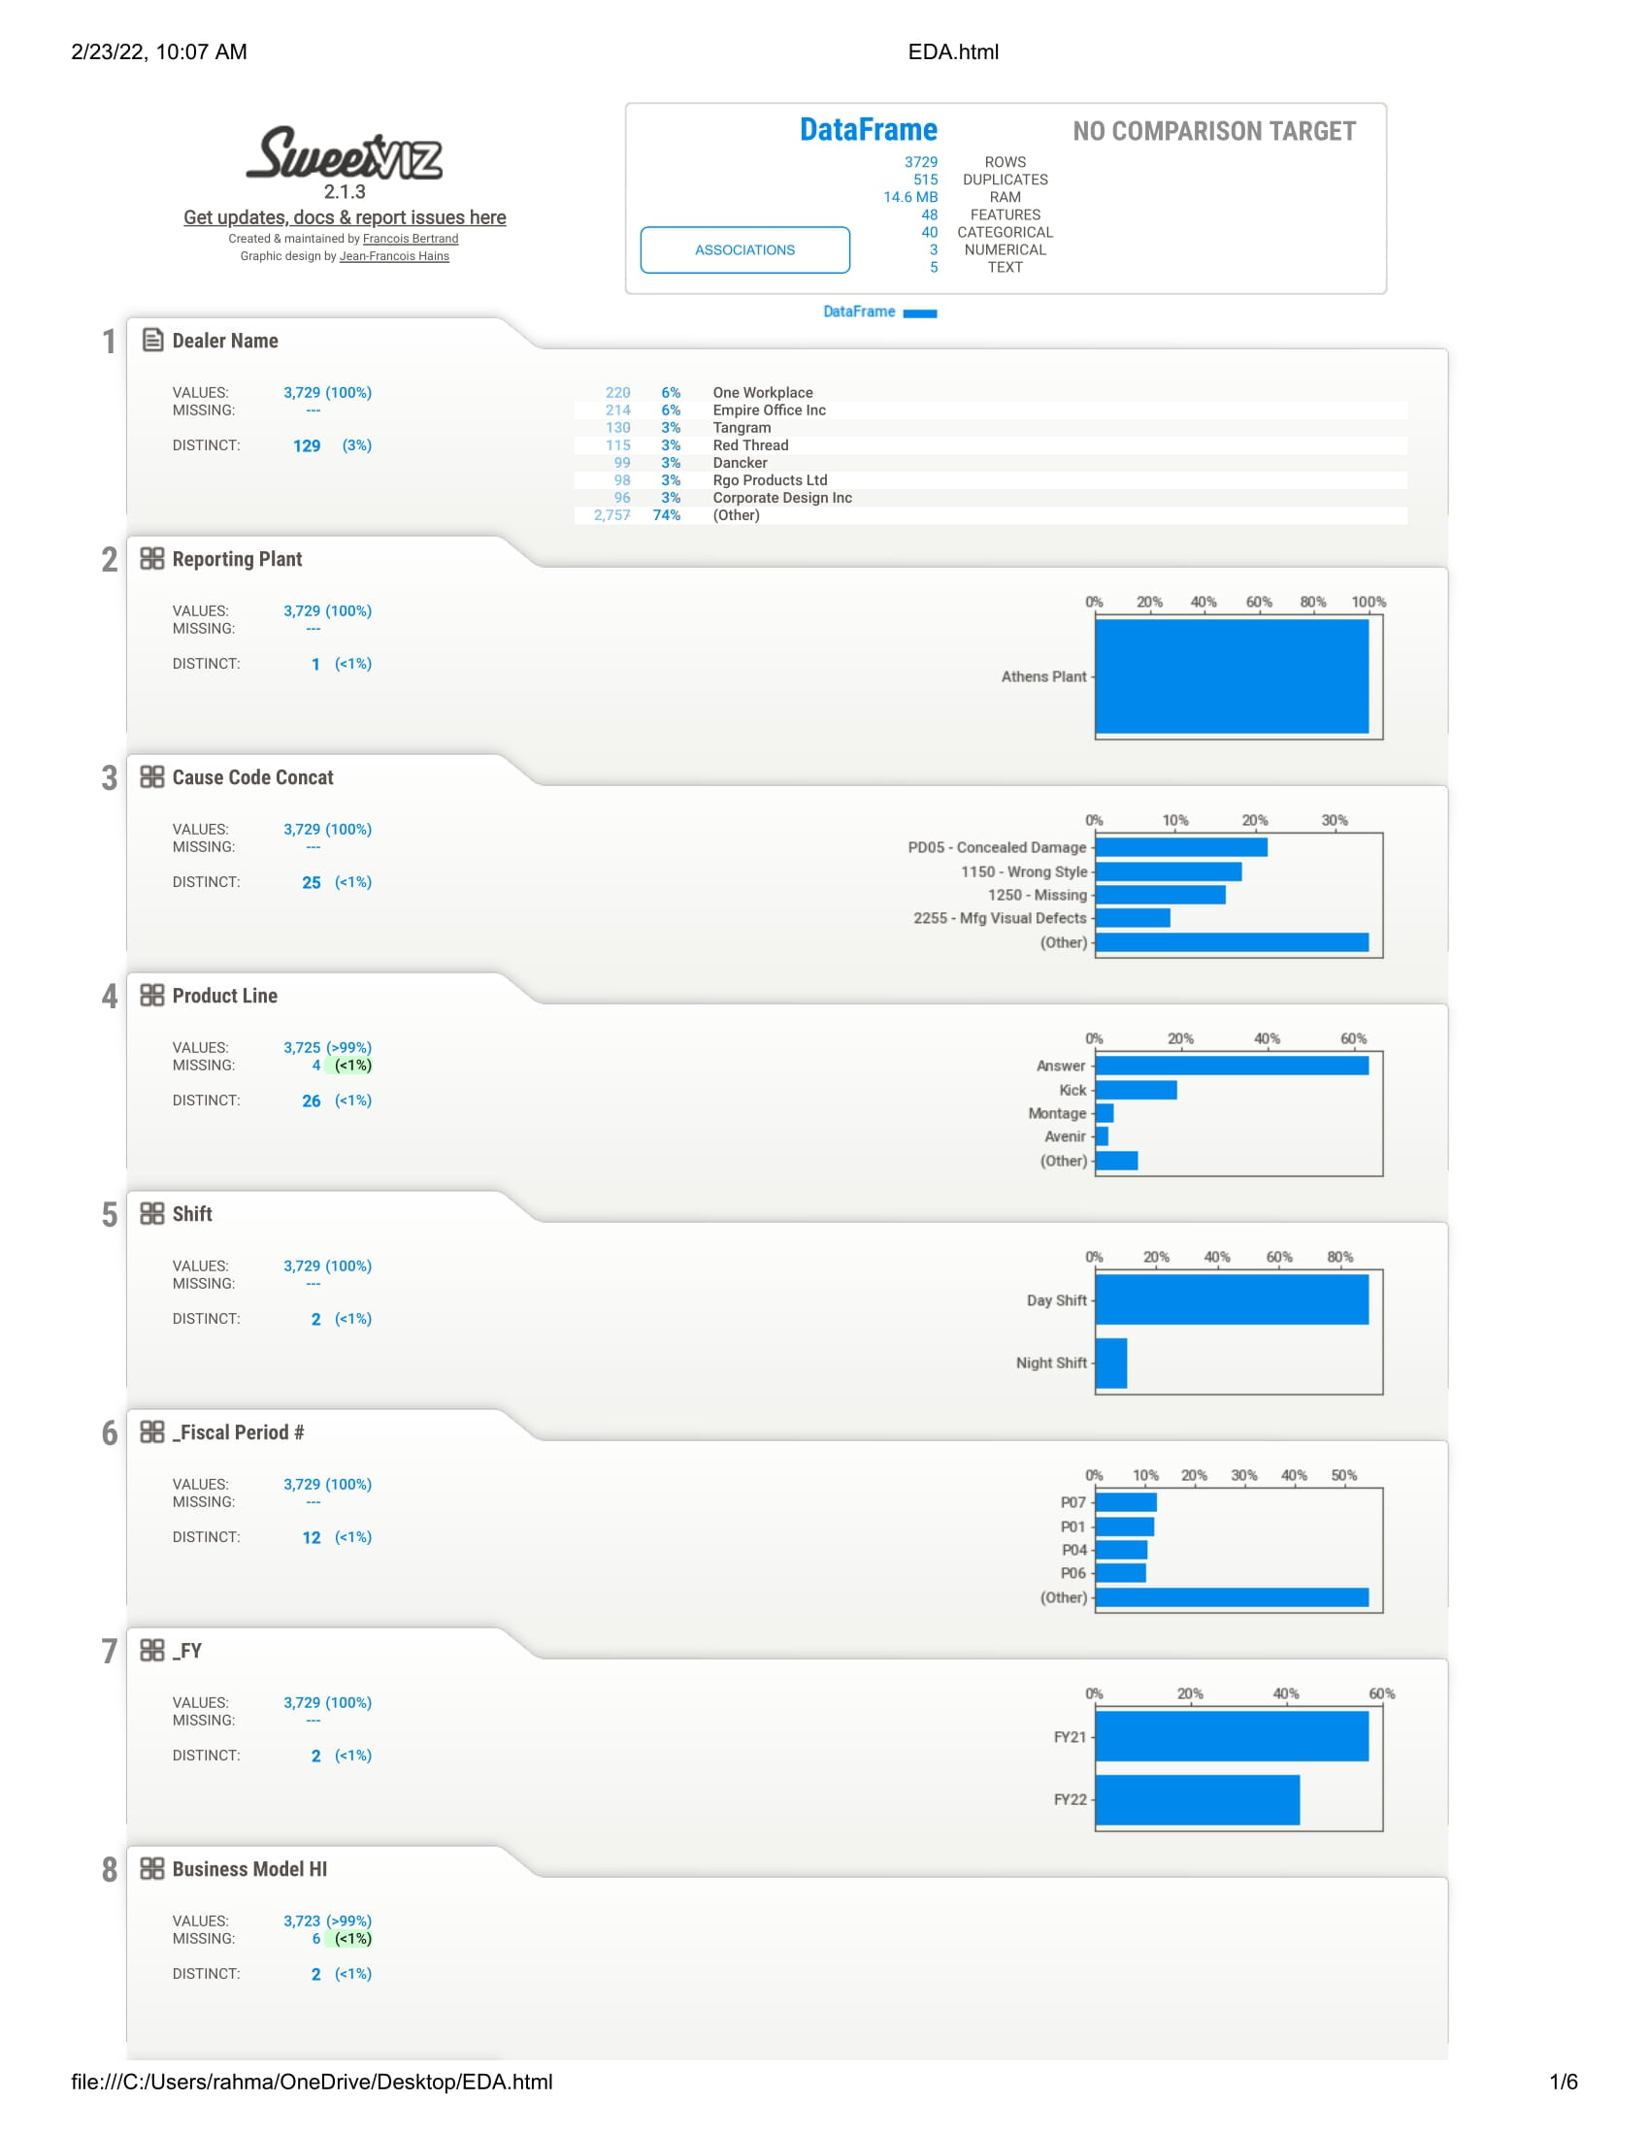
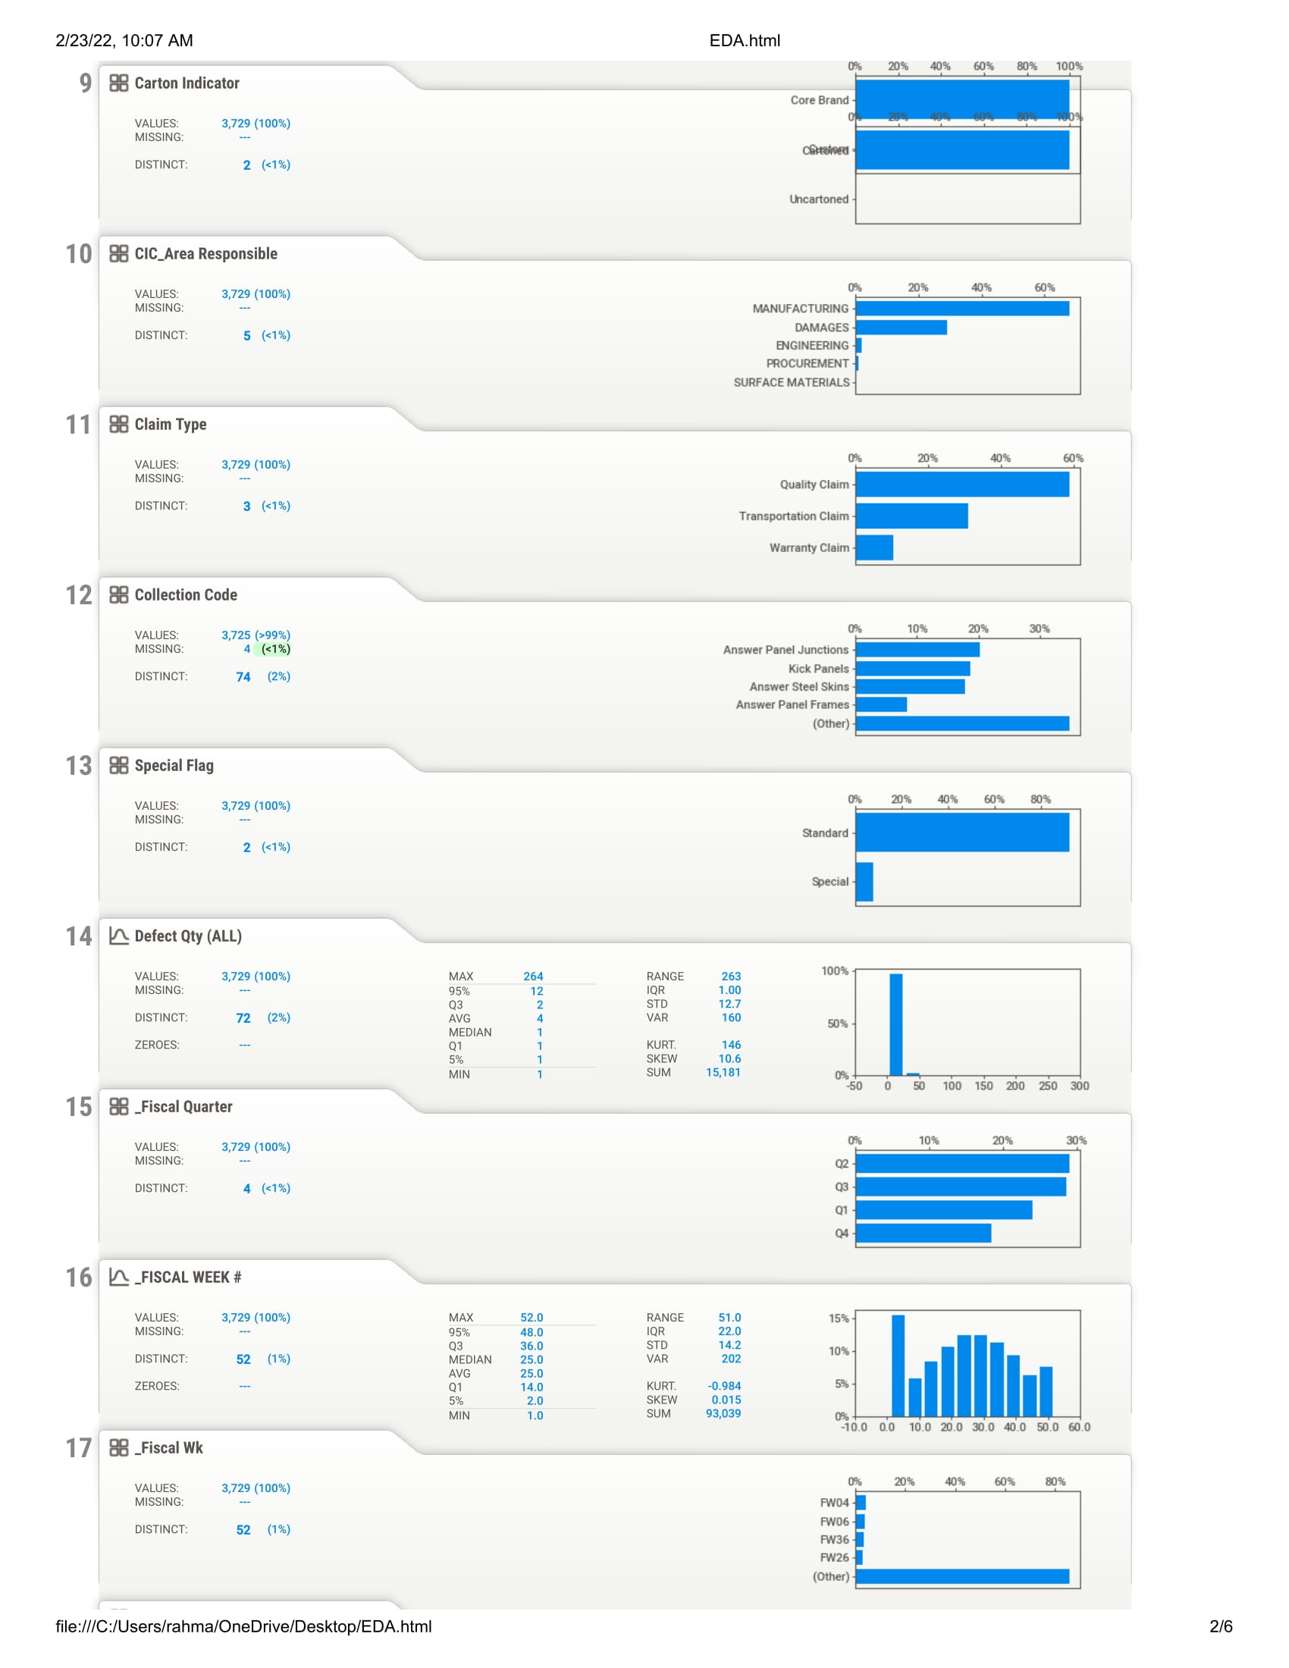
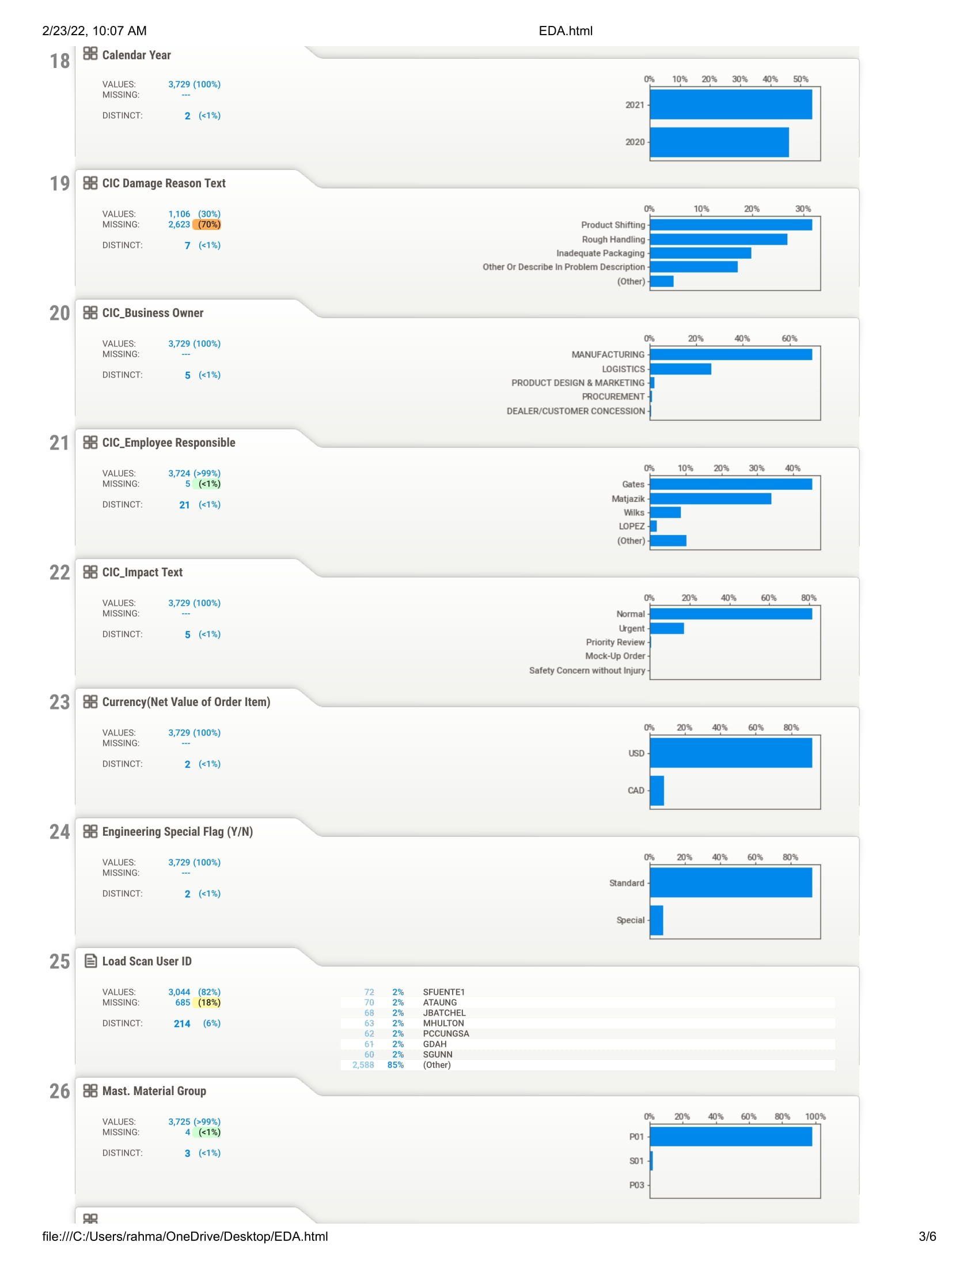
EDA_Sweetviz

Slide 11
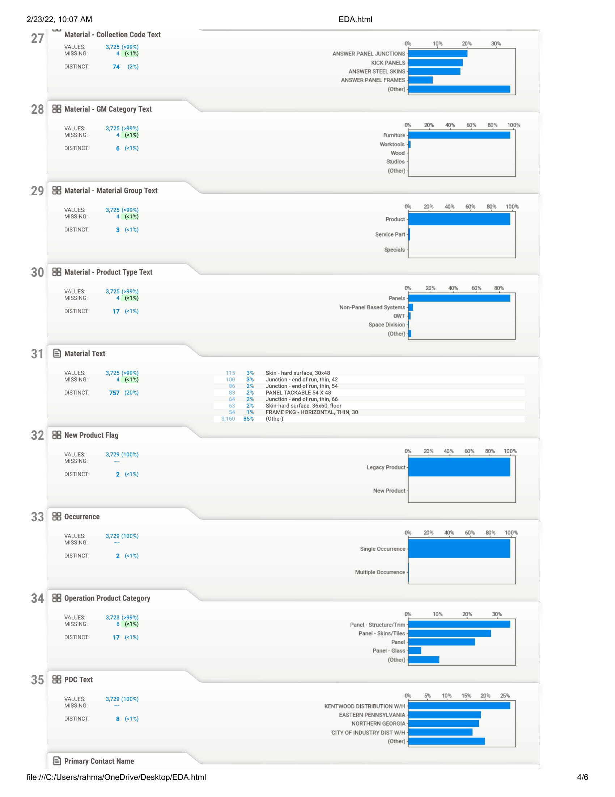
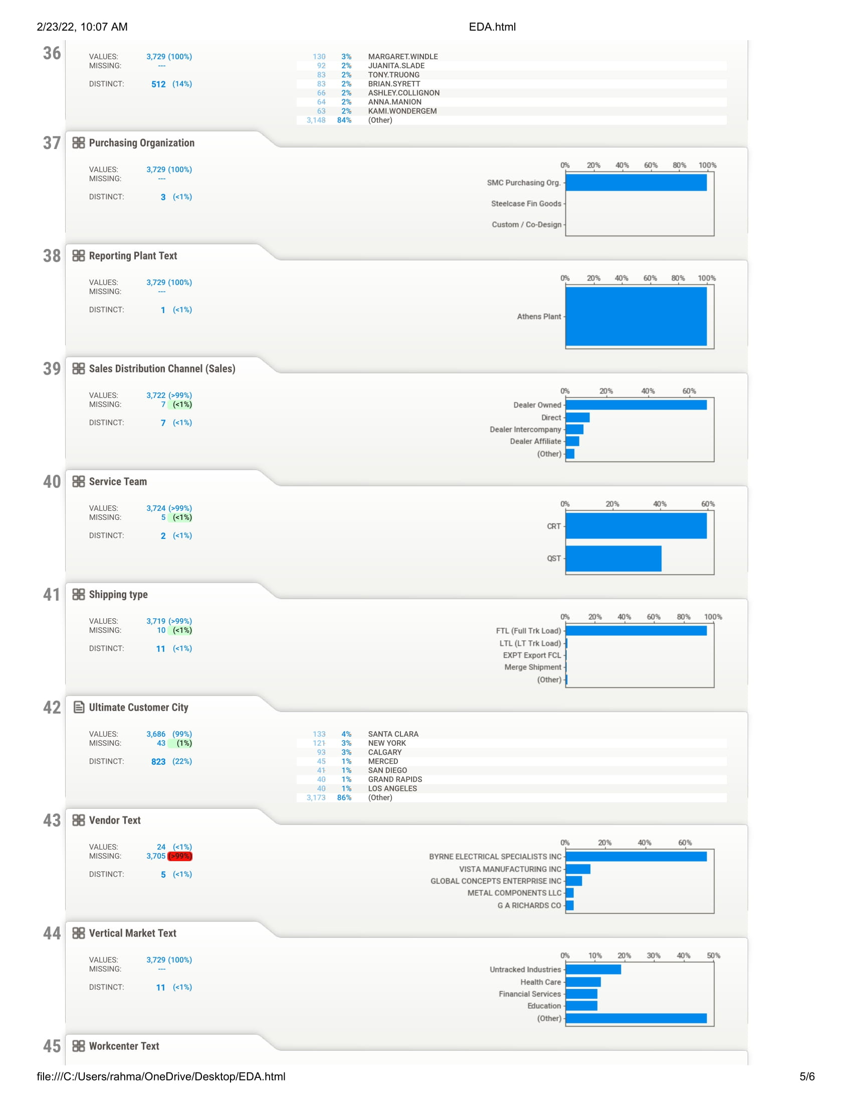
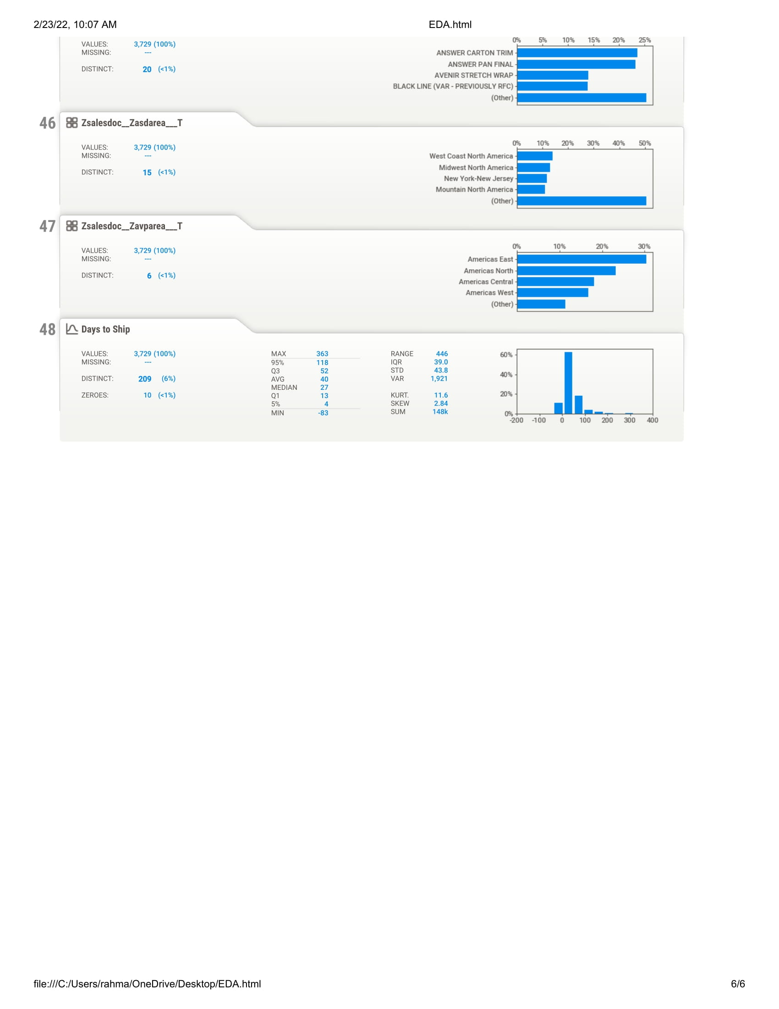
EDA_Sweetviz

Slide 12
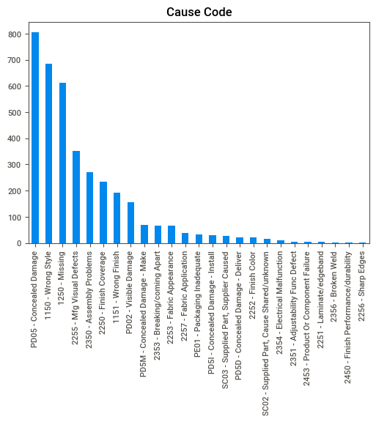
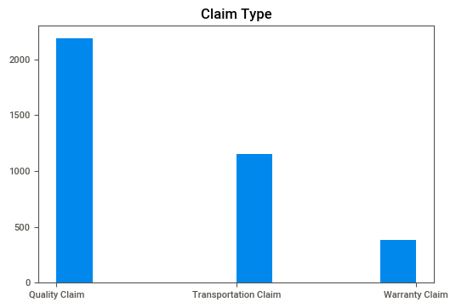
Data Analysis
Most frequent type of claims - "Quality claim”
Top defect types - Concealed damage, wrong style, and missing

Slide 13
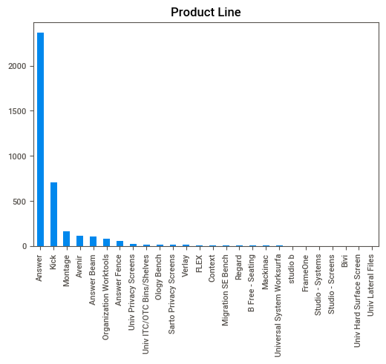
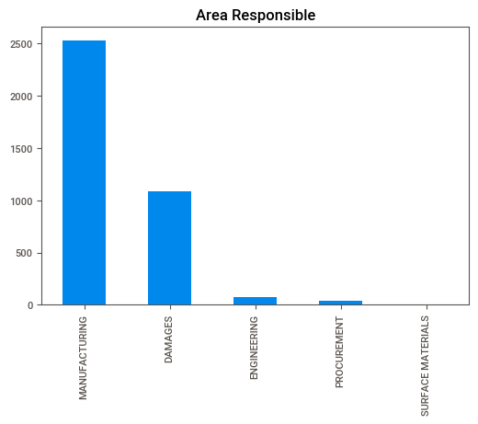
Data Analysis
Note: It is important to note that these results are from Defects file. They can give better insight if compared against the sales volume of each type .
Top product lines – Answer, Kick, Montage
Top areas responsible – Manufacturing and Damages

Slide 14
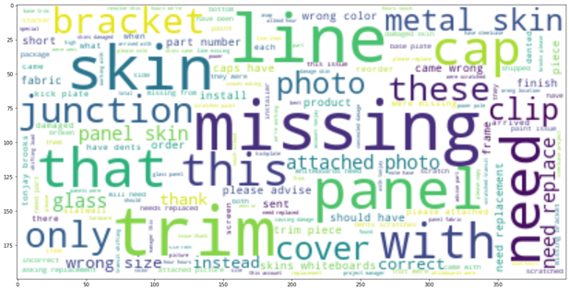
EDA - Word Cloud
Word cloud was created to identify any patterns that might emerge from the customer complaints using customer feedback from a user input field on the claims form. Certain word fillers were removed i.e., like, and, if, they, etc. to eliminate any possible noise.
Most mentioned keywords – Missing, skin, panel, trim
Other key words that showed up like line, bracket etc. seem to be parts specific to certain products that are being shipped. We have requested Steelcase to share the parts which get shipped along with different products so that we can identify if certain products are more prone to defects vs others. This would also be a feedback loop into the manufacturing and packaging process to incorporate stricter controls over parts being packaged.
We also plan to use this info to lookup the sales orders that correspond to these defects and pull effective features from the sales order metadata for our predictive modeling purpose.

Slide 15
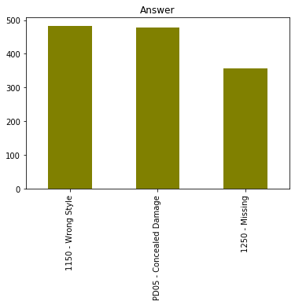
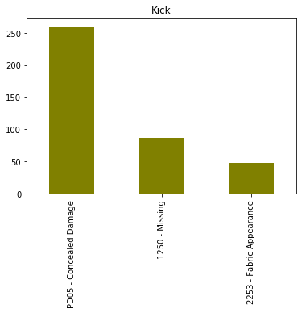
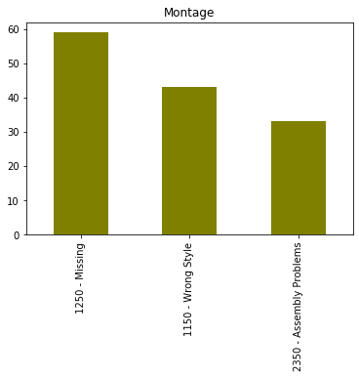
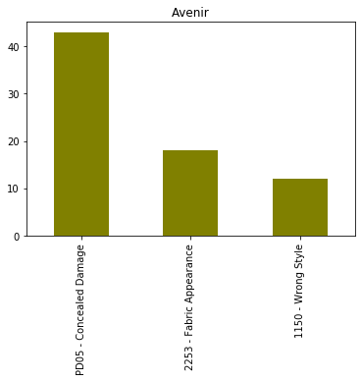
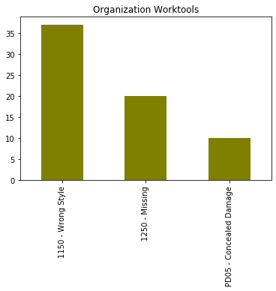
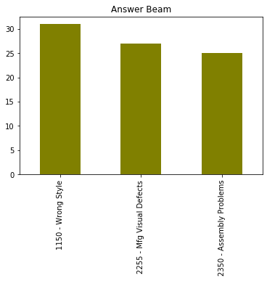
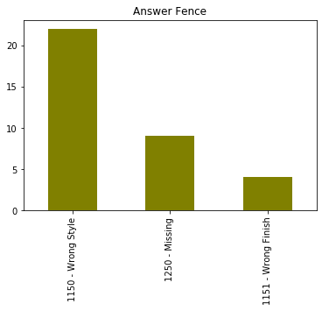
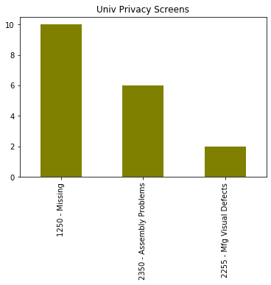
The following charts show 8 product lines with most defects and for each product line and their associated top 3 cause code. Between them, there are more defect claims for "Answer" and "Kick" product lines. Still need to compare the portion of defects for each product line based on sales data. The complementary analysis will be conducted after joining two "defects" and "sales" data.

Slide 16
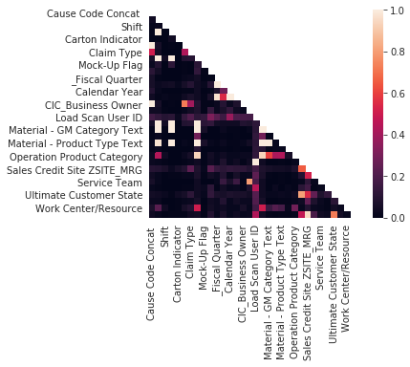
The Cramer's V (also known as Cramer's φ) is a measure of association between two nominal variables, giving a value between 0 and +1 (inclusive).
Heat Map
The heat map is mostly black and indicates there is no strong correlation between different features. Finding an association between "Cause code Concat" and any other feature could be informative for this project. The table shows the highest value of Cramer's v measure for this feature.
 | Cause Code Concat
Cause Code Concat | 1
CIC_Area Responsible | 1
CIC_Business Owner | 1
Claim Type | 0.51
Load Scan User ID | 0.17
Special Flag | 0.11
Sales Credit Site ZSITE_MRG | 0.1

Slide 17

Next steps
EDA
Analyze and extract features from sales orders leading to defects.
Feature Extraction and Modeling
One-hot encoding
Feature selection
Logistic Regression
Binary Classification
Random Forest
Autoencoder
Tools and technologies
Feature extraction and training regression models using Spyder and Jupyter notebooks.
Azure Databricks and in-built MLFlow

Slide 18
Project Timeline
Complete Data Analysis
Feature Extraction & Feature selection
Develop & train different models
Test model accuracy
Predict high risk orders
Executive suggestions
Final report
March 10
April 7
April 21
March 4
March 24
April 14
April 21

