Slide 1
MAAI901 · Applied Vision Transformer Report
When Labels Are Scarce: Fine-Tuned vs Frozen CLIP for Steel Defect Classification
How many labelled images per defect does a vision transformer really need?
Karthik Krishna · 1697286
University of Wollongong in Dubai · Dr. Milan Dordevic
Notes:
(about 20 seconds) Steel plants do not have big labelled defect archives. My question: how many labelled images per defect type does a vision transformer need, and is full fine-tuning worth its cost over frozen features? I answered it with real experiments on the NEU steel defect dataset, and I tested more than accuracy.

Slide 2
Defects are rare, so labelled images are the scarce resource
Question
As labelled images per class shrink from 240 to 1, which way of adapting a pretrained ViT works best, and what does accuracy hide?
Data
NEU surface defects: 1,800 grayscale images, six defect types, 300 each. Very homogeneous, so it saturates near 100%.
5-fold
1 to 240
cross-validation, 1,800 test predictions
labels per class (8 budgets)
5
0
methods, same splits and seeds
settings tuned on test images
Why it matters in the UAE: AI is a national priority, and manufacturing inspection needs data-efficient, trustworthy models.
Notes:
(about 35 seconds) Defects are rare, labels need experts. NEU has 1,800 images, six defect types. I used five-fold cross-validation, so every image is tested once, from 1 to 240 labelled images per class. Hyper-parameters were fixed before looking at test results. One honest point up front: this dataset is very uniform, every test image has a near-twin in training, so I focus on small label counts and on tests beyond accuracy.

Slide 3
Five ways to use a pretrained transformer, compared on identical splits
Zero-shot CLIP
Frozen CLIP + LR
Partial fine-tune
Full fine-tune
ImageNet ViT
No training
3k parameters
about 15M parameters
about 86M parameters
about 86M parameters
Text prompts only
Linear classifier on frozen features
Last 2 of 12 blocks
CLIP ViT-B/16, all weights
Reference, other pretraining
Measured: accuracy, log-loss, calibration error, confident mistakes, rare-defect recall, unseen-defect AUROC, blur and noise robustness.
Compared: paired differences with 95% intervals across folds; frozen baseline also tuned fairly on validation images.
Notes:
(about 35 seconds) Five methods. Zero-shot CLIP uses only text prompts. Frozen CLIP trains only a tiny linear classifier. Partial fine-tuning trains the last two blocks, about 15 million parameters. Full fine-tuning updates all 86 million. An ImageNet pretrained ViT is the reference with different pretraining data. I measured seven things, not just accuracy, and I tuned the frozen baseline fairly, because an untuned baseline would flatter fine-tuning.

Slide 4
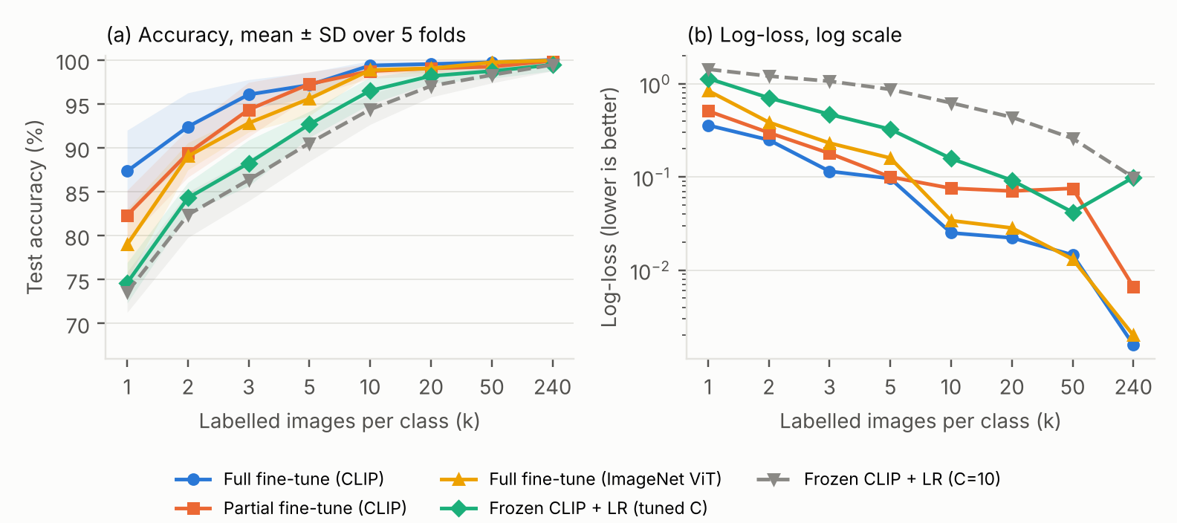
Fine-tuning wins with few labels, and the gap closes by about 50
3 labels
per class: full fine-tune reaches 95% (tuned frozen: 10)
+12.7 pts
at 1 label vs tuned frozen (95% CI 8.4 to 17.1)
about 1 pt
Partial fine-tuning is 5 and 3 points behind full at 1 and 2 labels, then equal. CLIP beats the ImageNet ViT only at 1 label (+8.4 pts).
difference from 50 labels on; interval includes zero
Mean over 5 folds, shaded band is one SD. Intervals are approximate because folds share training images.
Notes:
(about 40 seconds) Main result. Full fine-tuning of CLIP is best at every budget. At one label per class it is 12.7 points ahead of properly tuned frozen features, with an interval that excludes zero. It reaches 95 percent with 3 labels per class; tuned frozen features need 10. By 50 labels the difference is about one point and not reliable. So the answer to my question depends on label budget: with a handful of labels, fine-tune; with plenty, a tuned frozen encoder is nearly as good at a fraction of the cost.

Slide 5
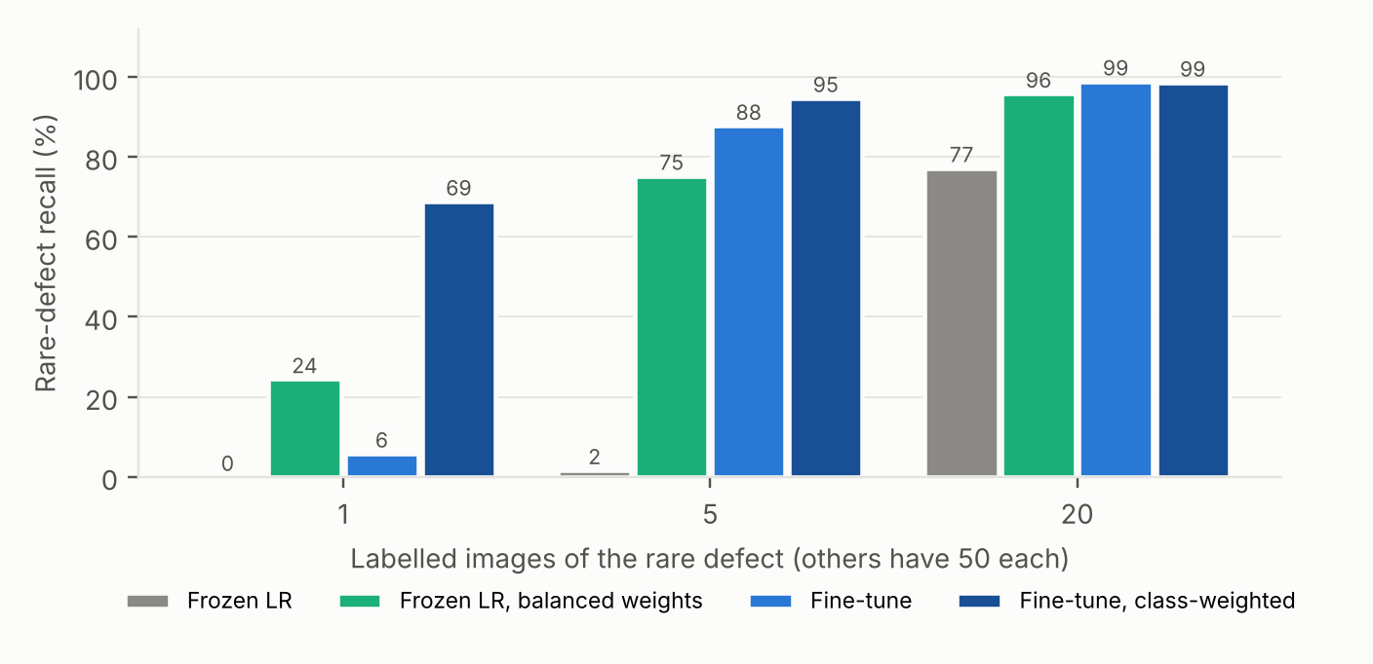
Beyond accuracy: rare defects, unseen defects and confident mistakes
69% vs 6%
rare-defect recall at 1 example: class-weighted vs plain fine-tuning
0.963 vs 0.866
AUROC for spotting a never-seen defect: fine-tuned vs frozen
Recall for a rare defect with 1, 5 or 20 labelled examples (others have 50)
22%
Good average calibration does not make a confident prediction trustworthy.
of the fine-tuned model's errors at 1 label are made with 90%+ confidence
Notes:
(about 40 seconds) Three findings beyond accuracy. First, rare defects: with one labelled example, plain fine-tuning finds only 6 percent; class weighting lifts that to 69 percent, so weight your classes. Second, a defect type never seen in training: fine-tuned CLIP separates it best, AUROC 0.96 versus 0.87 for frozen features. Third, a warning: although fine-tuned models are well calibrated overall, 22 percent of their mistakes at one label are made with more than 90 percent confidence. For a factory, that is the failure that matters.

Slide 6
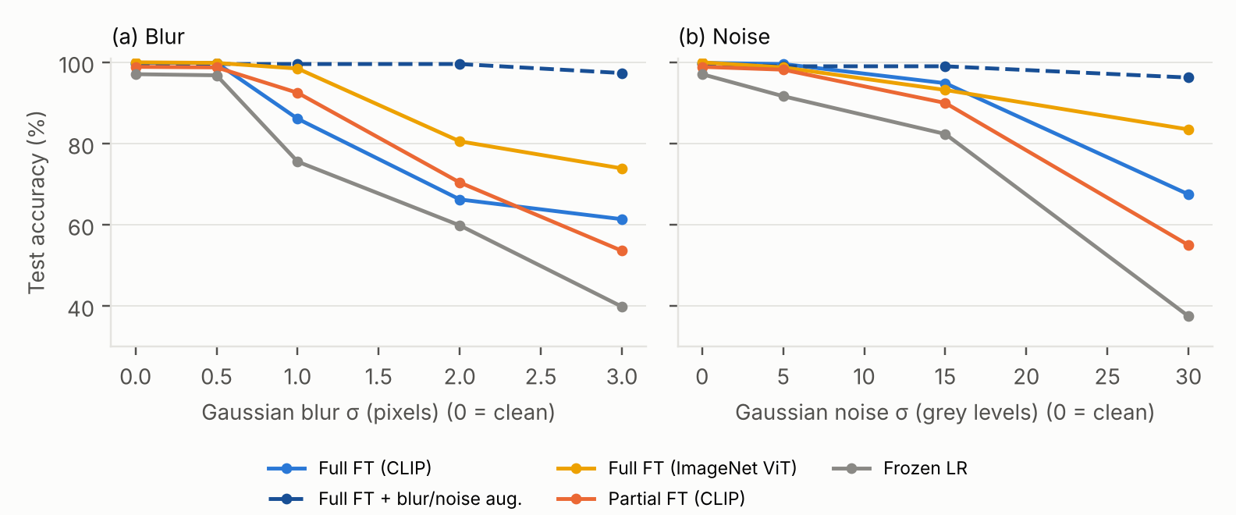
Robustness is not automatic, and deployment needs human oversight
Ethical and societal points
Human review of low-confidence and novel items; log every decision
Revalidate on each plant: one lab, one camera here
No people in the images; cameras on a shop floor would bring data-protection duties
Assist inspectors rather than replace them; the UAE AI strategy flags manufacturing for automation
Fine-tuning costs far more compute than frozen features
Heaviest blur: 61% (fine-tuned CLIP) to 97% with blur and noise augmentation. The gain applies only to distortions seen in training; brightness got slightly worse.
Notes:
(about 35 seconds) Clean accuracy hides fragility. Under heavy blur or noise, accuracy falls to between 40 and 74 percent. Training with blur and noise augmentation fixes those two, up to 97 percent, but it does not fix everything: strong brightening got slightly worse, so this is protection against what you trained for, not general robustness. On ethics: keep a human in the loop for uncertain and novel items, revalidate on every plant, keep responsibility with the quality team, think about data protection if cameras capture workers, and note the compute cost of fine-tuning.

Slide 7
Conclusions and what comes next
Few labels (1 to 5)
Many labels (50+)
Always
Fully fine-tune CLIP; use class weights for rare defects
A tuned frozen encoder is within about 1 point at a fraction of the cost
Check calibration, confident errors, novel defects and corruptions, not just accuracy
Limits
Future work
One homogeneous dataset; saturates above 50 labels
360 test images per fold; some tests use one fold
No convolutional baseline
A second dataset such as GC10-DET or X-SDD
Detection instead of classification; plant and camera shift
Parameter-efficient fine-tuning, calibrated abstention
Code, results and report: GitHub repository (link in the report)
Notes:
(about 35 seconds) Take-aways. With one to five labels per class, fully fine-tune a CLIP transformer, and weight rare classes. With 50 or more labels, a tuned frozen encoder is almost as good at much lower cost. Whatever you choose, check calibration, confident errors, novel defects and corruptions rather than accuracy alone. The limits are a single homogeneous dataset and few folds for some tests. Next: a more varied dataset, detection instead of classification, and testing across plants and cameras. Thank you; I am happy to take questions.

