Slide 1



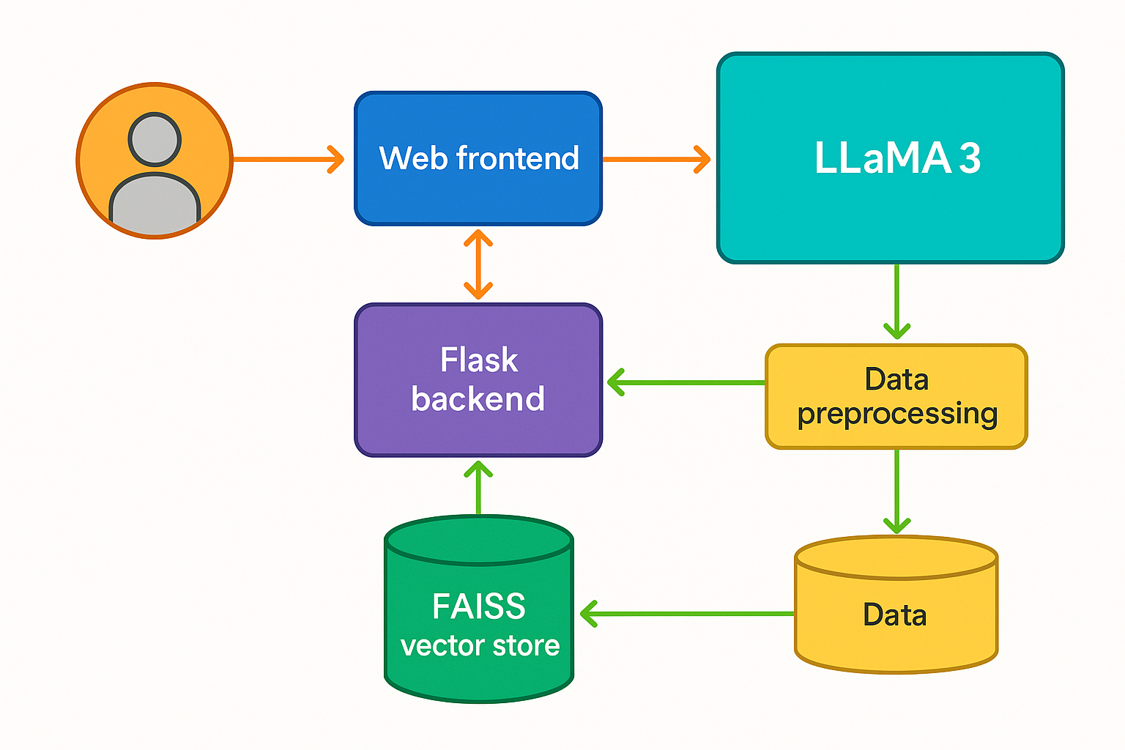
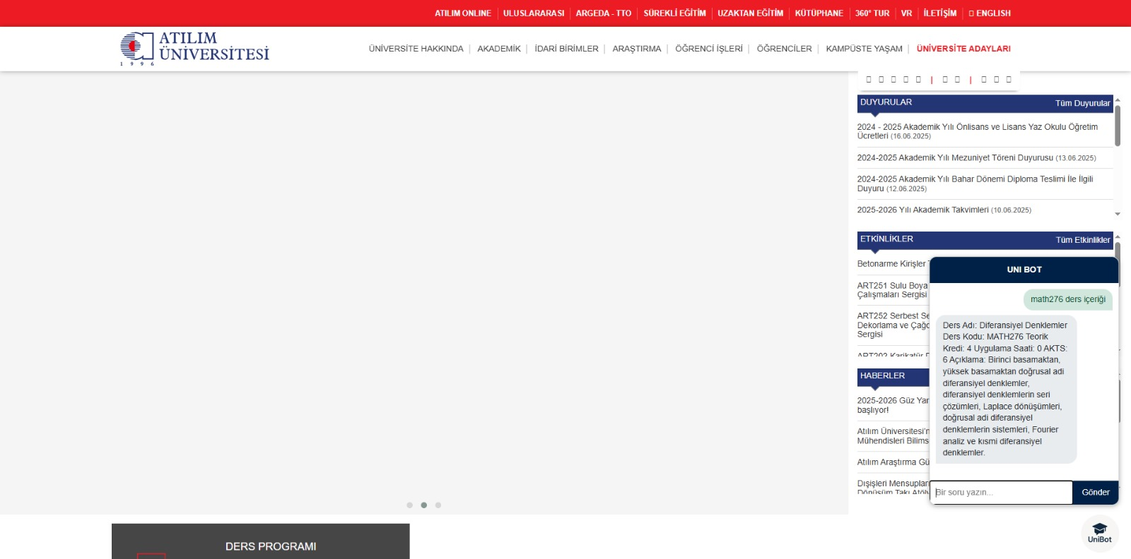




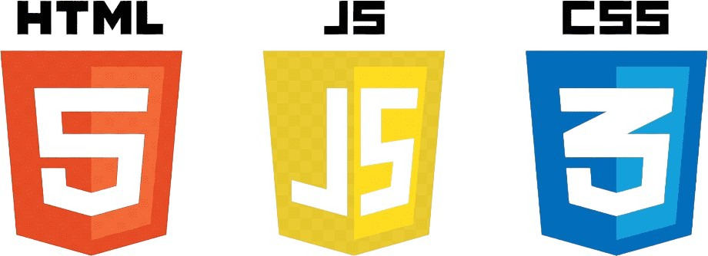
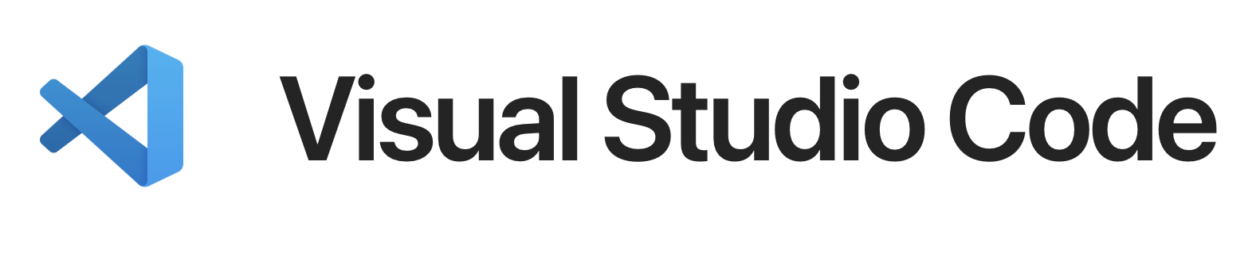



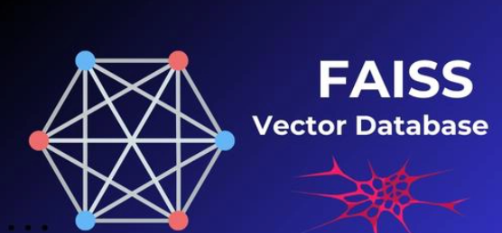
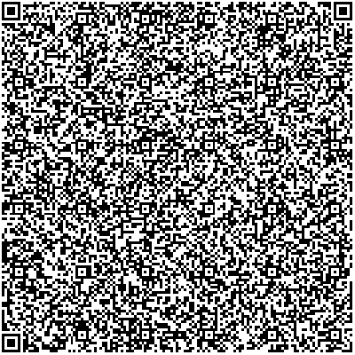
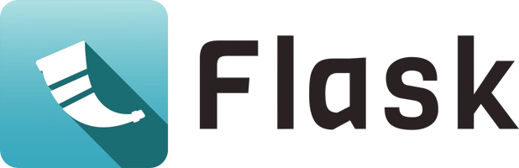
Supervisor Asst. Dr. Üyesi Ercan Selçuk BÖLÜKBAŞI
CMPE/ISE/SE 494 Senior Project
UUNIBOT
Team
Design and Architecture
Interfaces
Şamil YILDIRIM
Kaan TURAN
Altuğ Paşa BAL
Tayfun ZORBOZAN
Orhan Dinçer ÖZER
Objective
Unibot uses university data and artificial intelligence to develop an application that provides university information to Atılım University students, employees and anyone who visits the Atılım website from outside.
Application Areas
Methods/Tools
Conclusion
UniBot helps students access course schedules, curriculum, Bologna information, academic staff, secretarial contacts, and communication details. It works in integration with university portals to present academic and administrative information in one place. With its user-friendly design, UniBot makes accessing university resources faster and more efficient.
UniBot improves student experience by centralizing essential academic and administrative information in one accessible platform. It reduces confusion, saves time, and helps students navigate university life more efficiently through a smart, AI-powered assistant.
References

