Slide 1

Analyzing and Recording Transactions
Chapter
2
Notes:
1
1
1
1
1

Slide 2


Analyzing and Recording Process
Exchanges of economic consideration between two parties.
External Transactions occur between the organization and an outside party.
Internal Transactions occur within the organization.

Slide 3



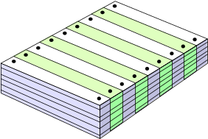
Analyzing and Recording Process
Analyze each transaction and event form source documents
Record relevant transactions and events in a journal
Prepare and analyze the trial balance
Post journal information to ledger accounts

Slide 4

Source Documents
Checks
Bills from Suppliers
Purchase Orders
Employee Earnings
Record
Bank Statement
Sales Tickets

Slide 5
The Account and its Analysis
An account is a record of increases and decreases in a specific asset, liability, equity, revenue, or expense item.
The general ledger is a record containing all accounts used by the company.

Slide 6

The Account and its Analysis
Assets
Accounts
Liabilities
Accounts
Equity
Accounts
=
+

Slide 7
Asset Accounts
Cash
Land
Accounts Receivable
Asset
Accounts
Buildings
Notes Receivable
Equipment
Prepaid Accounts
Supplies

Slide 8
Liability Accounts
Accounts Payable
Notes Payable
Liability
Accounts
Accrued Liabilities
Unearned Revenues

Slide 9
Equity Accounts
Owner’s Capital
Owner’s Withdrawals
Equity
Accounts
Revenues
Expenses

Slide 10
The Account and its Analysis
Assets
=
Liabilities
+
Equity
+
–
+
–
Owner’s Capital
Owner’s Withdrawals
Revenues
Expenses

Slide 11
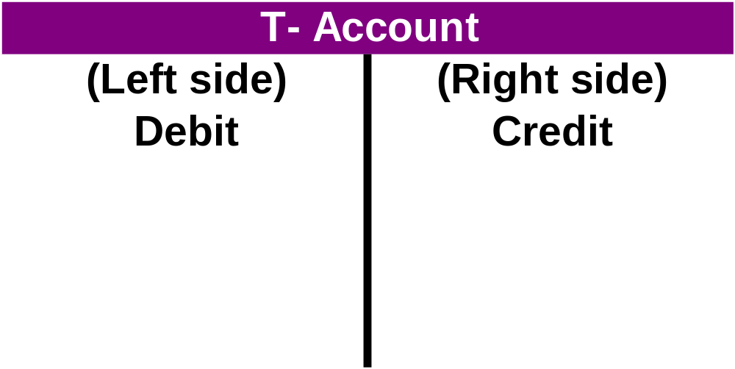
Debits and Credits
A T-account represents a ledger account and is a tool used to understand the effects of one or more transactions.

Slide 12
Double-Entry Accounting
=
+
Assets
Liabilities
Equity
ASSETS
LIABILITIES
EQUITIES
Debit Credit
Debit Credit
Debit Credit
+ -
- +
- +

Slide 13
Double-Entry Accounting
Exh.
3.8
Equity
_
_
Owner’s Capital
Owner’s Withdrawals
+
Revenues
Expenses
Capital
Withdrawals
Revenues
Expenses
Debit Credit
Debit Credit
Debit Credit
Debit Credit
- +
+ -
- +
+ -

Slide 14
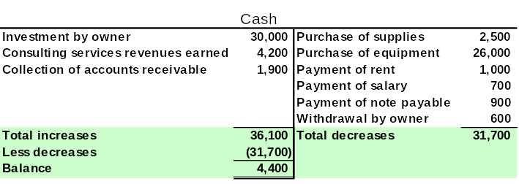
Double-Entry Accounting
An account balance is the difference between the increases and decreases in an account.

Slide 15

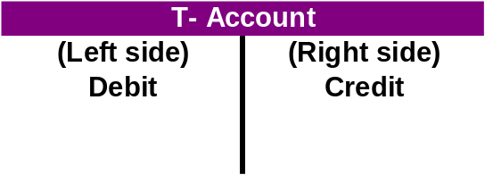
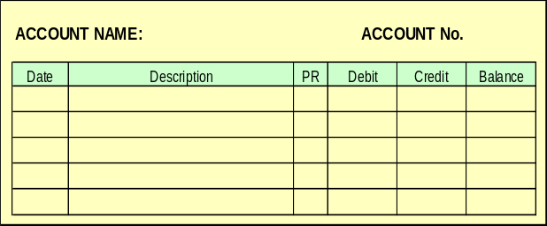
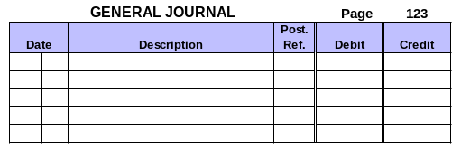
Journalizing and Posting Transactions
Assets
=
Liabilities
+
Equity
Step 1: Analyze transactions and source documents.
Step 2: Apply double-entry accounting
Step 4: Post entry to ledger
Step 3: Record journal entry

Slide 16
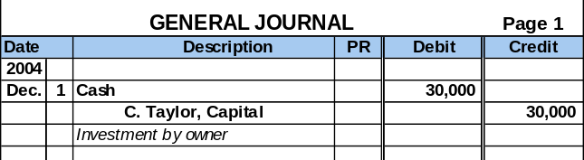
Journalizing Transactions
Transaction Date
Titles of Affected Accounts
Transaction explanation
Dollar amount of debits and credits

Slide 17
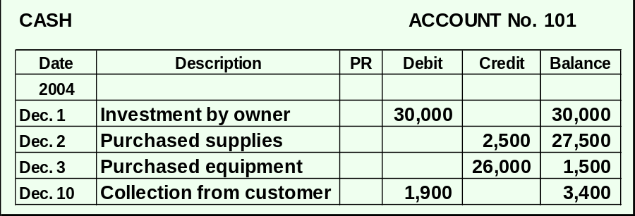
Balance Column Account
T-accounts are useful illustrations, but balance column ledger accounts are used in practice.

Slide 18
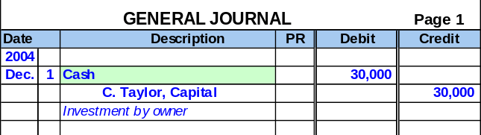
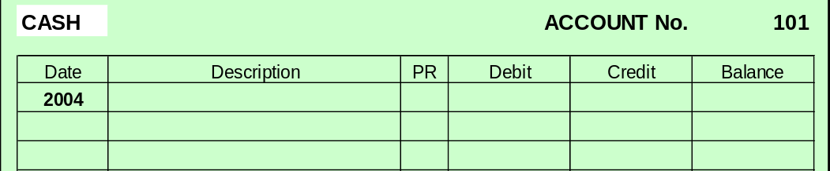
Posting Journal Entries
1
Identify the account.

Slide 19
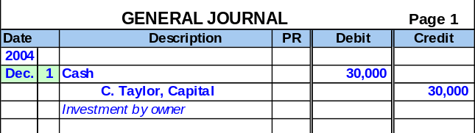
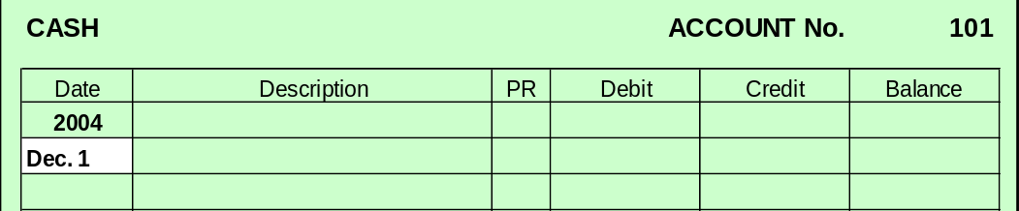
Posting Journal Entries
Enter the date.
2

Slide 20
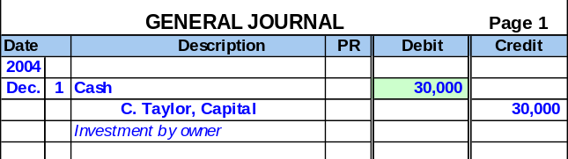
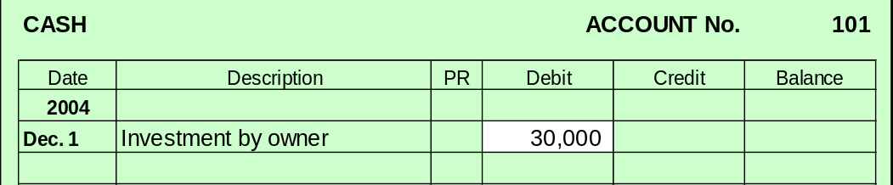
Posting Journal Entries
Enter the amount and description.
3

Slide 21
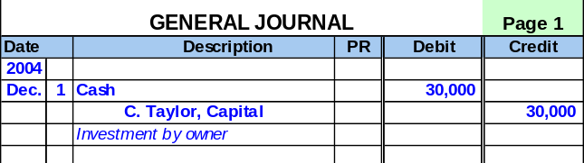
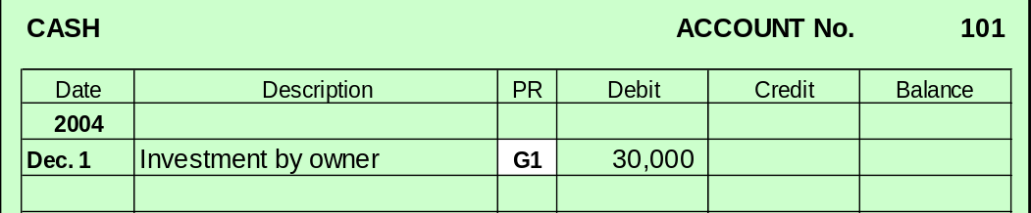
Posting Journal Entries
Enter the journal reference.
4

Slide 22
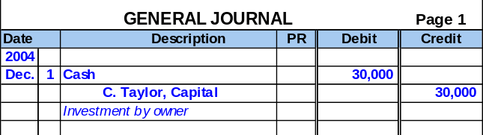
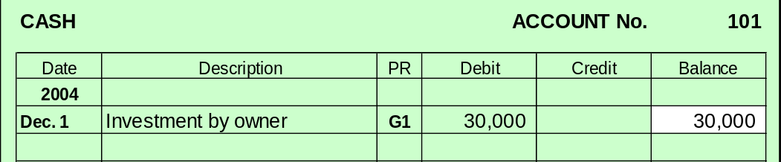
Posting Journal Entries
Compute the balance.
5

Slide 23
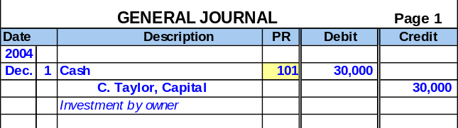
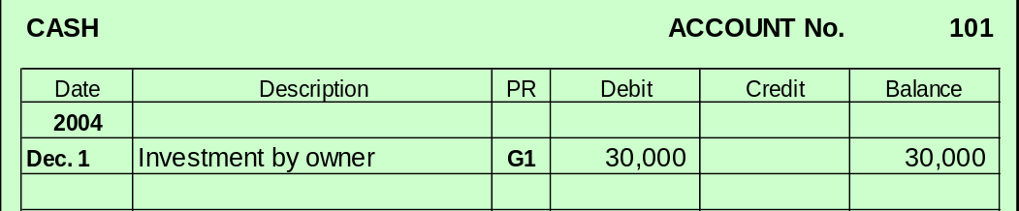
Posting Journal Entries
Enter the ledger reference.
6

Slide 24

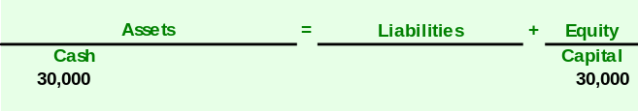


Analyzing Transactions – An Illustration
Analysis:
Double entry:
Posting:
101
301

Slide 25

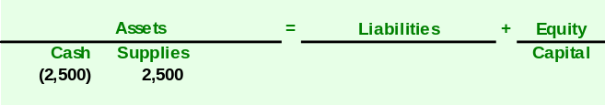

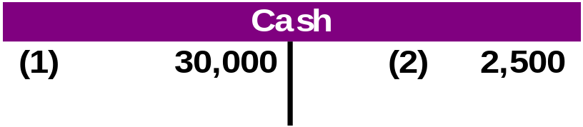
Analyzing Transactions – An Illustration
Analysis:
Double entry:
Posting:
126
101

Slide 26

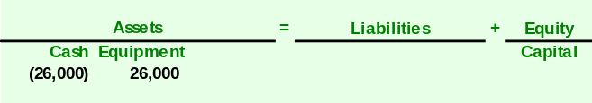

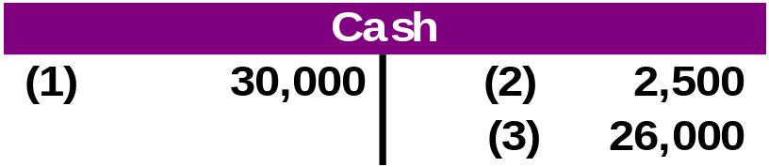
Analyzing Transactions – An Illustration
Analysis:
Double entry:
Posting:
167
101

Slide 27

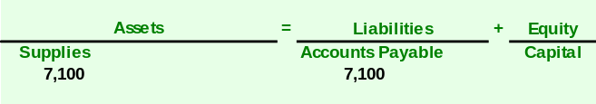


Analyzing Transactions – An Illustration
Analysis:
Double entry:
Posting:
126
201

Slide 28

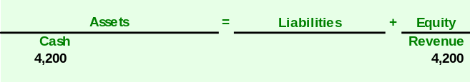

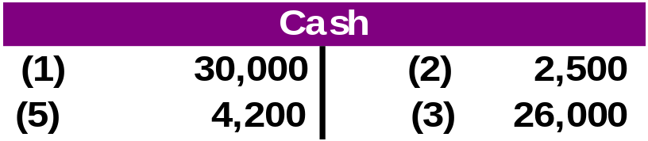
Analyzing Transactions – An Illustration
Analysis:
Double entry:
Posting:
403
101

Slide 29
After processing its remaining transactions for December, FastForward’s Trial Balance is prepared.
FastForward
Trial Balance
December 31, 2004
Debits
Credits
The trial balance lists all account balances in the general ledger. If the books are in balance, the total debits will equal the total credits.
Cash
$
3,950
Accounts receivable
-
Supplies
9,720
Prepaid Insurance
2,400
Equipment
26,000
Accounts payable
$
6,200
Unearned consulting revenue
3,000
C. Taylor, Capital
30,000
C. Taylor, Withdrawals
600
Consulting revenue
5,800
Rental revenue
300
Salaries expense
1,400
Rent expense
1,000
Utilities expense
230
Total
$
45,300
$
45,300

Slide 30

Searching for and Correcting Errors
If the trial balance does not balance, the error(s) must be found and corrected.
❶Make sure the trial balance columns are correctly added.
❹Recompute each account balance in the ledger.
❷Make sure account balances are correctly entered into the ledger.
❺Verify that each journal entry is posted correctly.
❸See if debit or credit accounts are mistakenly placed on the trial balance.
❻Verify that each original journal entry has equal debits and credits.

Slide 31
Using a Trial Balance to Prepare Financial Statements
Point in
Time
Point in
Time
Period of Time
Income Statement
Statement of Owner’s Equity
Income Statement of Cash Flows
Beginning Balance Sheet
Ending Balance Sheet

Slide 32
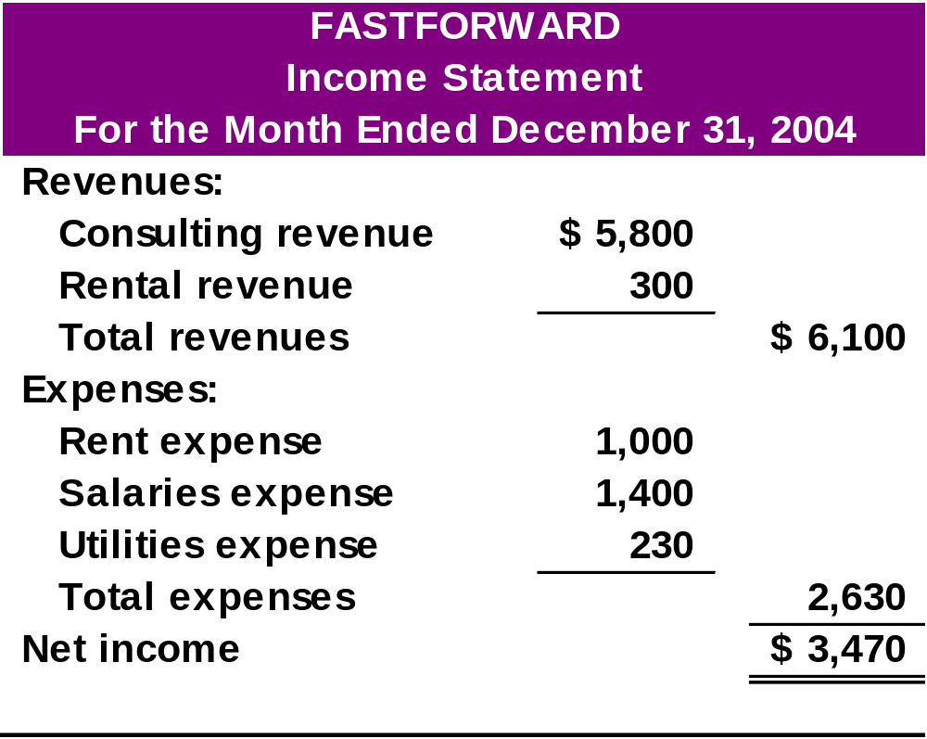
Income Statement

Slide 33
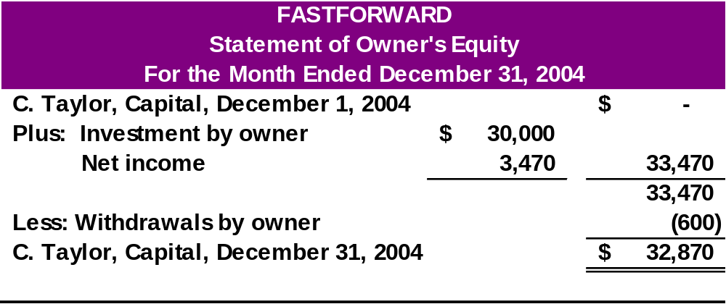
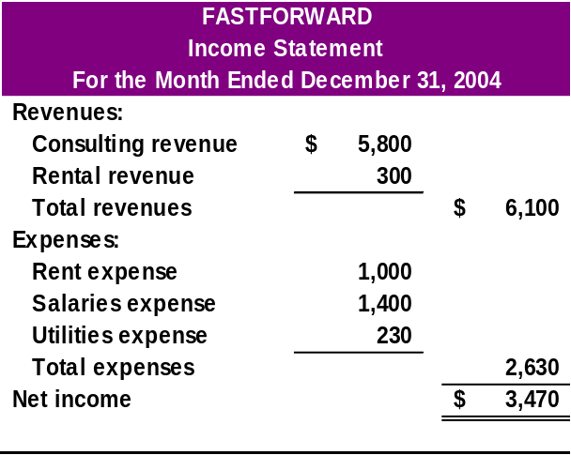
Statement of Owner’s Equity

Slide 34
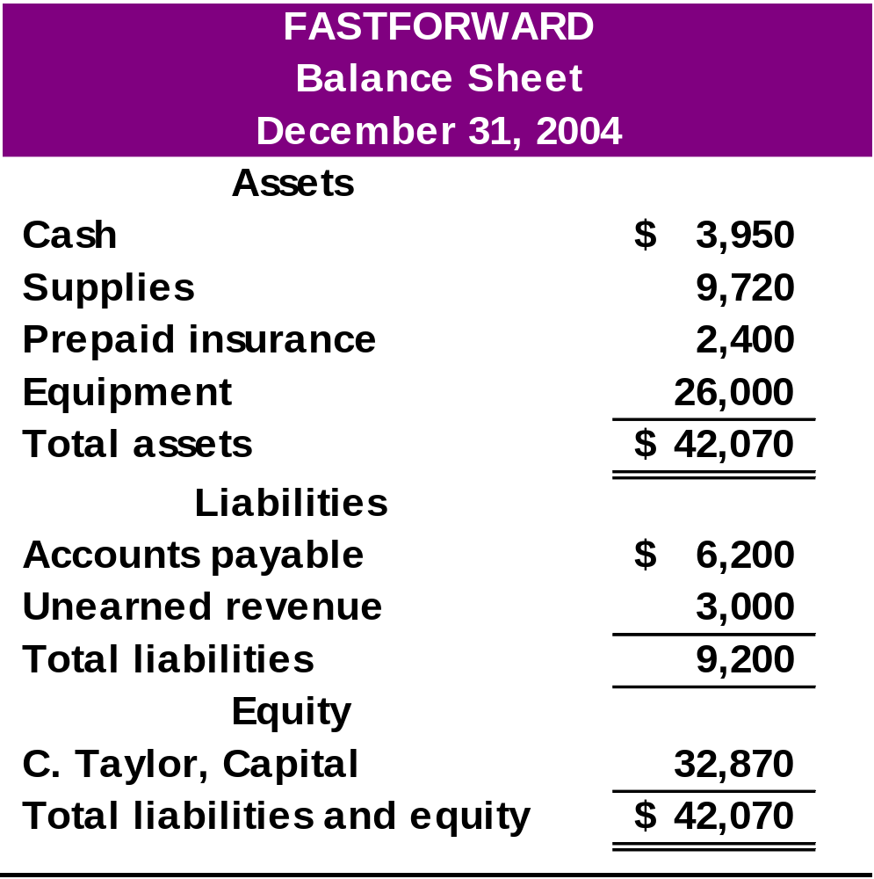
Balance Sheet

Slide 35

Debt Ratio
Describes the relationship between the amounts of the company’s liabilities and assets.
Helps to assess the risk that a company will fail to pay its debts.

Slide 36

End of Chapter 2

