Slide 1

Adjusting Accounts and Preparing Financial Statements
Chapter
3
Notes:
1
1
1
1
1

Slide 2
The Accounting Period
Annual
1
2
Semiannual
1
2
3
4
Quarterly
1
2
3
4
5
6
7
8
9
10
11
12
Jan
Feb
Mar
Apr
May
Jun
Jul
Aug
Sep
Oct
Nov
Dec
Monthly
Notes:
5
5

Slide 3
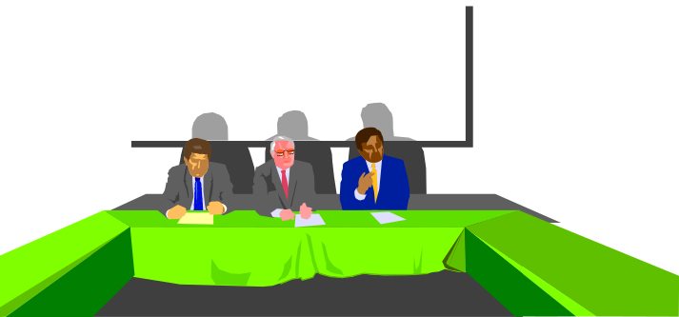
Accrual Basis vs. Cash Basis
Accrual Basis
Revenues are recognized when earned and expenses are recognized when incurred.
Cash Basis
Revenues are recognized when cash is received and expenses recorded when cash is paid.
Not GAAP
Accounting
Notes:
9
9

Slide 4

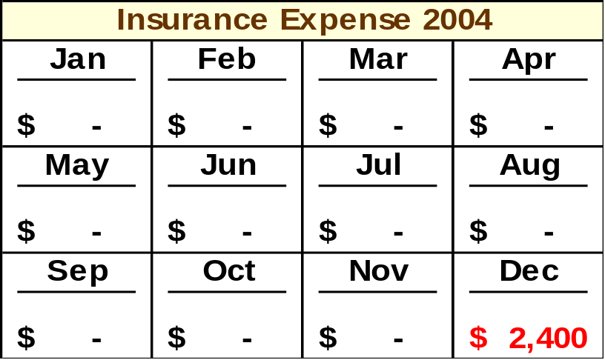
Accrual Basis vs. Cash Basis
On the cash basis the entire $2,400 would be recognized as insurance expense in 2004. No insurance expense from this policy would be recognized in 2005 or 2006, periods covered by the policy.
Notes:
9
9

Slide 5
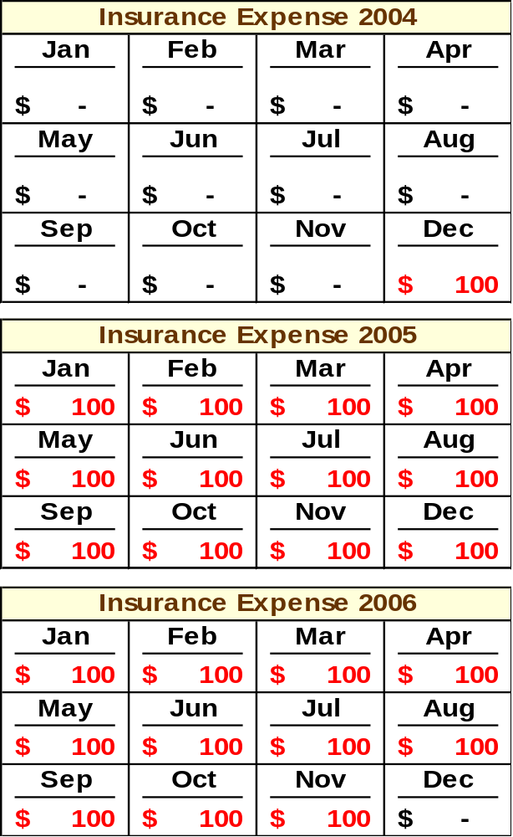
Accrual Basis vs. Cash Basis
On the accrual basis $100 of insurance expense is recognized in 2004, $1,200 in 2005, and $1,100 in 2006. The expense is matched with the periods benefited by the insurance coverage.
Notes:
9
9

Slide 6
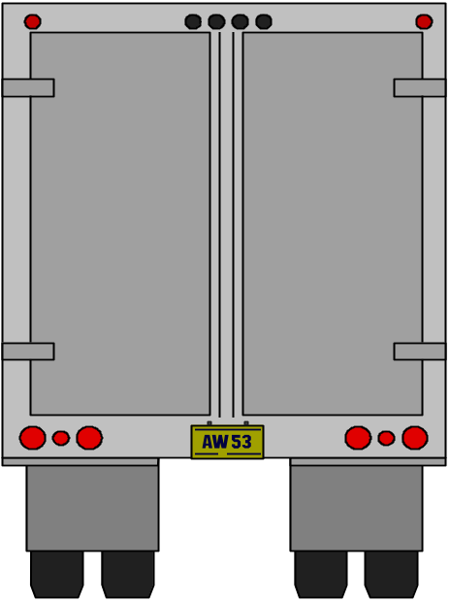

Recognizing Revenues and Expenses
Revenue Recognition
We have delivered the
product to our customer,
so I think we should record
the revenue earned.
Notes:
7
7

Slide 7

Recognizing Revenues and Expenses
Revenue Recognition
Matching
Now that we have
recognized the revenue,
let’s see what expenses
we incurred to
generate that revenue.
Summary
of Expenses
Rent
Gasoline
Advertising
Salaries
Utilities
and . . . .
$1,000
500
2,000
3,000
450
. . . .
Notes:
7
7

Slide 8
Adjusting Accounts
An adjusting entry is recorded to bring an asset or liability account balance to its proper amount.
Framework for Adjustments
Adjustments
Paid (or received) cash before expense (or revenue) recognized
Paid (or received) cash after expense (or revenue) recognized
Prepaid (Deferred) expenses*
Unearned (Deferred) revenues
Accrued
expense
Accrued
revenues
*including depreciation
Notes:
12
12

Slide 9
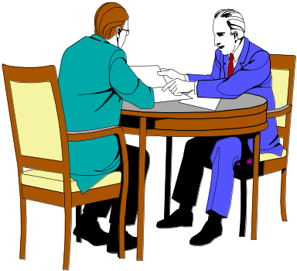
Adjusting Prepaid (Deferred) Expenses
Here is the check
for my first
6 months’ rent.
Resources paid for prior to receiving the actual benefits.
Asset
Expense
Unadjusted
Balance
Credit
Adjustment
Debit
Adjustment
Notes:
14
14

Slide 10
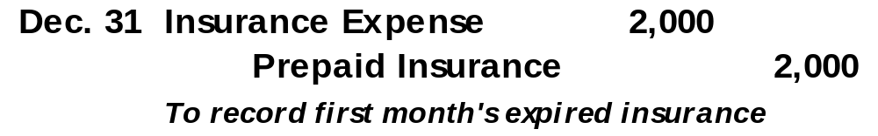
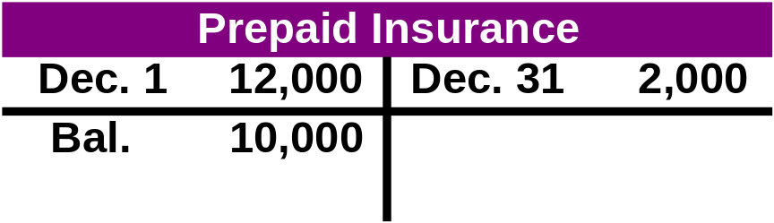

Prepaid Insurance
On December 1, 2004, Scott Company paid $12,000 to cover rent for December 2004 through May 2005. Scott recorded the expenditure as Prepaid Insurance on December 1. What adjustment is required?
637
128
Notes:
16
16

Slide 11
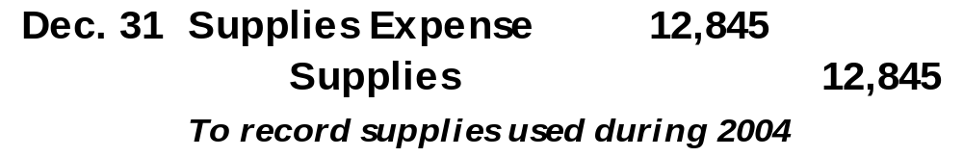
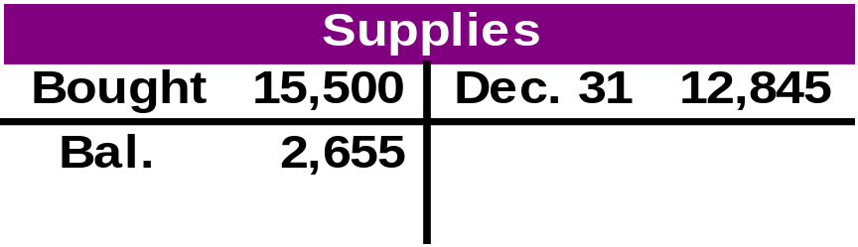

Supplies
During 2004, Scott Company purchase $15,500 of supplies. Scott recorded the expenditures as Supplies. At December 31, a count of the supplies indicated $2,655 on hand. What adjustment is required?
126
652
Notes:
16
16

Slide 12

Adjusting for Depreciation
Depreciation is the process of computing expense from allocating the cost of plant and equipment over their expected useful lives.
Straight-Line
Depreciation
Expense
Asset Cost - Salvage Value
Useful Life
=
Notes:
19
19

Slide 13
Adjusting for Depreciation
On January 1, 2004, Barton, Inc. purchased equipment for $62,000 cash. The equipment has an estimated useful life of 5 years and Barton expects to sell the equipment at the end of its life for $2,000 cash.
Let’s record depreciation expense for the year ended December 31, 2004.
2004
Depreciation
Expense
$62,000 - $2,000
5
=
=
$12,000
Notes:
20
20

Slide 14
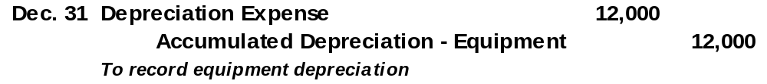
Adjusting for Depreciation
On January 1, 2004, Barton, Inc. purchased equipment for $62,000 cash. The equipment has an estimated useful life of 5 years and Barton expects to sell the equipment at the end of its life for $2,000 cash.
Let’s record depreciation expense for the year ended December 31, 2004.
Accumulated depreciation is
a contra asset account.
Notes:
22
22

Slide 15
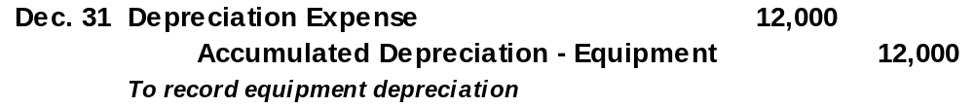
Adjusting for Depreciation
Equipment
Depreciation Expense
1/1 62,000
12/31 12,000
Accumulated Depreciation
12/31 12,000
Notes:
23
23

Slide 16
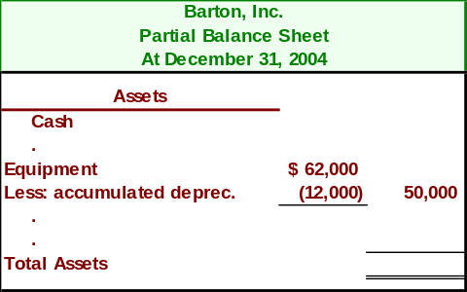
Adjusting for Depreciation
Equipment is shown net of accumulated depreciation.
$
Notes:
24
24

Slide 17


Adjusting Unearned (Deferred) Revenues
Cash received in advance of providing products or services.
Buy your season tickets for
all home basketball games NOW!
“Go Big Blue”
Liability
Revenue
Debit
Adjustment
Unadjusted
Balance
Credit
Adjustment
Notes:
25
25

Slide 18
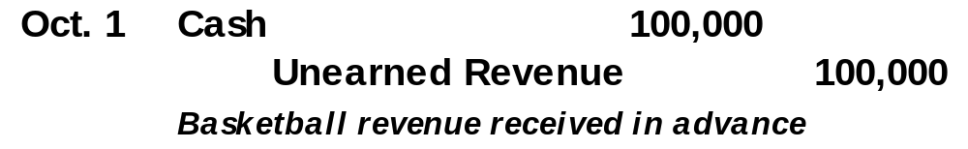

Adjusting Unearned (Deferred) Revenues
On October 1, 2004, Ox University sold 1,000 season tickets to its 20 home basketball games for $100 each. Ox University makes the following entry:
Notes:
27
27

Slide 19
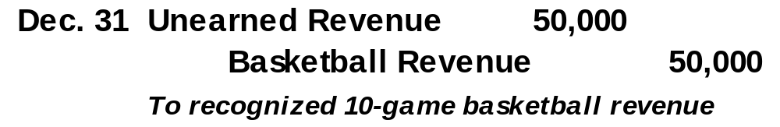
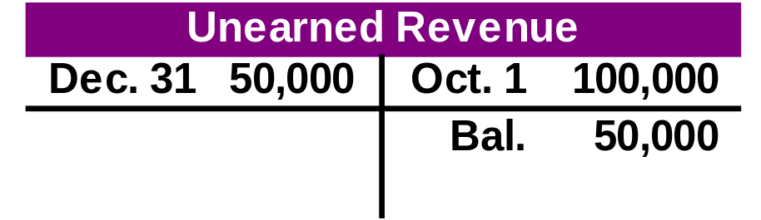

Adjusting Unearned (Deferred) Revenues
On December 31, Ox University has played 10 of its regular home games, winning 2 and losing 8.
Notes:
28
28

Slide 20


Adjusting for Accrued Expenses
Costs incurred in a period that are
both unpaid and unrecorded.
We’re about one-half
done with this job and
want to be paid for
our work!
Expense
Liability
Debit
Adjustment
Credit
Adjustment
Notes:
31
31

Slide 21
Adjusting for Accrued Expenses
Barton, Inc. pays its employees every Friday. Year-end, 12/31/04, falls on a Wednesday. As of 12/31/04, the employees have earned salaries of $47,250 for Monday through Wednesday of the week ended 1/02/05.
Last pay
date
12/26/04
Next pay
date
1/2/05
12/1/04
12/31/04
Year end
Record adjusting
journal entry.
Notes:
33
33

Slide 22
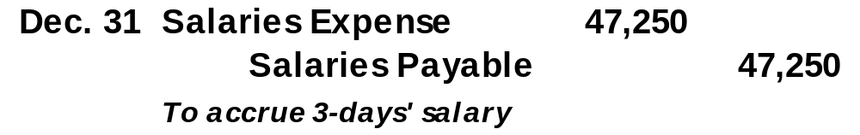
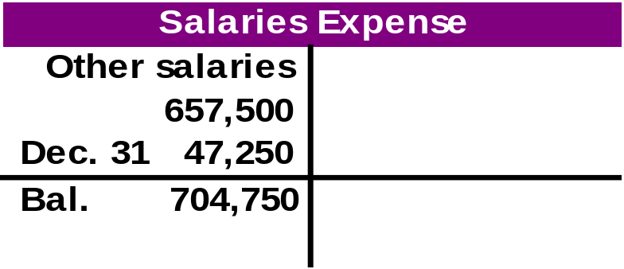
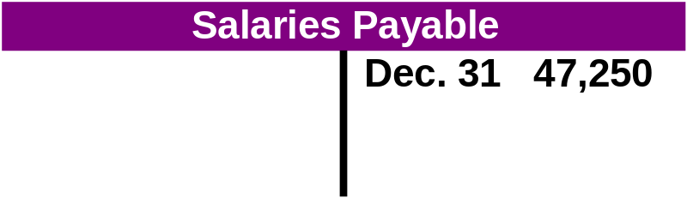
Adjusting for Accrued Expenses
Barton, Inc. pays its employees every Friday. Year-end, 12/31/04, falls on a Wednesday. As of 12/31/04, the employees have earned salaries of $47,250 for Monday through Wednesday of the week ended 1/02/05.
Notes:
34
34

Slide 23

Adjusting Accrued Revenues
Revenues earned in a period that
are both unrecorded and not yet received.
Yes, I’ve completed your
tax return, but have not had
time to bill you yet.
Asset
Revenue
Debit
Adjustment
Credit
Adjustment
Notes:
36
36

Slide 24
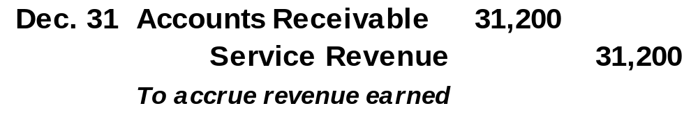
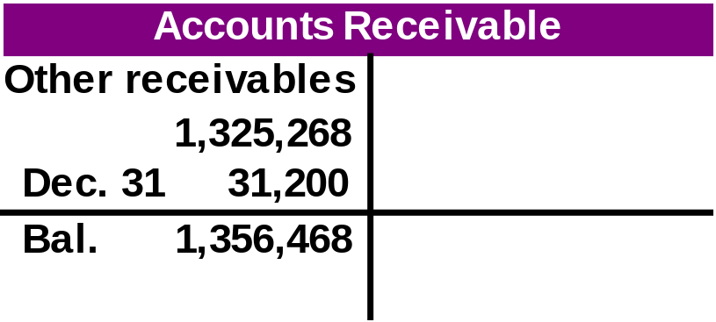
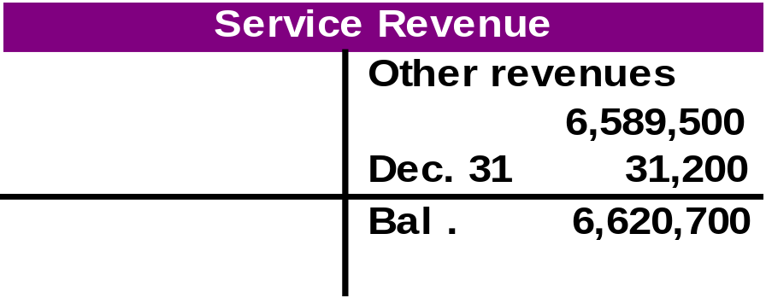
Adjusting for Accrued Revenues
Smith & Jones, CPAs, had $31,200 of work completed but not yet billed to clients. Let’s make the adjusting entry necessary on December 31, 2004, the end of the company’s fiscal year.
Notes:
38

Slide 25
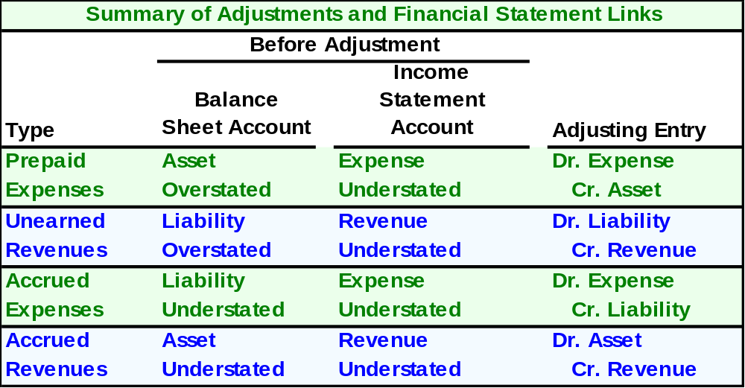
Links to Financial Statements
Notes:
41

Slide 26
FastForward
Trial Balance
December 31, 2004
$
First, the initial unadjusted amounts are added to the worksheet.
$
$
$
Notes:
43

Slide 27
FastForward
Trial Balance
December 31, 2004
Next, FastForward’s adjustments are added.
$
$
$
$
$
$
$
$
Notes:
44

Slide 28
Finally, the totals are determined.
FastForward
Trial Balance
December 31, 2004
$
$
$
$
$
$
$
$
$
$
$
$
Notes:
45

Slide 29

Preparing Financial Statements
Let’s use FastForward’s adjusted trial balance to prepare the company’s financial statements.

Slide 30
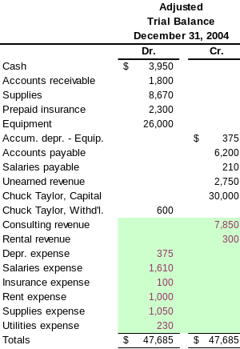
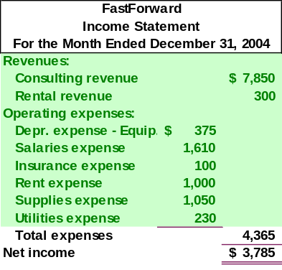
❶Prepare the Income
Statement.

Slide 31
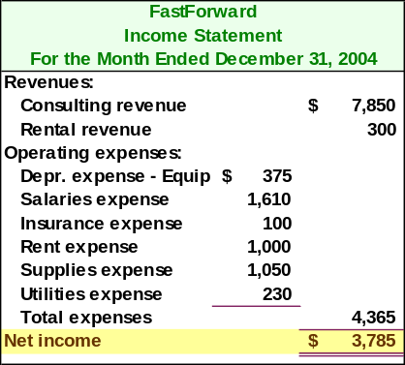
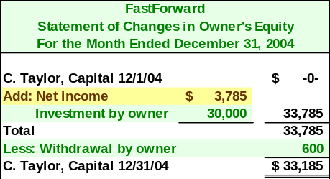
❷Prepare the Statement of Changes in Owner’s Equity.
Note: Net Income from the Income Statement carries to the Statement of Changes in Owner’s Equity.

Slide 32
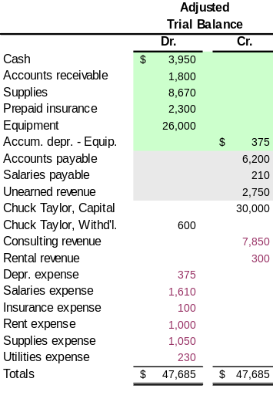
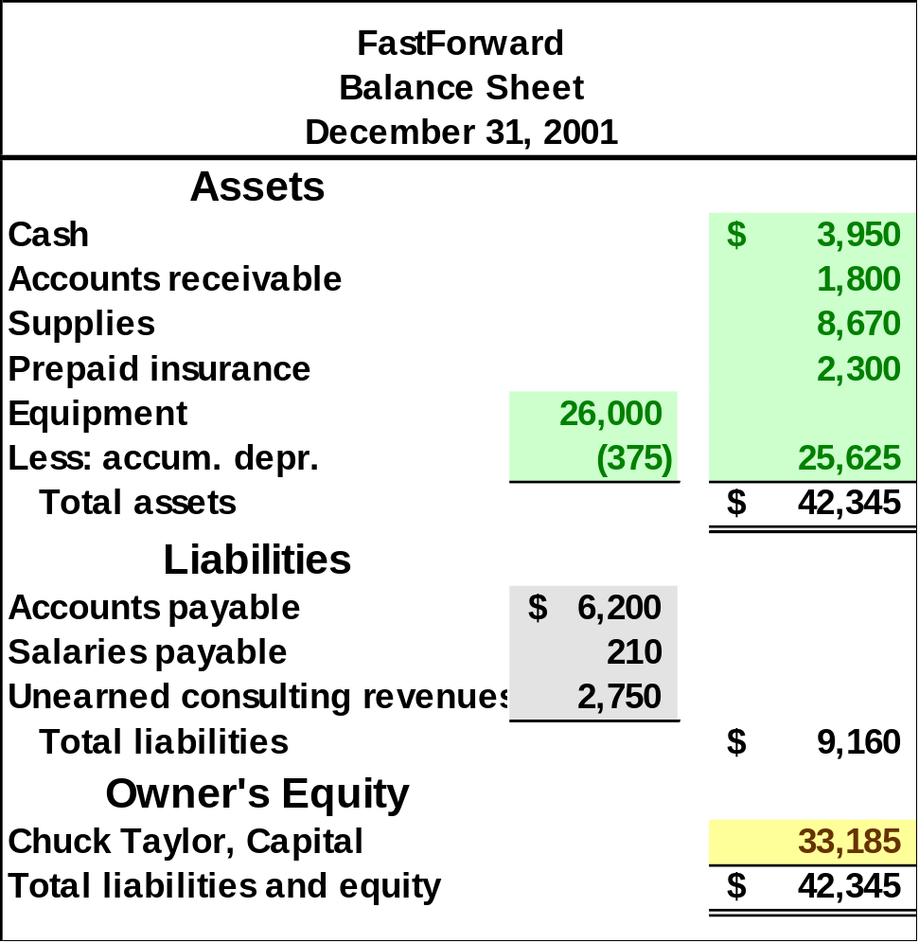
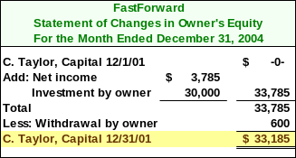
❸Prepare the Balance Sheet.

Slide 33
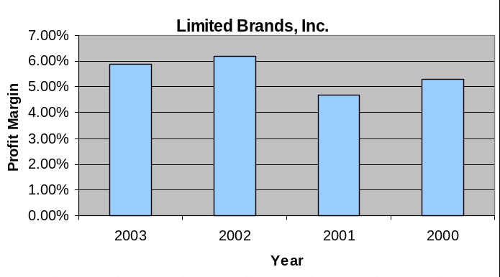
Profit Margin
The profit margin ratio measures the company’s net income to sales.
Profit
Margin
Net Income
Net Sales
=

Slide 34

End of Chapter 3

