Slide 1
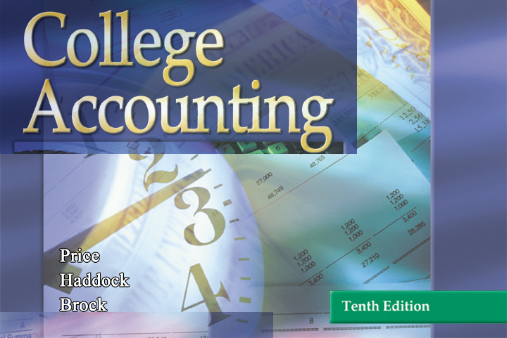

GLENCOE / McGraw-Hill

Slide 2
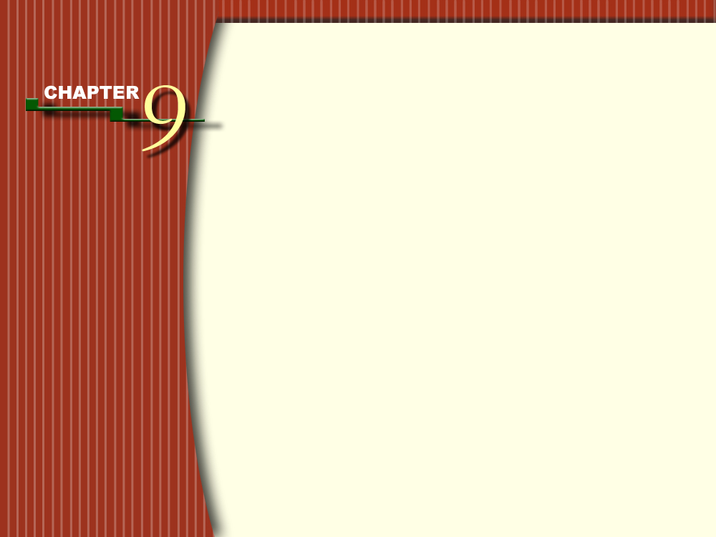

Cash
Receipts,
Cash
Payments,
and Banking Procedures

Slide 3
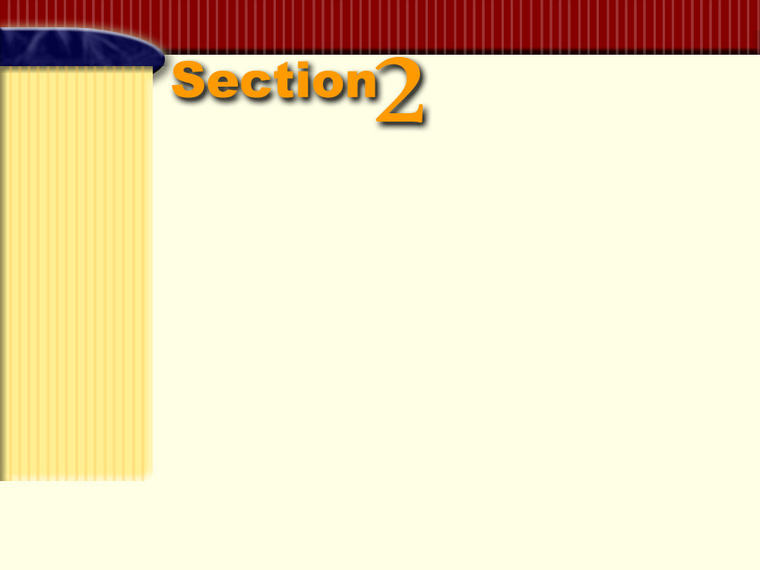

Cash Payments
Section Objectives
Record cash payments in a cash payments journal.
Post from the cash payments journal to subsidiary and general ledgers.
Demonstrate a knowledge of procedures for a petty cash fund.
Demonstrate a knowledge of internal control routines for cash.

Slide 4

The Cash Payments Journal
Page
299

Slide 5
QUESTION:
What is a cash payments journal?
ANSWER:
A cash payments journal is a special journal used to record transactions involving the payment of cash.
Page
299

Slide 6
Recording Transactions in the Cash Payments Journal
Page
299

Slide 7
Objective 4
Record cash payments in a
cash payments journal.
Page
299

Slide 8
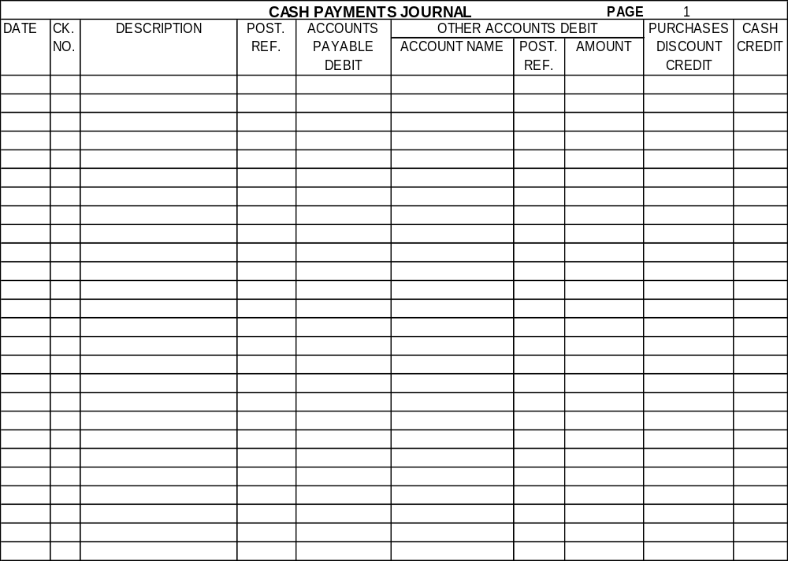
The cash payments journal has separate columns for accounts that are frequently used.
Page
299

Slide 9
Payments for Expenses
Businesses write checks for a variety of expenses each month.
In January The Trend Center issued checks for rent, electricity, telephone service, advertising, and salaries.
Consider the January 3 entry for rent expense.
Page
299

Slide 10
20--
Jan. 3
111
January rent
Rent Expense
1400.00
1400.00
The account name and amount are entered in the Other Accounts Debit section.
The credit is entered in the Cash Credit column.
Page
299

Slide 11
Cash Purchases of Equipment and Supplies
Businesses use cash to purchase equipment and other assets.
On January 10 The Trend Center issued a check for store fixtures.
Page
300

Slide 12
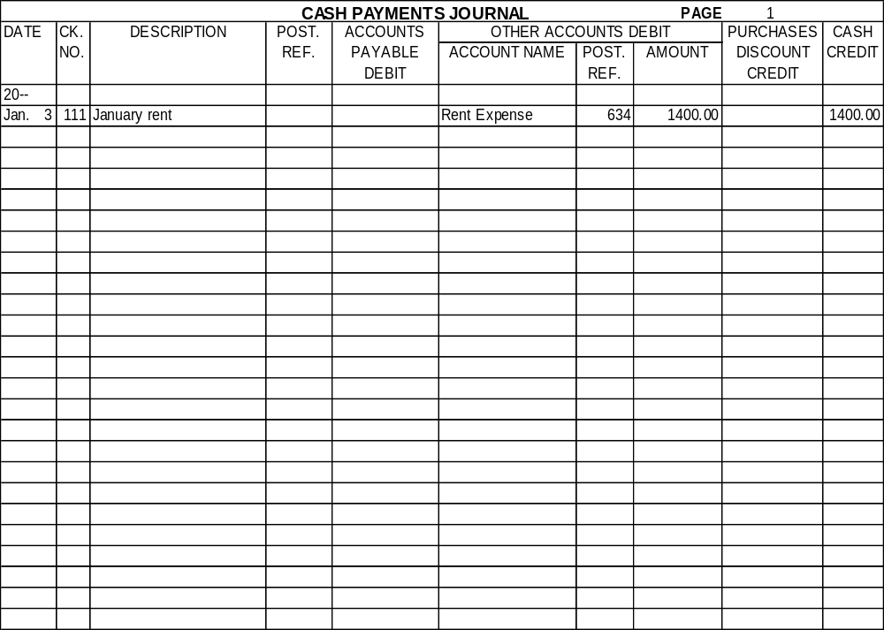
10
112
Store fixtures
Store Equip.
1200.00
1200.00
The account name and amount appear in the Other Accounts Debit section.
The credit is recorded in the Cash Credit column.
Page
300

Slide 13
Payment of Taxes
Retail businesses collect sales tax from their customers. Periodically the sales tax is remitted to the taxing authority.
Consider the entry on January 11.
Page
300

Slide 14
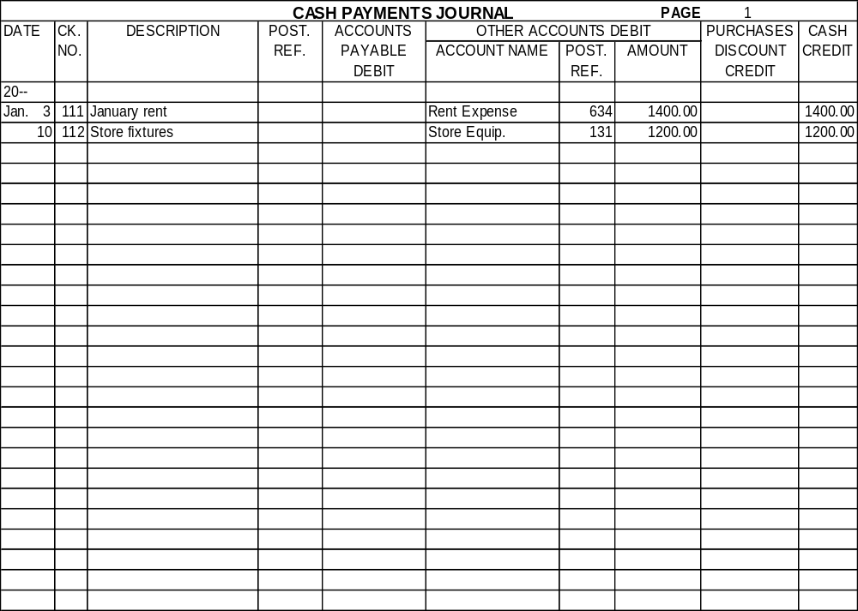
The Trend Center issued a check for $749 to pay the December sales tax.
11
113
Tax remittance
Sales Tax Pay.
749.00
749.00
Notice that the account name and amount appear in the Other Accounts Debit section.
The credit is entered in the Cash Credit column.
Page
300

Slide 15
Purchases Discounts
Purchases Discounts is a contra cost of goods sold account.
For an example of a payment with a discount, refer to the January 13 entry for Sebrina’s Clothing Store.
Page
299

Slide 16
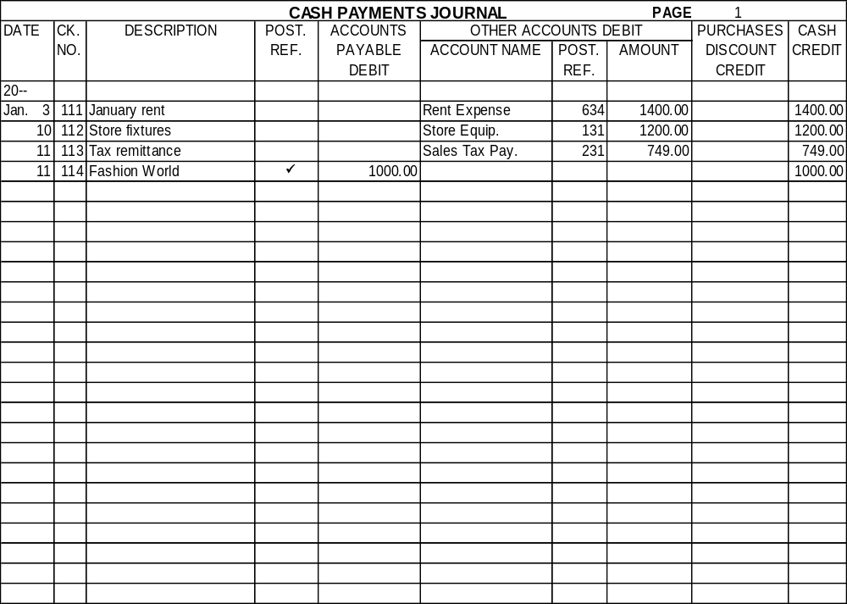
13
115
Sebrina’s Clothing Store
3250.00
65.00
3185.00
Debit Accounts Payable for the invoice amount, $3,250.
Page
300

Slide 17
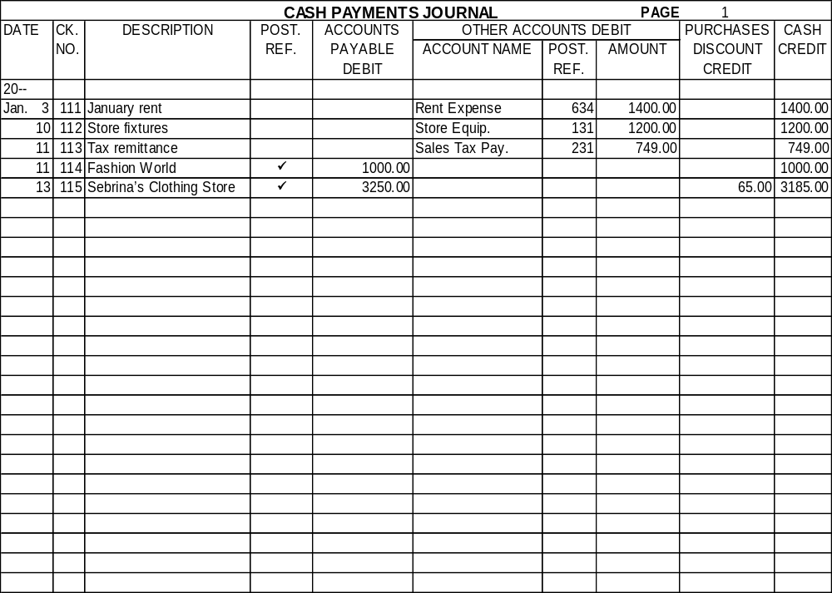
Credit Purchases Discounts for the amount of the discount, $65.
Credit Cash for the amount of cash paid, $3,185.
Page
300

Slide 18
Payments on Account
Merchandising businesses usually make numerous payments on account for goods that were purchased on credit.
Consider the January 27 entry for Clothes Rack Depot.
Page
299

Slide 19
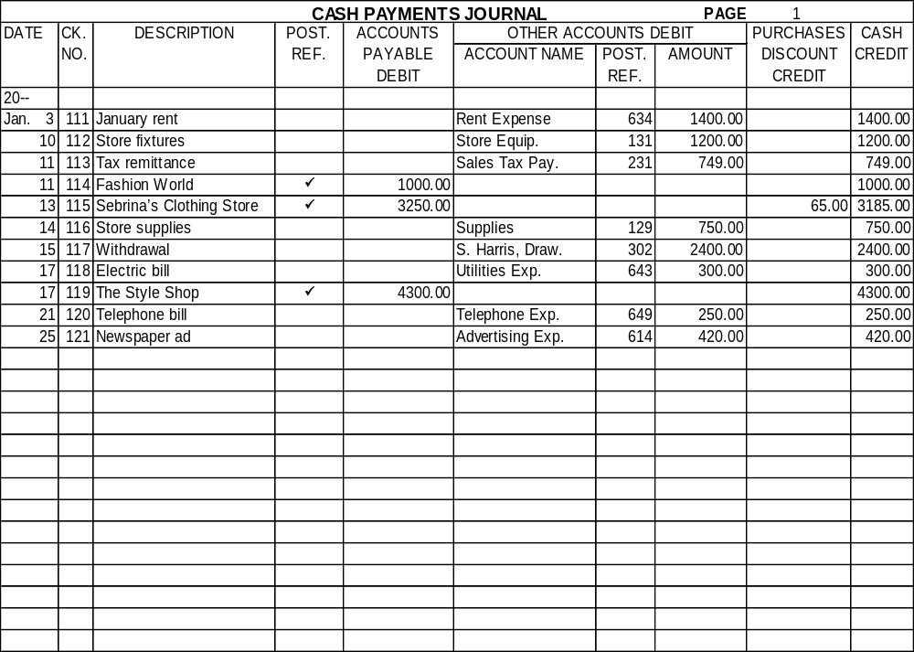
27
122
Clothes Rack Depot
1200.00
1200.00
If there is no cash discount, the entry in the cash payments journal is a debit to Accounts Payable and a credit to Cash.
Page
299

Slide 20
Cash Purchases of Merchandise
Although most merchandising businesses buy their goods on credit, occasionally purchases are made for cash.
Consider the January 31 entry for the purchase of goods.
Page
301

Slide 21
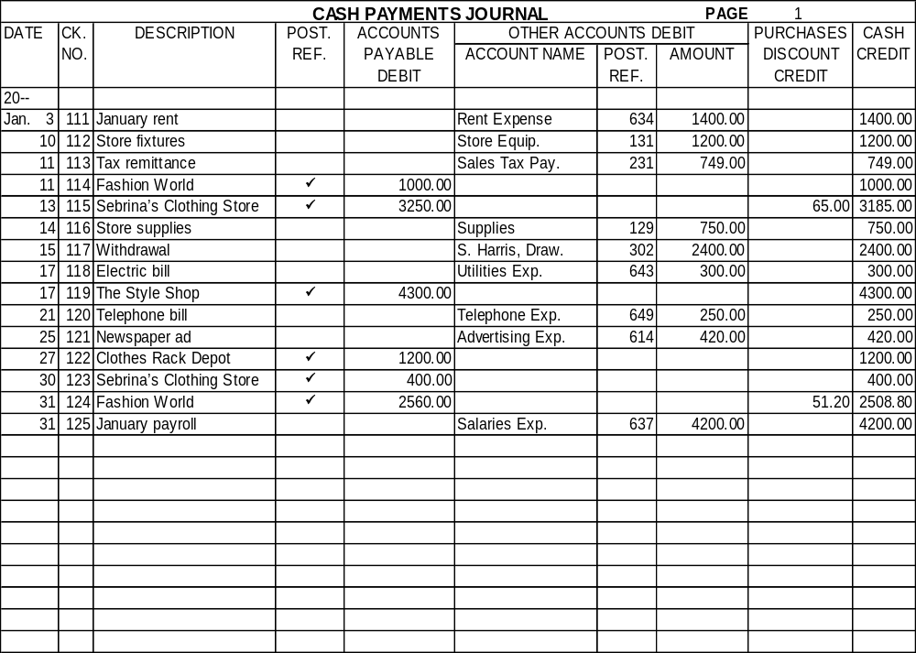
31
126
Purchase of goods
Purchases
2400.00
2400.00
Cash purchases are recorded in the cash payments journal.
Page
301

Slide 22
Payment of Freight Charges
Freight charges on purchases of goods are handled in two ways:
• The seller pays the freight charge and then includes
it on the invoice.
• The buyer pays the transportation company when
the goods arrive. The buyer issues a check for the
freight charge and records it in the cash payments
journal.
Consider the entry on January 31.
Page
301

Slide 23
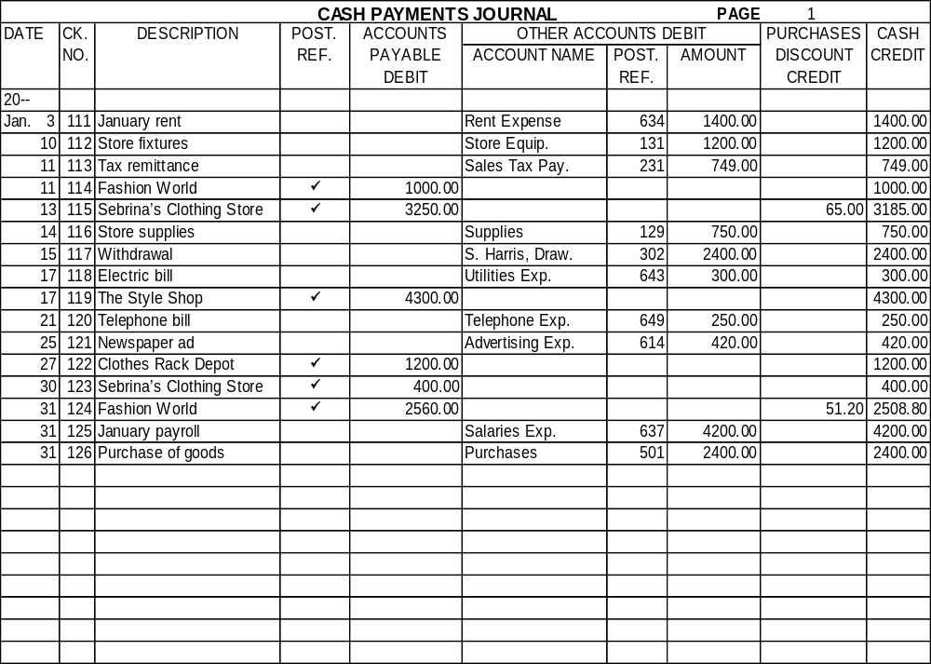
Page
301
31
127
Freight charge
Freight In
150.00
150.00
The account name and amount appear in the Other Accounts Debit section.
The credit is in the Cash Credit column.

Slide 24
Payment of a Cash Refund
When a customer purchases goods for cash and later returns them or receives an allowance, the customer is usually given a cash refund.
Consider the January 31 entry.
Page
301

Slide 25
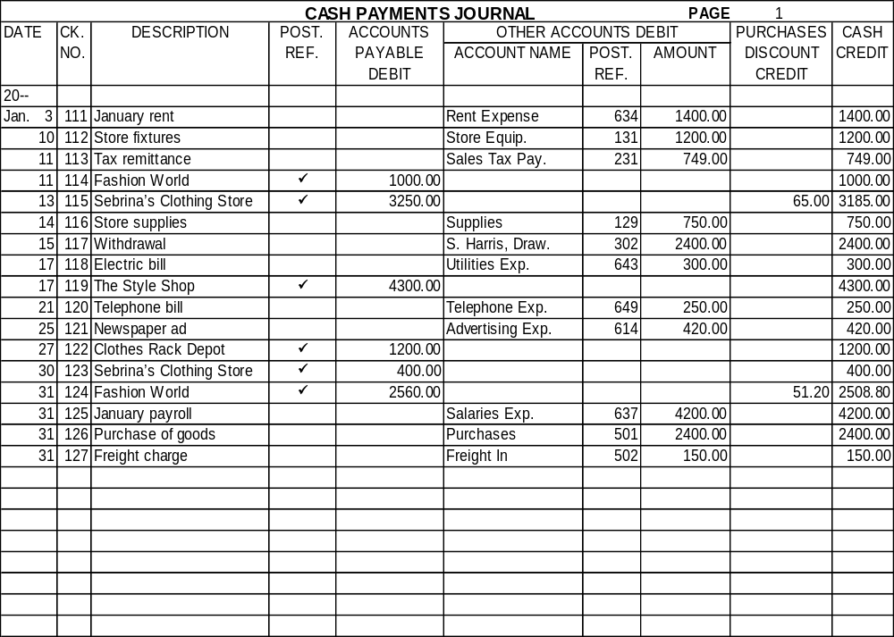
The Trend Center issued a check for $85.60 to a customer who returned a defective item.
31
128
Cash refund
Sales Ret. & Allow.
80.00
Sales Tax Payable
5.60
85.60
Page
301

Slide 26
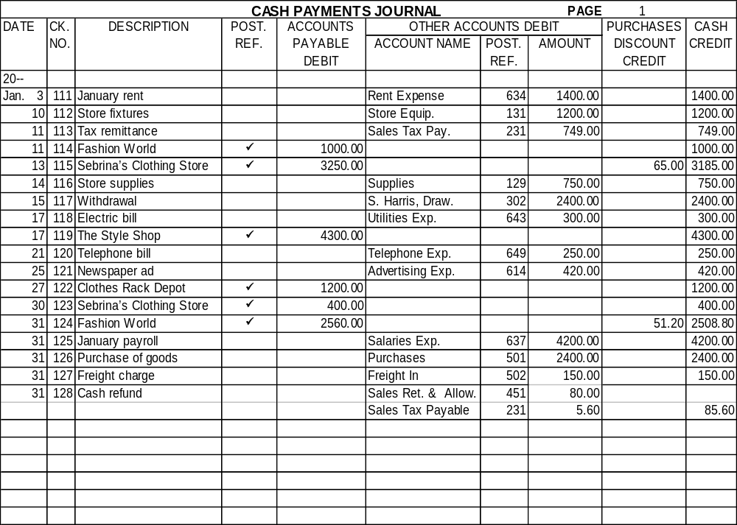
Notice that the debits in the Other Accounts Debit section appear on two lines because two general ledger accounts are debited.
Page
301

Slide 27
Payment of a Promissory Note and Interest
A promissory note can be issued to settle an overdue account or to obtain goods, equipment, or other property.
Page
301

Slide 28
On August 2, The Trend Center issued a six-month promissory note for $3,000 to purchase store fixtures from Dallas Equipment Company.
The note had an interest rate of 10 percent.
GENERAL JOURNAL Page 16
DATE DESCRIPTION POST. DEBIT CREDIT
REF.
20--
Aug. 2 Store Equipment 131 3,000.00
Notes Payable 201 3,000.00
Issued a 6-month, 10% note
to Dallas Equipment Company
for purchase of new store fixtures
Page
301

Slide 29
On January 31 The Trend Center issued a check for $3,150 in payment of the note ($3,000) and the interest ($150).
Page
301

Slide 30
Debit Notes Payable for $3,000
Debit Interest Expense for $150
31
129
Note paid to Dallas
Notes Payable
3000.00
Equipment Company
Interest Exp.
150.00
3150.00
Credit Cash for $3,150
Page
301

Slide 31
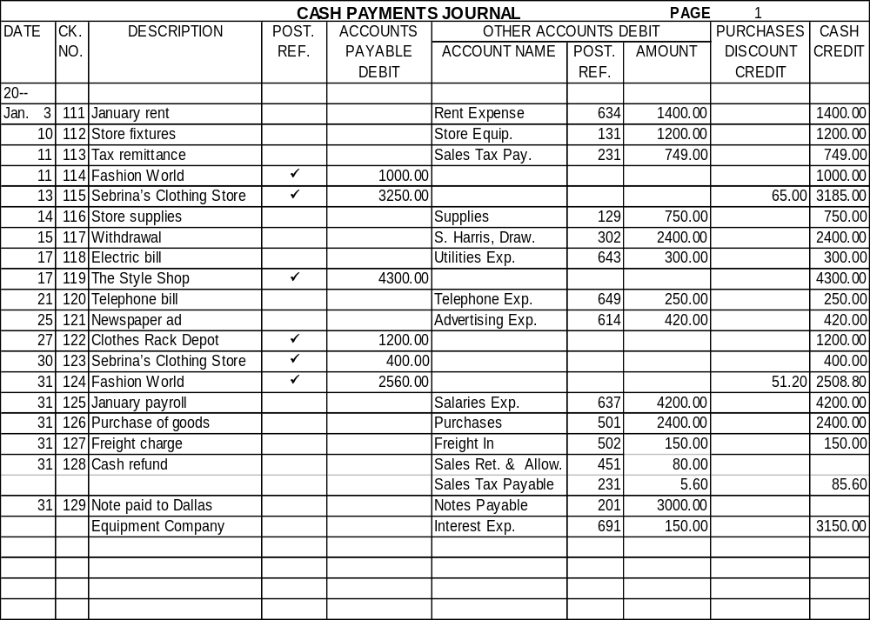
Notice that the debits in the Other Accounts Debit section appear on two lines.
Page
301

Slide 32
Posting from the Cash Payments Journal
Page
302

Slide 33
Objective 5
Post from the cash payments
journal to subsidiary and
general ledgers.
Page
302

Slide 34
During the month, the amounts recorded in the Accounts Payable Debit column are posted to the individual accounts in the accounts payable subsidiary ledger.
The amounts in the Other Accounts Debit column are also posted individually to the general ledger accounts during the month.
Page
302

Slide 35
Consider the January 3 entry in the cash payments journal that was posted to the Rent Expense account.
Page
302

Slide 36
CASH PAYMENTS JOURNAL PAGE 1
ACCOUNTS PURCH.
DATE CK. EXPLANATION POST. PAYABLE OTHER ACCOUNTS DEBIT DISCOUNT CASH
NO. REF. DEBIT ACCOUNT TITLE POST. AMOUNT CREDIT CREDIT
REF.
20--
Jan. 3 111 January rent Rent Expense 634 1400.00 1400.00
ACCOUNT Rent Expense ACCOUNT NO. 634
DATE DESCRIPTION POST. DEBIT CREDIT BALANCE
REF. DEBIT CREDIT
20--
Jan. 3 CP1 1400.00 1400.00
The “CP1” indicates that the entry is recorded on page 1 of the cash payments journal.
Page
302

Slide 37
Posting to the Accounts Payable Ledger
Post entries from the Accounts Payable Debit column of the cash payments journal to the vendor accounts in the accounts payable subsidiary ledger daily.
Page
302

Slide 38
On January 13, $3,250 was posted to Sebrina’s Clothing Store account in the subsidiary ledger.
Page
302

Slide 39
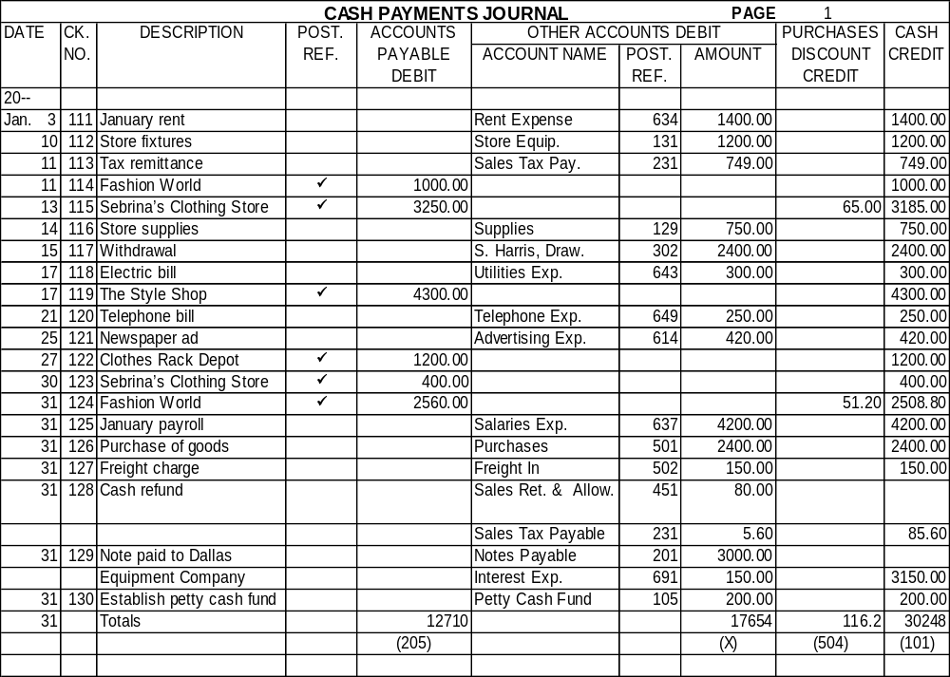
The amount of $3,250 was posted to Sebrina’s Clothing Store account in the subsidiary ledger.
Name Sebrina’s Clothing Store Terms 2/10, n/30
Address 5671 Preston Road, Dallas, Texas, 75267-6205
DATE DESCRIPTION POST. DEBIT CREDIT BALANCE
REF.
20--
Jan. 1 Balance  1,100.00
3 Invoice 8434,12/29/-- P1 3,250.00 4,350.00
13 CP1 3,250.00 1,100.00
30 CP1 400.00 700.00
Page
Page
302/303
303

Slide 40
Advantages of the Cash Payments Journal
The cash payments journal:
Saves time and effort when recording and posting cash payments
Allows for a division of labor among the accounting staff
Improves the audit trail because all cash payments are recorded in one place and listed by check number
Page
303

Slide 41
The Petty Cash Fund
Page
304

Slide 42
Objective 6
Demonstrate a knowledge of
procedures for a petty cash fund.
Page
304

Slide 43
Most businesses use a petty cash fund to pay for small expenditures with currency or coins.
Page
304

Slide 44
Establishing the Fund
Page
304

Slide 45
The amount of the petty cash fund depends on the needs of the business.
Usually the office manager, cashier, or assistant is in charge of the petty cash fund.
Page
304

Slide 46
The Trend Center’s cashier is responsible for petty cash. The Trend Center wrote a $200 check to the cashier, who cashed the check and put the currency in a locked cash box.
Page
305

Slide 47
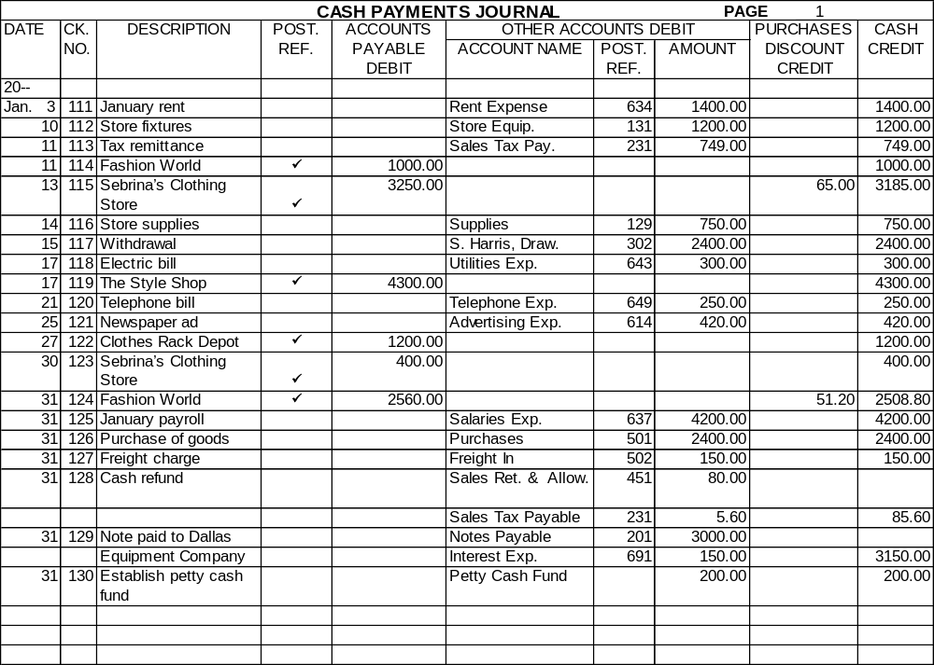
Page
305
Debit Petty Cash Fund in the other Accounts Debit section and enter the credit in the Cash Credit column.

Slide 48
Making Payments from the Fund
Page
305

Slide 49
QUESTION:
What is a petty cash voucher?
ANSWER:
A petty cash voucher is a form used to record the payments made from a petty cash fund.
Page
305

Slide 50
The person receiving the funds signs the voucher.
The person who controls the petty cash fund initials the voucher.
Page
305

Slide 51
A petty cash voucher shows:
PETTY CASH VOUCHER 1
NOTE: This form must be computer processed or filled out in black ink.
DESCRIPTION OF EXPENDITURE ACCOUNT TO BE CHARGED AMOUNT
Office Supplies Supplies 129 17 50
Total 17 50
RECEIVED
THE SUM OF Seventeen DOLLARS AND 50/100 CENTS
SIGNED A. C. Abbott DATE 2/3/-- APPROVED BY D.W. DATE 2/3/--
Delta Office Supply Co.
Voucher number
Page
305

Slide 52
A petty cash voucher shows:
PETTY CASH VOUCHER 1
NOTE: This form must be computer processed or filled out in black ink.
DESCRIPTION OF EXPENDITURE ACCOUNT TO BE CHARGED AMOUNT
Office Supplies Supplies 129 17 50
Total 17 50
RECEIVED
THE SUM OF Seventeen DOLLARS AND 50/100 CENTS
SIGNED A. C. Abbott DATE 2/3/-- APPROVED BY D.W. DATE 2/3/--
Delta Office Supply Co.
Amount
Page
305

Slide 53
A petty cash voucher shows:
PETTY CASH VOUCHER 1
NOTE: This form must be computer processed or filled out in black ink.
DESCRIPTION OF EXPENDITURE ACCOUNT TO BE CHARGED AMOUNT
Office Supplies Supplies 129 17 50
Total 17 50
RECEIVED
THE SUM OF Seventeen DOLLARS AND 50/100 CENTS
SIGNED A. C. Abbott DATE 2/3/-- APPROVED BY D.W. DATE 2/3/--
Delta Office Supply Co.
Purpose of expenditure
Page
305

Slide 54
A petty cash voucher shows:
PETTY CASH VOUCHER 1
NOTE: This form must be computer processed or filled out in black ink.
DESCRIPTION OF EXPENDITURE ACCOUNT TO BE CHARGED AMOUNT
Office Supplies Supplies 129 17 50
Total 17 50
RECEIVED
THE SUM OF Seventeen DOLLARS AND 50/100 CENTS
SIGNED A. C. Abbott DATE 2/3/-- APPROVED BY D.W. DATE 2/3/--
Delta Office Supply Co.
Account to debit
Page
305

Slide 55
Replenishing the Fund
The total vouchers plus the cash on hand should always equal the amount of the fund–$200 for The Trend Center.
Replenish the petty cash fund at the end of each month or sooner if the fund is low.
Page
305

Slide 56
Internal Control of the Petty
Cash Fund
Page
306

Slide 57
The following internal control procedures apply to petty cash:
Use the petty cash fund only for small payments that cannot conveniently be made by check.
Limit the amount set aside for petty cash to the approximate amount needed to cover one month's payments from the fund.
Write petty cash fund checks to the person in charge of the fund, not to the order of "Cash."
Page
306

Slide 58
The following internal control procedures apply to petty cash:
Assign one person to control the petty cash fund. This person has sole control of the money and is the only one authorized to make payments from the fund.
5. Keep petty cash in a safe, a locked cash box, or a locked drawer.
6. Obtain a petty cash voucher for each payment. The voucher should be signed by the person who receives the money and should show the payment details. This provides an audit trail for the fund.
Page
306

Slide 59
Internal Control over Cash
Page
307

Slide 60
Objective 7
Demonstrate a knowledge of
internal control routines for cash.
Page
307

Slide 61
The internal control over cash should be tailored to the needs of a business.
Accountants play a vital role in designing, establishing, and monitoring the cash control system.
Page
307

Slide 62
Control of Cash Receipts
Page
307

Slide 63
Essential Cash Receipt Controls
Have only designated employees receive and
handle cash. In some businesses employees
handling cash are bonded.
Page
307

Slide 64
QUESTION:
What is bonding?
ANSWER:
Bonding is the process by which employees are investigated by an insurance company that will insure the business against losses through employee theft or mishandling of funds.
Page
307

Slide 65
Essential Cash Receipt Controls
Keep cash receipts in a cash register, a locked cash drawer, or a safe while they are on the premises.
3. Make a record of all cash receipts as the funds come into the business.
4. Check the funds to be deposited against the record made when the cash was received. The employee who checks the deposit is someone other than the one who receives or records the cash.
Page
307

Slide 66
Essential Cash Receipt Controls
Deposit cash receipts in the bank promptly. Deposit the funds intact. The person who makes the bank deposit is someone other than the one who receives and records the funds.
Enter cash receipts transactions in the accounting records promptly. The person who records cash receipts is not the one who receives or deposits the funds.
Have the monthly bank statement sent to and reconciled by someone other than the employees who handle, record, and deposit the funds.
Page
307

Slide 67
Control of Cash Payments
Page
308

Slide 68
Essential Cash Payment Controls
Make all payments by check except for payments from special purpose cash funds such as a petty cash fund.
Issue checks only with an approved bill, invoice, or other document that describes the reason for the payment.
Have only designated personnel approve bills and invoices.
Have checks prepared and recorded in the checkbook or check register by someone other than the person who approves the payments.
Page
308

Slide 69
Essential Cash Payment Controls
Have still another person sign and mail the checks to creditors.
Use prenumbered check forms.
During the bank reconciliation process, compare the canceled checks to the checkbook or check register. The person responsible for this should be someone other than the person who prepares or records the checks.
Enter promptly in the accounting records all cash payment transactions. The person who records cash payments should not be the one who approves payments or the one who writes the checks.
Page
308

Slide 70
R
E
V
I
E
W
Complete the following sentences:
cash payments journal
The ____________________ is a special journal used to record transactions involving the payment of cash.
The cash payments journal will always have a ___________ column.
Cash Credit
petty cash voucher
The _________________ is a form used to record the payments made from the petty cash fund.

Slide 71
R
E
V
I
E
W
Complete the following sentences:
In a well-managed business, there are internal control procedures for handling and recording ____________ and ____ _________.
cash receipts
cash
payments
separation
Good internal control requires a _________ of duties.
Bonding
________ is the process by which an insurance company insures the business against losses through employee theft or mishandling of funds.

Slide 72
Thank You
for using
College Accounting, Tenth Edition
Price • Haddock • Brock

