Slide 1
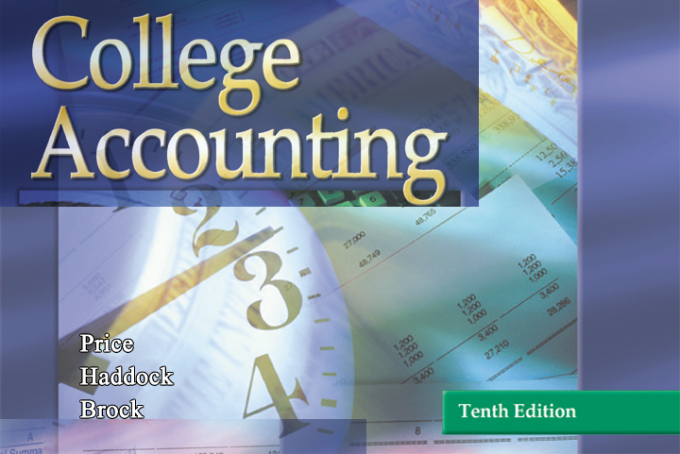

GLENCOE / McGraw-Hill

Slide 2


Merchandise Inventory

Slide 3


Inventory
Costing Methods
Section Objectives
Compute inventory cost by applying four commonly used costing methods.
Compare the different methods of inventory costing.

Slide 4

Types of Inventory Systems
Perpetual Inventory
Periodic Inventory
Page
612

Slide 5
Perpetual Inventory
Based on a running total of number of units
Uses point-of-sale cash registers and scanners
Page
612

Slide 6
Periodic Inventory
Based on a periodic count of goods on hand
Requires a physical inventory (count)
Periodic inventory is the method used in this chapter.
Page
612

Slide 7
Assigning Costs to Inventory
Page
612

Slide 8
The methods used to assign costs to inventory are based on assumptions about the physical flow of goods.
Specific Identification Method
Average Cost Method
FIFO Method
LIFO Method
Page
613

Slide 9
Specific Identification Method
A method of inventory costing based on the
actual cost of each piece of merchandise.
Automobile dealers, and merchants who deal
with items having a large unit cost or one-of-a
kind items may account for their inventory by
this method.
Page
613

Slide 10
Average Cost Method
If the company’s inventory is composed of
many similar items, it may be advantageous to
use the average cost method to value the
inventory.
With this method, the average cost of all the
similar items is used to value the ending
inventory.
Page
613

Slide 11
Average Cost Method
Steps used in determining the value of the inventory using the average cost method:
1. Add the total number of units purchased plus the
beginning inventory.
2. Calculate the total cost by adding the cost of
beginning inventory plus purchases.
3. Divide the total cost by the number of units to
determine the average cost of each item.
$3,230.00 (total cost)
340 (number of units)
=
$9.50 average cost of each item
Page
614

Slide 12
Average Cost Method
Number Unit Total
Explanation of Units Cost Cost
Beginning inventory, January 1 50 $ 8.00 $ 400.00
Purchases:
March 19 150 9.00 1,350.00
May 15 100 10.00 1,000.00
October 5 40 12.00 480.00
Total merchandise available for sale 340 $3,230.00
Average cost ($3,230/340) = $9.50
Ending inventory, December 31 48 9.50 456.00
Cost of goods sold ($3,230 - $456) 292 9.50 $2,774.00
Page
613

Slide 13
First In, First Out
Method (FIFO)
Assumes that merchants sell the oldest items
first.
The merchandise on hand at any given time is
usually the most recently purchased item.
The cost of ending inventory is computed by
referring to the cost of the latest purchases.
Page
614

Slide 14
First In, First Out
Method (FIFO)
Number Unit Total
Explanation of Units Cost Cost
From purchase
of October 5 40 $12.00 $480.00
From purchase
of May 15 8 10.00 80.00
Ending inventory 48 $560.00
Page
614

Slide 15
First In, First Out Method
The inventory valuation on the balance sheet will reflect
the most recent price levels.
The cost of goods sold will reflect the cost applicable to
the oldest goods handled during the period. In a time of
rising prices, the difference in cost of goods sold may
have a significant impact on the reported net income.
Many accountants, owners, and managers believe that
this method of valuation is less conservative and
less realistic than the LIFO method.
Page
614

Slide 16
Last In, First Out
Method (LIFO)
Assumes that merchants sell the items that were
most recently purchased.
The value assigned to the ending inventory is the
cost of the oldest merchandise on hand during the
period.
Page
614

Slide 17
Last In, First Out
Method (LIFO)
Number Unit Total
Explanation of Units Cost Cost
Beginning inventory,
Jan. 1 50 $8.00 $400.00
Ending inventory,
Dec. 31 48 $8.00 $384.00
Page
615

Slide 18
Last In, First Out
Method (LIFO)
In a time of rising prices, the relatively lower
inventory value tends to increase the reported
cost of goods sold and decrease the reported
net income.
The lower net income will produce a lower
income tax liability for the company.
Page
616

Slide 19
Comparison of Inventory
Costing Methods
Since price trends are a vital element in any inventory costing method, remember these basic rules:
In a period of rising prices, the LIFO method results in a higher reported cost of goods sold and a lower reported net income than the FIFO or average cost method.
In a period of falling prices, the LIFO method results in a lower reported cost of goods sold and a higher reported net income than the FIFO or average cost method.
Whatever direction prices take, the average cost method
results in a reported net income somewhere between the
amounts obtained with FIFO and LIFO.
Page
616

Slide 20
Inventory Costing Methods
Following the consistency principle, once the firm adopts a method, it should use that method consistently from one period to the next.
A firm can generally use one inventory costing method for financial accounting purposes and another for federal income tax purposes.
Exception: The firm must use the LIFO method for financial accounting if that method is adopted for tax purposes.
Page
616

Slide 21
R
E
V
I
E
W
Complete the following sentences:
periodic
The _______ inventory system requires a physical inventory.
Methods used to assign costs to inventory are based on assumptions about the ___________ of goods.
physical flow
specific identification method
The __________________________ is based on the actual cost of each piece of merchandise.

Slide 22
R
E
V
I
E
W
Complete the following sentences:
average cost
The ___________ method is appropriate when a company’s inventory is composed of many similar items.
first in, first out
The ______________ method assumes that merchants sell the oldest items first.
falling
In a period of ______ prices, the last in, first out method results in a higher reported net income than the first in, first out method.

Slide 23
Thank You
for using
College Accounting, Tenth Edition
Price • Haddock • Brock

