Slide 1

Inventories and Cost of Sales
Chapter
6
Notes:
1
1
1
1
1

Slide 2
Determining Inventory Items
Merchandise inventory includes all goods that a company owns and holds for sale, regardless of where the goods are located when inventory is counted.
Items requiring special attention include:
Goods in Transit
Goods Damaged or Obsolete
Goods on Consignment

Slide 3
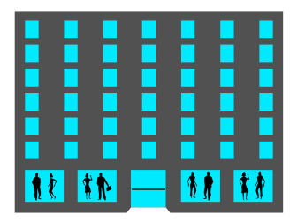
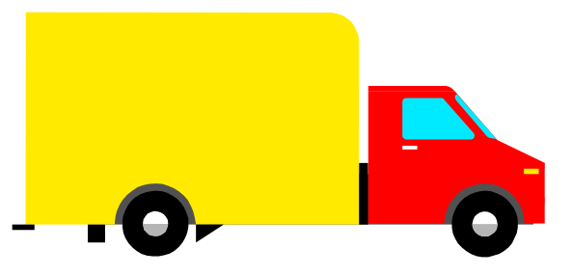

Goods in Transit
FOB Shipping Point
Public
Carrier
Seller
Buyer
Ownership passes
to the buyer here.
Public
Carrier
Seller
FOB Destination Point
Buyer

Slide 4

Goods on Consignment
Merchandise is included in the inventory of the consignor, the owner of the inventory.
Thanks for selling my inventory in your store.
Consignee
Consignor

Slide 5

Goods Damaged or Obsolete
Damaged or obsolete goods are not counted in inventory.
Cost should be reduced to net realizable value.

Slide 6
Determining Inventory Costs
Include all expenditures necessary to bring an item to a salable condition and location.
Invoice Cost
Minus Discounts
Plus
Insurance
Plus Import Duties
Plus
Freight
Plus
Storage

Slide 7

Internal Controls and Taking a Physical Count
Most companies take a physical count of inventory at least once each year.
When the physical count does not match the Merchandise Inventory account, an adjustment must be made.
Inventory
Count Tag
Quantity
Counted ___
Counted
by _______

Slide 8


Inventory Costing Under a Perpetual System
Inventory affects . . .
Balance Sheet
Income Statement
The matching principle requires matching cost of sales with sales.

Slide 9
Inventory Costing Under a Perpetual System
Accounting for inventory requires several decisions . . .
Costing Method.
  Specific Identification, FIFO, LIFO, or Weighted Average
Inventory System.
  Perpetual or Periodic
Items included in inventory and their costs.
Use of market values or other estimates.

Slide 10
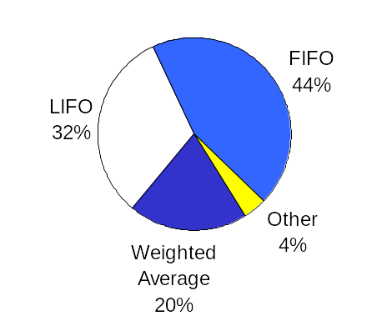
Frequency in Use of Inventory Methods
Exh.
6.1

Slide 11
Inventory Cost Flow Assumptions
First-In, First-Out
(FIFO)
Assumes costs flow in the order incurred.
Last-In, First-Out
(LIFO)
Assumes costs flow in the reverse order incurred.
Weighted
Average
Assumes costs flow at an average of the costs available.

Slide 12
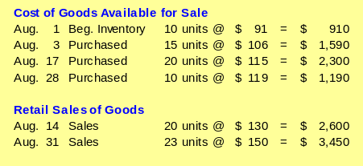
Inventory Costing Illustration

Slide 13

Specific Identification
When units are sold, the specific cost of the unit sold is added to cost of goods sold.

Slide 14


Specific Identification
The above purchases were made by Trekking in August. On August 14, Trekking sold 8 bikes originally costing $91 and 12 bikes originally costing $106.

Slide 15
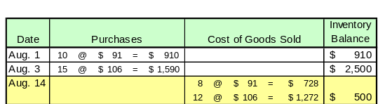
Specific Identification
The Cost of Goods Sold for the August 14 sale is $2,000.
After this sale, there are 5 units in inventory at $500:
2 @ $91
3 @ $106

Slide 16
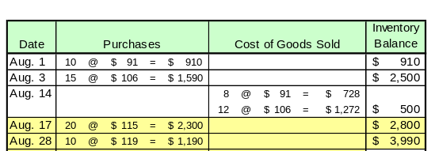
Specific Identification
Additional purchases were made on August 17 and 28.
The cost of items sold on August 31 were as follows:
2 @ $91
3 @ $106
15 @ $115
3 @ $119

Slide 17
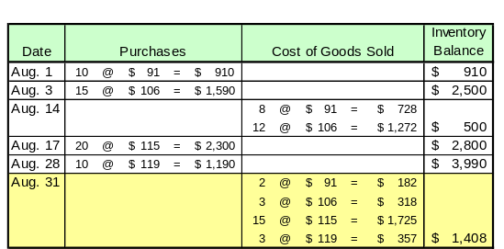
Specific Identification
Cost of Goods Sold for August 31 = $2,582

Slide 18
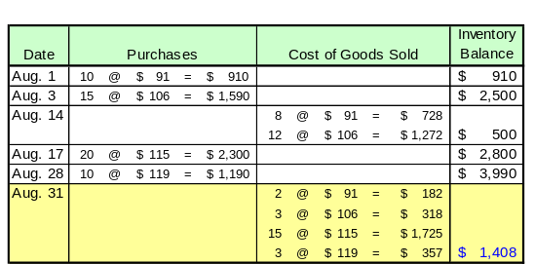
Specific Identification
After the August 31 sale, there are 12 units in inventory at $1,408:
5 @ $115
7 @ $119

Slide 19

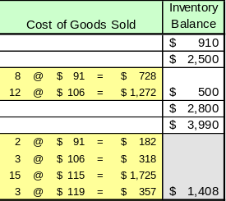
Specific Identification
Income Statement COGS = $4,582
Balance Sheet Inventory = $1,408

Slide 20
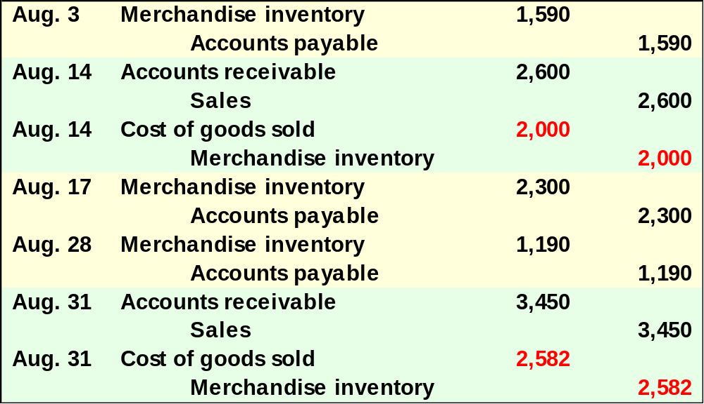
Specific Identification
Here are the entries to record the purchases and sales entries for Trekking. The numbers in red are determined by the cost flow assumption used.
All purchases and sales are made on credit.
The selling price of inventory was as follows:
8/14 $130
8/31 150

Slide 21

First-In, First-Out (FIFO)
Oldest Costs
Cost of Goods Sold
Recent Costs
Ending Inventory

Slide 22
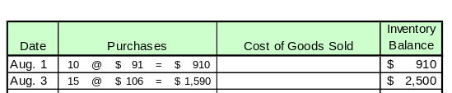
First-In, First-Out (FIFO)
The above purchases were made by Trekking in August.
On August 14, Trekking sold 20 bikes.

Slide 23
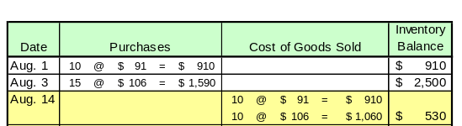
First-In, First-Out (FIFO)
The Cost of Goods Sold for the August 14 sale is $1,970.
After this sale, there are 5 units in inventory at $530:
5 @ $106

Slide 24
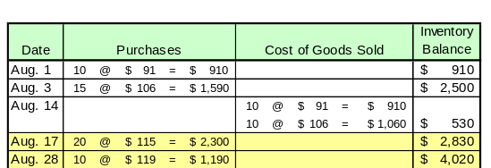
First-In, First-Out (FIFO)
Additional purchases were made on August 17 and 28.
Twenty-three bikes were sold on August 31.

Slide 25
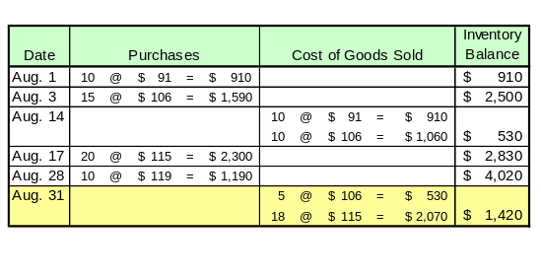
First-In, First-Out (FIFO)
Cost of Goods Sold for August 31 = $2,600

Slide 26
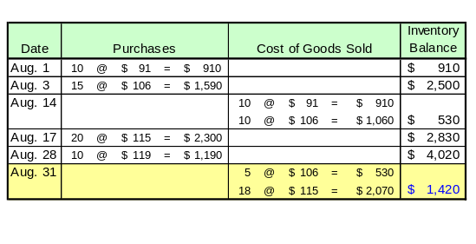
First-In, First-Out (FIFO)
After the August 31 sale, there are 12 units in inventory at $1,420:
2 @ $115
10 @ $119

Slide 27
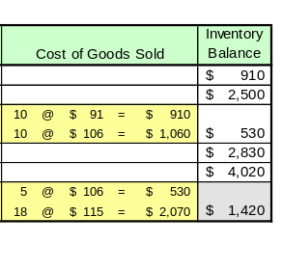
First-In, First-Out (FIFO)
Income Statement COGS = $4,570
Balance Sheet Inventory = $1,420

Slide 28

First-In, First-Out (FIFO)
Here are the entries to record the purchases and sales entries for Trekking. The numbers in red are determined by the cost flow assumption used.
All purchases and sales are made on credit.
The selling price of inventory was as follows:
8/14 $130
8/31 150

Slide 29
Last-In, First-Out (LIFO)
Recent Costs
Cost of Goods Sold
Oldest Costs
Ending Inventory

Slide 30
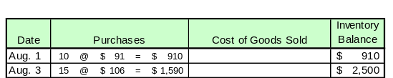
Last-In, First-Out (LIFO)
The above purchases were made by Trekking in August.
On August 14, Trekking sold 20 bikes.

Slide 31

Last-In, First-Out (LIFO)
The Cost of Goods Sold for the August 14 sale is $2,045.
After this sale, there are 5 units in inventory at $455:
5 @ $91

Slide 32
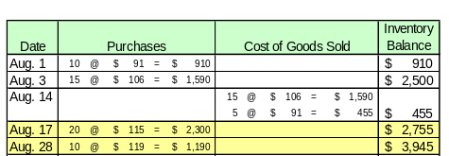
Last-In, First-Out (LIFO)
Additional purchases were made on August 17 and 28.
Twenty-three bikes were sold on August 31.

Slide 33
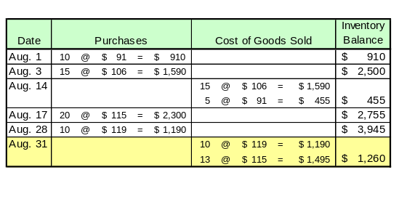
Last-In, First-Out (LIFO)
Cost of Goods Sold for August 31 = $2,685

Slide 34
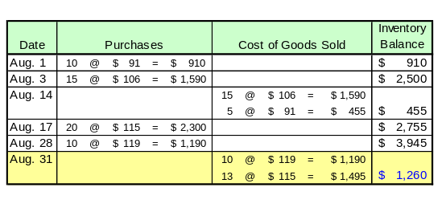
Last-In, First-Out (LIFO)
After the August 31 sale, there are 12 units in inventory at $1,260:
5 @ $91
7 @ $115

Slide 35
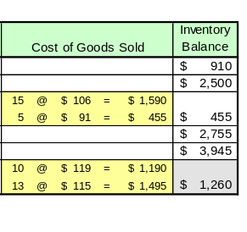
Last-In, First-Out (LIFO)
Income Statement COGS = $4,730
Balance Sheet Inventory = $1,260

Slide 36

Last-In, First-Out (LIFO)
Here are the entries to record the purchases and sales entries for Trekking. The numbers in red are determined by the cost flow assumption used.
All purchases and sales are made on credit.
The selling price of inventory was as follows:
8/14 $130
8/31 150

Slide 37

Weighted Average
When a unit is sold, the average cost of each unit in inventory is assigned to cost of goods sold.
Cost of Goods Available for Sale
Units on hand on the date of sale
÷

Slide 38

Weighted Average
The above purchases were made by Trekking in August.
On August 14, Trekking sold 20 bikes.

Slide 39
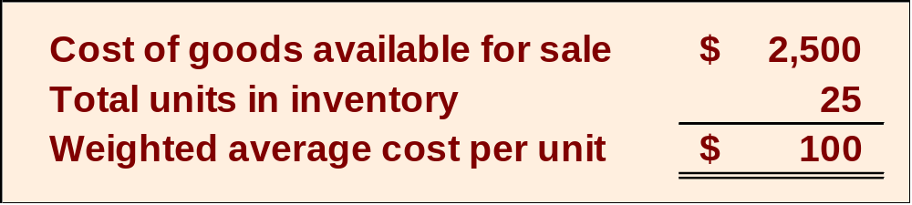
Weighted Average
First, we need to compute the weighted average cost per unit of items in inventory.
÷

Slide 40
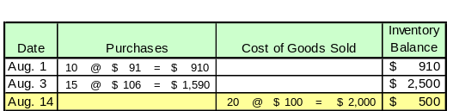
Weighted Average
The Cost of Goods Sold for the August 14 sale is $2,000.
After this sale, there are 5 units in inventory at $500:
5 @ $100

Slide 41
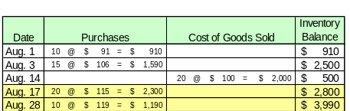
Weighted Average
Additional purchases were made on August 17 and 28.
Twenty-three bikes were sold on August 31.
What is the weighted average cost per unit of items in inventory?

Slide 42
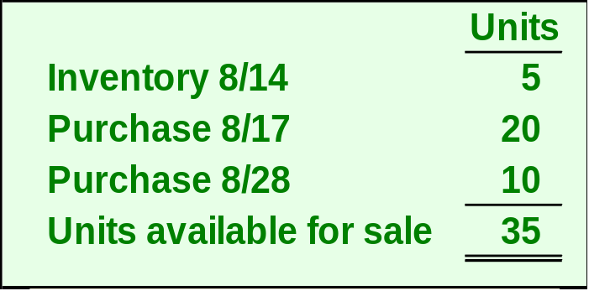
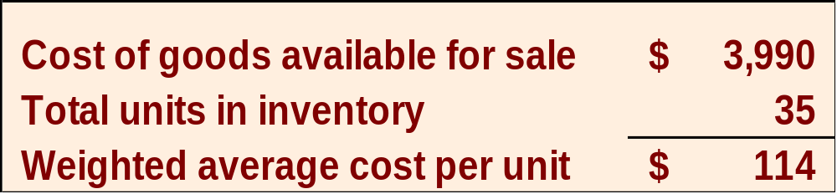
Weighted Average
÷

Slide 43
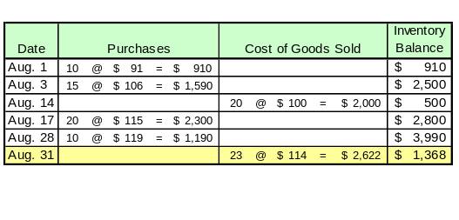
Weighted Average
Cost of Goods Sold for August 31 = $2,622

Slide 44
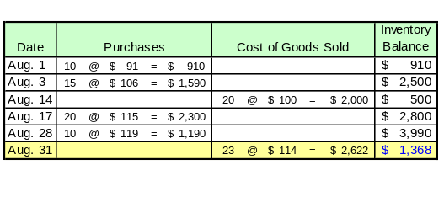
Weighted Average
After the August 31 sale, there are 12 units in inventory at $1,368:
12 @ $114

Slide 45
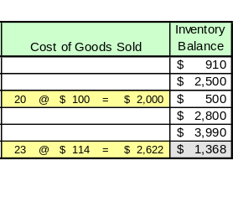
Weighted Average
Income Statement COGS = $4,622
Balance Sheet Inventory = $1,368

Slide 46

Weighted Average
Here are the entries to record the purchases and sales entries for Trekking. The numbers in red are determined by the cost flow assumption used.
All purchases and sales are made on credit.
The selling price of inventory was as follows:
8/14 $130
8/31 150

Slide 47
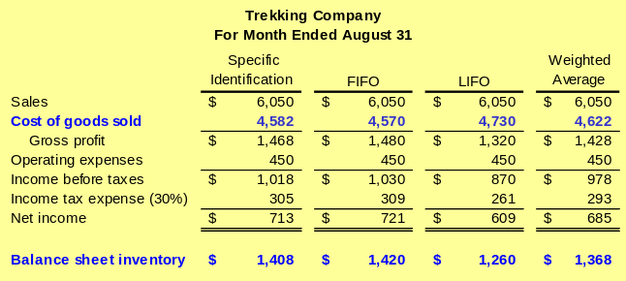
Financial Statement Effects of Costing Methods
Exh.
6.8
Because prices change, inventory methods nearly always assign different cost amounts.

Slide 48
Financial Statement Effects of Costing Methods
Advantages of Methods
Weighted Average
First-In, First-Out
Last-In, First-Out
Smooths out price changes.
Ending inventory approximates current replacement cost.
Better matches current costs in cost of goods sold with revenues.

Slide 49

Tax Effects of Costing Methods
The Internal Revenue Service (IRS) identifies several acceptable methods for inventory costing for reporting taxable income.
If LIFO is used for tax purposes, the IRS requires it be used in financial statements.

Slide 50

Consistency in Using Costing Methods
The consistency principle requires a company to use the same accounting methods period after period so that financial statements are comparable across periods.

Slide 51
Lower of Cost or Market
Inventory must be reported at market value when market is lower than cost.
Defined as current replacement cost (not sales price).
Consistent with
the conservatism
principle.
Can be applied three ways:
(1) separately to each individual item.
(2) to major categories of assets.
(3) to the whole inventory.

Slide 52
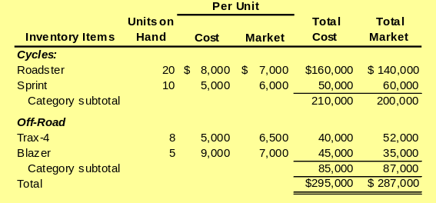
Lower of Cost or Market
A motorsports retailer has the following items in inventory:

Slide 53
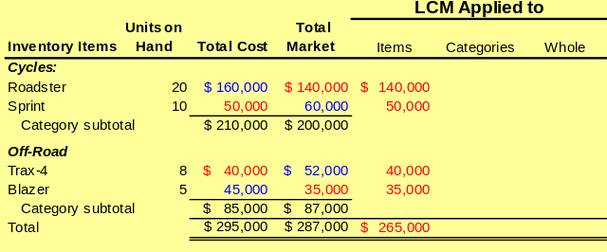
Lower of Cost or Market
Here is how to compute lower of cost or market for individual inventory items.

Slide 54
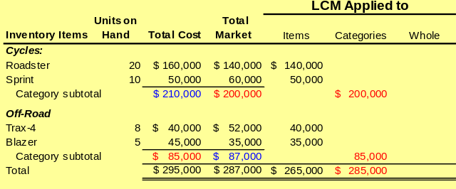
Lower of Cost or Market
Here is how to compute lower of cost or market for the two groups of inventory items.

Slide 55
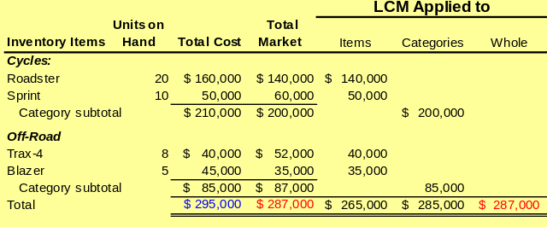
Lower of Cost or Market
Here is how to compute lower of cost or market for the entire inventory.

Slide 56
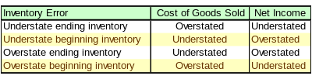

Financial Statement Effects of Inventory Errors
Exh.
6.10
Income Statement Effects

Slide 57


Financial Statement Effects of Inventory Errors
Exh.
6.12
Balance Sheet Effects

Slide 58
Inventory Turnover
Shows how many times a company turns over its inventory during a period. Indicator of how well management is controlling the amount of inventory available.
Inventory
Cost of goods sold
=
Turnover
Avg. inventory

Slide 59

Days’ Sales in Inventory
Reveals how much inventory is available in terms of the number of days’ sales.
Days' Sales in
Ending Inventory
=
×
365
Inventory
Cost of goods sold

Slide 60

End of Chapter 6

