Slide 1


GLENCOE / McGraw-Hill

Slide 2


Accounting
for Purchases
and Accounts Payable

Slide 3
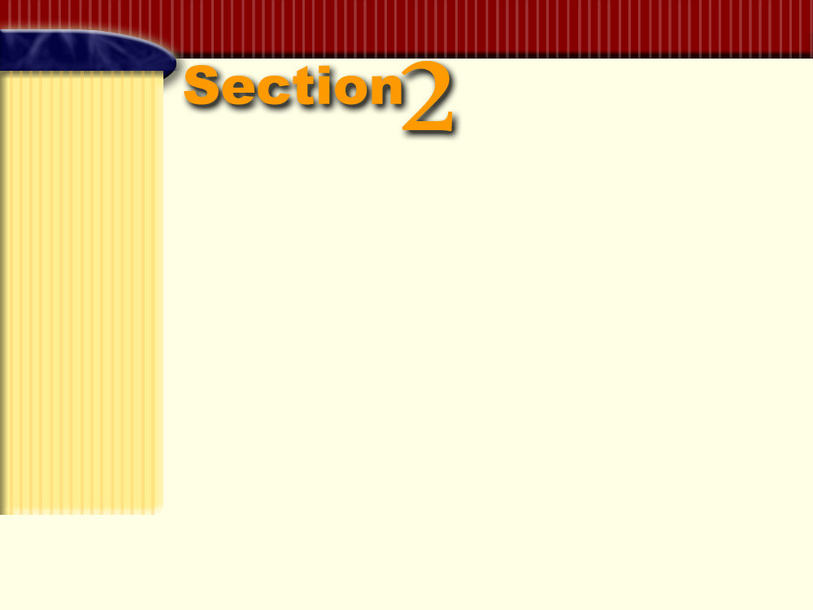

Accounts
Payable
Section Objectives
Post credit purchases from the purchases journal to the accounts payable subsidiary ledger.
Record purchases returns and allowances in the general journal and post them to the accounts payable subsidiary ledger.
Prepare a schedule of accounts payable.
Compute the net delivered cost of purchases.
Demonstrate a knowledge of the procedures for effective internal control of purchases.

Slide 4

The Accounts Payable Ledger
Page
262

Slide 5
QUESTION:
What is an accounts payable ledger?
ANSWER:
An accounts payable ledger is a subsidiary ledger that contains a separate account for each creditor.
Page
262

Slide 6
The Accounts Payable Ledger
NAME Clothes Rack Depot TERMS n/30
ADDRESS 1677 Mandela Lane, Dallas, Texas 75267-6205
DATE DESCRIPTION POST. DEBIT CREDIT BALANCE
REF.
20--
JAN.
1 Balance  800.00
23 Invoice 7985, 01/22/-- P1 2,560.00 3,360.00
The accounts payable ledger has three money columns.
The Balance column is presumed to contain credit amounts.
Page
262

Slide 7
Posting a Credit Purchase
Page
262

Slide 8
Objective 3
Post credit purchases from
the purchases journal to
the accounts payable
subsidiary ledger.
Page
262

Slide 9
To keep the accounting records up to date, invoices are posted to the accounts payable subsidiary ledger every day.
Page
262

Slide 10
Steps to post to the accounts payable ledger
Locate the accounts payable ledger account for the creditor Clothes Rack Depot.
NAME Clothes Rack Depot TERMS n/30
ADDRESS 1677 Mandela Lane, Dallas, Texas 75267-6205
DATE DESCRIPTION POST. DEBIT CREDIT BALANCE
REF.
20--
JAN.
1 Balance  800.00
23 Invoice 7985, 01/22/-- P1 2,560.00 3,360.00
Page
262

Slide 11

Enter the date, invoice number and date, and the page number from the purchases journal.
PAGE 1
PURCHASES JOURNAL
DATE CREDITOR’S INVOICE INV. TERMS POST. ACCOUNTS PURCHASES FREIGHT IN
ACCOUNT NUMBER DATE REF. PAYABLE DEBIT DEBIT
CREDITED CREDIT
20--
Jan. 3 Sebrina’s Clothing Store 8434 12/29/-- 2/10, n/30 3,250.00 3,000.00 250.00
18 Designer’s Fashion 9789 01/15/-- 2/10, n/30 2,100.00 1,930.00 170.00
23 Clothes Rack Depot 7985 01/22/-- 2/10, n/30 2,560.00 2,380.00 180.00
✓
✓
3
NAME Clothes Rack Depot TERMS n/30
ADDRESS 1677 Mandela Lane, Dallas, Texas 75267-6205
DATE DESCRIPTION POST. DEBIT CREDIT BALANCE
REF.
20--
JAN.
1 Balance 800.00
23 Invoice 7985, 01/22/-- P1 2,560.00 3,360.00
1
2
Page
262

Slide 12
Enter the amount from the Accounts Payable Credit column in the purchases journal in the Credit column of the accounts payable subsidiary ledger.
PAGE 1
PURCHASES JOURNAL
DATE CREDITOR’S INVOICE INV. TERMS POST. ACCOUNTS PURCHASES FREIGHT IN
ACCOUNT NUMBER DATE REF. PAYABLE DEBIT DEBIT
CREDITED CREDIT
20--
Jan. 3 Sebrina’s Clothing Store 8434 12/29/-- 2/10, n/30 3,250.00 3,000.00 250.00
18 Designer’s Fashion 9789 01/15/-- 2/10, n/30 2,100.00 1,930.00 170.00
23 Clothes Rack Depot 7985 01/22/-- 2/10, n/30 2,560.00 2,380.00 180.00
✓
✓
3
NAME Clothes Rack Depot TERMS n/30
ADDRESS 1677 Mandela Lane, Dallas, Texas 75267-6205
DATE DESCRIPTION POST. DEBIT CREDIT BALANCE
REF.
20--
JAN.
1 Balance 800.00
23 Invoice 7985, 01/22/-- P1 2,560.00 3,360.00
1
2
4
Page
262

Slide 13
Compute and enter the new balance in the Balance column.
PAGE 1
PURCHASES JOURNAL
DATE CREDITOR’S INVOICE INV. TERMS POST. ACCOUNTS PURCHASES FREIGHT IN
ACCOUNT NUMBER DATE REF. PAYABLE DEBIT DEBIT
CREDITED CREDIT
20--
Jan. 3 Sebrina’s Clothing Store 8434 12/29/-- 2/10, n/30 3,250.00 3,000.00 250.00
18 Designer’s Fashion 9789 01/15/-- 2/10, n/30 2,100.00 1,930.00 170.00
23 Clothes Rack Depot 7985 01/22/-- 2/10, n/30 2,560.00 2,380.00 180.00
✓
✓
3
NAME Clothes Rack Depot TERMS n/30
ADDRESS 1677 Mandela Lane, Dallas, Texas 75267-6205
DATE DESCRIPTION POST. DEBIT CREDIT BALANCE
REF.
20--
JAN.
1 Balance 800.00
23 Invoice 7985, 01/22/-- P1 2,560.00 3,360.00
1
2
4
5
Page
262

Slide 14
In the purchases journal, enter the check mark in the Posting Reference column. This indicates that the transaction is posted in the accounts payable subsidiary ledger.
PAGE 1
PURCHASES JOURNAL
DATE CREDITOR’S INVOICE INV. TERMS POST. ACCOUNTS PURCHASES FREIGHT IN
ACCOUNT NUMBER DATE REF. PAYABLE DEBIT DEBIT
CREDITED CREDIT
20--
Jan. 3 Sebrina’s Clothing Store 8434 12/29/-- 2/10, n/30 3,250.00 3,000.00 250.00
18 Designer’s Fashion 9789 01/15/-- 2/10, n/30 2,100.00 1,930.00 170.00
23 Clothes Rack Depot 7985 01/22/-- 2/10, n/30 2,560.00 2,380.00 180.00
6
✓
✓
3
NAME Clothes Rack Depot TERMS n/30
ADDRESS 1677 Mandela Lane, Dallas, Texas 75267-6205
DATE DESCRIPTION POST. DEBIT CREDIT BALANCE
REF.
20--
JAN.
1 Balance 800.00
23 Invoice 7985, 01/22/-- P1 2,560.00 3,360.00
1
2
4
5
Page
262

Slide 15
Posting Cash Paid on Account
Page
263

Slide 16
When cash is paid to a supplier for an outstanding invoice, the transaction is first recorded in a cash payments journal.
Sneak Preview!Page 299
Page
263

Slide 17
The cash payment is then posted to the individual creditor’s account in the accounts payable ledger.
NAME Clothes Rack Depot TERMS n/30
ADDRESS 1677 Mandela Lane, Dallas, Texas 75267-6205
DATE DESCRIPTION POST. DEBIT CREDIT BALANCE
REF.
20--
Jan. 1 Balance ✓ 800.00
23 Invoice 7985, 01/22/-- P1 2,560.00 3,360.00
27 CP1 1,200.00 2,160.00
Posted from page 1 of the cash payments journal
Page
263

Slide 18
Purchases Returns and Allowances
Page
263

Slide 19
Objective 4
Record purchases returns
and allowances in the general
journal and post them to the
accounts payable subsidiary ledger.
Page
263

Slide 20
QUESTION:
What is a purchase return?
ANSWER:
A purchase return is a return of unsatisfactory goods.
Page
263

Slide 21
QUESTION:
What is a purchase allowance?
ANSWER:
A purchase allowance is a price reduction from the amount originally billed.
Page
263

Slide 22
A credit to the Purchases Returns and Allowances account is preferred to making a direct credit to Purchases.
Purchases
Returns
and
Allowances
Page
263

Slide 23
A credit to the Purchase Returns and Allowances account is preferred to making a direct credit to Purchases.
Purchases Returns and Allowances
Returns
and
Allowances
Page
263

Slide 24
Purchases Returns and Allowances Account
A complete record of returns and allowances
A contra cost of goods sold account
Normal credit balance
Page
263

Slide 25
Recording Purchases Returns and Allowances
Page
263

Slide 26
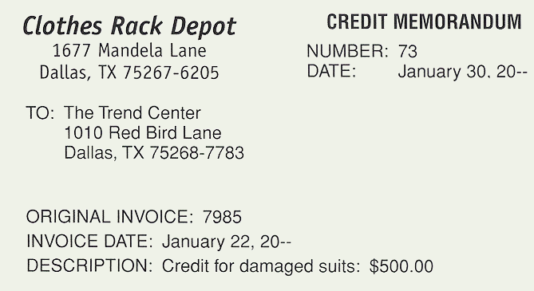
Business Transaction
On January 30 The Trend Center received a credit
memorandum for $500 from Clothes Rack Depot as an
allowance for damaged merchandise.
Page
264

Slide 27
Purchase Allowance
Which account is debited?
Which account is credited?
For what amount?
For what amount?
Page
264

Slide 28
Purchase Allowance
Accounts Payable
Purchases Returns and Allowances
500
500
Page
264

Slide 29
Posting a Purchases Return or Allowance
Page
264

Slide 30
Whether recorded in the general journal or in a special journal, it is important to promptly post returns and allowances to the creditor’s account in the accounts payable ledger.
Page
264

Slide 31
Posting from the General Journal
GENERAL JOURNAL PAGE 2
DATE DESCRIPTION POST.
REF. DEBIT CREDIT
Jan. 30 Accounts Payable/ 205/ ✓  500.00
Clothes Rack Depot
Purchases Returns and Allowances 503 500.00
Received Credit Memo 73 for
an allowance for damaged
merchandise; original Invoice
7985, Jan. 22, 20--
Enter the date, the credit memorandum number, and the general journal page number.
Page
1
2
3
265
NAME Clothes Rack Depot TERMS n/30
ADDRESS 1677 Mandela Lane, Dallas, Texas 75267-6205
DATE DESCRIPTION POST. DEBIT CREDIT BALANCE
REF.
20--
JAN.
1 Balance ✓ 800.00
23 Invoice 7985, 01/22/-- P1 2,560.00 3360.00
27 CP1 1,200.00 2160.00
30 CM 73 J2 500.00 1660.00

Slide 32
Posting from the General Journal
GENERAL JOURNAL PAGE 2
DATE DESCRIPTION POST.
REF. DEBIT CREDIT
Jan. 30 Accounts Payable/ 205/ ✓  500.00
Clothes Rack Depot
Purchases Returns and Allowances 503 500.00
Received Credit Memo 73 for
an allowance for damaged
merchandise; original Invoice
7985, Jan. 22, 20--
Enter the amount of the return or allowance in the Debit column of the creditor’s account.
Page
1
2
3
265
NAME Clothes Rack Depot TERMS n/30
ADDRESS 1677 Mandela Lane, Dallas, Texas 75267-6205
DATE DESCRIPTION POST. DEBIT CREDIT BALANCE
REF.
20--
JAN.
1 Balance ✓ 800.00
23 Invoice 7985, 01/22/-- P1 2,560.00 3360.00
27 CP1 1,200.00 2160.00
30 CM 73 J2 500.00 1660.00
4

Slide 33
Posting from the General Journal
GENERAL JOURNAL PAGE 2
DATE DESCRIPTION POST.
REF. DEBIT CREDIT
Jan. 30 Accounts Payable/ 205/ ✓  500.00
Clothes Rack Depot
Purchases Returns and Allowances 503 500.00
Received Credit Memo 73 for
an allowance for damaged
merchandise; original Invoice
7985, Jan. 22, 20--
Compute the new balance and enter it in the Balance column.
Page
1
2
3
265
NAME Clothes Rack Depot TERMS n/30
ADDRESS 1677 Mandela Lane, Dallas, Texas 75267-6205
DATE DESCRIPTION POST. DEBIT CREDIT BALANCE
REF.
20--
JAN.
1 Balance ✓ 800.00
23 Invoice 7985, 01/22/-- P1 2,560.00 3360.00
27 CP1 1,200.00 2160.00
30 CM 73 J2 500.00 1660.00
4
5

Slide 34
Posting from the General Journal
GENERAL JOURNAL PAGE 2
DATE DESCRIPTION POST.
REF. DEBIT CREDIT
Jan. 30 Accounts Payable/ 205/ ✓  500.00
Clothes Rack Depot
Purchases Returns and Allowances 503 500.00
Received Credit Memo 73 for
an allowance for damaged
merchandise; original Invoice
7985, Jan. 22, 20--
6
In the general journal, enter a check mark to show that the transaction was posted to the creditor’s account in the accounts payable subsidiary ledger.
Page
1
2
3
265
NAME Clothes Rack Depot TERMS n/30
ADDRESS 1677 Mandela Lane, Dallas, Texas 75267-6205
DATE DESCRIPTION POST. DEBIT CREDIT BALANCE
REF.
20--
JAN.
1 Balance ✓ 800.00
23 Invoice 7985, 01/22/-- P1 2,560.00 3360.00
27 CP1 1,200.00 2160.00
30 CM 73 J2 500.00 1660.00
4
5

Slide 35
Schedule of Accounts Payable
Page
265

Slide 36
Objective 5
Prepare a schedule of
accounts payable.
Page
265

Slide 37
The total of the individual creditor accounts in the subsidiary ledger must equal the balance of the Accounts Payable control account.
To prove that the control account and the subsidiary ledger are equal, businesses prepare a schedule of accounts payable.
Page
265

Slide 38
QUESTION:
What is a schedule of accounts payable?
ANSWER:
A schedule of accounts payable is a list of all balances owed to creditors.
Page
265

Slide 39
The Trend Center
Schedule of Accounts Payable
January 31, 20--
Clothes Rack Depot 1,660.00
Designer’s Fashions 2,100.00
Fashion World 2,240.00
Sebrina’s Clothing Store 700.00
The Style Shop 520.00
The Women’s Shop 3,720.00
Total 10,940.00
A comparison of the total of the schedule of accounts payable and the balance of the Accounts Payable account shows that the two figures are the same.
ACCOUNT Accounts Payable ACCOUNT NO. 205
DATE DESCRIPTION POST. DEBIT CREDIT BALANCE
REF. DEBIT CREDIT
20--
Jan. 1 Balance ✓ 5,400.00
30 J1 500.00 4,900.00
31 P1 18,750.00 23,650.00
31 CP1 12,710.00 10,940.00
Page
267

Slide 40
Determining the Cost of Purchases
Page
267

Slide 41
Objective 6
Compute the net delivered
cost of purchases.
Page
267

Slide 42
The income statement of a merchandising
business contains a section showing the total
cost of purchases.
This section combines information about
  Cost of the purchases
  Freight in
  Purchases returns and allowances
Page
267

Slide 43
The net delivered cost of purchases for The Trend Center for January is calculated as follows.
Purchases $28,125
Freight In 2,295
Delivered Cost of Purchases $30,420
Less Purchases Returns and Allowances 4,250
Net Delivered Cost of Purchases $26,170
Page
267

Slide 44
For firms that do not have freight charges, the amount of net purchases is calculated as follows.
Purchases $28,125
Less Purchases Returns and Allowances 4,250
Net Purchases $23,875
Page
268

Slide 45
Internal Control of Purchases
Page
268

Slide 46
Objective 7
Demonstrate a knowledge of
the procedures for effective
internal control of purchases.
Page
268

Slide 47
The objectives of the controls are to
create written proof that purchases and
payments are authorized, and
ensure that different people are involved
in the process of buying goods, receiving
goods, and making payments.
Page
268

Slide 48
Effective systems have the following controls in place.
1. All purchases should be made only after proper authorization has been given in writing.
2. Goods should be carefully checked when they are
received. They should then be compared with the
purchase order and with the invoice received from the
supplier.
3. The purchase order, receiving report, and invoice should
be checked to confirm that the information on the
documents is in agreement.
Page
269

Slide 49
4. The computations on the invoice should be checked
for accuracy.
5. Authorization for payment should be made by someone
other than the person who ordered the goods, and this
authorization should be given only after all the
verifications have been made.
6. Another person should write the check for payment.
7. Prenumbered forms should be used for purchase
requisitions, purchase orders, and checks. Periodically the
numbers of the documents issued should be verified to
make sure that all forms can be accounted for.
Page
269

Slide 50
R
E
V
I
E
W
Complete the following sentences:
A subsidiary ledger that contains a separate account for each creditor is called the _____________________.
accounts payable ledger
Purchases
The _________ account accumulates the cost of merchandise bought for resale.
reduction
A purchase allowance is a price ________ from the amount originally billed.

Slide 51
R
E
V
I
E
W
Complete the following sentences:
schedule of accounts payable
The __________________________ lists all balances of the accounts in the accounts payable subsidiary ledger.
The Purchase Returns and Allowances account is classified as a ____________ __________ account.
contra cost of
goods sold
The accounts used to determine net delivered cost of purchases are __________, _________, and _____________________ __________.
Purchases
Freight In
Purchases Returns and
Allowances

Slide 52
Thank You
for using
College Accounting, Tenth Edition
Price • Haddock • Brock

