Slide 1

Accounting Information Systems
Chapter
7
Notes:
1
1
1
1
1

Slide 2

Fundamental System Principles
Control Principle
Internal controls for management to monitor the business.
Flexibility Principle Need to change as company and environment change.
Relevance Principle Provide relevant, timely and pertinent information.
Cost-Benefit Principle Benefits of the system must outweigh the costs incurred.
Compatibility Principle System must be compatible with aims of the company.
Notes:
2
2

Slide 3

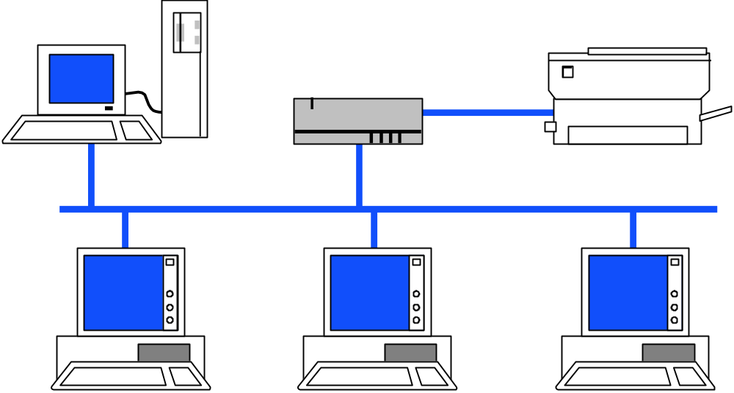
Components of Accounting Systems
Source Documents
Invoice from supplier
Increasingly, source documents are electronic files creating a “paperless” system.
Employee earnings records
Billings to customers
Notes:
3
3

Slide 4

Components of Accounting Systems
Source Documents
Input
Keyboards
Scanners
Modems
Bar-Code Reader
Notes:
3
3

Slide 5

Components of Accounting Systems
Source Documents
Input
Hardware
Software
Professional Judgment
Processor
Notes:
3
3

Slide 6

Components of Accounting Systems
Source Documents
Input
CD
Hard Drive
Tape
Paper Document
Processor
Storage
Notes:
3
3

Slide 7
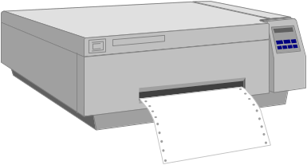
Components of Accounting Systems
Printer
Monitor
Telephone
CD
Tape
Disk
Electronic File
Source Documents
Input
Processor
Storage
Output
Notes:
3
3

Slide 8

Now, let’s look at how we use special journals in accounting.
Notes:
5
73

Slide 9
Special Journals in Accounting
Sales Journal
Cash Receipts
Journal
For recording
credit sales
For recording
cash receipts
Purchases
Journal
Cash
Disbursements
Journal
For recording
credit purchases
General
Journal
For recording
cash payments
For transactions
not in special
journals
Notes:
5
73

Slide 10
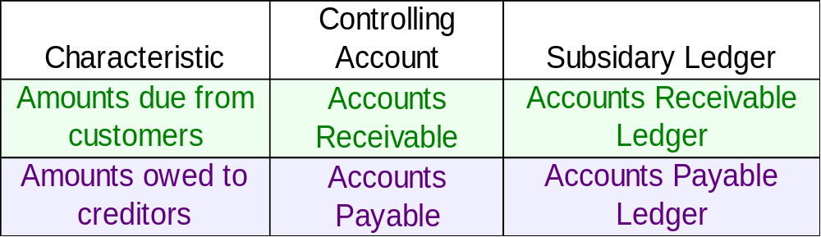
Subsidiary Ledgers
Subsidiary ledgers are a listing of individual accounts with common characteristics.
Notes:
5
73

Slide 11
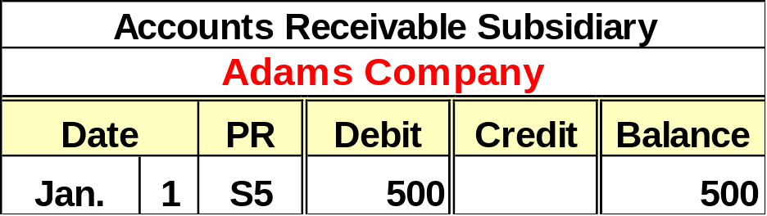
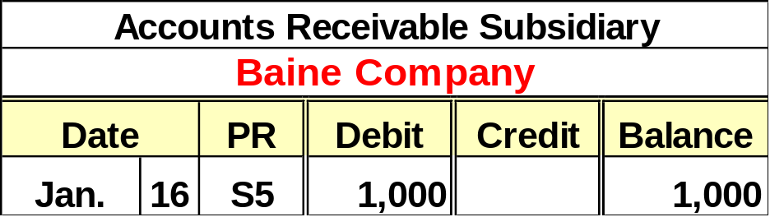
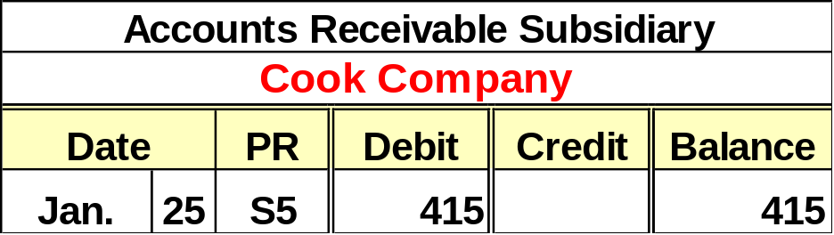

Accounts Receivable Ledger
After all items are posted, the balance in the accounts receivable controlling account is equal to the sum of the balances in the subsidiary ledger.
Notes:
5
73

Slide 12

Sales Journal
On January 1, Jim Carson purchased $600 of merchandise on account from Barry’s Bikes. Record the entry in the Sales Journal.
(Assume the use of a periodic inventory system.)
Notes:
5
73

Slide 13
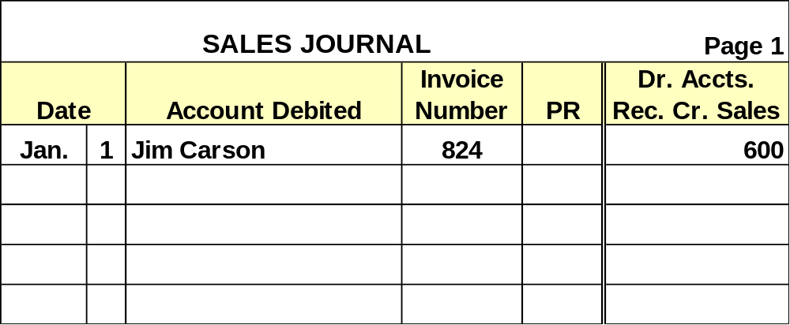
Sales Journal
Each transaction yields a debit to Accounts Receivable and a credit to Sales. We need only one column for this transaction. This column total is posted monthly.
Notes:
5
73

Slide 14
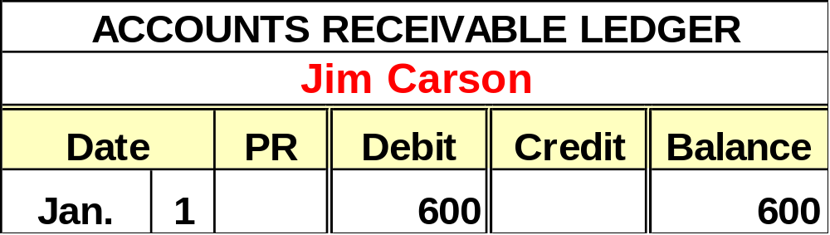
Sales Journal
Daily, each transaction is posted to the appropriate accounts receivable subsidiary account.
Notes:
5
73

Slide 15
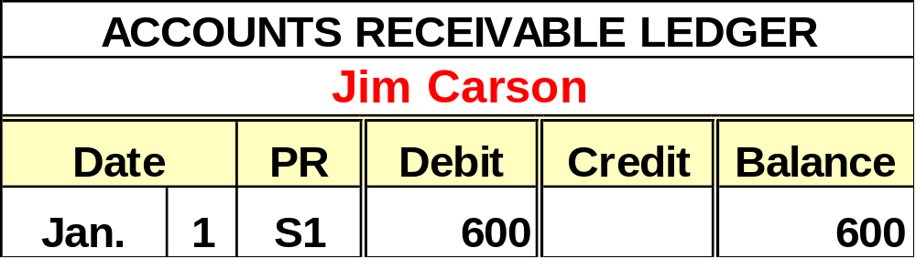
Sales Journal
A ✓ in the posting reference column indicates the transaction was posted to the subsidiary account.
Notes:
5
73

Slide 16
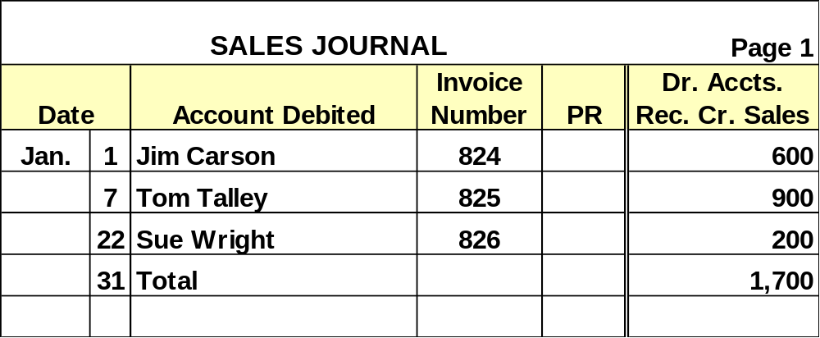
Sales Journal
Here is the Sales Journal after recording some additional sales.
Notes:
5
73

Slide 17


Sales Journal
Post the total to the General Ledger accounts.
Notes:
5
73

Slide 18


Sales Journal
Notes:
5
73

Slide 19
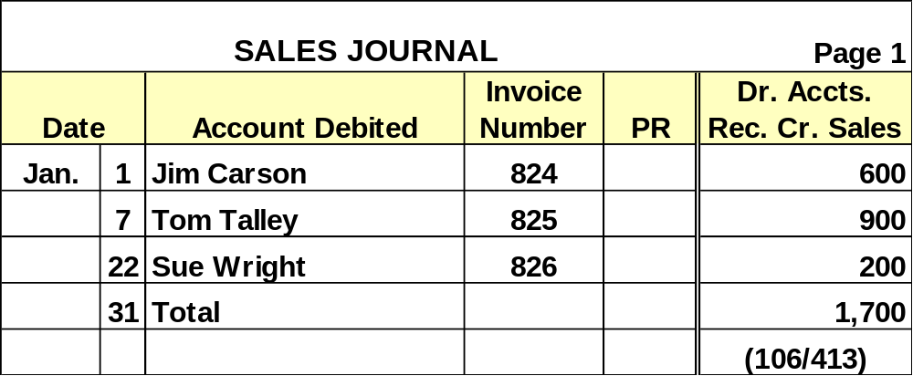
Sales Journal
Notes:
5
73

Slide 20
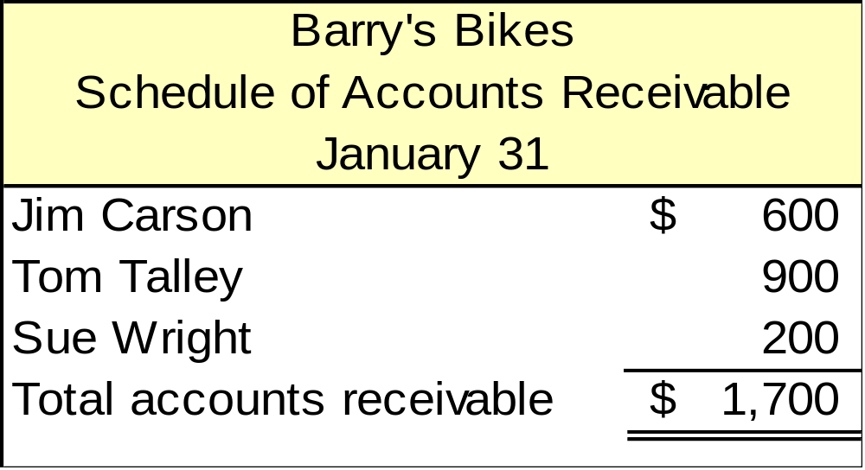
Proving the Ledgers
The Accounts Receivable controlling account and the subsidiary ledger are in balance.
Notes:
5
73

Slide 21
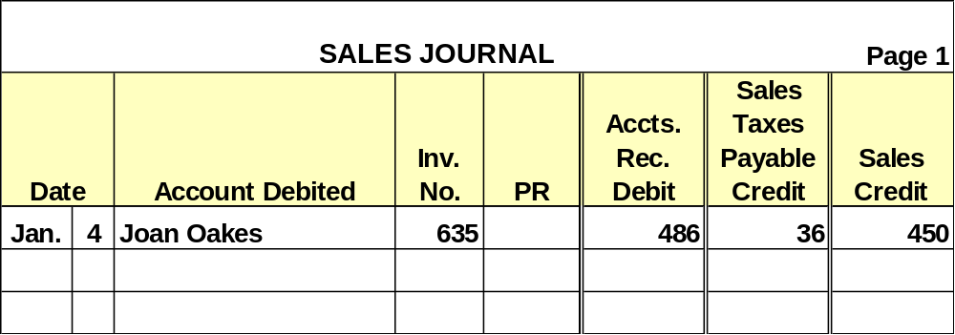
Sales Taxes
On January 4, Jeri’s Jewelry sold a necklace for $450 plus 8% sales tax on credit to Joan Oakes.
$450 × .08 = $36
Notes:
5
73

Slide 22
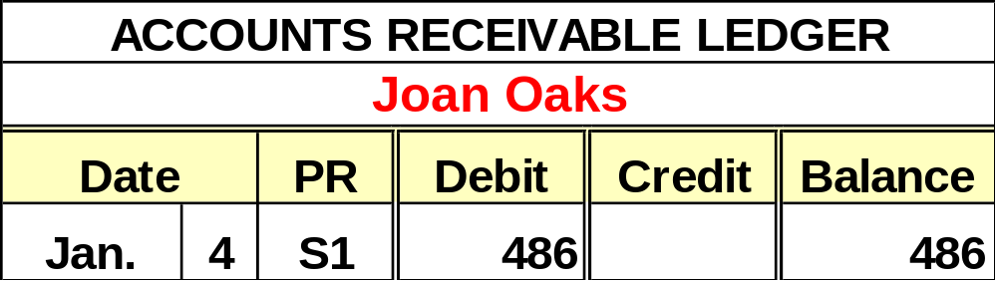
Sales Tax
Each transaction is posted daily to the appropriate Accounts Receivable Ledger account.
Column totals are posted monthly.
Notes:
5
73

Slide 23
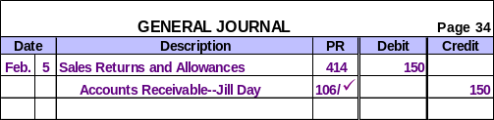
Sales Returns and Allowances
If a company has few sales returns, they may be recorded in the General Journal.
A company with many sales returns, may use a Sales Returns and Allowances Journal.
Notes:
5
73

Slide 24
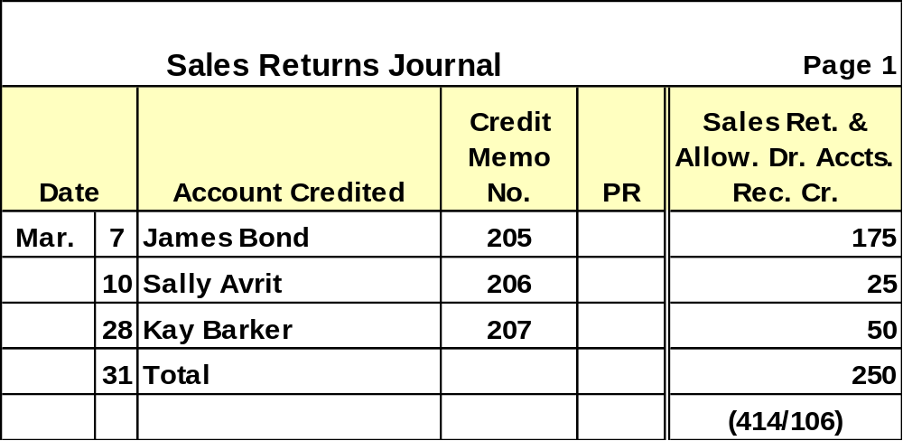
Sales Returns and Allowances
Each transaction is posted daily to the appropriate Accounts Receivable subsidiary account.
Column totals are posted monthly.
Notes:
5
73

Slide 25
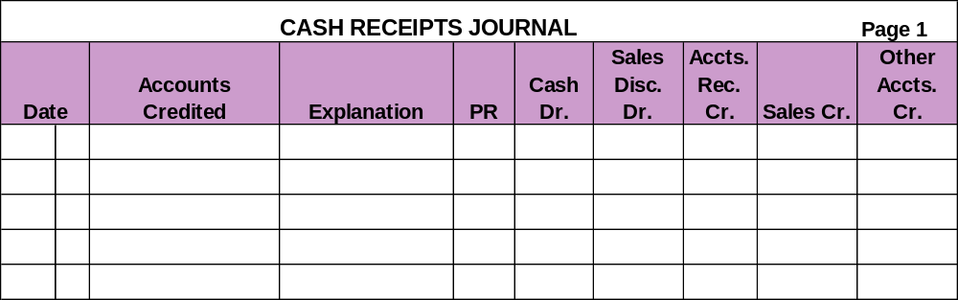
Cash Receipts Journal
Categories of Cash Receipts
  Cash from cash sales
  Cash from credit customers
  Cash from other sources
Notes:
5
73

Slide 26

Cash Receipts Journal
CASH RECEIPTS JOURNAL
Page 1
Sales
Accts.
Accounts
Cash
Disc.
Rec.
Other
Date
Credited
Explanation
PR
Dr.
Dr.
Cr.
Sales Cr.
Accts. Cr.
May
7
Sales
Cash Sales
✓
✓
300
300
16
Jane Waters
Invoice 656
✓
441
9
450
31
Interest Revenue
Bank Acct.
409
15
15
31
Total
756
9
450
300
15
(101)
(415)
(106)
(413)
(
✓
✓
)
     
Amount is not posted individually to an account.
✓
Amount is posted individually to subsidiary ledger.
Acct. No.
Amount is posted to specified account.
Notes:
5
73

Slide 27

Purchases Journal
The Purchases Journal is used to record all purchases on credit.

Slide 28
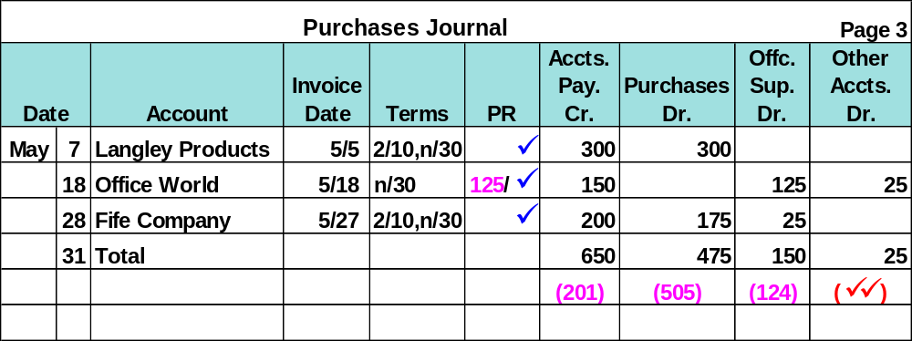
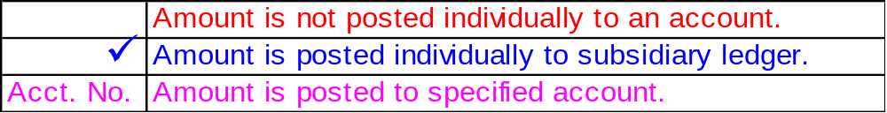
Purchases Journal
Notes:
5
73

Slide 29
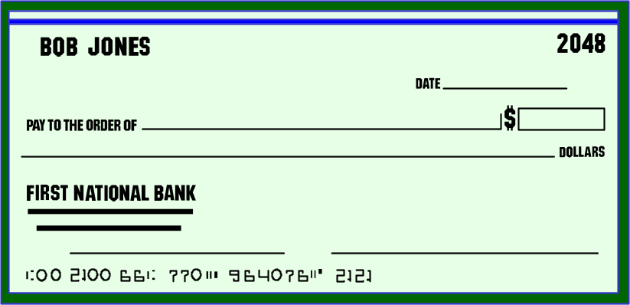
Cash Disbursements Journal
The Cash Disbursements Journal is used to record all payments of cash.
Notes:
5
73

Slide 30
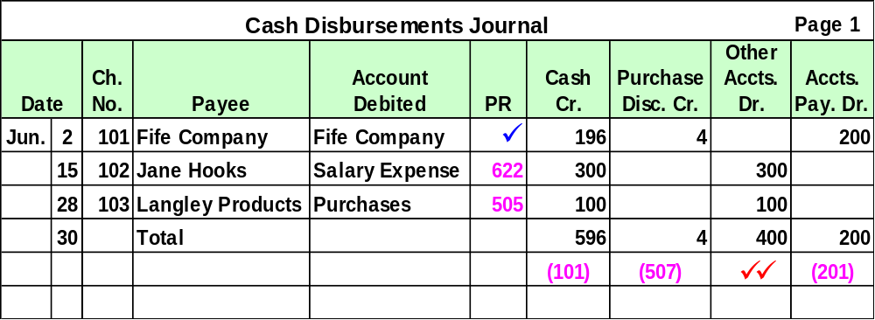

Cash Disbursements Journal
( )
Notes:
5
73

Slide 31

General Journal Transactions
Adjusting Entries
Reversing Entries
Closing Entries
Other transactions not recorded in Special Journals
Notes:
5
73

Slide 32

Technology-Based Accounting Systems
Hardware
Processing units
Hard Drives
RAM
Modems
CD-ROM Drives
Speakers
Monitors
Servers
Printers
Software
Programs with a series of commands directing operations of computer hardware such as data input, storage, processing, or output

Slide 33

Computer Technology in Accounting
Integrated accounting programs automatically update related accounts, journals, and ledgers for a single transaction.

Slide 34

Data Processing in Accounting
On-line processing enters and processes data immediately.
Batch processing accumulates information for a period of time and then processes all the data at one time (daily, weekly, or monthly).

Slide 35
Computer Networks in Accounting
Server
Work Stations
Computer networks are links among computers giving different users access to a common database and programs.

Slide 36

Enterprise Resource Planning Software
Enterprise resource planning software, such as SAP or Oracle, links ordering, inventory, production, purchasing, planning, tracking and human resources for many of the world’s largest companies.

Slide 37

Segment Return on Assets
A good AIS collects financial data for a company’s various segments.
A segment is a part of a company that is separately identified by its products, services, or geographic market.

Slide 38
Segment Return on Assets
Segment return
on assets
Segment operating income
Segment average assets
=
This ratio reflects the profitability of the segment.

Slide 39

End of Chapter 7

