Slide 1
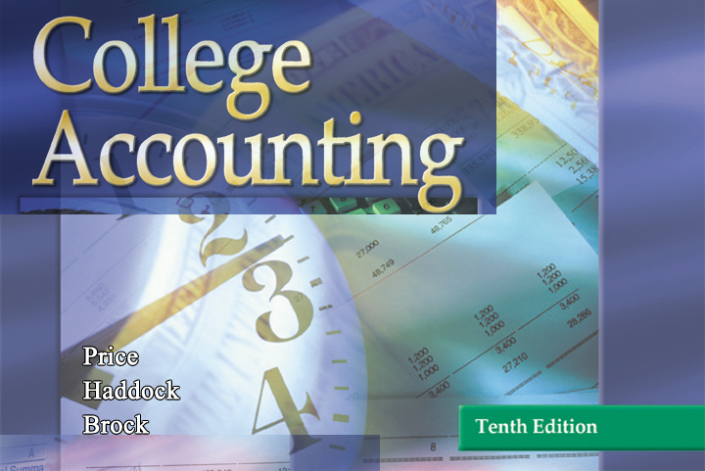

GLENCOE / McGraw-Hill

Slide 2


Cash
Receipts,
Cash
Payments,
and Banking Procedures

Slide 3
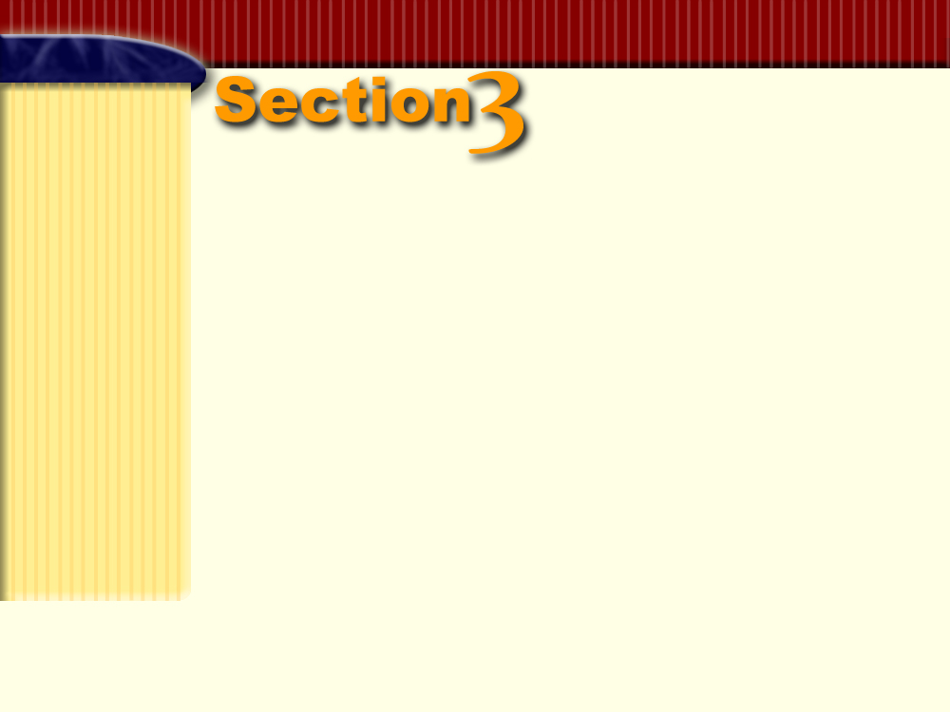

Banking
Procedures
Section Objectives
Write a check, endorse checks, prepare a bank deposit slip, and maintain a checkbook balance.
Reconcile the monthly bank statement.
Record any adjusting entries required from the bank reconciliation.

Slide 4

Objective 8
Write a check, endorse checks,
prepare a bank deposit slip, and
maintain a checkbook balance.
Page
310

Slide 5
Writing Checks
Page
309

Slide 6
QUESTION:
What is a check?
ANSWER:
A check is a written order signed by an authorized person instructing a bank to pay a specific sum of money to a designated person or business.
Page
309

Slide 7
QUESTION:
Who is the drawer?
ANSWER:
The drawer is the person or firm issuing a check.
Page
309

Slide 8
QUESTION:
Who is the drawee?
ANSWER:
The drawee is the bank on which a check is written.
Page
309

Slide 9
QUESTION:
Who is the payee?
ANSWER:
The payee is the person or firm to whom a check is payable.
Page
309

Slide 10
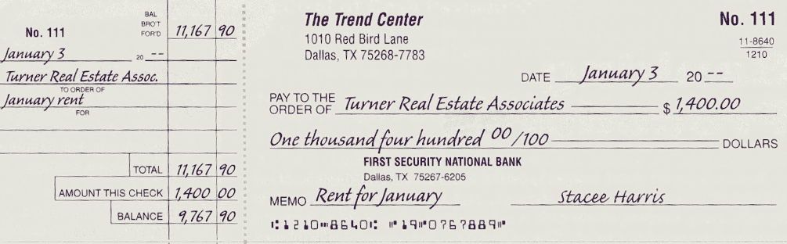
Checks and Check Stubs
This check is a negotiable financial instrument.
Page
310

Slide 11
QUESTION:
What is meant by negotiable?
ANSWER:
A financial instrument is negotiable if ownership can be transferred to another person or business.
Page
309

Slide 12
Before writing the check, complete the check stub. The check stub shows:
Balance brought forward: $11,167.90
Check amount: $1,400
Balance: $9,767.90
Page
309

Slide 13
Before writing the check, complete the check stub. The check stub shows:
Date: January 3, 20--
Payee: Turner Real Estate Associates
Purpose: January rent
Page
309

Slide 14
Once the stub has been completed, fill in the check. Carefully enter:
Date
Payee
Amount in figures and words
Page
309

Slide 15
Draw a line to fill any empty space after the payee's name and after the amount in words.
To be valid, checks need an authorized signature. For The Trend Center only Stacee Harris, the owner, is authorized to sign checks.
Page
309

Slide 16
Endorsing Checks
Page
309

Slide 17
QUESTION:
What is an endorsement?
ANSWER:
An endorsement is a written authorization that transfers ownership of a check.
Page
309

Slide 18
There are three types of endorsements:
Blank endorsement
Full endorsement
Restrictive endorsement
Page
310

Slide 19
QUESTION:
What is a blank endorsement?
ANSWER:
A blank endorsement is a signature of the payee written on the back of the check that transfers ownership of the check without specifying to whom or for what purpose.
Page
309

Slide 20
QUESTION:
What is a full endorsement?
ANSWER:
A full endorsement is a signature transferring a check to a specific person, firm, or bank.
Page
310

Slide 21
QUESTION:
What is a restrictive endorsement?
ANSWER:
A restrictive endorsement is a signature that transfers a check to a specific party for a stated purpose.
Page
310

Slide 22
Full Endorsement
PAY TO THE ORDER OF
FIRST SECURITY NATIONAL BANK
THE TREND CENTER
19-07-67889
Blank Endorsement
Restrictive Endorsement
Stacee Harris
19-07-67889
PAY TO THE ORDER OF
FIRST SECURITY NATIONAL BANK
FOR DEPOSIT ONLY
THE TREND CENTER
19-07-67889
Page
310

Slide 23
Preparing the Deposit Slip
Page
310

Slide 24
QUESTION:
What is a deposit slip?
ANSWER:
A deposit slip is a form prepared to record the deposit of cash or checks to a bank account.
Page
310

Slide 25
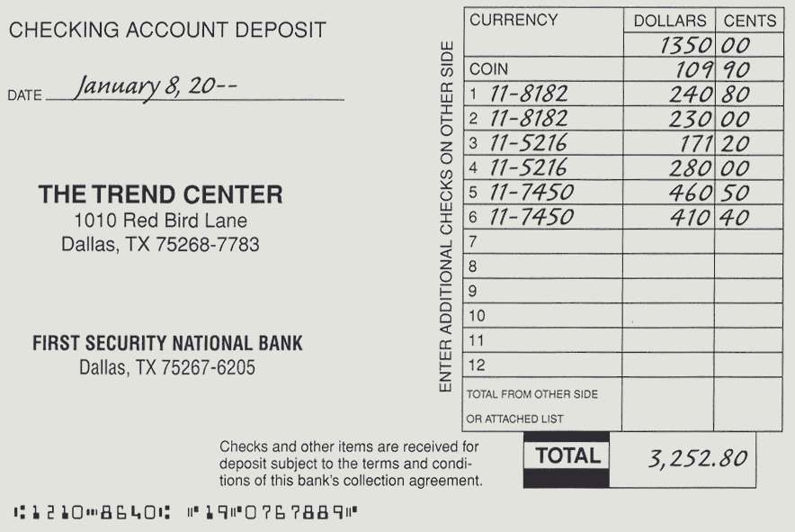
Deposit Slip
The printed numbers on the lower edge of the deposit slip are the same numbers on the bottom of the checks.
Page
311

Slide 26
The numbers are printed using a special magnetic ink character recognition (MICR) type that can be "read" by machine.
Page
311
Deposit slips and checks encoded with MICR are rapidly and efficiently processed by machine.

Slide 27
The 12 indicates that the bank is in the 12th Federal Reserve District.
Page
311

Slide 28
The 10 is the routing number used in processing the document.
Page
311

Slide 29
The 8640 identifies First Security National Bank.
Page
311

Slide 30
The 19 07 67889 is The Trend Center account number.
Page
311

Slide 31
The deposit slip shows the date, January 8.
Currency indicates paper money, $1,350.00.
Coin indicates the amount in coins, $109.90.
Some banks ask that the American Bankers
Association (ABA) transit number for each check
be entered on the deposit slip.
Page
311

Slide 32
The transit number appears on the top part of the fraction that appears in the upper right corner of the check.
The transit number for this check is 11-8640.
Page
311

Slide 33
Handling Postdated Checks
Page
311

Slide 34
Postdated Checks
A postdated check is a check dated some time in the future.
If the business receives a postdated check, it should not deposit it before the date on the check.
Otherwise, the check could be refused by the drawer's bank.
Page
311

Slide 35
Reconciling the Bank Statement
Page
311

Slide 36
Objective 9
Reconcile the monthly
bank statement.
Page
311

Slide 37
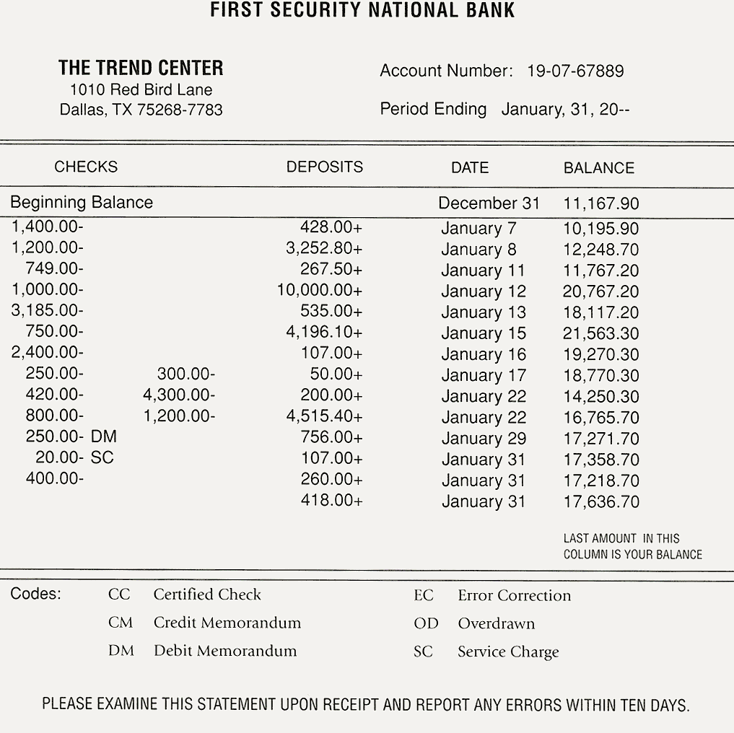
Bank Statement
A code, explained at the bottom, identifies transactions that do not involve checks or deposits.
Page
311/313

Slide 38
Bank Statement
The last column of the bank statement shows the account balance at the beginning of the period, after each day's transactions, and at the end of the period.
Page
312/313

Slide 39

QUESTION:
What is a canceled check?
ANSWER:
A canceled check is a check paid by the bank on which it was drawn.
Page
312

Slide 40
Usually there is a difference between the ending bank statement balance and the checkbook balance.
A bank reconciliation determines why the difference exists and brings the records into agreement.
Page
312

Slide 41
Changes in the Checking Account
Balance
Page
312

Slide 42
QUESTION:
What is a credit memorandum?
ANSWER:
A credit memorandum is a form that explains any addition, other than a deposit, to a checking account.
Page
312

Slide 43
QUESTION:
What is a debit memorandum?
ANSWER:
A debit memorandum is a form that explains any deduction, other than a check, from a checking account.
Page
313

Slide 44
QUESTION:
What is a service charge?
ANSWER:
A service charge is a fee charged by a bank to cover the costs of maintaining accounts and providing services.
Page
313

Slide 45
QUESTION:
What is a dishonored check?
ANSWER:
A dishonored check is a check returned to the depositor unpaid because of insufficient funds in the drawer’s account. It is also called an NSF check.
Page
313

Slide 46
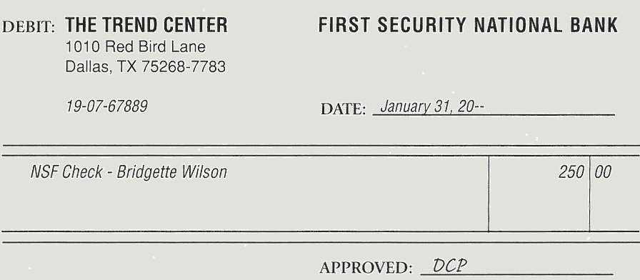
A debit memorandum for a $250 dishonored check.
Page
314

Slide 47
The Bank Reconciliation Process:
An Illustration
Page
314

Slide 48
When the bank statement is received, it is reconciled with the financial records of the business.
Consider the bank statement received by The Trend Center.
Page
314

Slide 49
The ending cash balance according to the bank is $17,636.70.
Page
313/314

Slide 50
On January 31 the Cash account, called the
book balance of cash, is $9,554.00.
The same amount appears on the check stub at the end of January.
Page
314

Slide 51
Sometimes the difference between the bank balance and the book balance is due to errors.
Errors made by banks | Errors made by businesses
Arithmetic errors
Arithmetic errors
Giving credit to the wrong
depositor
Not recording a check or
deposit
Charging a check against
the wrong account
Recording a check or
deposit for the wrong amount
Many banks require that errors in the bank statement be reported within a short period of time, usually 10 days.
Page
314

Slide 52
Other than errors, there are four reasons why the book balance of cash may not agree with the balance on the bank statement.
1. Outstanding checks.
2. Deposit in transit.
3. Service charges and other deductions not recorded in
the business records.
4. Deposits, such as the collection of promissory notes,
not recorded in the business records.
Page
314

Slide 53
QUESTION:
What are outstanding checks?
ANSWER:
Outstanding checks are checks that have been recorded in the cash payments journal but have not yet been paid by the bank.
Page
314

Slide 54
QUESTION:
What is a deposit in transit?
ANSWER:
A deposit in transit is a deposit that is recorded in the cash receipts journal but that reaches the bank too late to be shown on the monthly bank statement.
Page
314

Slide 55
QUESTION:
What is a bank reconciliation statement?
ANSWER:
A bank reconciliation statement is a statement that accounts for all differences between the balance on the bank statement and the book balance of cash.
Page
314

Slide 56
Format of a bank reconciliation statement
First Section
Second Section
=
Bank statement balance
Book balance
+ deposits in transit
+ deposits not recorded
– outstanding checks
– deductions
+ or – bank errors
+ or – errors in books
=
Adjusted bank balance
Adjusted book balance
Page
314

Slide 57
Steps to prepare the bank reconciliation statement:
First Section
Enter the balance on the bank statement.
Compare the deposits in the checkbook with the deposits on the bank statement.
List the outstanding checks.
List any bank errors.
Compute the adjusted bank balance.
Page
315

Slide 58
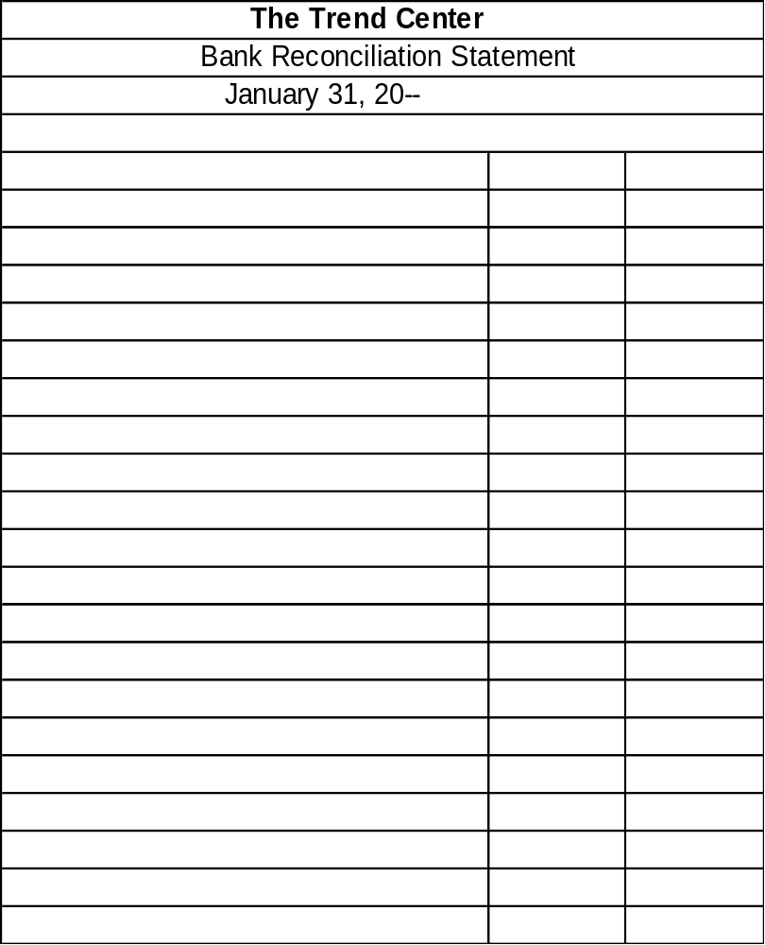
Bank statement balance
17636.70
Step 1: Enter the balance on the bank statement, $17,636.70.
Page
315

Slide 59
Bank statement balance
17636.70
Additions:
Deposit of January 31 in transit
3541.70
Step 2: Compare the deposits in the checkbook with the deposits on the bank statement.
On January 31 receipts of $3,541.70 were placed in the bank's night deposit box.
The bank recorded the deposit on February 1. The deposit will appear on the February bank statement.
Page
315

Slide 60
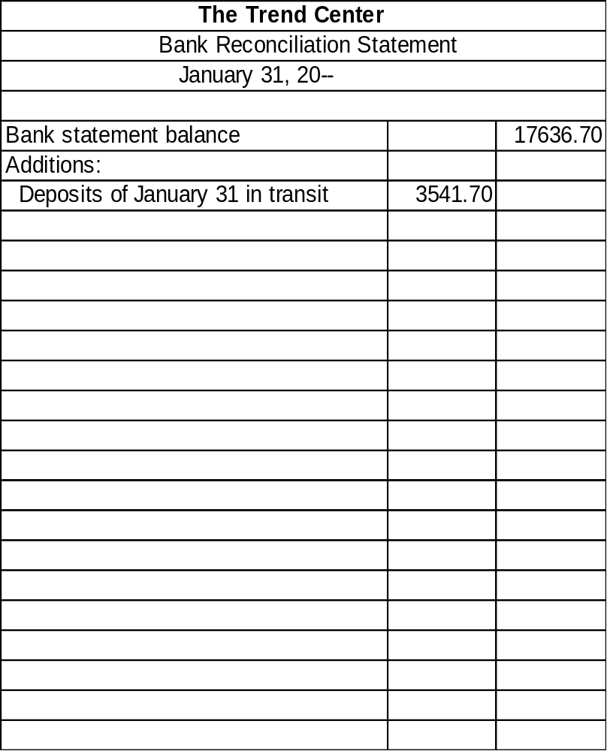
Deductions for outstanding checks:
Check 124 of January 31
2,508.80
Check 125 of January 31
4,200.00
Check 126 of January 31
2,400.00
Check 127 of January 31
150.00
Check 128 of January 31
85.60
Check 129 of January 31
3,150.00
Check 130 of January 31
200.00
Total outstanding checks
12694.40
Step 3: List the outstanding checks. The Trend Center has seven outstanding checks totaling $12,694.40.
Page
315

Slide 61
Check incorrectly charged to account
800.00
4341.70
21978.40
Deductions for outstanding checks:
Check 124 of January 31
2,508.80
Check 125 of January 31
4,200.00
Check 126 of January 31
2,400.00
Check 127 of January 31
150.00
Check 128 of January 31
85.60
Check 129 of January 31
3,150.00
Step 4: List any bank errors.
Check 130 of January 31
200.00
Total outstanding checks
12694.40
An $800 check was incorrectly deducted from The Trend Center’s account.
Page
315

Slide 62
Check incorrectly charged to account
800.00
4341.70
21978.40
Deductions for outstanding checks:
Check 124 of January 31
2,508.80
Check 125 of January 31
4,200.00
Check 126 of January 31
2,400.00
Check 127 of January 31
150.00
Check 128 of January 31
85.60
Check 129 of January 31
3,150.00
Check 130 of January 31
200.00
Total outstanding checks
12694.40
Adjusted bank balance
9284.00
Step 5: Compute the adjusted bank balance.
Page
315

Slide 63
Steps to prepare the bank reconciliation statement:
Second Section
Enter the balance in books from the Cash account.
Record any deposits made by the bank that have not been recorded in the accounting records.
Record deductions made by the bank.
Record any errors in the accounting records that were discovered during the reconciliation process.
Compute the adjusted book balance.
Page
316

Slide 64
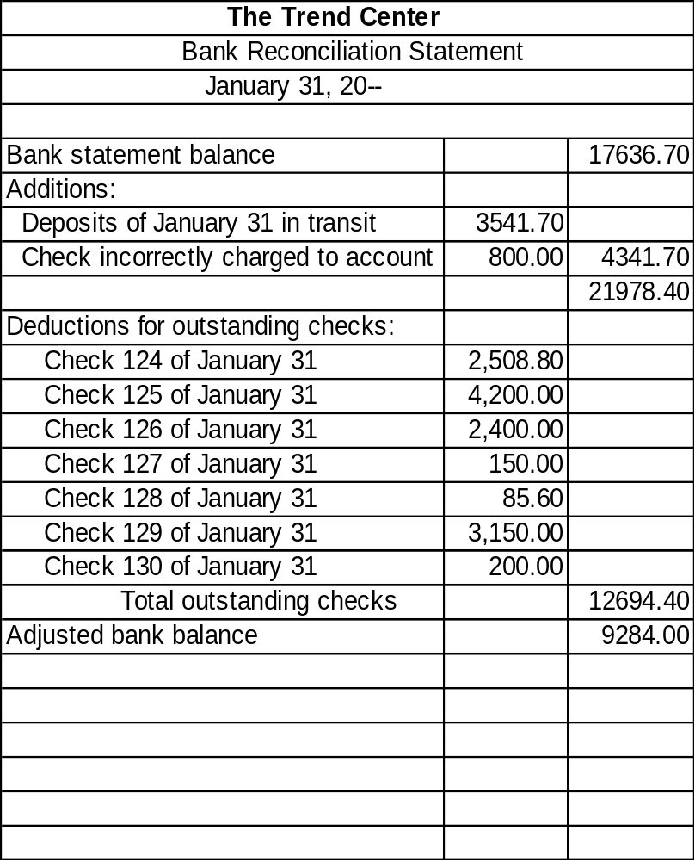
Step 1: Enter the balance in books from the Cash account, $9,554.
Book balance
9554.00
Page
316

Slide 65
Step 2: Record any deposits made by the bank that have not been
recorded in the accounting records.
The Trend Center did not have any.
Book balance
9554.00
Page
316

Slide 66
Step 3: Record deductions made by the bank. There are two items:
The NSF check for $250
The bank service charge for $20
Book balance
9554.00
Deductions:
NSF Check
250.00
Bank service charge
20.00
270.00
Page
316

Slide 67
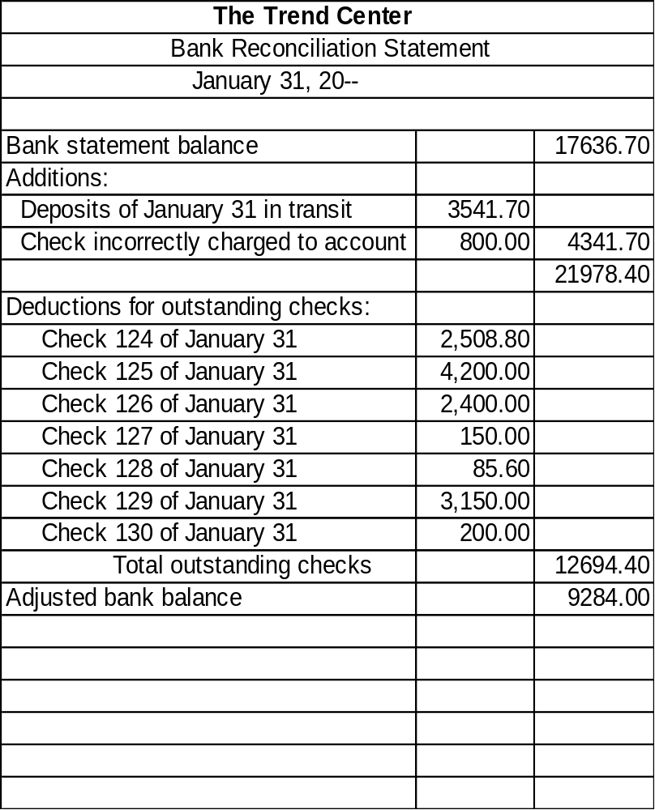
Step 4: Record any errors in the accounting records that were discovered during the reconciliation process.
The Trend Center did not have any errors in January.
Book balance
9554.00
Deductions:
NSF Check
250.00
Bank service charge
20.00
270.00
Page
316

Slide 68
Step 5: Compute the adjusted book balance.
Book balance
9554.00
Deductions:
NSF Check
250.00
Bank service charge
20.00
270.00
Page
Adjusted book balance
9284.00
316

Slide 69
Notice that the adjusted bank balance and the adjusted book balance agree.
Book balance
9554.00
Deductions:
NSF Check
250.00
Bank service charge
20.00
270.00
Page
Adjusted book balance
9284.00
316

Slide 70
Adjusting the Financial Records
Page
316

Slide 71
Objective 10
Record any adjusting entries
required from the bank
reconciliation.
Page
316

Slide 72
For The Trend Center, two entries must be made.
GENERAL JOURNAL PAGE 16
DATE DESCRIPTION POST. DEBIT CREDIT
REF.
Jan 31 Accts. Rec./Bridgette Wilson 250.00
Bank Fees Expense 20.00
Cash 270.00
To record NSF check and service charge
The first entry is for the NSF check from Bridgette Wilson, a
credit customer.
The second entry is for the bank service charge.
The effect of the two items is a decrease in the Cash account balance.
Page
316/317

Slide 73
Internal Control of Banking
Activities
Page
318

Slide 74
Well-run businesses put the following internal controls in place.
Limit access to the checkbook to designated employees.
Use prenumbered check forms.
Have a separation of duties.
File all deposit receipts, canceled checks, voided checks, and bank statements for future reference.
Page
318

Slide 75
R
E
V
I
E
W
Complete the following sentences:
An endorsement is a written authorization that transfers _________ of a check.
ownership
deposit slip
The __________ is a form prepared to record the deposit of cash or checks to a bank account.
Canceled checks
_______________ are checks paid by the bank during the month.

Slide 76
R
E
V
I
E
W
Complete the following sentences:
credit memorandum
A(n) __________________ is a form that explains any addition, other than a deposit, to a checking account.
service charge
A(n) _____________ is a fee charged by a bank to cover the costs of maintaining accounts and providing services.
bank reconciliation statement
The __________________________ accounts for all differences between the balance on the bank statement and the book balance of cash.

Slide 77
Thank You
for using
College Accounting, Tenth Edition
Price • Haddock • Brock

