Slide 1


GLENCOE / McGraw-Hill

Slide 2


Payroll Taxes, Deposits,
and Reports

Slide 3

Social Security,
Medicare, and
Employee
Income Tax
Section Objectives
Explain how and when payroll taxes are paid to the government.
Compute and record the employer’s social security and Medicare taxes.
Record deposit of social security, Medicare, and employee income taxes.
Prepare an Employer’s Quarterly Federal Tax Return,
Form 941.
Prepare Wage and Tax Statement (Form W-2) and Annual Transmittal of Wage and Tax Statements (Form W-3).

Slide 4


Payment of Payroll Taxes
Page
390

Slide 5
Objective 1
Explain how and when
payroll taxes are paid
to the government.
Page
391

Slide 6
The payroll register provides information about wages subject to payroll taxes.
Page
390

Slide 7
Who Deposits Payroll Taxes
Employers make tax deposits for
  Federal income tax withheld from employee earnings
  Employees' share of social security and Medicare taxes
  withheld from earnings
  Employer's share of social security and Medicare taxes
Businesses usually make payroll tax deposits at their
own bank.
Page
390

Slide 8
There are two ways to deposit payroll taxes:
  Electronic Federal Tax Payment System (EFTPS)
  Federal Tax Deposit Coupon
Page
390

Slide 9
The frequency of deposits depends on
the amount of tax liability, and
the amount reported in the lookback period.
For simplicity this textbook uses $1,000 as the tax liability threshold.
The lookback period is a four-quarter period ending on June 30 of the preceding year.
Page
390

Slide 10
Is the amount owed less than $1,000?
Yes
No
The payment is due quarterly with the payroll tax return.
The schedule is determined from the total taxes reported during the lookback period.
Page
391

Slide 11
Is the amount reported in the lookback period less than or equal to $50,000?
Yes
No
The employer is subject to the Monthly Deposit Schedule Rule.
The employer is subject to the Semiweekly Deposit Schedule Rule.
For new employers with no lookback period, if the amount owed is $1,000 or more, payments are due under the Monthly Deposit Schedule Rule.
Page
391

Slide 12
Is payday a Wednesday, Thursday, or Friday?
Yes
No
The deposit is due on the following Wednesday.
The deposit is due on the following Friday.
If the total accumulated tax liability reaches $100,000 or more on any day, a deposit is due on the next banking day.
Page
391

Slide 13
Employer’s Social Security and Medicare Tax Expenses
Page
392

Slide 14
Objective 2
Compute and record the
employer’s social security
and Medicare taxes.
Page
392

Slide 15
Remember that both employers and employees pay social security and Medicare taxes.
Employee Employer (Withheld) (Matched)
Social security $121.52 $121.52
Medicare 28.42 28.42
$149.94 $149.94
Total $299.88
Page
392

Slide 16
Business Transaction
On January 8 On Line Furnishings recorded the employer’s share of social security and Medicare taxes.
The information on the payroll register is used to record the payroll taxes expense.
Page
392

Slide 17
Record Employer’s Payroll Taxes
Which account is debited?
Which accounts are credited?
For what amount?
For what amounts?
Page
393

Slide 18

Record Employer’s Payroll Taxes
Payroll Taxes Expense
Social Security Tax Payable
Medicare Tax Payable
149.94
121.52
28.42
Page
393

Slide 19
Objective 3
Record deposit of social
security, Medicare, and
employee income taxes.
Page
393

Slide 20
Recording the Payment of Taxes Withheld
Page
393

Slide 21
At the end of January, the accounting records for
On Line Furnishings contained the following information.
Employee Employer (Withheld) (Matched) Total
Social security $ 486.08 $486.08 $ 972.16
Medicare 113.68 113.68 227.36
Federal income tax 692.00 -- 692.00
Total $1,291.76 $599.76 $1,891.52
The tax liability is more than the threshold ($1,000) in this textbook.
Page
393

Slide 22
The amount reported in the lookback period was less than $50,000.
Therefore, On Line Furnishings is on a monthly payment schedule.
A tax payment is due on the 15th day of the following month, February 15.
Page
393

Slide 23
Payroll Tax Deposit
Which accounts are debited?
Which account is credited?
For what amounts?
For what amount?
Page
394

Slide 24
Payroll Tax Deposit
Social Security
Tax Payable
Medicare
Tax Payable
Employee Income
Tax Payable
Cash
972.16
227.36
692.00
1891.52
Page
394

Slide 25
Quarterly Summary of Earnings Records
Page
394

Slide 26
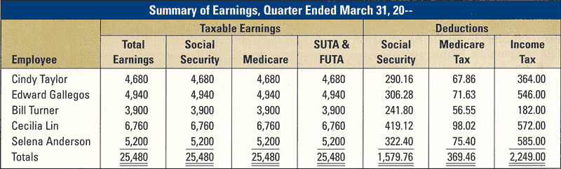
At the end of each quarter, the individual earnings records are totaled. This involves adding the columns in the Earnings, Deductions, and Net Pay sections.
The quarterly totals for each employee of On Line Furnishings:
Page
394

Slide 27
Employer’s Quarterly Federal Tax Return
Page
395

Slide 28
Objective 4
Prepare an Employer’s Quarterly Federal Tax Return, Form 941.
Page
395

Slide 29
QUESTION:
What is Form 941?
ANSWER:
Form 941 is the Employer’s Quarterly Federal Tax Return. It is a preprinted government form.
Page
395

Slide 30
When to File Form 941
The due date for Form 941 is the last day of the month
following the end of each calendar quarter.
If the taxes for the quarter were deposited when due,
the due date is extended by 10 days.
Page
395

Slide 31
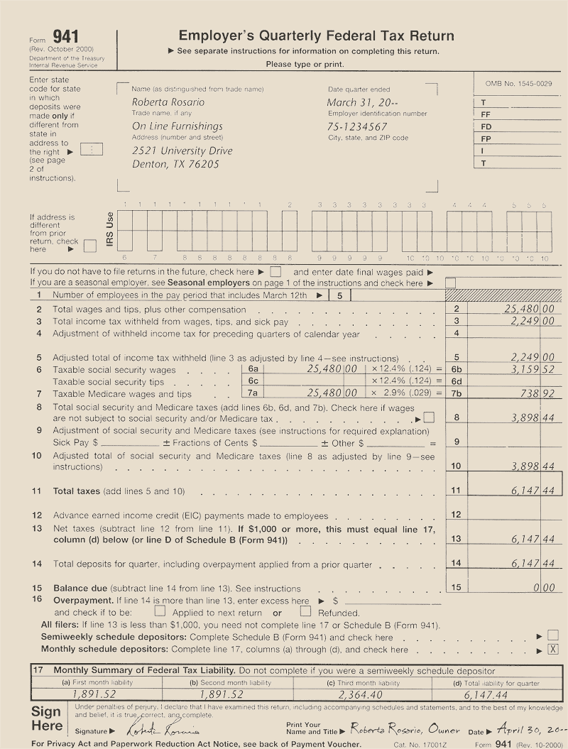
Completing Form 941
Use the preprinted form if it is available. Otherwise, enter
the employer's name, address, and identification number at
the top of Form 941. Enter the date the quarter ended.
Page
396

Slide 32
Line 1 is completed for the first quarter only. Enter the
number of employees in the pay period that includes
March 12.
Page
396

Slide 33
Line 2 shows total wages and tips
subject to withholding.
Page
396

Slide 34
Line 3 shows the total employee income tax withheld
during the quarter.
Page
396

Slide 35
Line 4 shows adjustments of income tax withheld in
prior quarters of the year. This line would be used to
show corrections of errors made in previous
withholdings.
Page
396

Slide 36
Line 5 shows the adjusted income tax withheld. Since
there were no adjustments on Line 4, the amount on
Line 5 is the same as on Line 3.
Page
396

Slide 37
Line 6a shows the total amount of wages that are
subject to social security taxes. The amount is
multiplied by the combined social security tax rate, 12.4
percent.
Social security tax:
Employee's share 6.2%
Employer's share 6.2
Total 12.4%
Page
396

Slide 38
Line 6b shows the amount of social security taxes.
Page
396

Slide 39
Line 6c is for reporting social security tips. It is blank
for On Line Furnishings.
Page
396

Slide 40
Line 7a shows the amount of wages and tips that are
subject to Medicare taxes. The amount is
multiplied by the combined Medicare tax rate, 2.9
percent.
Medicare tax:
Employee's share 1.45%
Employer's share 1.45
Total 2.90%
Page
396

Slide 41
Line 7b shows the amount of Medicare taxes.
Page
396

Slide 42
Line 8 shows the total social security and Medicare
taxes ($3,159.52 + $738.92).
Page
396

Slide 43
Line 9 is blank. There were no adjustments.
Page
396

Slide 44
Line 10 shows the adjusted social security and
Medicare taxes. It is the same as Line 8 because
there were no adjustments on Line 9.
Page
396

Slide 45
Line 11 shows the total tax liability for employee
income tax withheld plus social security and Medicare
taxes ($2,249.00 + $3,898.44).
Page
396

Slide 46
Line 12 is blank. There were no advance earned
income credit payments.
Page
398

Slide 47
Line 13 shows total net taxes for the quarter.
Page
398

Slide 48
Line 14 shows total deposits for the quarter.
Page
398

Slide 49
Line 15 and Line 16 are blank. There is no balance due
and no overpayment.
Page
398

Slide 50
Read Line 13 carefully.
The taxes for On Line Furnishings were more than $1,000, so Line 17 is completed.
This section shows the taxes for each month during the quarter.
Line 17(d) and Line 13 must be equal.
Page
398

Slide 51
Line 17(d) and Line 13 must be equal.
Page
398

Slide 52
Wage and Tax Statement, Form W-2
Page
398

Slide 53
Objective 5
Prepare Wage and Tax
Statement (Form W-2) and
Annual Transmittal of
Wage and Tax Statements
(Form W-3).
Page
398

Slide 54
QUESTION:
What is Form W-2?
ANSWER:
Form W-2 is a Wage and Tax Statement. It contains information about an employee’s earnings and tax withholdings for the year.
Page
398

Slide 55
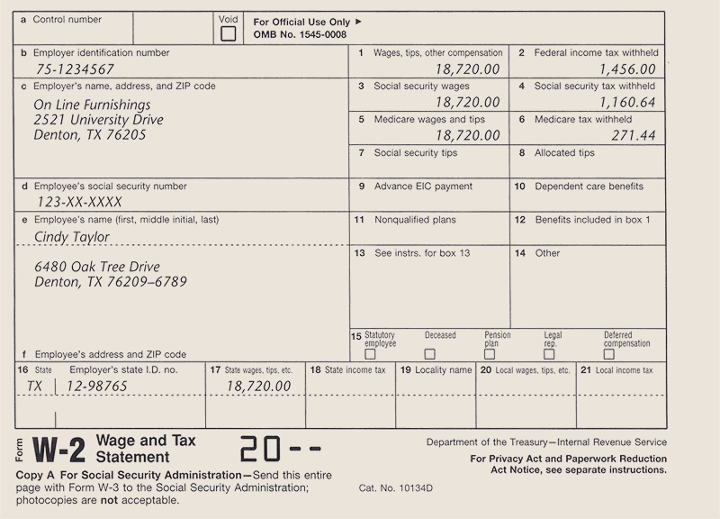
Wage and Tax Statement, Form W-2
Page
399

Slide 56
Annual Transmittal of Wage and Tax Statements, Form W-3
Page
399

Slide 57
QUESTION:
What is Form W-3?
ANSWER:
Form W-3 is the Transmittal of Wage and Tax Statements. It is a preprinted government form submitted with Forms
W-2 to the Social Security Administration.
Page
399

Slide 58
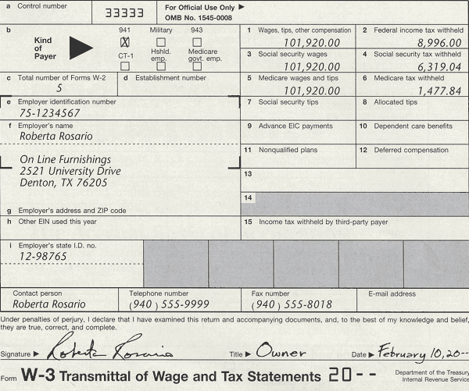
Transmittal of Wage and Tax Statements, Form W-3
The amounts on Form W-3 must equal the sums of the amounts on the attached Forms W-2.
Page
400

Slide 59
R
E
V
I
E
W
Complete the following sentences:
Electronic Federal Tax Payment System (EFTPS)
The __________________________________________ is a system for electronically depositing employment taxes using a telephone or a computer .
The employer is required to match the employee’s _____________ and ________ taxes.
social security
Medicare
lookback period
The ______________ is the four-quarter period ending on June 30 of the preceding year.

Slide 60
R
E
V
I
E
W
Complete the following sentences:
The ____________________________________________ is a preprinted government form used by the employer to report payroll tax information relating to social security, Medicare, and employee income tax withholding to the Internal Revenue Service.
Employer’s Quarterly Federal Tax Return, Form 941
Transmittal of Wage and Tax statements, Form W-3
The ____________________________________________ is a preprinted government form submitted with Forms W-2 to the Social Security Administration.
Wage and Tax Statement, Form W-2
The _______________________________ is a preprinted government form that contains information about an employee’s earnings and tax withholdings for the year.

Slide 61
Thank You
for using
College Accounting, Tenth Edition
Price • Haddock • Brock

