Slide 1
Defining Liabilities
The
company
has a
present
obligation
Because of a
past event . . .
. . . For future
sacrifices
Past
Present
Future
Notes:
2
2

Slide 2
Classifying Liabilities
Current Liabilities
Long-Term Liabilities
Expected to be paid within one year or the company’s operating cycle, whichever is longer.
Expected not to be paid within one year or the company’s operating cycle, whichever is longer.
Notes:
2
2

Slide 3
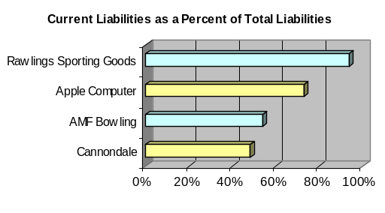
Current and Long-Term Liabilities
$44 mil.
$719 mil.
$1,658 mil.
$46 mil.
Notes:
2
2

Slide 4



Uncertainty in Liabilities
Uncertainty in Whom to Pay
Uncertainty in When to Pay
Uncertainty in How Much to Pay
Notes:
2
2

Slide 5


Known (Determinable) Liabilities
Accounts Payable
Sales Taxes Payable
Unearned Revenues
Short-Term Notes Payable
Payroll Liabilities
Multi-Period Known Liabilities
Notes:
2
2

Slide 6

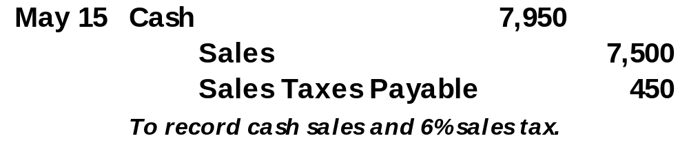
Sales Taxes Payable
On May 15, 2004, Max Hardware sold building materials for $7,500 that are subject to a 6% sales tax.
$7,500 × 6% = $450
Notes:
2
2

Slide 7


Unearned Revenues
On May 1, 2004, A-1 Catering received $3,000 in advance for catering a wedding party to take place on July 12, 2004.
Notes:
2
2

Slide 8

Short-Term Notes Payable
A written promise to pay a specified amount on a definite future date within one year or the company’s operating cycle, whichever is longer.
Notes:
2
2

Slide 9


Note Given to Extend Credit Period
On August 1, 2004, Matrix, Inc. asked Carter, Co. to accept a 90-day, 12% note to replace its existing $5,000 account payable to Carter. Matrix would make the following entry:
Notes:
2
2

Slide 10
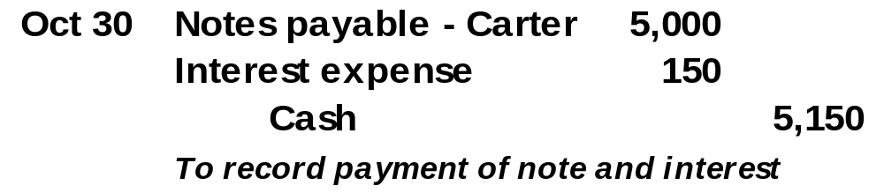
Note Given to Extend Credit Period
On October 30, 2004, Matrix, Inc. pays the note plus interest to Carter.
Interest expense = $5,000 × 12% × (90 ÷ 360) = $150
Notes:
2
2

Slide 11
Note Given to Borrow from Bank
PROMISSORY NOTE
Face Value Date
after date promise to pay to the order of
American Bank
Nashville, TN
Dollars
plus interest at the annual rate of .
$20,000
Sept. 1, 2005
Ninety days
I
Twenty thousand and no/100 - - - - - - - - - - - - - - - - -
6%
Jackson Smith
Notes:
2
2

Slide 12

Face Value Equals Amount Borrowed
On September 1, 2005, Jackson Smith borrows $20,000 from American Bank. The note bears interest at 6% per year. Principal and interest are due in 90-days (November 30, 2005).
Notes:
2
2

Slide 13
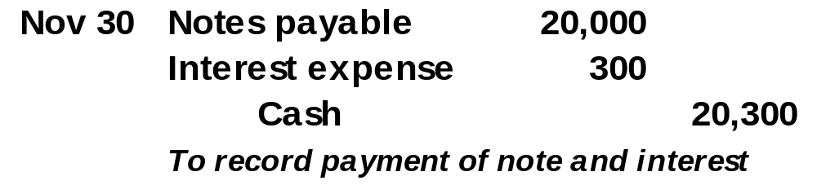
Face Value Equals Amount Borrowed
On November 30, 2005, Smith would make the following entry:
$20,000 × 6% × (90 ÷ 360) = $300
Notes:
2
2

Slide 14
End-of-Period Adjustment to Notes
Note Date
End of Period
Maturity Date
An adjusting entry is required to record Interest Expense incurred to date.
Notes:
2
2

Slide 15
End-of-Period Adjustment to Notes
Dec. 31, 2005
Dec. 16, 2005
Feb. 14, 2006
Note Date
End of Period
Maturity Date
James Burrows borrowed $8,000 on Dec. 16, 2005, by signing a 12%, 60-day note payable.
Notes:
2
2

Slide 16
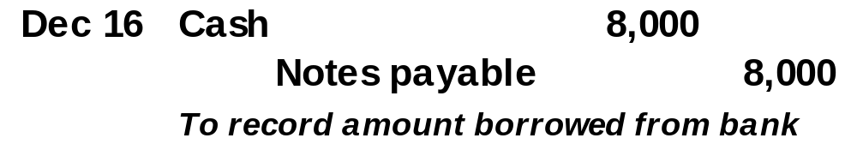
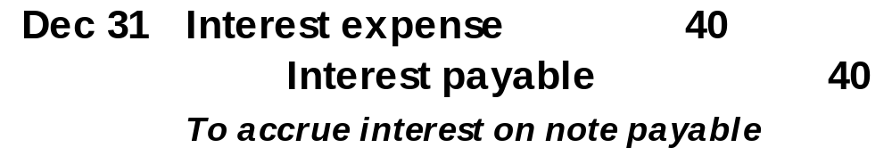
End-of-Period Adjustment to Notes
On December 16, 2005, James Burrows would make the following entry.
On December 31, 2005, the adjustment is:
$8,000 × 12% × (15 ÷ 360) = $40
Notes:
2
2

Slide 17
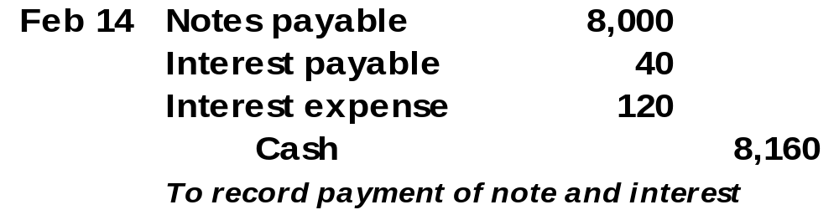
End-of-Period Adjustment to Notes
On February 14, 2006, James Burrows would make the following entry.
$8,000 × 12% × (45 ÷ 360) = $120
Notes:
2
2

Slide 18

Payroll Liabilities
Employers incur several expenses and liabilities from having employees.
Notes:
2
2

Slide 19







Employee Payroll Deductions
Gross Pay
Medicare Taxes
Federal Income Tax
State and Local Income Taxes
Voluntary Deductions
FICA Taxes
Net Pay
Notes:
2
2

Slide 20
Employee FICA Taxes
Federal Insurance Contributions Act (FICA)
FICA Taxes
Medicare Taxes
2003: 6.2% of the first $87,000 earned in the year ( Max = $5,394).
2003: 1.45% of all wages earned in the year.
Employers must pay withheld taxes to the Internal Revenue Service (IRS).
Notes:
2
2

Slide 21


Employee Income Tax
State and Local Income Taxes
Federal Income Tax
Amounts withheld depend on the employee’s earnings, tax rates, and number of withholding allowances.
Employers must pay the taxes withheld from employees’ gross pay to the appropriate government agency.
Notes:
2
2

Slide 22
Employee Voluntary Deductions
Voluntary Deductions
Amounts withheld depend on the employee’s request.
Examples include union dues, savings accounts, pension contributions, insurance premiums, charities
Employers owe voluntary amounts withheld from employees’ gross pay to the designated agency.
Notes:
2
2

Slide 23
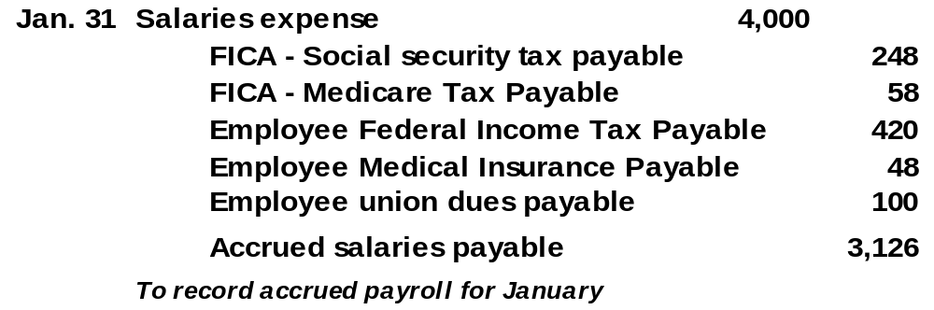
Recording Employee Payroll Deductions
The entry to record payroll expenses and deductions for an employee might look like this.
$4,000 × 6.2% = $248
$4,000 × 1.45% = $58
Notes:
2
2

Slide 24

Employer Payroll Taxes
Medicare Taxes
Federal and State Unemployment Taxes
FICA Taxes
Employers pay amounts equal to that withheld from the employee’s gross pay.
Notes:
2
2

Slide 25
Federal and State Unemployment Taxes
2003: 6.2% on the first $7,000 of wages paid to each employee (A credit up to 5.4% is given for SUTA paid.)
Federal Unemployment Tax (FUTA)
2003: Basic rate of 5.4% on the first $7,000 of wages paid to each employee (Merit ratings may lower SUTA rates.)
State Unemployment Tax (SUTA)
Notes:
2
2

Slide 26
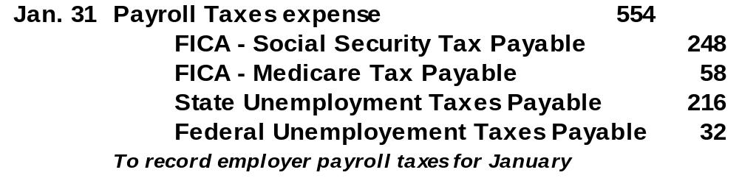
Recording Employer Payroll Taxes
The entry to record the employer payroll taxes for January might look like this.
FICA amounts are the same as that withheld from the employee’s gross pay.
SUTA: $4,000 × 5.4% = $216
FUTA: $4,000 × (6.2% - 5.4%) = $32
Notes:
2
2

Slide 27


Multi-Period Known Liabilities
Often include accrued revenues and notes payable.
Accrued revenues from magazine subscriptions often cover more than one accounting period. A portion of the earned revenue is recognized each period and unearned revenue account is reduced.
Notes payable often extend over more than one accounting period. A three-year note payable would be classified as a current liability for one year and a long-term liability for two years.
Notes:
2
2

Slide 28

Estimated Liabilities
An estimated liability is a known obligation of an uncertain amount, but one that can be reasonably estimated.
Notes:
5
73

Slide 29
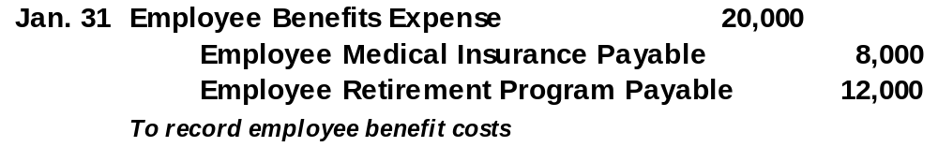
Health and Pension Benefits
Employer expenses for pensions or medical, dental, life and disability insurance
Assume an employer agrees to pay an amount for medical insurance equal to $8,000, and contribute an additional 10% of the employees’ $120,000 gross salary to a retirement program.
Notes:
5
73

Slide 30
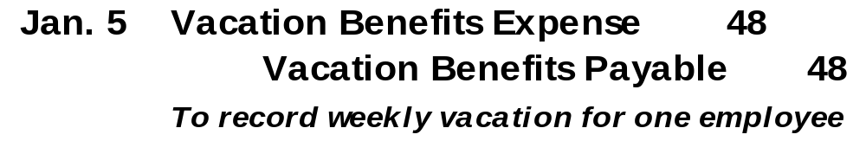
Vacation Benefits
Employer expenses for paid vacation by employees
Assume an employee earns $62,400 per year and earns two weeks of paid vacation each year.
$62,400 ÷ 52 weeks = $1,200
$62,400 ÷ 50 weeks = $1,248
Weekly vacation benefit
$ 48
Notes:
5
73

Slide 31
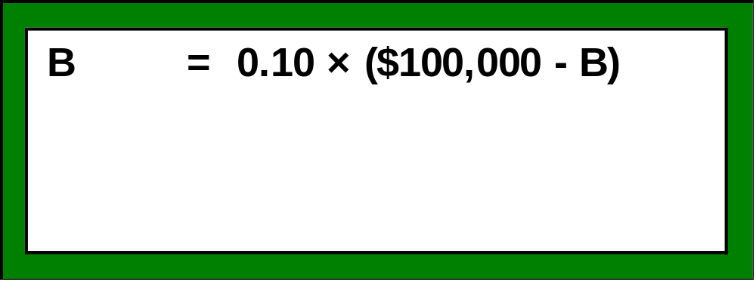
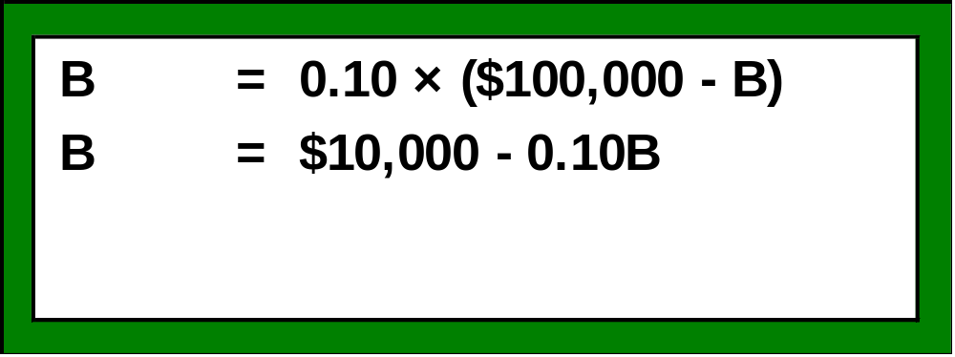
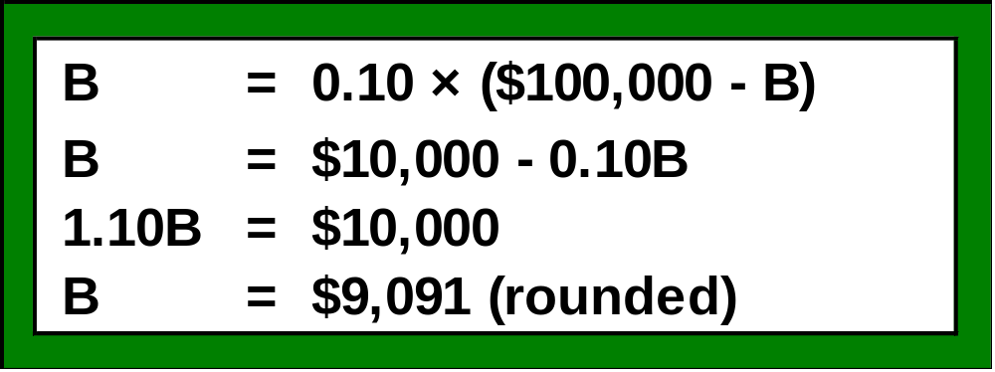
Bonus Plans
Many bonuses paid to employees are based on reported net income.
Assume the annual yearly bonus to the store manager is equal to 10% of the company’s annual net income minus the bonus. The store earned $100,000 net income this year.
Notes:
5
73

Slide 32
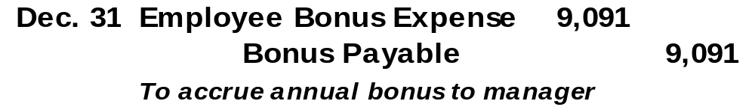
Bonus Plans
Many bonuses paid to employees are based on reported net income.
Assume the annual yearly bonus to the store manager is equal to 10% of the company’s annual net income minus the bonus. The store earned $100,000 net income this year.
Notes:
5
73

Slide 33
Warranty Liabilities
Seller’s obligation to replace or correct a product (or service) that fails to perform as expected within a specified period. To conform with the matching principle, the seller reports expected warranty expense in the period when revenue from the sale is reported.
A dealer sells a car for $32,000, on December 1, 2005, with a warranty for parts and labor for 12-months, or 12,000 miles. The dealership experiences an average warranty cost of 3% of the selling price of each car.
Notes:
5
73

Slide 34
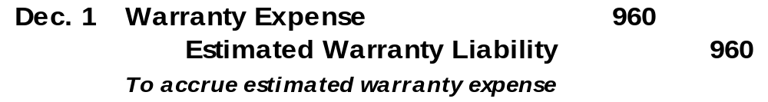
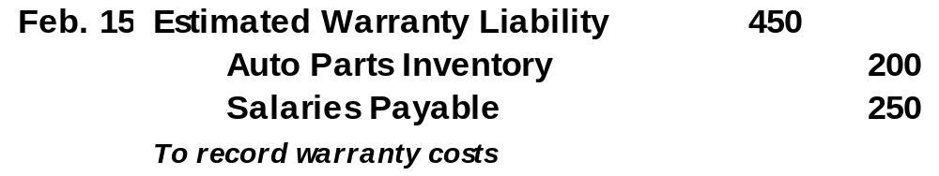
Warranty Liabilities
A dealer sells a car for $32,000, on December 1, 2005, with a warranty for parts and labor for 12-months, or 12,000 miles. The dealership experiences an average warranty cost of 3% of the selling price of each car.
On February 15, 2006, parts of $200 and labor of $250 covered under warranty were incurred.
Notes:
5
73

Slide 35
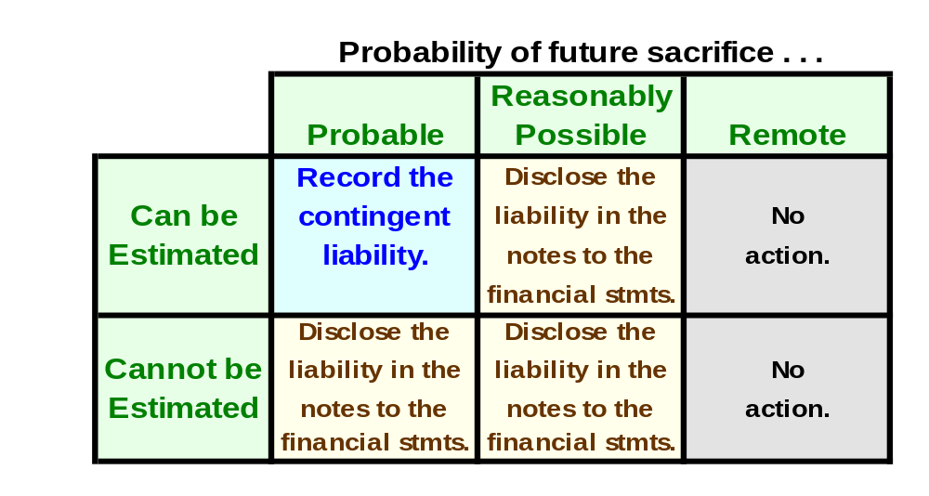
Contingent Liabilities
Potential obligation that depends on a future event arising out of a past transaction or event.
Amount . . .

Slide 36
Reasonably Possible Contingent Liabilities
Potential Legal Claims – A potential claim is recorded if the amount can be reasonably estimated and payment for damages is probable.
Debt Guarantees – The guarantor usually discloses the guarantee in its financial statement notes. If it is probable that the debtor will default, the guarantor should record and report the guarantee as a liability.
Notes:
5
73

Slide 37
Times Interest Earned
Income before interest
and income taxes
Times Interest
Earned
=
Interest Expense
If income before interest and taxes varies greatly from year to year, fixed interest charges can increase the risk that an owner will not earn a positive return and be unable to pay interest charges.
Notes:
5
73

