Slide 1
The three types of business operations are:
Service business
Merchandising business
Manufacturing business

Slide 2
QUESTION:
What is a service business?
ANSWER:
A service business is a business that sells services.

Slide 3
QUESTION:
What is a merchandising business?
ANSWER:
A merchandising business is a business that sells goods purchased for resale.

Slide 4
QUESTION:
What is a manufacturing business?
ANSWER:
A manufacturing business is a business that sells goods that it has produced.

Slide 5
Recall Carter Consulting Services from earlier chapters.
QUESTION:
What kind of business operation is Carter Consulting Services?
ANSWER:
It is a service business.

Slide 6
Meet The Trend Center
Stacee Harris is the sole proprietor of the firm.
The Trend Center is a merchandising business that sells the latest fashion clothing for men, women, and children.
It is a retail business.

Slide 7
QUESTION:
What is a retail business?
ANSWER:
A retail business is a business that sells directly to individual customers.

Slide 8
The Trend Center must account for the purchases and sales of goods, and for merchandise inventory.

Slide 9
QUESTION:
What is merchandise inventory?
ANSWER:
Merchandise inventory is the stock of goods a merchandising business keeps on hand.

Slide 10
To allow for efficient recording of financial data, the accounting systems of most merchandising businesses include special journals and subsidiary ledgers.

Slide 11
Special Journals and Subsidiary Ledgers

Slide 12
QUESTION:
What is a special journal?
ANSWER:
A special journal is a journal used to record only one type of transaction.

Slide 13
QUESTION:
What is a subsidiary ledger?
ANSWER:
A subsidiary ledger is a ledger dedicated to accounts of a single type.

Slide 14

Journals Used by
Merchandising Businesses
Type of Journal
Purpose
Sales
To record sales of merchandise on credit
Purchases
To record purchases of merchandise on credit
Cash receipts
To record cash received from all sources
Cash payments
To record all disbursements of cash
General
To record all transactions that are not recorded in another special journal and all adjusting and closing entries
Page
202

Slide 15
Ledgers Used by
Merchandising Businesses
Type of Ledger
Content
General
Assets, liabilities, owner’s equity, revenue, and expense accounts
Accounts receivable
Accounts for credit customers
Accounts payable
Accounts for creditors

Slide 16
Merchandising Business
Chart of Accounts
A merchandising business has accounts that are not used in a service business.
You will learn about these accounts in this and following chapters.

Slide 17
THE TREND CENTER
Chart of Accounts
ASSETS
101 Cash
105 Petty Cash Fund
109 Notes Receivable
111 Accounts Receivable
112 Allowance for Doubtful Accounts
116 Interest Receivable
121 Merchandise Inventory
126 Prepaid Insurance
127 Prepaid Interest
129 Supplies
131 Store Equipment
132 Accumulated Depreciation - Store Equip.
141 Office Equipment
142 Accumulated Depreciation - Office Equip.
REVENUE
401 Sales
451 Sales Returns and Allowances
491 Interest Income
493 Miscellaneous Income
COST OF GOODS SOLD
501 Purchases
502 Freight In
503 Purchases Returns and Allowances
504 Purchases Discounts
EXPENSES
611 Salaries Expense - Sales
612 Supplies Expense
Advertising Expense
617 Cash Short or Over
626 Depreciation Expense - Store Equipment
Rent Expense
637 Salaries Expense - Office
Insurance Expense
Payroll Taxes Expense
643 Utilities Expense
649 Telephone Expense
Uncollectible Accounts Expense
657 Bank Fees Expense
658 Delivery Expense
659 Depreciation Expense - Office Equipment
691 Interest Expense
693 Miscellaneous Expense
LIABILITIES
201 Notes Payable — Trade
202 Notes Payable — Bank
205 Accounts Payable
216 Interest Payable
221 Social Security Tax Payable
222 Medicare Tax Payable
223 Employee Income Tax Payable
225 Federal Unemployment Tax Payable
227 State Unemployment Tax Payable
229 Salaries Payable
231 Sales Tax Payable
OWNER’S EQUITY
301 Stacee Harris, Capital
302 Stacee Harris, Drawing
399 Income Summary

Slide 18
The Sales Journal

Slide 19
QUESTION:
What is a sales journal?
ANSWER:
A sales journal is a special journal used to record sales of merchandise on credit.

Slide 20
General Journal and General Ledger
Consider how credit sales made at The Trend Center would be entered and posted using a general journal and a general ledger.

Slide 21
General Journal and General Ledger
Four credit sales made on January 3, 8, 11, and 15 require four separate entries in the general journal:
Four debits to Accounts Receivable
Four credits to Sales Tax Payable
Four credits to Sales
Four descriptions

Slide 22
GENERAL JOURNAL
PAGE 2
Date
20--
DESCRIPTION
POST. REF.
DEBIT
CREDIT
Jan. 3
Accounts Receivable
Sales Tax Payable
Sales
Sold merchandise on credit to
John Allen, Sales Slip 1101
111
231
401
214.00
14.00
200.00
8
Accounts Receivable
Sales Tax Payable
Sales
Sold merchandise on credit to
Larry Bates, Sales Slip 1102
111
231
401
535.00
35.00
500.00
11
Accounts Receivable
Sales Tax Payable
Sales
Sold merchandise on credit to
Blake Howard, Sales Slip 1103
111
231
401
642.00
42.00
600.00
15
Accounts Receivable
Sales Tax Payable
Sales
Sold merchandise on credit to
Sarah Gomez, Sales Slip 1104
111
231
401
428.00
28.00
400.00

Slide 23
General Journal and General Ledger
The four credit sales require twelve postings to the general ledger:
Four postings to Accounts Receivable
Four postings to Sales Tax Payable
Four postings to Sales

Slide 24
General Ledger
ACCOUNT Accounts Receivable ACCOUNT NO. 111
DATE EXPLANATION POST. DEBIT CREDIT BALANCE
REF. DEBIT CREDIT
20--
Jan. 1 Balance  3,210.00
3 J2 214.00 3,424.00
8 J2 535.00 3,959.00
11 J2 642.00 4,601.00
15 J2 428.00 5,029.00

Slide 25
General Ledger
ACCOUNT Sales Tax Payable ACCOUNT NO. 231
DATE DESCRIPTION POST. DEBIT CREDIT BALANCE
REF. DEBIT CREDIT
20--
Jan. 1 Balance  749.00
3 J2 14.00 763.00
8 J2 35.00 798.00
11 J2 42.00 840.00
15 J2 28.00 868.00

Slide 26
General Ledger
ACCOUNT Sales ACCOUNT NO. 401
DATE DESCRIPTION POST. DEBIT CREDIT BALANCE
REF. DEBIT CREDIT
20--
Jan. 3 J2 200.00 200.00
8 J2 500.00 700.00
11 J2 600.00 1300.00
15 J2 400.00 1700.00

Slide 27
Recording Transactions in a Sales Journal

Slide 28
The posting of twelve items to three general ledger accounts represents duplication of effort.
This is not efficient for a business that has a substantial number of credit sales each month.

Slide 29
A special journal intended only for credit sales provides a more efficient method of recording these transactions.

Slide 30
In a retail business such as The Trend Center, the data needed for each entry is taken from a copy of the customer’s sales slip.

Slide 31
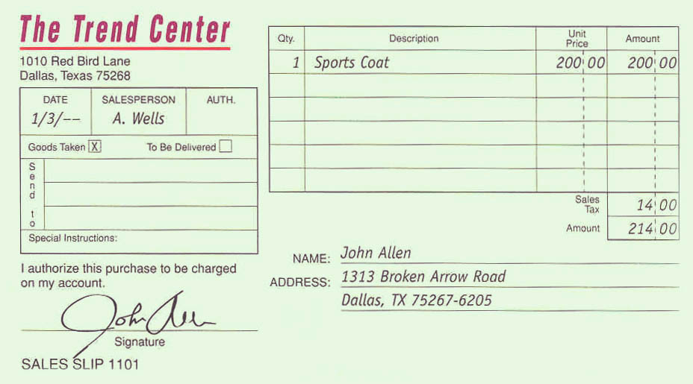
Sales Slip

Slide 32
In a sales journal, only one line is needed to record all information for each transaction. This helps avoid repetition.

Slide 33
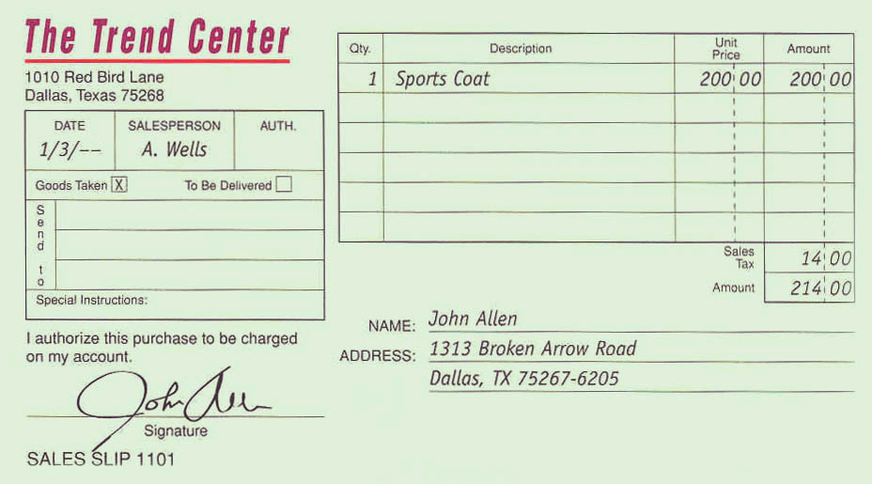
SALES JOURNAL PAGE 1
SALES ACCOUNTS SALES TAX
DATE SLIP CUSTOMER’S NAME POST. RECEIVABLE PAYABLE SALES
NO. REF. DEBIT CREDIT CREDIT
20--
Jan. 3 1101 John Allen  214.00 14.00 200.00

Slide 34
SALES JOURNAL PAGE 1
SALES ACCOUNTS SALES TAX
DATE SLIP CUSTOMER’S NAME POST. RECEIVABLE PAYABLE SALES
NO. REF. DEBIT CREDIT CREDIT
20--
Jan. 3 1101 John Allen  214.00 14.00 200.00
8 1102 Larry Bates  535.00 35.00 500.00
11 1103 Blake Howard  642.00 42.00 600.00
15 1104 Sarah Gomez  428.00 28.00 400.00
18 1105 Ed Ramirez  856.00 56.00 800.00
21 1106 James Walker  321.00 21.00 300.00
28 1107 Linda Sanchez  107.00 7.00 100.00
29 1108 Newton Wu  1070.00 70.00 1000.00
31 1109 Kim Johnson  963.00 63.00 900.00
31 1110 John Allen  267.50 17.50 250.00
31 Totals 5403.50 353.50 5050.00

Slide 35
Posting from a Sales Journal

Slide 36
With a sales journal it is not necessary to post each credit sale individually to general ledger accounts.
Instead, summary postings are made at the end of the month after the amount columns of the sales journal are totaled.

Slide 37
Before any posting takes place, the equality of the debits and credits recorded in the sales journal is proved by comparing the column totals.

Slide 38
Proof of Sales Journal
Debits
Accounts Receivable Debit column
$5,403.50
Credits
Sales Tax Payable Credit column
Sales Credit column
$ 353.50
5,050.00
$5,403.50

Slide 39
SALES JOURNAL PAGE 1
SALES ACCOUNTS SALES TAX
DATE SLIP CUSTOMER’S NAME POST. RECEIVABLE PAYABLE SALES
NO. REF. DEBIT CREDIT CREDIT
20--
Jan. 3 1101 John Allen 214.00 14.00 200.00
8 1102 Larry Bates 535.00 35.00 500.00
11 1103 Blake Howard 642.00 42.00 600.00
15 1104 Sarah Gomez 428.00 28.00 400.00
18 1105 Ed Ramirez 856.00 56.00 800.00
21 1106 James Walker 321.00 21.00 300.00
28 1107 Linda Sanchez 107.00 7.00 100.00
29 1108 Newton Wu 1070.00 70.00 1000.00
31 1109 Kim Johnson 963.00 63.00 900.00
31 1110 John Allen 267.50 17.50 250.00
     
Summary postings are made at the end of the month.
Proof of Sales Journal Debits
Accounts Receivable Debit column | $5,403.50
Sales Tax Payable Credit column Sales Credit column | $ 353.50 5,050.00 $5,403.50
31 Totals 5,403 .50 353.50 5,050.00
(111)
(231)
(401)
ACCOUNT Accounts Receivable ACCOUNT NO.
DATE EXPLANATION POST. DEBIT CREDIT BALANCE
REF. DEBIT CREDIT
20--
Jan. 1 Balance  3,210.00
23 J2 107.00 3,103.00
25 J2 321.00 2,782.00
111
1
Page
206
31

Slide 40
SALES JOURNAL PAGE 1
SALES ACCOUNTS SALES TAX
DATE SLIP CUSTOMER’S NAME POST. RECEIVABLE PAYABLE SALES
NO. REF. DEBIT CREDIT CREDIT
20--
Jan. 3 1101 John Allen 214.00 14.00 200.00
8 1102 Larry Bates 535.00 35.00 500.00
11 1103 Blake Howard 642.00 42.00 600.00
15 1104 Sarah Gomez 428.00 28.00 400.00
18 1105 Ed Ramirez 856.00 56.00 800.00
21 1106 James Walker 321.00 21.00 300.00
28 1107 Linda Sanchez 107.00 7.00 100.00
29 1108 Newton Wu 1070.00 70.00 1000.00
31 1109 Kim Johnson 963.00 63.00 900.00
31 1110 John Allen 267.50 17.50 250.00
     
S1 shows the data is posted from page 1 of the sales journal.
2
31 Totals 5,403 .50 353.50 5,050.00
(111)
(231)
(401)
ACCOUNT Accounts Receivable ACCOUNT NO.
DATE EXPLANATION POST. DEBIT CREDIT BALANCE
REF. DEBIT CREDIT
20--
Jan. 1 Balance  3,210.00
23 J2 107.00 3,103.00
25 J2 321.00 2,782.00
111
1
31
S1

Slide 41
SALES JOURNAL PAGE 1
SALES ACCOUNTS SALES TAX
DATE SLIP CUSTOMER’S NAME POST. RECEIVABLE PAYABLE SALES
NO. REF. DEBIT CREDIT CREDIT
20--
Jan. 3 1101 John Allen 214.00 14.00 200.00
8 1102 Larry Bates 535.00 35.00 500.00
11 1103 Blake Howard 642.00 42.00 600.00
15 1104 Sarah Gomez 428.00 28.00 400.00
18 1105 Ed Ramirez 856.00 56.00 800.00
21 1106 James Walker 321.00 21.00 300.00
28 1107 Linda Sanchez 107.00 7.00 100.00
29 1108 Newton Wu 1070.00 70.00 1000.00
31 1109 Kim Johnson 963.00 63.00 900.00
31 1110 John Allen 267.50 17.50 250.00
     
Column totals are posted to general ledger accounts involved.
2
31 Totals 5,403 .50 353.50 5,050.00
(111)
(231)
(401)
ACCOUNT Accounts Receivable ACCOUNT NO.
DATE EXPLANATION POST. DEBIT CREDIT BALANCE
REF. DEBIT CREDIT
20--
Jan. 1 Balance  3,210.00
23 J2 107.00 3,103.00
25 J2 321.00 2,782.00
111
1
3
31
S1
5,403.50

Slide 42
SALES JOURNAL PAGE 1
SALES ACCOUNTS SALES TAX
DATE SLIP CUSTOMER’S NAME POST. RECEIVABLE PAYABLE SALES
NO. REF. DEBIT CREDIT CREDIT
20--
Jan. 3 1101 John Allen 214.00 14.00 200.00
8 1102 Larry Bates 535.00 35.00 500.00
11 1103 Blake Howard 642.00 42.00 600.00
15 1104 Sarah Gomez 428.00 28.00 400.00
18 1105 Ed Ramirez 856.00 56.00 800.00
21 1106 James Walker 321.00 21.00 300.00
28 1107 Linda Sanchez 107.00 7.00 100.00
29 1108 Newton Wu 1070.00 70.00 1000.00
31 1109 Kim Johnson 963.00 63.00 900.00
31 1110 John Allen 267.50 17.50 250.00
     
The new account balance is entered in the Debit Balance or Credit Balance column.
2
31 Totals 5,403 .50 353.50 5,050.00
(111)
(231)
(401)
ACCOUNT Accounts Receivable ACCOUNT NO.
DATE EXPLANATION POST. DEBIT CREDIT BALANCE
REF. DEBIT CREDIT
20--
Jan. 1 Balance  3,210.00
23 J2 107.00 3,103.00
25 J2 321.00 2,782.00
111
1
3
31
S1
5,403.50
4
8,185.50

Slide 43
SALES JOURNAL PAGE 1
SALES ACCOUNTS SALES TAX
DATE SLIP CUSTOMER’S NAME POST. RECEIVABLE PAYABLE SALES
NO. REF. DEBIT CREDIT CREDIT
20--
Jan. 3 1101 John Allen 214.00 14.00 200.00
8 1102 Larry Bates 535.00 35.00 500.00
11 1103 Blake Howard 642.00 42.00 600.00
15 1104 Sarah Gomez 428.00 28.00 400.00
18 1105 Ed Ramirez 856.00 56.00 800.00
21 1106 James Walker 321.00 21.00 300.00
28 1107 Linda Sanchez 107.00 7.00 100.00
29 1108 Newton Wu 1070.00 70.00 1000.00
31 1109 Kim Johnson 963.00 63.00 900.00
31 1110 John Allen 267.50 17.50 250.00
     
The general ledger account numbers are entered in parentheses under column totals.
2
31 Totals 5,403 .50 353.50 5,050.00
(111)
(231)
(401)
5
ACCOUNT Accounts Receivable ACCOUNT NO.
DATE EXPLANATION POST. DEBIT CREDIT BALANCE
REF. DEBIT CREDIT
20--
Jan. 1 Balance  3,210.00
23 J2 107.00 3,103.00
25 J2 321.00 2,782.00
111
1
3
31
S1
5,403.50
4
8,185.50

Slide 44
SALES JOURNAL PAGE 1
SALES ACCOUNTS SALES TAX
DATE SLIP CUSTOMER’S NAME POST. RECEIVABLE PAYABLE SALES
NO. REF. DEBIT CREDIT CREDIT
20--
Jan. 3 1101 John Allen 214.00 14.00 200.00
8 1102 Larry Bates 535.00 35.00 500.00
11 1103 Blake Howard 642.00 42.00 600.00
15 1104 Sarah Gomez 428.00 28.00 400.00
18 1105 Ed Ramirez 856.00 56.00 800.00
21 1106 James Walker 321.00 21.00 300.00
28 1107 Linda Sanchez 107.00 7.00 100.00
29 1108 Newton Wu 1070.00 70.00 1000.00
31 1109 Kim Johnson 963.00 63.00 900.00
31 1110 John Allen 267.50 17.50 250.00
2
31 Totals 5,403 .50 353.50 5,050.00
(111)
5
(231)
(401)
ACCOUNT Sales Tax Payable ACCOUNT NO. 231
DATE DESCRIPTION POST. DEBIT CREDIT BALANCE
REF. DEBIT CREDIT
20--
Jan. 1 Balance  749.00
11 CP1 749.00 -0-
23 J2 7.00 7.00
25 J2 21.00 28.00
31 S1 353.50 325.50
1
3
4

Slide 45
SALES JOURNAL PAGE 1
SALES ACCOUNTS SALES TAX
DATE SLIP CUSTOMER’S NAME POST. RECEIVABLE PAYABLE SALES
NO. REF. DEBIT CREDIT CREDIT
20--
Jan. 3 1101 John Allen 214.00 14.00 200.00
8 1102 Larry Bates 535.00 35.00 500.00
11 1103 Blake Howard 642.00 42.00 600.00
15 1104 Sarah Gomez 428.00 28.00 400.00
18 1105 Ed Ramirez 856.00 56.00 800.00
21 1106 James Walker 321.00 21.00 300.00
28 1107 Linda Sanchez 107.00 7.00 100.00
29 1108 Newton Wu 1070.00 70.00 1000.00
31 1109 Kim Johnson 963.00 63.00 900.00
31 1110 John Allen 267.50 17.50 250.00
2
31 Totals 5,403 .50 353.50 5,050.00
(111)
(231)
(401)
5
ACCOUNT Sales ACCOUNT NO. 401
DATE DESCRIPTION POST. DEBIT CREDIT BALANCE
REF. DEBIT CREDIT
1
3
20--
Jan. 31 Balance S1 5,050.00 5,050.00
4

Slide 46
Advantages of a Sales Journal

Slide 47
Advantages of a Sales Journal
Saves time, effort, and recording space
Makes journalizing and posting more efficient
Requires only three summary postings to the general ledger at the end of each month
Allows division of work
Improves the audit trail

Slide 48
R
E
V
I
E
W
Complete the following sentences:
A business that sells goods that it has produced is a(n) _____________________.
manufacturing business
A business that sells goods that it purchases for resale is a(n) _____________
________.
merchandising
business
The stock of goods a merchandising business keeps on hand is ___________
_________.
merchandise
inventory

Slide 49
R
E
V
I
E
W
Complete the following sentences:
A journal used to record sales of merchandise on credit is called a(n) ____________.
sales journal
A journal used to record only one type of transaction is a(n) _____________.
special journal
A ledger that contains accounts of a single type is a(n) ________________.
subsidiary ledger

