Slide 1

Accounting for Receivables
Chapter
9
Notes:
1
1
1
1
1

Slide 2

Accounts Receivable
Amounts due from customers for credit sales.
Credit sales require:
  Maintaining a separate account receivable for each customer.
  Accounting for bad debts that result from credit sales.

Slide 3
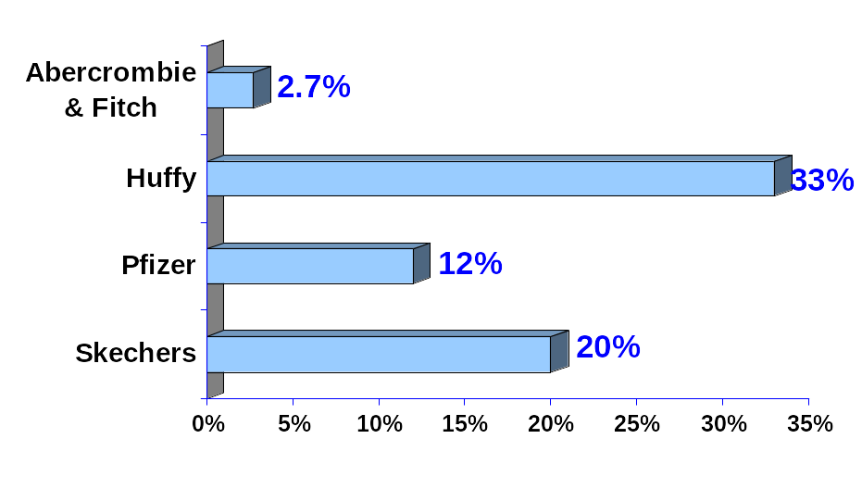
Recognizing Accounts Receivable
$20.5 Mil.
$92.2 Mil.
$6,785 Mil.
$97.4 Mil.
As a percentage of total assets

Slide 4
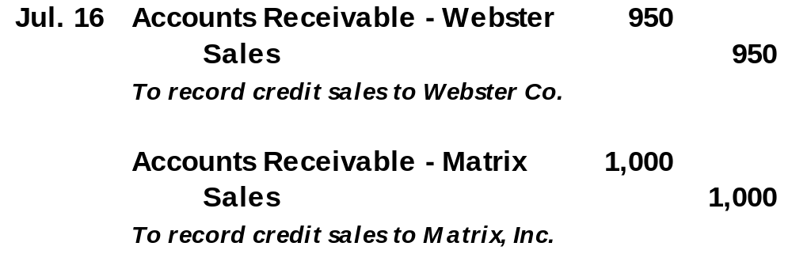
Sales on Credit
On July 16, Barton, Co. sells $950 of merchandise on credit to Webster, Co., and $1,000 of merchandise on account to Matrix, Inc.

Slide 5
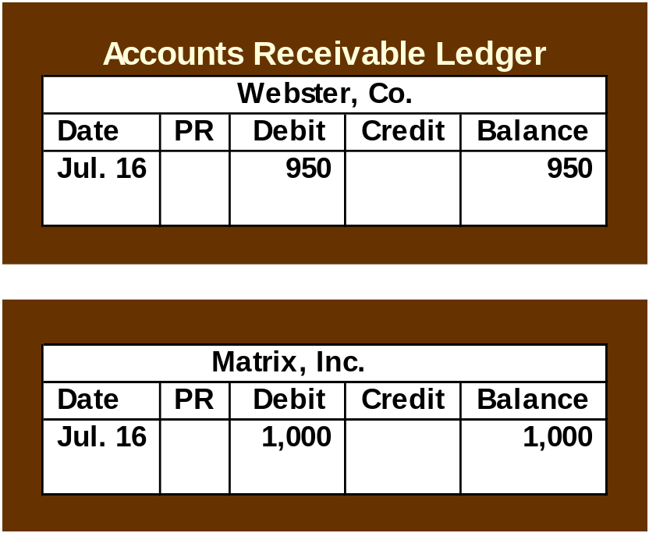
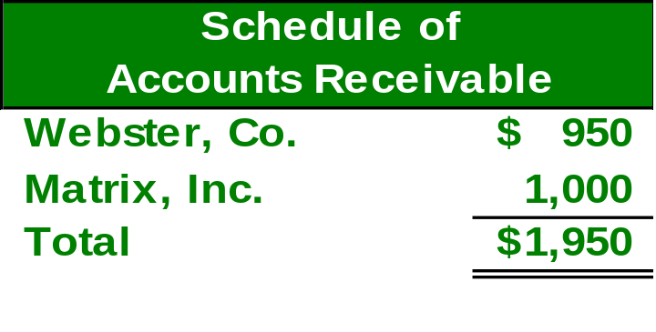
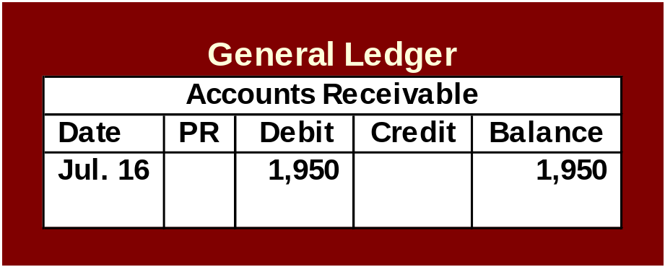
Sales on Credit

Slide 6
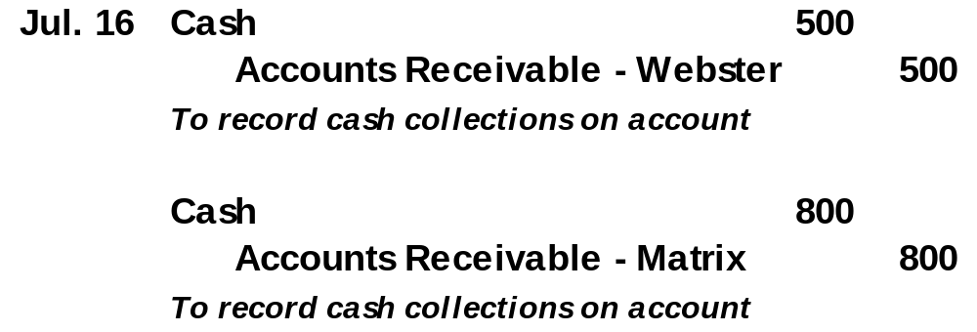
Sales on Credit
On July 31, Barton, Co. collects $500 from Webster, Co., and $800 from Matrix, Inc. on account.

Slide 7
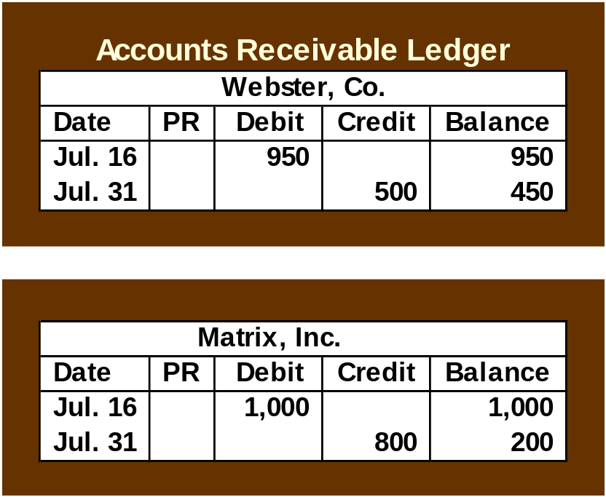
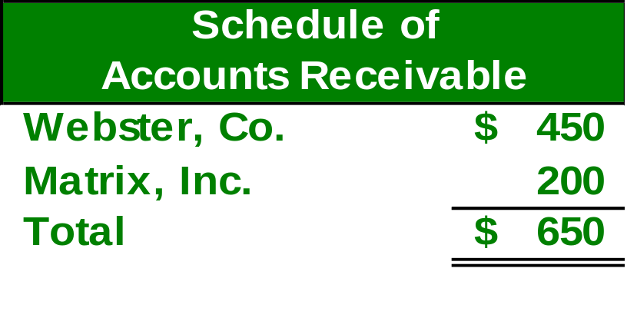
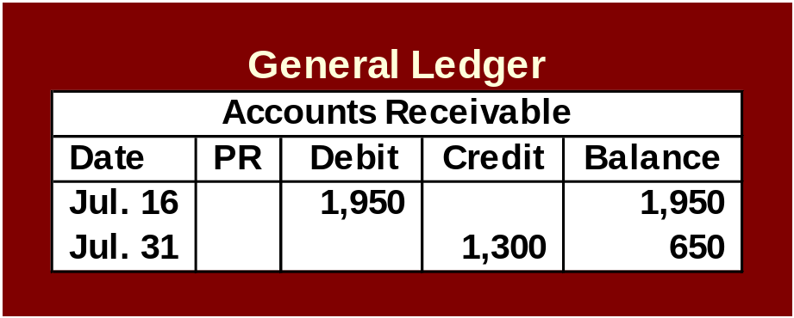
Sales on Credit

Slide 8

Credit Card Sales
Advantages of allowing customers to use credit cards:
Customers’ credit is evaluated by the credit card issuer.
Sales increase by providing purchase options to the customer.
The risks of extending credit are transferred to the credit card issuer.
Cash collections are speeded up.

Slide 9
Credit Card Sales
With bank credit cards, the seller
deposits the credit card sales receipt
in the bank just like it deposits a
customer’s check.
The bank increases the balance in the
company’s checking account.
The company usually pays a fee of 1%
to 5% for the service.

Slide 10
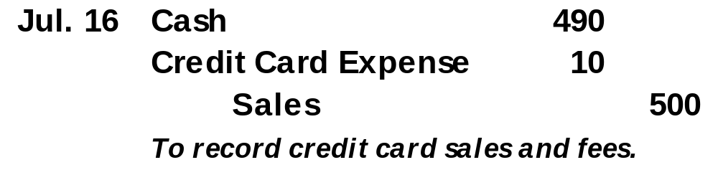
Credit Card Sales
On July 16, 2004, Barton, Co. has a bank credit card sale of $500 to a customer. The bank charges a processing fee of 2%. The cash is received immediately.

Slide 11
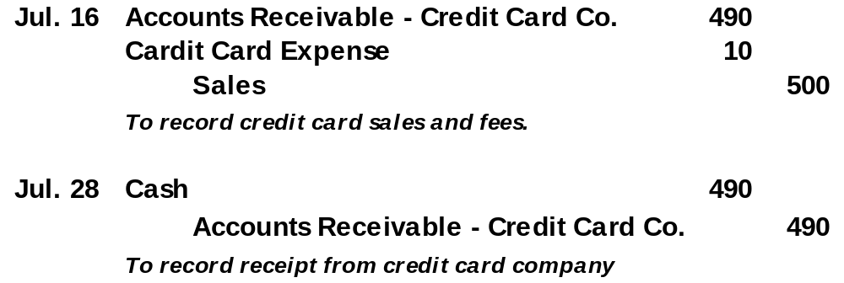
Credit Card Sales
On July 16, 2004, Barton, Co. has a bank credit card sale of $500 to a customer. The bank charges a processing fee of 2%. Barton must remit the credit card sale to the credit card company and wait for the payment.

Slide 12

Installment Accounts Receivable
Amounts owed by customers from credit sales for which payment is required in periodic amounts over an extended time period. The customer is usually charged interest.

Slide 13

Valuing Accounts Receivable
Some customers may not pay their account. Uncollectible amounts are referred to as bad debts. There are two methods of dealing with bad debts:
  Direct Write-Off Method
  Allowance Method

Slide 14
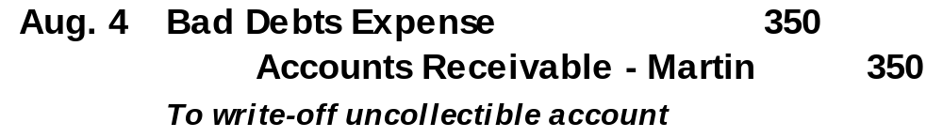
Direct Write-Off Method
On August 4, Barton determines it cannot collect $350 from Martin, Inc., a credit customer.

Slide 15
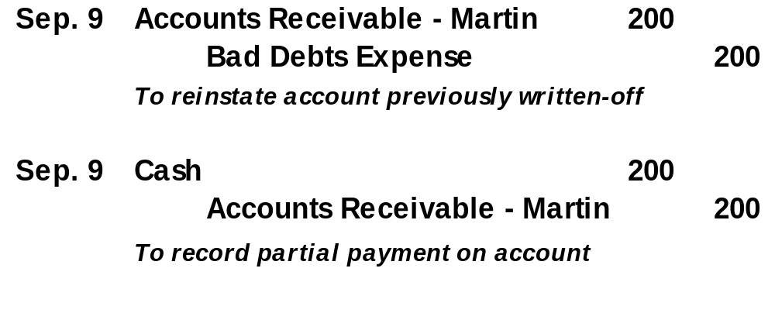
Direct Write-Off Method
After the write-off, Martin decides to pay $200.

Slide 16

Matching vs. Materiality
Materiality states that an amount can be ignored if its effect on the financial statements is unimportant to users’ business decisions.
Matching requires expenses to be reported in the same accounting period as the sales they help produce.

Slide 17

Allowance Method
At the end of each period, estimate total bad debts expected to be realized from that period’s sales.
There are two advantages to the allowance method:
It records estimated bad debts expense in the period when the related sales are recorded.
It reports accounts receivable on the balance sheet at the estimated amount of cash to be collected.

Slide 18

Recording Bad Debts Expense
At the end of its first year of operations, Barton Co. estimates that $3,000 of it accounts receivable will prove uncollectible. The total accounts receivable balance at December 31, 2004, is $278,000.
Contra asset account

Slide 19
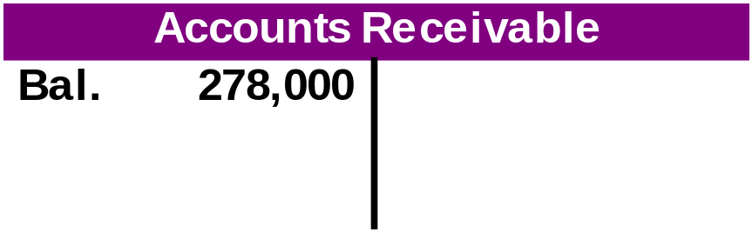

Recording Bad Debts Expense
At the end of its first year of operations, Barton Co. estimates that $3,000 of it accounts receivable will prove uncollectible. The total accounts receivable balance at December 31, 2004, is $278,000.

Slide 20
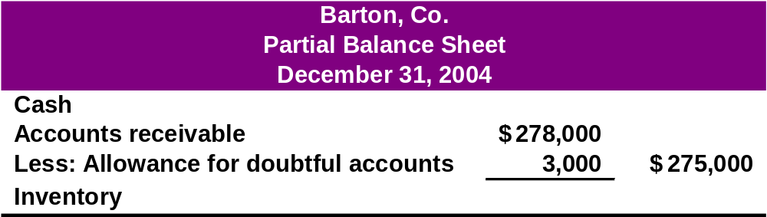
Recording Bad Debts Expense
At the end of its first year of operations, Barton Co. estimates that $3,000 of it accounts receivable will prove uncollectible. The total accounts receivable balance at December 31, 2004, is $278,000.

Slide 21

Estimating Bad Debts Expense
Two Methods
Percent of Sales Method
Accounts Receivable Methods
  Percent of Accounts Receivable
  Aging of Accounts Receivable Method

Slide 22


Percent of Sales Method
Bad debts expense is computed as follows:

Slide 23

Percent of Sales Method
Barton has credit sales of $1,400,000 in 2004. Management estimates 0.5% of credit sales will eventually prove uncollectible.
What is Bad Debts Expense for 2004?

Slide 24


Percent of Sales Method
Barton’s accountant computes estimated Bad Debts Expense of $7,000.

Slide 25

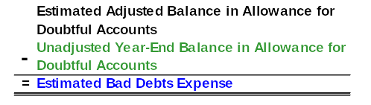
Percent of Accounts Receivable Method
Compute the estimate of the Allowance for Doubtful Accounts.
Bad Debts Expense is computed as:

Slide 26

Percent of Accounts Receivable
Barton has $100,000 in accounts receivable and a $900 credit balance in Allowance for Doubtful Accounts on December 31, 2004. Past experience suggests that 4% of receivables are uncollectible.
What is Barton’s Bad Debts Expense for 2004?

Slide 27

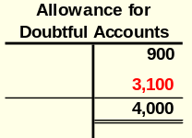
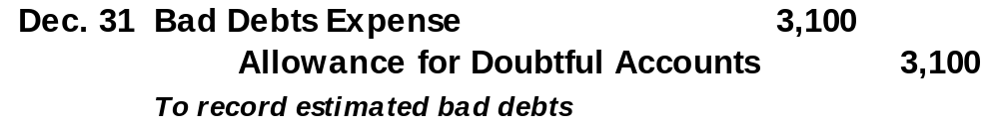
Percent of Accounts Receivable
Desired balance in Allowance for Doubtful Accounts.

Slide 28

Aging of Accounts Receivable Method
Year-end Accounts Receivable is
broken down into age
classifications.
Each age grouping has a
different likelihood of being
uncollectible.
Compute a separate allowance
for each age grouping.

Slide 29
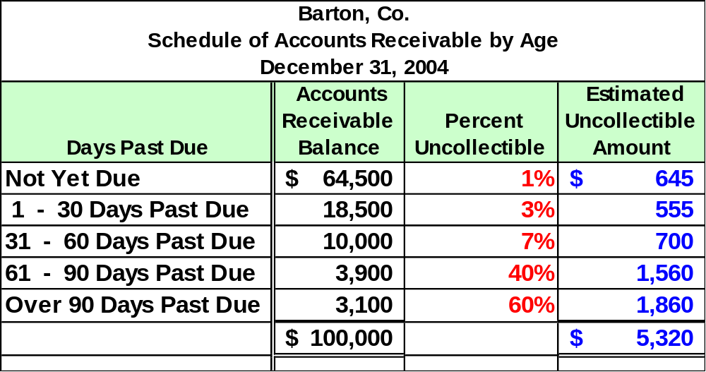
Aging of Accounts Receivable

Slide 30
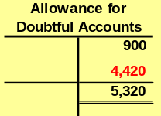

Aging of Accounts Receivable
Barton’s unadjusted balance in the allowance account is $900.
We estimated the proper balance to be $5,320.

Slide 31
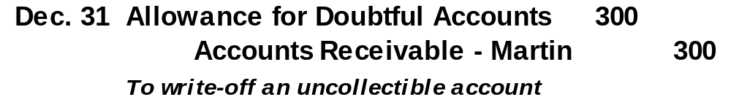
Writing Off a Bad Debt
With the allowance method, when an account is determined to be uncollectible, the debit goes to Allowance for Doubtful Accounts.
Barton determines that Martin’s $300 account is uncollectible.

Slide 32
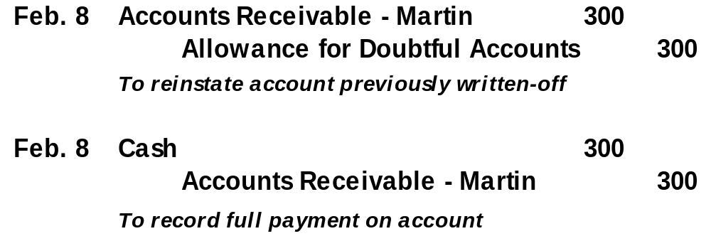
Recovery of a Bad Debt
Subsequent collections on accounts written-off require that the original write-off entry be reversed before the cash collection is recorded.

Slide 33
Summary
% of Sales
% of Receivables
Aging of Receivables
Emphasis on Matching
Emphasis on Realizable Value
Emphasis on Realizable Value
Sales
Accts. Rec.
Accts. Rec.
Bad Debts Exp.
All. for Doubtful Accts.
All. for Doubtful Accts.
Income Statement Focus
Balance Sheet Focus
Balance Sheet Focus

Slide 34

Let’s look at notes receivable!

Slide 35

Notes Receivable
A note is a written
promise to pay a specific amount at a specific future date.

Slide 36
Notes Receivable
Term
$1,000.00
July 10, 2004
Payee
Ninety days
after date I promise to pay to
the order of
Barton Company, Los Angeles, CA
One thousand and no/100 ---------------------------------
Dollars
Payable at
First National Bank of Los Angeles, CA
Maker
12%
Value received with interest at per annum
Julia Browne
42
Oct. 8, 2004
No. Due
For Barton, Co.

Slide 37
Notes Receivable
$1,000.00
July 10, 2004
Ninety days
after date I promise to pay to
Principal
Barton Company, Los Angeles, CA
the order of
One thousand and no/100 ---------------------------------
Dollars
Payable at
First National Bank of Los Angeles, CA
Interest Rate
12%
Value received with interest at per annum
Julia Browne
42
Oct. 8, 2004
No. Due
For Barton, Co.
Due Date

Slide 38

Interest Computation
Even for maturities less than 1 year, the rate is annualized.
If the note is expressed in days, base a year on 360 days.

Slide 39

Computing Maturity and Interest
On March 1, 2004, Matrix, Inc. purchased a copier for $12,000 from Office Supplies, Inc. Matrix gave Office Supplies a 9% note due in 90 days in payment for the copier.
How much interest will be paid to Office Supplies, Inc. in 90 days?

Slide 40
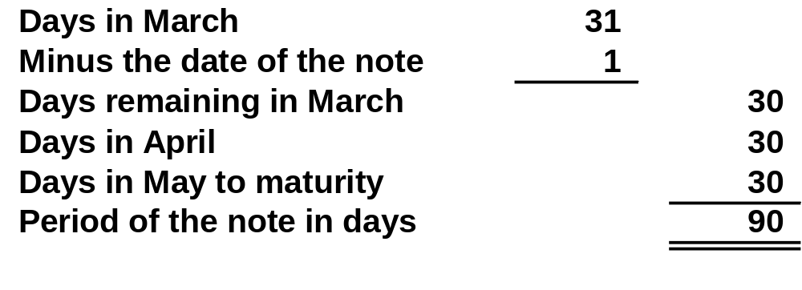
Computing Maturity and Interest
The note is due and payable on May 30, 2004.

Slide 41
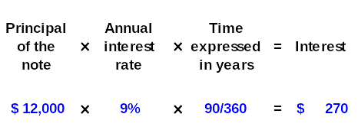
Computing Maturity and Interest
Total interest due at May 30.

Slide 42

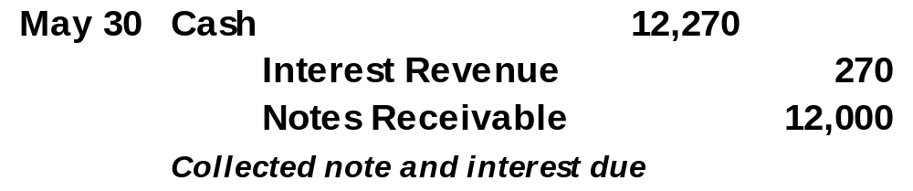
Recognizing Notes Receivable
Here are the entries to record the note on
March 1, and the settlement on May 30, 2004.

Slide 43
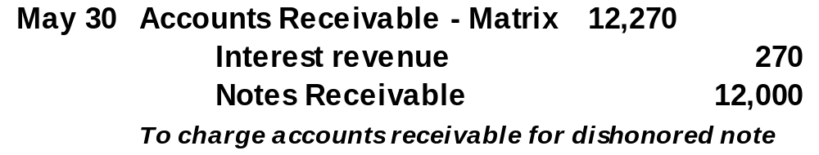
Recording a Dishonored Note
On May 30, 2004, Matrix informs us that the company is unable to pay the note or interest.

Slide 44

Recording End-of-Period Interest Adjustments
When a note receivable is outstanding at the end of an accounting period, the company must prepare an adjusting entry to accrue interest income.

Slide 45
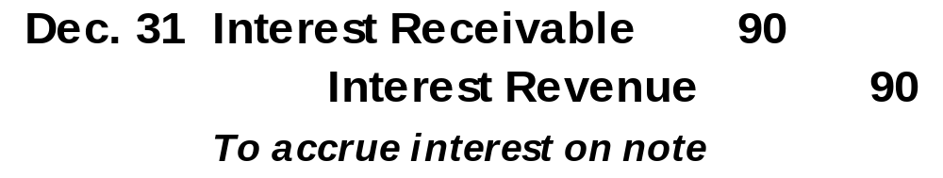
Recording End-of-Period Interest Adjustments
On December 1, 2004, Matrix, Inc. purchased a copier for $12,000 from Office Supplies, Inc. Matrix issued a 9% note due in 90 days in payment for the copier.
What adjusting entry is required on December 31, the end of the company’s accounting period?
$12,000 × 9% × 30/360 = $90

Slide 46
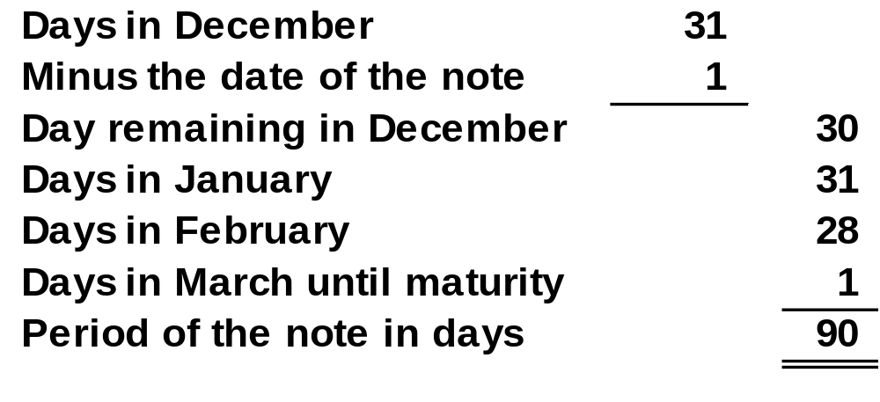
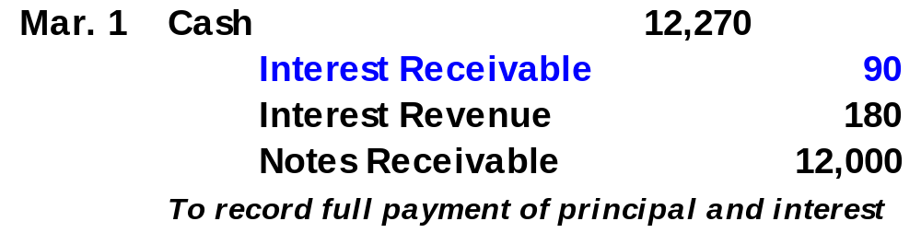
Recording End-of-Period Interest Adjustments
Recording collection on note at maturity.

Slide 47

Accounts Receivable Turnover
This ratio provides useful information for evaluating how efficient management has been in granting credit to produce revenue.
Net sales
Average accounts receivable

Slide 48

End of Chapter 9

