Slide 1
Plant Assets
Tangible in Nature
Actively Used in Operations
Expected to Benefit Future Periods
Called Property, Plant, & Equipment

Slide 2
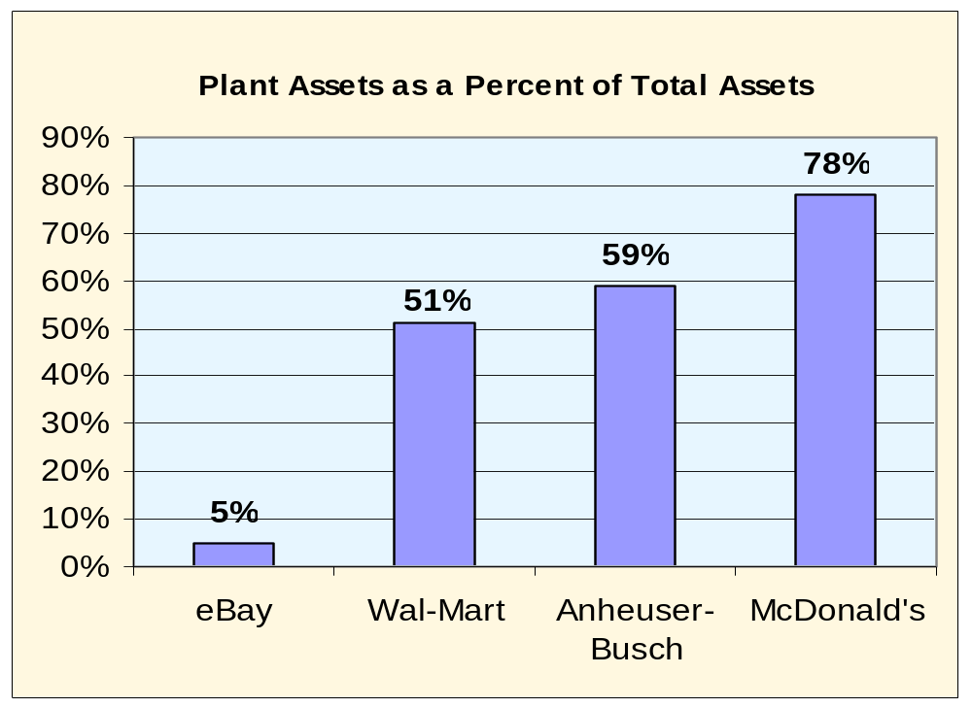
Plant Assets

Slide 3



Plant Assets
Decline in asset value over its useful life
Use
2. Allocate cost to periods
benefited.
3. Account for subsequent
expenditures.
Acquisition
1. Compute cost.
Disposal
4. Record disposal

Slide 4

Cost Determination
Purchase
price
All expenditures needed to prepare the asset for its intended use
Acquisition
Cost
Acquisition cost excludes financing charges and
cash discounts.

Slide 5

Land
Title insurance premiums
Purchase
price
Delinquent
taxes
Real estate
commissions
Surveying
fees
Title search and transfer fees
Land is not depreciable.

Slide 6
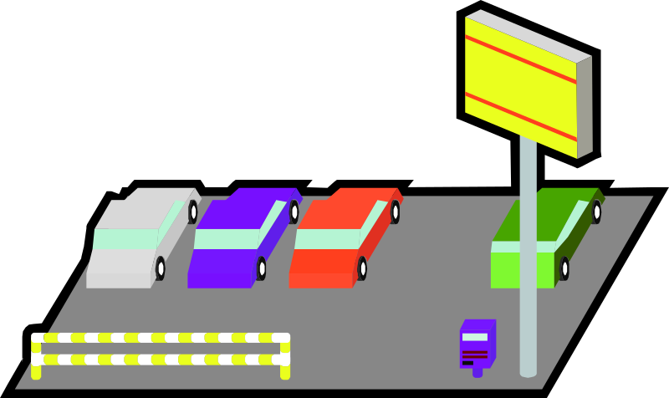
Land Improvements
Parking lots, driveways, fences, walks, shrubs, and lighting systems.
Depreciate over useful life of improvements.

Slide 7

Buildings
Cost of purchase or construction
Title fees
Brokerage
fees
Attorney fees
Taxes

Slide 8

Machinery and Equipment
Purchase
price
Taxes
Transportation
charges
Installing,
assembling, and
testing
Insurance while
in transit

Slide 9

Lump-Sum Asset Purchase
The total cost of a combined purchase of land and building is separated on the basis of their relative market values.
On January 1, Matrix, Inc. purchased land and building for $200,000 cash. The appraised values are building, $162,500, and land, $87,500.
How much of the $200,000 purchase price will be charged to the building and land accounts?

Slide 10
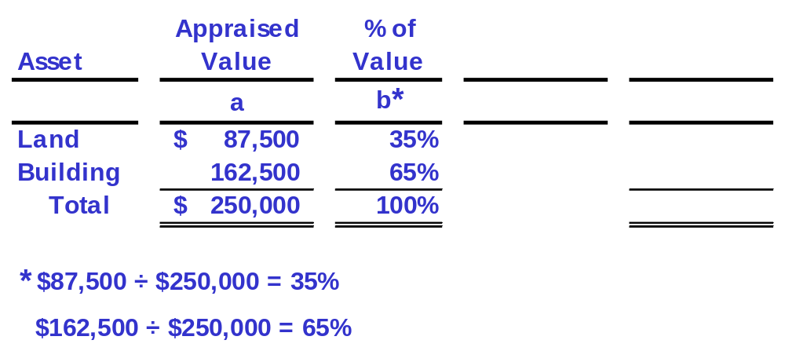
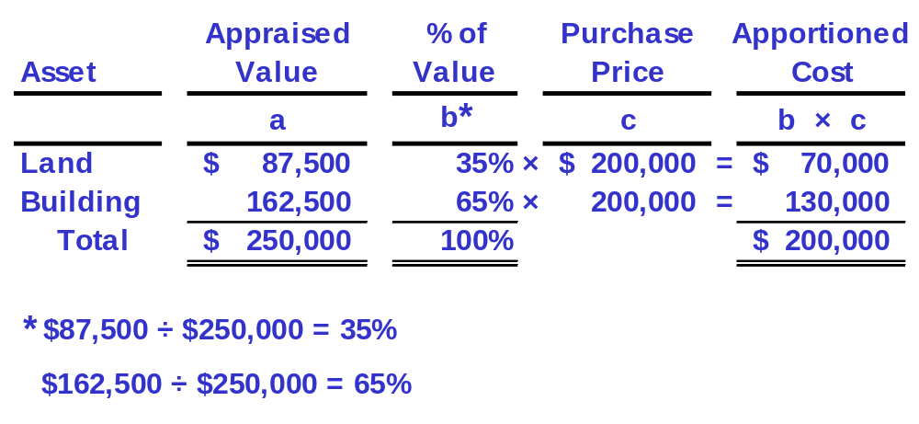
Lump-Sum Asset Purchase

Slide 11
Depreciation
Depreciation is the process of allocating the cost of a plant asset to expense in the accounting periods benefiting from its use.
Balance Sheet
Income Statement
Acquisition
Cost
Cost
Expense
Allocation
(Unused)
(Used)

Slide 12

Factors in Computing Depreciation
The calculation of depreciation requires three amounts for each asset:
  Cost.
  Salvage Value.
  Useful Life.

Slide 13
Depreciation Methods
Straight-line
Units-of-production
Declining balance

Slide 14
Straight-Line Method
Depreciation
Expense for Period
Cost - Salvage Value
Useful life in periods
=
On January 1, 2004, equipment was purchased for $50,000 cash. The equipment has an estimated useful life of 5 years and an estimated residual value of $5,000.

Slide 15
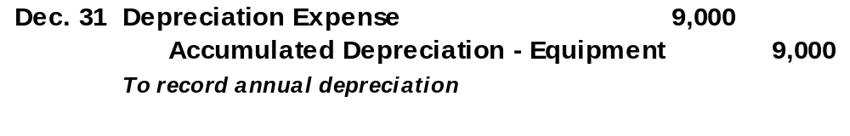
Straight-Line Method
Depreciation
Expense for Period
Cost - Salvage Value
Useful life in periods
=
Depreciation
Expense per Year
$50,000 - $5,000
5 years
=
=
$9,000

Slide 16
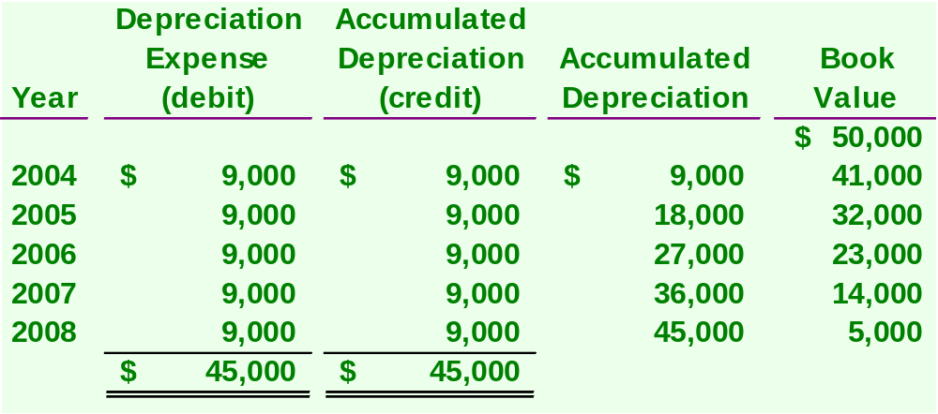
Straight-Line Method
Salvage Value
Depreciation
Rate
=
(100% ÷ 5 years)
= 20% per year

Slide 17
$9,000
$7,000
Depreciation Expense reported on the
Income Statement.
Depreciation Expense
$5,000
$3,000
$1,000
$0
2004
2005
2006
2007
2008
For the year ended December 31
$45,000
$40,000
$41,000
$35,000
$30,000
$32,000
Book Value
reported on the
Balance Sheet.
$25,000
Book Value
$23,000
$20,000
$15,000
$14,000
$10,000
$5,000
$5,000
$0
2004
2005
2006
2007
2008
As of December 31

Slide 18
Units-of-Production Method
Step 1:
Depreciation
Per Unit
Cost - Salvage Value
Total Units of Production
=
Step 2:
Number of Units Produced
in the Period
Depreciation
Expense
Depreciation
Per Unit
=
×

Slide 19

Units-of-Production Method
On December 31, 2001, equipment was purchased for $50,000 cash. The equipment is expected to produce 100,000 units during its useful life and has an estimated salvage value of $5,000.
If 22,000 units were produced in 2002, what
is the amount of depreciation expense?

Slide 20
Units-of-Production Method
Step 1:
Depreciation
Per Unit
$50,000 - $5,000
100,000 units
=
= $.45 per unit
Step 2:
Depreciation
Expense
=
$.45 per unit × 22,000 units = $9,900

Slide 21
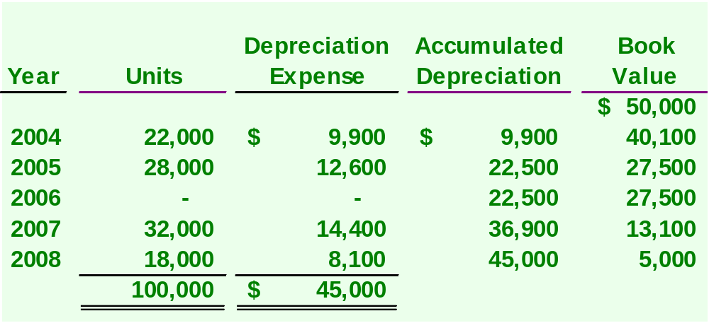
Units-of-Production Method
No depreciation expense if the equipment is idle.

Slide 22
Declining Balance Method
Depreciation
Repair
Expense
Expense
Early Years
High
Low
Later Years
Low
High
Early years’ total expense approximates
later years’ total expense.

Slide 23
Double-Declining-Balance Method
Step 1:
Straight-line
rate
=
100 % ÷ Useful life = 100% ÷ 5 = 20%
Step 2:
Double-declining-
balance rate
= 2 × Straight-line rate = 2 × 20% = 40%
Step 3:
Depreciation
expense
Double-declining-
balance rate
Beginning period
book value
=
×
40% × $50,000 = $20,000 for 2004

Slide 24
Double-Declining-Balance Method
2004 Depreciation:
40% × $50,000 = $20,000
2005 Depreciation:
40% × ($50,000 - $20,000) = $12,000

Slide 25
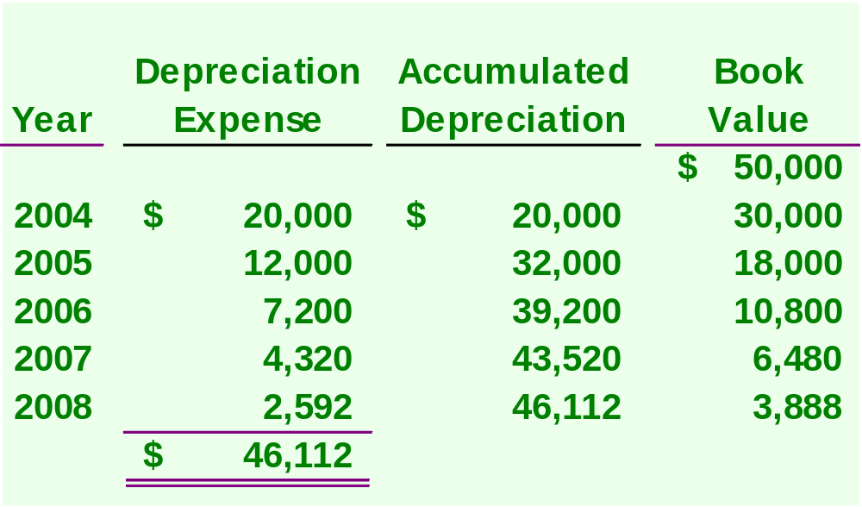
Double-Declining-Balance Method
Below salvage value

Slide 26
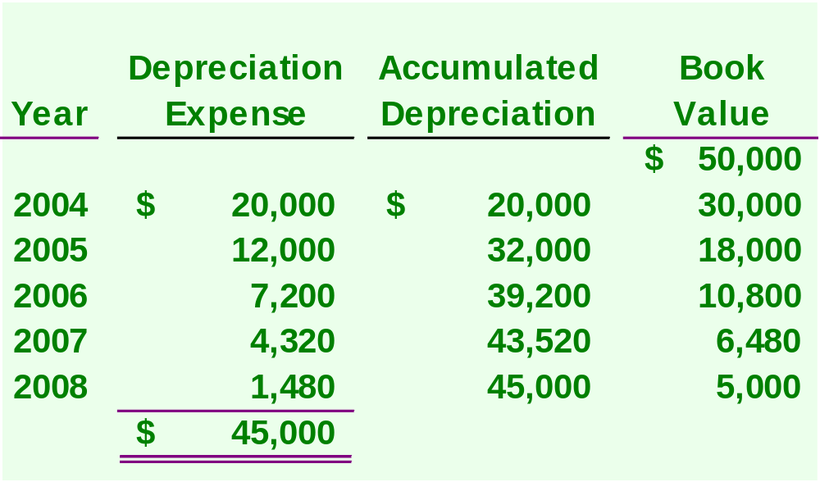
Double-Declining-Balance Method
We usually must force depreciation expense in the
last year so that book value equals salvage value.

Slide 27
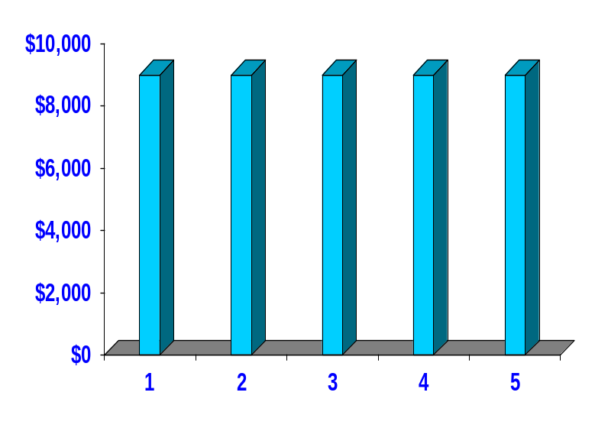
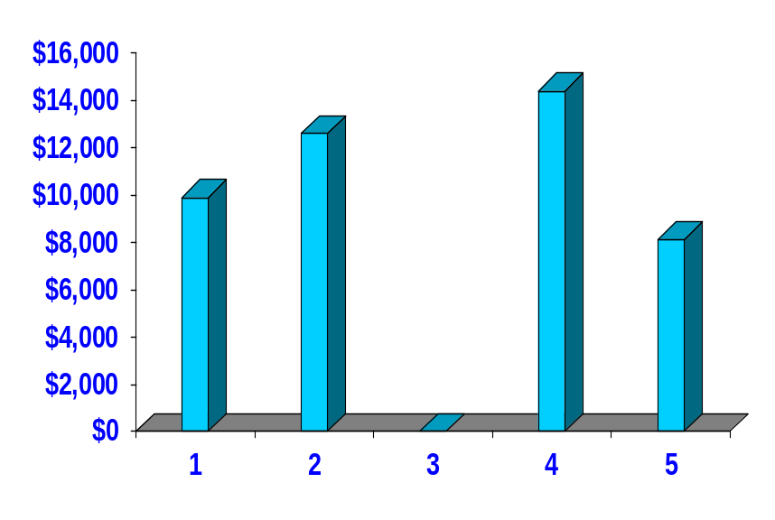
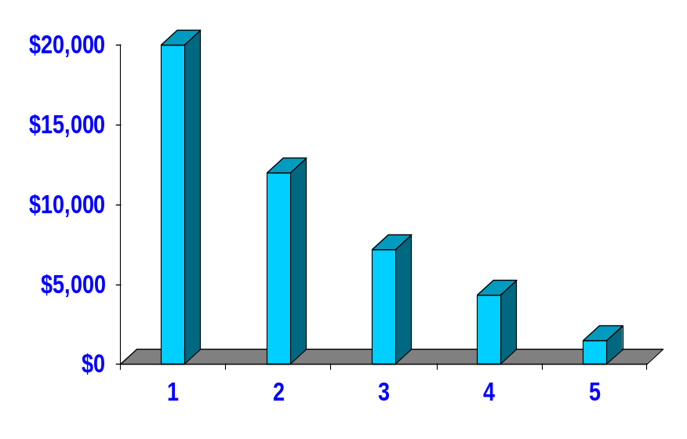
Comparing Depreciation Methods
Annual SL
Depreciation
Annual Production
Depreciation
Life in Years
Life in Years
Annual DDB
Depreciation
Life in Years

Slide 28

Depreciation for Tax Reporting
Most corporations use the Modified Accelerated Cost Recovery System (MACRS) for tax purposes.
MACRS depreciation provides for rapid write-off of an asset’s cost in order to stimulate new investment.

Slide 29

Partial-Year Depreciation
When a plant asset is acquired during the year, depreciation is calculated for the fraction of the year the asset is owned.
June
30

Slide 30
Partial Year Depreciation
Calculate the straight-line depreciation on December 31, 2004, for equipment purchased on June 30, 2004. The equipment cost $75,000, has a useful life of 10 years and an estimated salvage value of $5,000.
Depreciation = ($75,000 - $5,000) ÷ 10
= $7,000 for all 2004
Depreciation = $7,000 × ⁶/₁₂ = $3,500

Slide 31
Change in Estimates for Depreciation
Predicted
salvage value
Predicted
useful life
So depreciation
is an estimate.
Over the life of an asset, new information may come to light that indicates the
original estimates were inaccurate.

Slide 32
Change in Estimates for Depreciation
On January 1, 2004, equipment was purchased that cost $30,000, has a useful life of 10 years and no salvage value. During 2007, the useful life was revised to 8 years total (5 years remaining).
Calculate depreciation expense for the year
ended December 31, 2004, using the
straight-line method.
Book value at
date of change
–
Salvage value at
date of change
Remaining useful life at date of change

Slide 33
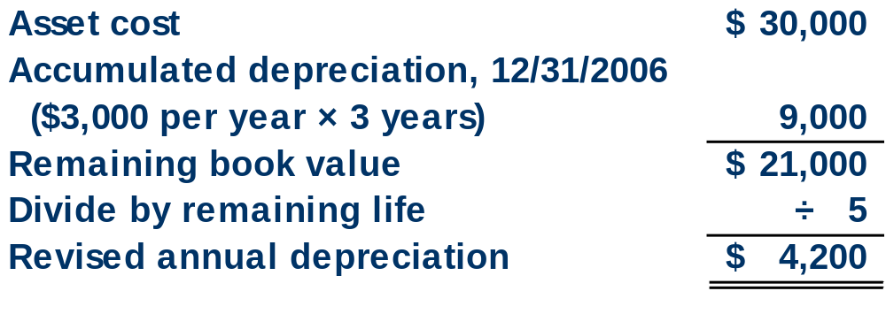
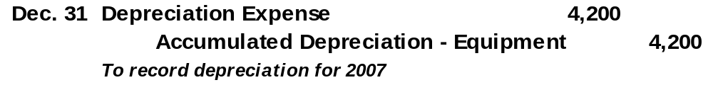
Change in Estimates for Depreciation

Slide 34
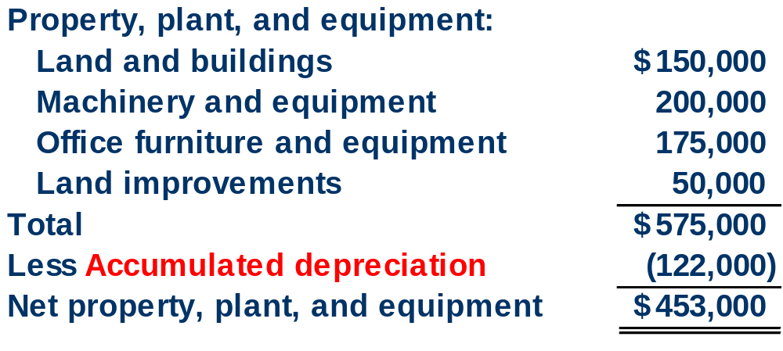
Reporting Depreciation

Slide 35
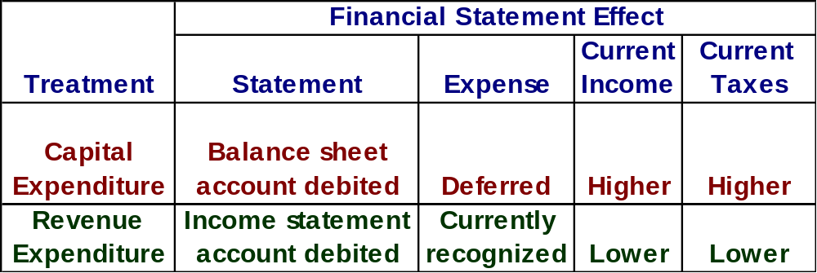
Additional Expenditures
If the amounts involved are not material, most companies expense the item.

Slide 36
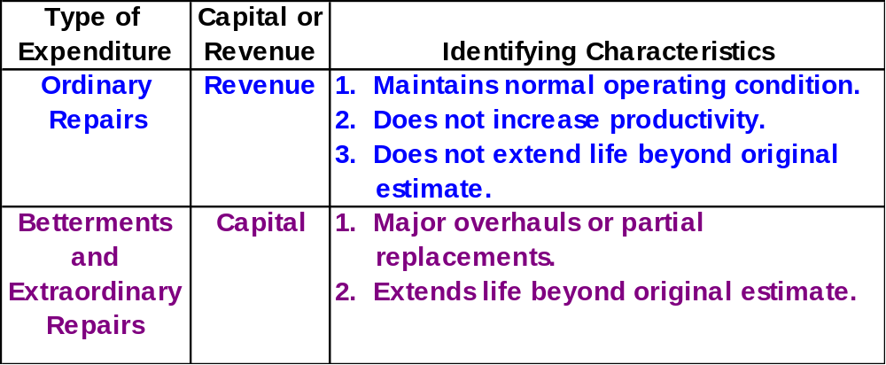
Revenue and Capital Expenditures

Slide 37
Disposals of Plant Assets
Update depreciation
to the date of disposal.
Journalize disposal by:
Recording cash
received (debit)
or paid (credit).
Recording a
gain (credit)
or loss (debit).
Removing accumulated
depreciation (debit).
Removing the
asset cost (credit).

Slide 38
Discarding Plant Assets
Update depreciation
to the date of disposal.
If Cash > BV, record a gain (credit).
If Cash < BV, record a loss (debit).
If Cash = BV, no gain or loss.
Journalize disposal by:
Recording cash
received (debit)
or paid (credit).
Recording a
gain (credit)
or loss (debit).
Removing accumulated
depreciation (debit).
Removing the
asset cost (credit).

Slide 39
Selling Plant Assets
On September 30, 2004, Evans Company sells a machine that originally cost $100,000 for $60,000 cash. The machine was placed in service on January 1, 2000. It was depreciated using the straight-line method with an estimated salvage value of $20,000 and a useful life of 10 years.

Slide 40
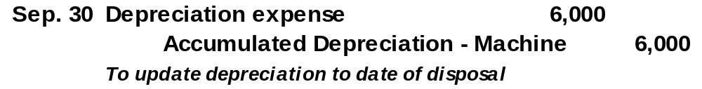
Update Depreciation to Date of Disposal
Selling Plant Assets
Annual Depreciation:
($100,000 - $20,000) ÷ 10 Yrs. = $8,000
Depreciation to September 30, 2004:
9/12 × $8,000 = $6,000

Slide 41
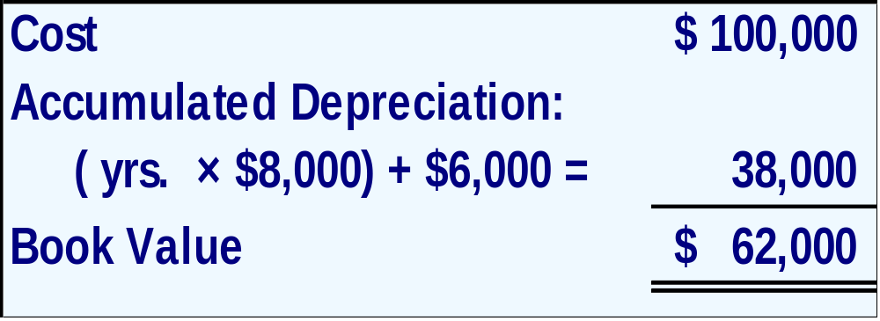

Determine Book Value of Asset
Selling Plant Assets

Slide 42
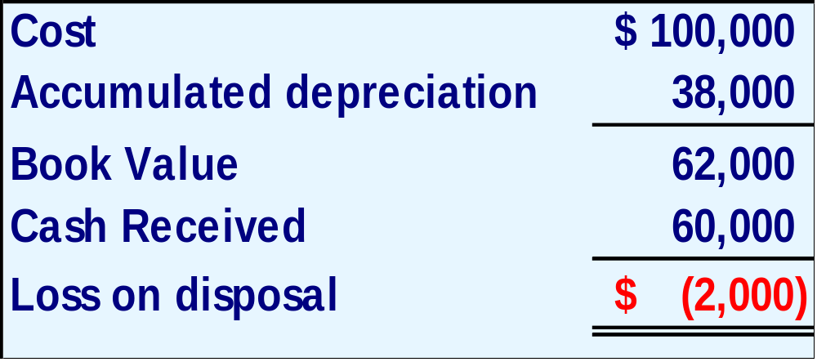
Determine Gain or Loss on Disposal
Selling Plant Assets
If Cash > BV, record a gain (credit).
If Cash < BV, record a loss (debit).
If Cash = BV, no gain or loss.

Slide 43
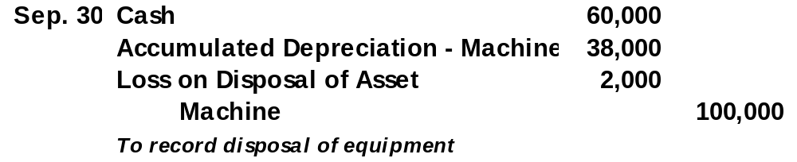

Record the Disposal in the Journal
Selling Plant Assets

Slide 44



Exchanging Plant Assets
SIMILAR
Accounting for exchanges of similar assets depends on whether the book value of the asset(s) given up is less or more than the market value of the asset(s) received.

Slide 45
Exchanging Plant Assets
SIMILAR
Accounting for exchanges of similar assets depends on whether the book value of the asset(s) given up is less or more than the market value of the asset(s) received.
A loss is recognized when the book value given up is less than the market value received.
A gain is not recognized when the book value given up is more than the market value received.

Slide 46
Exchanging Plant Assets
On May 30, 2004, Matrix, Inc. exchanged a used bus and $35,000 cash for a new European-style bus. The old bus originally cost $40,000, had up-to-date accumulated depreciation of $30,000. The new bus had a market value of $39,000.
SIMILAR

Slide 47
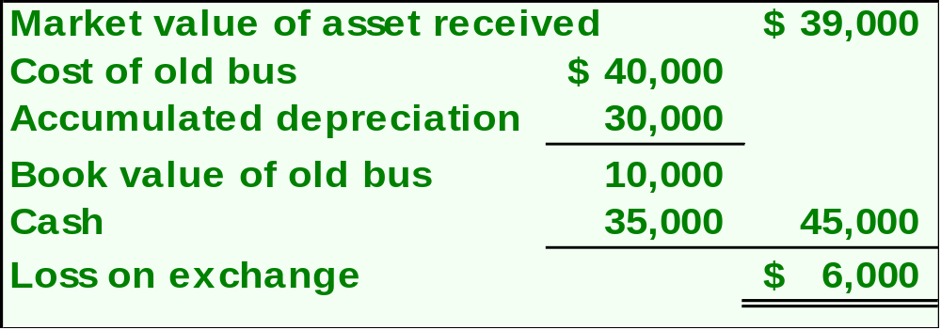
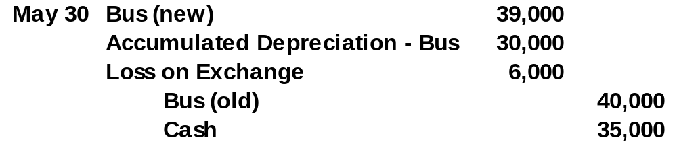
Exchanging Plant Assets
Remember -- Losses are always recorded immediately.

Slide 48
Exchanging Plant Assets
On May 30, 2004, Matrix, Inc. exchanged a used bus and $35,000 cash for a new European-style bus. The old bus originally cost $40,000, had up-to-date accumulated depreciation of $30,000. The new bus had a market value of $49,000.
SIMILAR

Slide 49

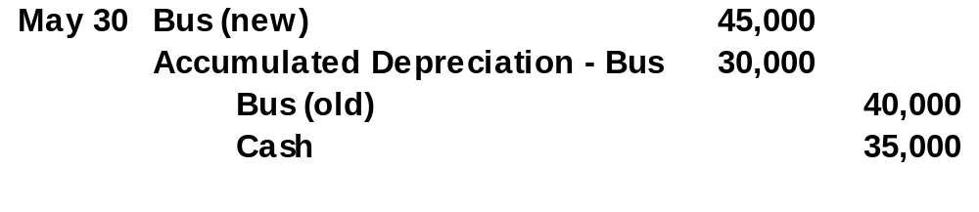
Exchanging Plant Assets
Market value of new bus – gain not recognized
$49,000 - $4,000 = $45,000

Slide 50
Exchanging Plant Assets
Comparison of Treatment of Gains and Losses
The $4,000 gain in not recognized

Slide 51

Let’s Talk About Natural Resources!
Let’s change the subject!

Slide 52

Natural Resources
Total cost,
including
exploration and
development,
is charged to
depletion expense
over periods
benefited.
Extracted from
the natural
environment
and reported
at cost less
accumulated
depletion.
Examples: oil, coal, gold

Slide 53
Cost Determination and Depletion
Step 1:
Depletion
Per Unit
Cost - Salvage Value
Total Units of Capacity
=
Step 2:
Units Extracted and Sold in Period
Depletion
Expense
Depletion
Per Unit
=
×

Slide 54
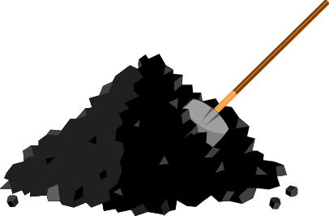
Depletion of Natural Resources
Apex Mining acquired a tract of land containing ore deposits. Total costs of acquisition and development were $1,000,000 and Apex estimates the land contained 40,000 tons of ore. During the first year of operations Apex extracted and sold 13,000 tons of ore.

Slide 55
Units-of-Production Method
Step 1:
Depletion
Per Unit
$1,000,000 - $0
40,000 tons
=
= $25 per ton
Step 2:
Depletion
Expense
=
$25 per ton × 13,000 units = $325,000

Slide 56
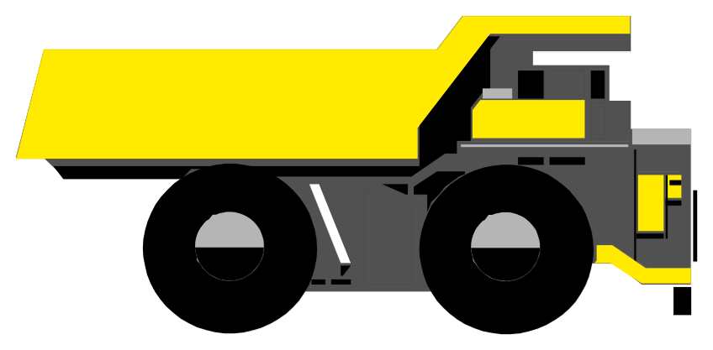
Plant Assets Used in Extracting Natural Resources
Specialized plant assets may be required to extract the natural resource.
These assets are recorded in a separate account and depreciated.

Slide 57

Now Let’s Look at Intangible Assets!
Let’s change the subject!

Slide 58
Intangible Assets
Noncurrent assets
without physical
substance.
Often provide
exclusive rights
or privileges.
Intangible
Assets
Useful life is
often difficult
to determine.
Usually acquired
for operational
use.

Slide 59
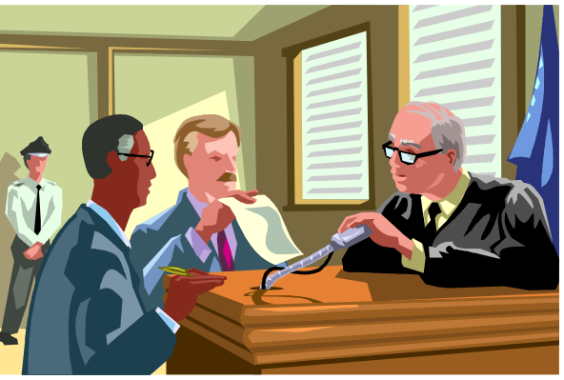
Cost Determination and Amortization
Record at current cash equivalent cost, including purchase price, legal fees, and filing fees.
Patents
Copyrights
Leaseholds
Leasehold Improvements
Franchises & Licenses
Goodwill
Trademarks & Trade Names

Slide 60

Types of Intangibles
Patents
The exclusive right granted to its owner to manufacture and sell a patented item or use a process for 17 years. Patents are generally amortized, using the straight-line method, over its useful life not to exceed 17 years.

Slide 61
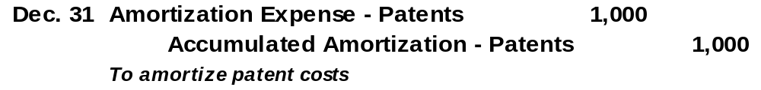

Types of Intangibles
Patents
Matrix, Inc. purchased a patent for $10,000. The patent is expected to have a useful life of 10 years.

Slide 62
Type’ of Intangibles
Copyrights
The exclusive right to publish and sell a musical, literary, or artistic work during the life of the creator plus 70 years.
Leaseholds
The rights the lessor grants to the lessee under the terms of a lease. Most leases have a determinable life.

Slide 63
Types of Intangibles
Leasehold Improvements
A lessee may pay for alternations or improvements to the leased property such as partitions, painting, and storefronts. These costs are usually amortized over the term of the lease.
Franchises and Licenses
The right granted by a company or the government to deliver a product or service under specified conditions.

Slide 64

Types of Intangibles
Trademarks and Trade Names
A symbol, name, phrase, or jingle identified with a company, product, or service.

Slide 65
Goodwill
Goodwill
Occurs when one
company buys
another company.
Only purchased
goodwill is an
intangible asset.
Goodwill is not amortized. It is tested
each year to determine if there has been
any impairment in carrying value.

Slide 66
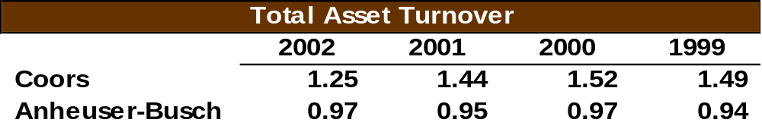
Total Asset Turnover
Total Asset
Turnover
Net Sales
Average Total Assets
=
Provides information about a company’s
efficiency in using its assets.

