Slide 1


GLENCOE / McGraw-Hill

Slide 2


Accounting
for Purchases
and Accounts Payable

Slide 3
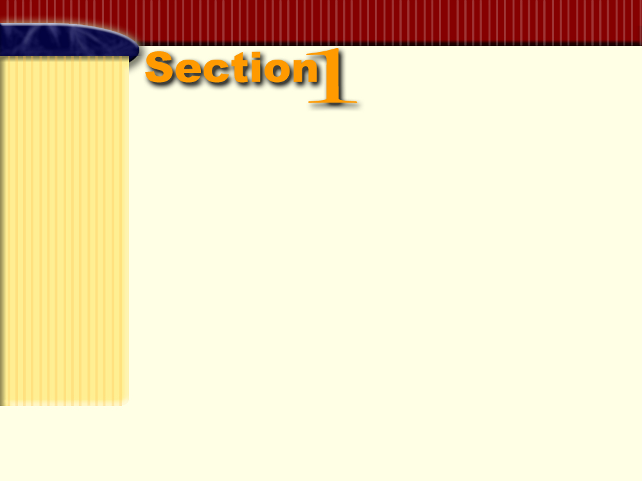

Merchandise
Purchases
Section Objectives
Record purchases of merchandise on credit in a three-column purchases journal.
Post from the three-column purchases journal to the
general ledger accounts.

Slide 4

Accounting for Purchases
Page
254

Slide 5
Most merchandising businesses purchase goods on credit under open-account arrangements.
A large firm usually has a centralized purchasing department.
Page
254

Slide 6

Purchasing Procedures
Page
254

Slide 7
Purchasing Procedures
The Sales Department
sends an authorized purchase requisition to the Purchasing Department.
The Purchasing Department
issues an authorized purchase order and sends to the selected supplier.
A receiving report is prepared when the merchandise is received.
The Accounting Department
receives the invoice and copies of the purchase order and receiving report.
Page
254

Slide 8
QUESTION:
What is a purchase requisition?
ANSWER:
A purchase requisition is a list sent to the purchasing department showing the items to be ordered.
Page
254

Slide 9
QUESTION:
What is a purchase order?
ANSWER:
A purchase order is an order to the supplier of goods specifying items needed, quantity, price, and credit terms.
Page
254

Slide 10
QUESTION:
What is a receiving report?
ANSWER:
A receiving report is a form showing quantity and condition of goods received.
Page
254

Slide 11
QUESTION:
What is a purchase invoice?
ANSWER:
A purchase invoice is a bill received for goods purchased.
Page
254

Slide 12
QUESTION:
What is a sales invoice?
ANSWER:
A sales invoice is a supplier’s billing document.
Page
254

Slide 13
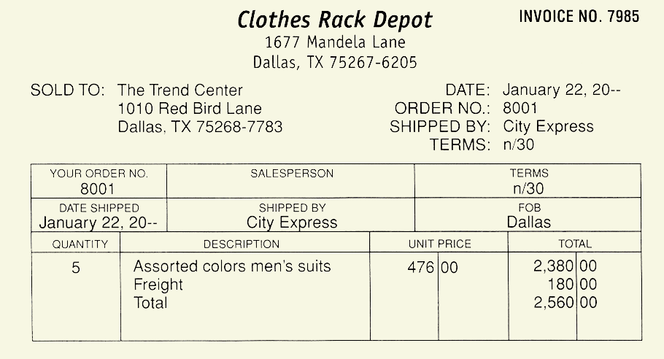
This is a purchase invoice for the customer.
This is a sales invoice for the seller.
Page
255

Slide 14
The Purchases Account
Page
256

Slide 15
QUESTION:
What is the Purchases account?
ANSWER:
The Purchases account is an account used to record cost of goods bought for resale during a period.
Page
256

Slide 16
Account Classifications
Recall the major account classifications from earlier chapters:
Assets
Liabilities
Owner’s Equity
Revenue
Expenses
The Purchases account is under a different classification:
Cost of Goods Sold
Page
256

Slide 17
QUESTION:
What is cost of goods sold?
ANSWER:
Cost of goods sold is the actual cost to the business of the merchandise sold to customers.
Page
256

Slide 18
Freight Charges for Purchases
Page
256

Slide 19
QUESTION:
What is the Freight In account?
ANSWER:
The Freight In account is an account showing transportation charges for items purchased. It is also called Transportation In account.
Page
256

Slide 20
There are two ways to handle freight charges paid by the buyer:
The buyer is billed directly by the transportation company for the freight charge. The buyer issues a check directly to the freight company.
The seller pays the freight charge and includes it on the invoice. The invoice includes the price of the goods
and the freight charge.
Page
256

Slide 21
Cost of Goods Sold
Price of goods (debit Purchases) $2,380.00
Total invoice (credit Accounts Payable) $2,560.00
Freight charge (debit Freight In) 180.00
Purchases
+
Freight In
=
Accounts Payable
Dr.
Cr.
Dr.
Cr.
Dr.
Cr.
2,380
180
2,560
The cost of goods sold accounts have normal debit balances.
Page
256

Slide 22
The Purchases Journal
Page
256

Slide 23
QUESTION:
What is a purchases journal?
ANSWER:
A purchases journal is a special journal used to record the purchase of goods on credit.
Page
256

Slide 24
For most merchandising businesses, it is not efficient to enter purchases of goods in the general journal.
Page
256

Slide 25
GENERAL JOURNAL
PAGE 1
DATE DESCRIPTION POST. REF. DEBIT CREDIT
20–
Jan.
3
5
Purchases
Freight In
Accounts Payable
Purchased merchandise from
Sebrina’s Clothing Store,
Invoice 8434, dated Dec. 29,
terms 2/10, n/30
Purchases
Freight In
Accounts Payable
Purchased merchandise from
The Style Shop, Invoice 336,
dated Dec. 30, terms n/30
501
502
205
501
502
205
501
502
205
501
502
205
3,000.00
250.00
3,250.00
3360.00
260.00
These four general journal entries require twelve separate postings to general ledger accounts. It takes a great deal of time and effort to post them.
3,620.00
6
Purchases
Freight In
Accounts Payable
Purchased merchandise from
The Women’s Shop, Invoice 9080,
dated Dec. 31, terms n/30
Purchases
Freight In
Accounts Payable
Purchased merchandise from
Fashion World, Invoice 4321, dated
Dec. 31, terms 2/10, n/30
2700.00
220.00
2,920.00
7
3,850.00
450.00
4,300.00
Page
257

Slide 26
The purchases journal makes it possible to record each purchase on a single line.
In addition, there is no need to enter account names and descriptions.
Page
258

Slide 27
PAGE 1
PURCHASES JOURNAL
DATE CREDITOR’S INVOICE INV. TERMS POST. ACCOUNTS PURCHASES FREIGHT IN
ACCOUNT NUMBER DATE REF. PAYABLE DEBIT DEBIT
CREDITED CREDIT
20--
Jan. 3 Sebrina’s Clothing Store 8434 12/29/-- 2/10, n/30 3,250.00 3,000.00 250.00
5 The Style Shop 336 12/30/-- n/30 3,620.00 3,360.00 260.00
6 The Women’s Shop 9080 12/31/-- n/30 2,920.00 2,700.00 220.00
7 Fashion World 4321 01/03/-- 2/10, n/30 4,300.00 3,850.00 450.00
18 Designer’s Fashion 9789 01/15/-- 2/10, n/30 2,100.00 1,930.00 170.00
22 Clothes Rack Depot 7985 01/22/-- 2/10, n/30 2,560.00 2,380.00 180.00
31 18,750.00 17,220.00 1,530.00
ACCOUNT ACCOUNT NO. 205
DATE DESCRIPTION POST. DEBIT CREDIT BALANCE
REF. DEBIT CREDIT
20--
Jan. 1 Balance  5,400.00
J1 3,250.00 8,650.00
Accounts Payable
(205)
(501)
(502)
ACCOUNT ACCOUNT NO. 501
DATE DESCRIPTION POST. DEBIT CREDIT BALANCE
REF. DEBIT CREDIT
20--
Jan. J1 3,000.00 3,000.00
Purchases
ACCOUNT ACCOUNT NO. 502
DATE DESCRIPTION POST. DEBIT CREDIT BALANCE
REF. DEBIT CREDIT
20--
Jan. 3 J1 250.00 250.00
Freight In
Page
258

Slide 28
Recording Transactions in a Purchases Journal
Page
258

Slide 29
Objective 1
Record purchases of
merchandise on credit
in a three-column
purchases journal.
Page
258

Slide 30
1. Enter the date, supplier’s name, invoice number, invoice date, and credit terms.
PAGE 1
PURCHASES JOURNAL
DATE CREDITOR’S INVOICE INV. TERMS POST. ACCOUNTS PURCHASES FREIGHT IN
ACCOUNT NUMBER DATE REF. PAYABLE DEBIT DEBIT
CREDITED CREDIT
20--
Jan. 3 Sebrina’s Clothing Store 8434 12/29/-- 2/10, n/30 3,250.00 3,000.00 250.00
5 The Style Shop 336 12/30/-- n/30 3,620.00 3,360.00 260.00
6 The Women’s Shop 9080 12/31/-- n/30 2,920.00 2,700.00 220.00
7 Fashion World 4321 01/03/-- 2/10, n/30 4,300.00 3,850.00 450.00
19 Designer’s Fashions 9789 01/15/-- 2/10, n/30 2,100.00 1,930.00 170.00
23 Clothes Rack Depot 7985 01/22/-- 2/10, n/30 2,560.00 2,380.00 180.00
31 18,750.00 17,220.00 1,530.00
(205)
(501)
(502)
Page
258

Slide 31
2. In the Accounts Payable Credit column, enter the total owed to the supplier.
PAGE 1
PURCHASES JOURNAL
DATE CREDITOR’S INVOICE INV. TERMS POST. ACCOUNTS PURCHASES FREIGHT IN
ACCOUNT NUMBER DATE REF. PAYABLE DEBIT DEBIT
CREDITED CREDIT
20--
Jan. 3 Sebrina’s Clothing Store 8434 12/29/-- 2/10, n/30 3,250.00 3,000.00 250.00
5 The Style Shop 336 12/30/-- n/30 3,620.00 3,360.00 260.00
6 The Women’s Shop 9080 12/31/-- n/30 2,920.00 2,700.00 220.00
7 Fashion World 4321 01/03/-- 2/10, n/30 4,300.00 3,850.00 450.00
19 Designer’s Fashions 9789 01/15/-- 2/10, n/30 2,100.00 1,930.00 170.00
23 Clothes Rack Depot 7985 01/22/-- 2/10, n/30 2,560.00 2,380.00 180.00
31 18,750.00 17,220.00 1,530.00
(205)
(501)
(502)
Page
258

Slide 32
3. In the Purchases Debit column, enter the price of the goods purchased .
PAGE 1
PURCHASES JOURNAL
DATE CREDITOR’S INVOICE INV. TERMS POST. ACCOUNTS PURCHASES FREIGHT IN
ACCOUNT NUMBER DATE REF. PAYABLE DEBIT DEBIT
CREDITED CREDIT
20--
Jan. 3 Sebrina’s Clothing Store 8434 12/29/-- 2/10, n/30 3,250.00 3,000.00 250.00
5 The Style Shop 336 12/30/-- n/30 3,620.00 3,360.00 260.00
6 The Women’s Shop 9080 12/31/-- n/30 2,920.00 2,700.00 220.00
7 Fashion World 4321 01/03/-- 2/10, n/30 4,300.00 3,850.00 450.00
19 Designer’s Fashions 9789 01/15/-- 2/10, n/30 2,100.00 1,930.00 170.00
23 Clothes Rack Depot 7985 01/22/-- 2/10, n/30 2,560.00 2,380.00 180.00
31 18,750.00 17,220.00 1,530.00
(205)
(501)
(502)
Page
258

Slide 33
4. In the Freight In Debit column, enter the freight amount.
PAGE 1
PURCHASES JOURNAL
DATE CREDITOR’S INVOICE INV. TERMS POST. ACCOUNTS PURCHASES FREIGHT IN
ACCOUNT NUMBER DATE REF. PAYABLE DEBIT DEBIT
CREDITED CREDIT
20--
Jan. 3 Sebrina’s Clothing Store 8434 12/29/-- 2/10, n/30 3,250.00 3,000.00 250.00
5 The Style Shop 336 12/30/-- n/30 3,620.00 3,360.00 260.00
6 The Women’s Shop 9080 12/31/-- n/30 2,920.00 2,700.00 220.00
7 Fashion World 4321 01/03/-- 2/10, n/30 4,300.00 3,850.00 450.00
19 Designer’s Fashions 9789 01/15/-- 2/10, n/30 2,100.00 1,930.00 170.00
23 Clothes Rack Depot 7985 01/22/-- 2/10, n/30 2,560.00 2,380.00 180.00
31 18,750.00 17,220.00 1,530.00
(205)
(501)
(502)
Page
258

Slide 34
The invoice date and credit terms determine when payment is due.
Page
259

Slide 35
Examples of Credit Terms
Net 30 days or n/30:
Payment in full is due 30 days after the date of the invoice.
Net 10 days EOM, or n/10 EOM:
Payment in full is due 10 days after the end of the month
in which the invoice was issued.
2% 10 days, net 30 days; or 2/10, n/30:
If payment is made within 10 days of the invoice date, the
customer can take a 2 percent discount. Otherwise,
payment in full is due in 30 days.
Page
259

Slide 36
QUESTION:
What is a cash discount?
ANSWER:
A cash discount is a discount offered by suppliers for payment received within a specified period of time.
Page
259

Slide 37
QUESTION:
What is a purchases discount?
ANSWER:
A purchases discount is a cash discount offered to the customer for payment within a specified period.
Page
259

Slide 38
QUESTION:
What is a sales discount?
ANSWER:
A sales discount is a cash discount offered by the supplier for payment within a specified period.
Page
259

Slide 39
Posting to the General Ledger
Page
260

Slide 40
Objective 2
Post from the three-column
purchases journal to the
general ledger accounts.
Page
260

Slide 41
The purchases journal simplifies the posting process.
Summary amounts are posted at the end of the month.
Page
260

Slide 42
Before posting, prove the equality of the debits and credits recorded in the purchases journal.
Proof of Purchases Journal
Debits
Purchases Debit column $17,220.00
Freight In Debit column 1,530.00
$18,750.00
Credits
Accounts Payable Credit column $18,750.00
Page
260

Slide 43
Post a column total to the general ledger in six steps.
Locate the general ledger account.
Enter the date.
Enter the posting reference.
Enter the amount from the purchases journal column.
Enter the new balance in the Debit Balance or Credit Balance column.
Go back to the purchases journal.
Enter the general ledger account number under the column total.
Page
261

Slide 44
Steps to Post the Column Totals to the General Ledger
PAGE 1
PURCHASES JOURNAL
DATE CREDITOR’S INVOICE INV. TERMS POST. ACCOUNTS PURCHASES FREIGHT IN
ACCOUNT NUMBER DATE REF. PAYABLE DEBIT DEBIT
CREDITED CREDIT
20--
Jan. 3 Sebrina’s Clothing Store 8434 12/29/-- 2/10, n/30 √ 3,250.00 3,000.00 250.00
5 The Style Shop 336 12/30/-- n/30 √ 3,620.00 3,360.00 260.00
6 The Women’s Shop 9080 12/31/-- n/30 √ 2,920.00 2,700.00 220.00
7 Fashion World 4321 01/03/-- 2/10, n/30 √ 4,300.00 3,850.00 450.00
19 Designer’s Fashions 9789 01/15/-- 2/10, n/30 √ 2,100.00 1,930.00 170.00
23 Clothes Rack Depot 7985 01/22/-- 2/10, n/30 √ 2,560.00 2,380.00 180.00
31 18,750.00 17,220.00 1,530.00
(205)
(501)
(502)
ACCOUNT ACCOUNT NO. 205
DATE DESCRIPTION POST. DEBIT CREDIT BALANCE
REF. DEBIT CREDIT
20--
Jan. 1 Balance ✓ 5,400.00
31 P1 18,750.00 24,150.00
Accounts Payable
(205)
Page
261

Slide 45
PAGE 1
PURCHASES JOURNAL
DATE CREDITOR’S INVOICE INV. TERMS POST. ACCOUNTS PURCHASES FREIGHT IN
ACCOUNT NUMBER DATE REF. PAYABLE DEBIT DEBIT
CREDITED CREDIT
20--
Jan. 3 Sebrina’s Clothing Store 8434 12/29/-- 2/10, n/30 √ 3,250.00 3,000.00 250.00
5 The Style Shop 336 12/30/-- n/30 √ 3,620.00 3,360.00 260.00
6 The Women’s Shop 9080 12/31/-- n/30 √ 2,920.00 2,700.00 220.00
7 Fashion World 4321 01/03/-- 2/10, n/30 √ 4,300.00 3,850.00 450.00
19 Designer’s Fashions 9789 01/15/-- 2/10, n/30 √ 2,100.00 1,930.00 170.00
23 Clothes Rack Depot 7985 01/22/-- 2/10, n/30 √ 2,560.00 2,380.00 180.00
31 18,750.00 17,220.00 1,530.00
(205)
(501)
(502)
ACCOUNT ACCOUNT NO. 501
DATE DESCRIPTION POST. DEBIT CREDIT BALANCE
REF. DEBIT CREDIT
20--
Jan. 31 P1 17,220.00 17,220.00
Purchases
Page
261

Slide 46
PAGE 1
PURCHASES JOURNAL
DATE CREDITOR’S INVOICE INV. TERMS POST. ACCOUNTS PURCHASES FREIGHT IN
ACCOUNT NUMBER DATE REF. PAYABLE DEBIT DEBIT
CREDITED CREDIT
20--
Jan. 3 Sebrina’s Clothing Store 8434 12/29/-- 2/10, n/30 √ 3,250.00 3,000.00 250.00
5 The Style Shop 336 12/30/-- n/30 √ 3,620.00 3,360.00 260.00
6 The Women’s Shop 9080 12/31/-- n/30 √ 2,920.00 2,700.00 220.00
7 Fashion World 4321 01/03/-- 2/10, n/30 √ 4,300.00 3,850.00 450.00
19 Designer’s Fashions 9789 01/15/-- 2/10, n/30 √ 2,100.00 1,930.00 170.00
23 Clothes Rack Depot 7985 01/22/-- 2/10, n/30 √ 2,560.00 2,380.00 180.00
31 18,750.00 17,220.00 1,530.00
(205)
(501)
(502)
ACCOUNT Freight In ACCOUNT NO. 502
DATE DESCRIPTION POST. DEBIT CREDIT BALANCE
REF. DEBIT CREDIT
20--
Jan. 31 P1 1,530.00 1,530.00
Page
261

Slide 47
Advantages of a Purchases Journal
Page
261

Slide 48
Advantages of a Purchases Journal
Allows for the division of accounting work among different employees
Strengthens the audit trail
Records all credit purchases in one place
Page
261

Slide 49
R
E
V
I
E
W
Complete the following sentences:
The purchase requisition is sent to the _____________________.
purchasing department
supplier
The purchase order is sent to the _______.
receiving report
The ______________ shows the quantity and condition of goods received.

Slide 50
R
E
V
I
E
W
Complete the following sentences:
A bill received for goods purchased is called the _______________.
purchase invoice
Purchases account
The _________________ is an account used to record cost of goods bought for resale during a period.
The Purchases account has a normal _____ balance.
debit

Slide 51
Thank You
for using
College Accounting, Tenth Edition
Price • Haddock • Brock

