Slide 1


GLENCOE / McGraw-Hill

Slide 2


Cash
Receipts,
Cash
Payments,
and Banking Procedures

Slide 3


Cash Receipts
Section Objectives
Record cash receipts in a cash receipts journal.
Account for cash short or over.
Post from the cash receipts journal to subsidiary and general ledgers.

Slide 4

Cash Transactions
Page
292

Slide 5
QUESTION:
What is cash?
ANSWER:
In accounting, cash refers to currency, coins, checks, money orders, and funds on deposit in a bank.
Page
292

Slide 6
Cash Receipts
Page
292

Slide 7
The type of cash receipts depends on the nature of the business.
  Supermarkets receive checks as well as
  currency and coins.
  Department stores receive checks in the
  mail from charge account customers.
  Wholesalers usually receive cash in the
  form of checks.
Page
292

Slide 8
Cash Payments
Page
292

Slide 9
For safety and convenience, most businesses make payments by check.
Sometimes a limited number of transactions are paid with currency and coins.
Page
292

Slide 10
QUESTION:
What is a petty cash fund?
ANSWER:
A petty cash fund is a special-purpose fund used to handle payments involving small amounts of money.
Page
292

Slide 11
The Cash Receipts Journal
Page
292

Slide 12
QUESTION:
What is a cash receipts journal?
ANSWER:
A cash receipts journal is a special journal used to record and post transactions involving the receipt of cash.
Page
292

Slide 13

Recording Transactions in the
Cash Receipts Journal
Page
292

Slide 14
Objective 1
Record cash receipts in a
cash receipts journal.
Page
292

Slide 15
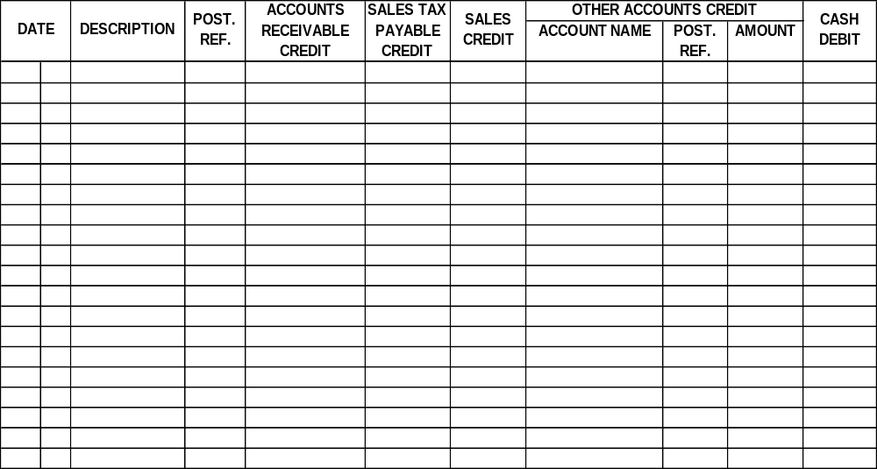
The cash receipts journal has separate columns for accounts that are frequently used.
CASH RECEIPTS JOURNAL PAGE 1
Debits to Cash
Page
293

Slide 16
There are columns for:
CASH RECEIPTS JOURNAL PAGE 1
Credits to Accounts Receivable for payments received on account
Page
293

Slide 17
There are columns for:
CASH RECEIPTS JOURNAL PAGE 1
Credits to Sales and Sales Tax Payable
for cash sales
Page
293

Slide 18
At the end of the month, the totals of all these columns are posted to the general ledger.
CASH RECEIPTS JOURNAL PAGE 1
Page
293

Slide 19
CASH RECEIPTS JOURNAL PAGE 1
The Other Accounts Credit section includes entries that do not fit into the special columns.
Page
293

Slide 20
Cash Received on Account
The Trend Center makes sales on account and bills customers once a month.
It sends a statement of account to each customer.
Page
294

Slide 21
QUESTION:
What is a statement of account?
ANSWER:
A statement of account is a form sent to a firm’s customers showing transactions during the month and the balance owed.
Page
294

Slide 22
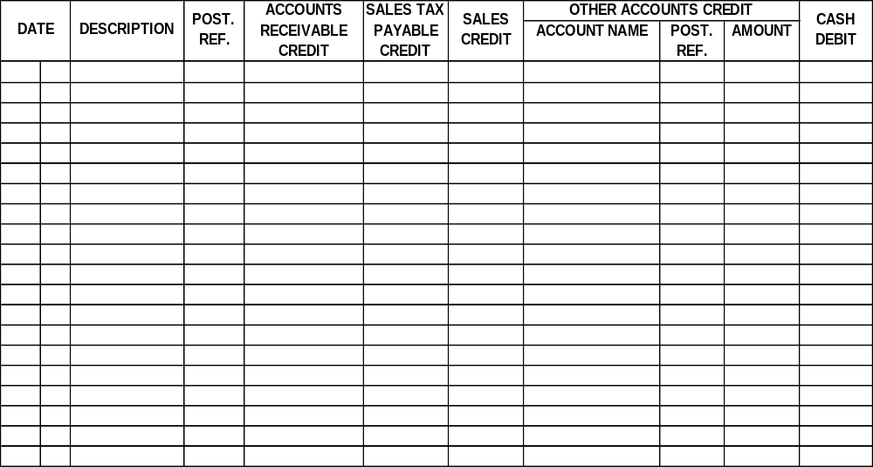
Look at the January 7 entry for John Allen.
CASH RECEIPTS JOURNAL PAGE 1
20--
Jan.
7
John Allen
428.00
428.00
The check amount is entered in the Accounts Receivable Credit and Cash Debit columns.
Page
293

Slide 23
Cash Discounts on Sales
The Trend Center does not offer cash discounts.
However, many wholesale businesses offer cash discounts to customers who pay within a certain time period. These are sales discounts.
Businesses with many sales discounts add a Sales Discounts Debit column to the cash receipts journal.
Page
294

Slide 24
Cash Sales and Sales Taxes
Consider the cash sales entries for January 8 in the cash receipts journal for The Trend Center.
Page
293

Slide 25
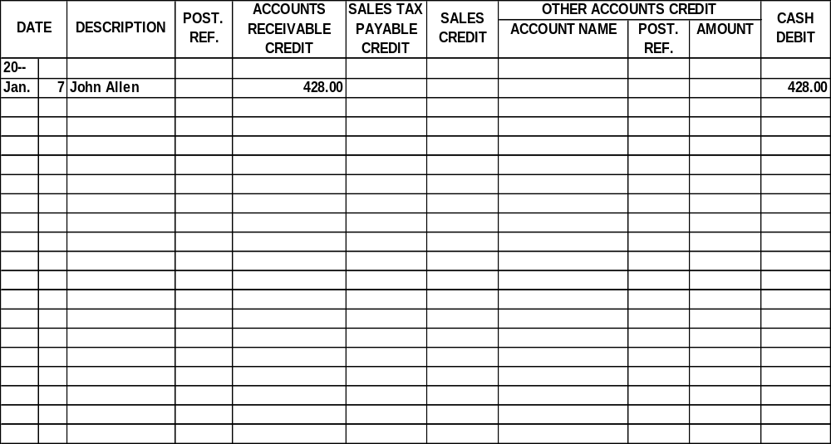
CASH RECEIPTS JOURNAL PAGE 1
8
Cash Sales
212.80
3,040.00
3,252.80
The sales tax collected is entered in the Sales Tax Payable Credit column.
Page
293

Slide 26
CASH RECEIPTS JOURNAL PAGE 1
8
Cash Sales
212.80
3,040.00
3,252.80
The sales is entered in the Sales Credit column.
Page
293

Slide 27
CASH RECEIPTS JOURNAL PAGE 1
8
Cash Sales
212.80
3,040.00
3,252.80
The cash received is entered in the Cash Debit column.
Page
293

Slide 28
CASH RECEIPTS JOURNAL PAGE 1
8
Cash Sales
212.80
3,040.00
3,252.80
Confirm that total credits equal total debits.
Page
293

Slide 29
Additional Investment by the Owner
On January 12 Stacee Harris invested an additional $10,000 in The Trend Center.
Page
294

Slide 30
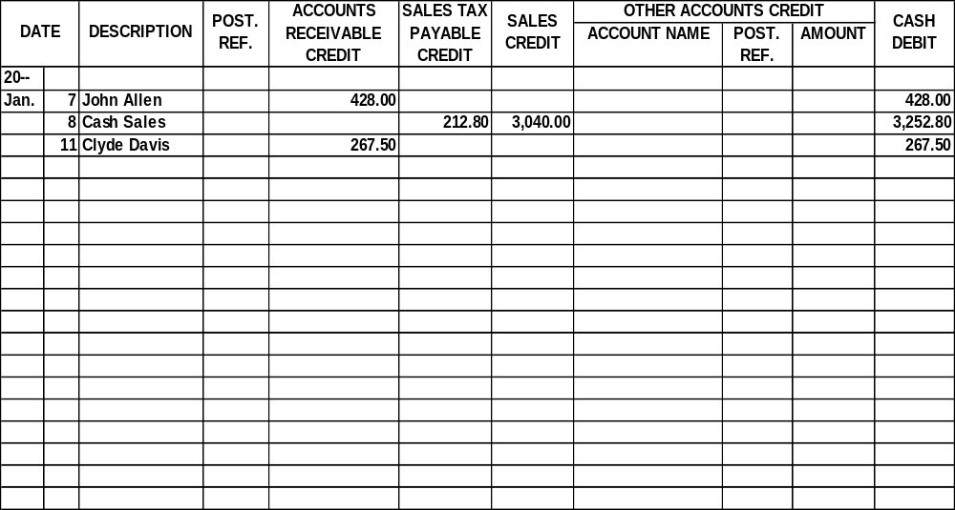
CASH RECEIPTS JOURNAL PAGE 1
12
Investment
S. Harris, Capital
10,000.00
10,000.00
The account name and amount are entered in the Other Accounts Credit section and the debit is entered in the Cash Debit column.
Page
293

Slide 31
Objective 2
Account for cash short or over.
Page
293

Slide 32
Cash Short or Over
Occasionally errors occur when making change.
When errors happen, the cash in the cash register is
either more or less than the cash listed on the audit tape.
Page
293

Slide 33
Cash Short or Over
When cash in the register is more than the audit tape, cash is over.
When the cash in the register is less than the audit tape, cash is short.
These are listed in the Cash Short or Over account.
Page
293

Slide 34
QUESTION:
What is the Cash Short or Over account?
ANSWER:
The Cash Short or Over account is an account used to record any discrepancies between the amount of currency and coins in the cash register and the amount shown on the audit tape.
Page
294

Slide 35
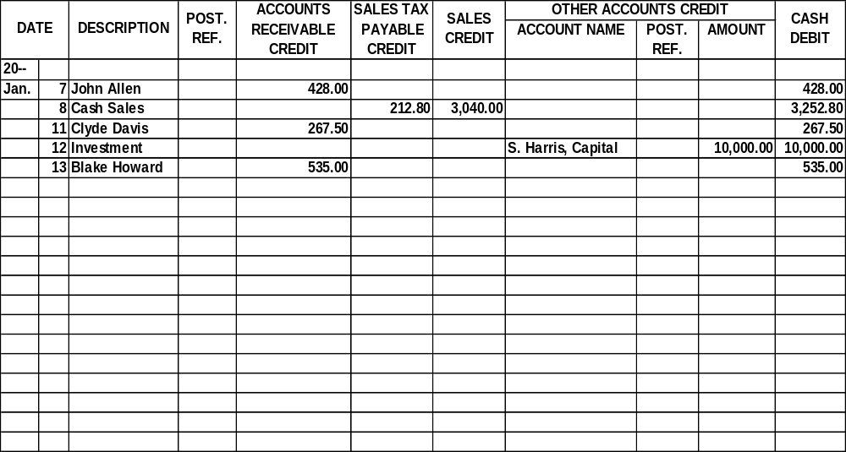
CASH RECEIPTS JOURNAL PAGE 1
15
Cash Sales
275.10
3,930.00
Cash Short/Over
9.00
4,196.10
Consider the entry for January 15.
Page
293

Slide 36
CASH RECEIPTS JOURNAL PAGE 1
15
Cash Sales
275.10
3,930.00
Cash Short/Over
9.00
4,196.10
$275.10 + $3,930.00 = $4,205.10
The cash is short. Shortages are recorded as debits.
Page
293

Slide 37
CASH RECEIPTS JOURNAL PAGE 1
15
Cash Sales
275.10
3,930.00
Cash Short/Over
9.00
4,196.10
Debits are not the normal balance of the Other Accounts Credit column, so the debit entry is circled.
Page
293

Slide 38
Receipt of a Cash Refund
On January 17 The Trend Center received a $50 cash refund for supplies that were returned to the seller.
Page
294

Slide 39
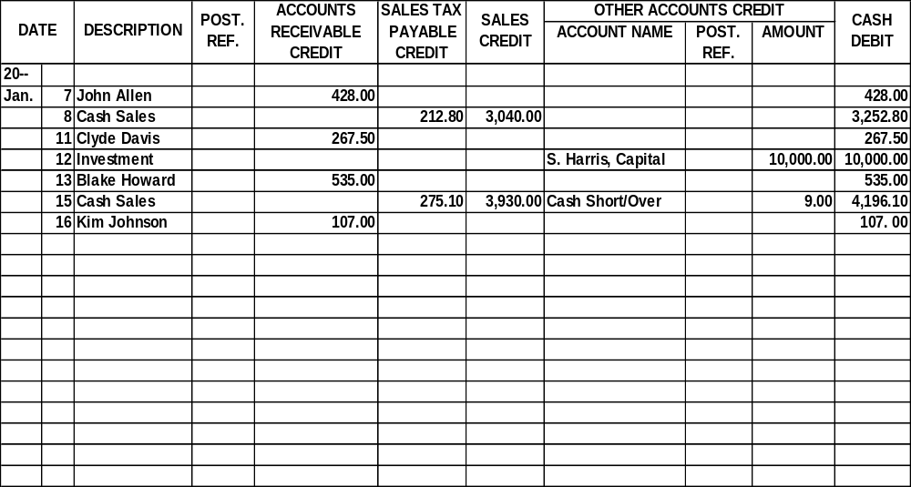
CASH RECEIPTS JOURNAL PAGE 1
17
Cash Refund
Supplies
50.00
50.00
The name and amount are entered in the Other Accounts Credit section. The debit is entered in the Cash Debit column.
Page
293

Slide 40
Collection of a Promissory Note and Interest
Businesses use promissory notes to
extend credit for some sales transactions.
Page
294

Slide 41
QUESTION:
What is a promissory note?
ANSWER:
A promissory note is a written promise to pay a specified amount of money on a certain date.
Page
294

Slide 42
Sometimes promissory notes are used to replace an accounts receivable balance when the account is overdue.
Page
295

Slide 43
On July 31 The Trend Center accepted a six-month promissory note from Jeff Wells, who owed $400 on account.
$400.00 July 31, 20--
Six months AFTER DATE I PROMISE TO PAY
TO THE ORDER OF The Trend Center
Four hundred and no/100 - - - - - - - - - - - - - - - - - - - - - - - - - - - - - - - - - DOLLARS
PAYABLE AT First Security National Bank
VALUE RECEIVED with interest at 9%
NO. 30 DUE January 31, 20-- Jeff Wells
Page
295

Slide 44
On July 31 The Trend Center recorded a general journal entry to increase notes receivable and to decrease accounts receivable for $400.
The asset account, Notes Receivable, was debited. The Accounts Receivable account was credited.
GENERAL JOURNAL Page 16
DATE DESCRIPTION POST. DEBIT CREDIT
REF.
20--
July 31 Notes Receivable 400.00
Accounts Rec./Jeff Wells 400.00
Received a 6-month, 9% note
from Jeff Wells to replace
open account
Page
295

Slide 45
Interest rate = 9% per year
Rate for six-month period = (9%) ÷ 2
= 4.5%
Interest amount = $400 x 4.5%
= $18
Total amount with interest = $400 + $18
= $418
Amount owed = $400
Page
295

Slide 46
On January 31 The Trend Center received a check for $418 from Jeff Wells.
This sum covered the amount of the note ($400) and the interest owed for the six-month period ($18).
Page
295

Slide 47
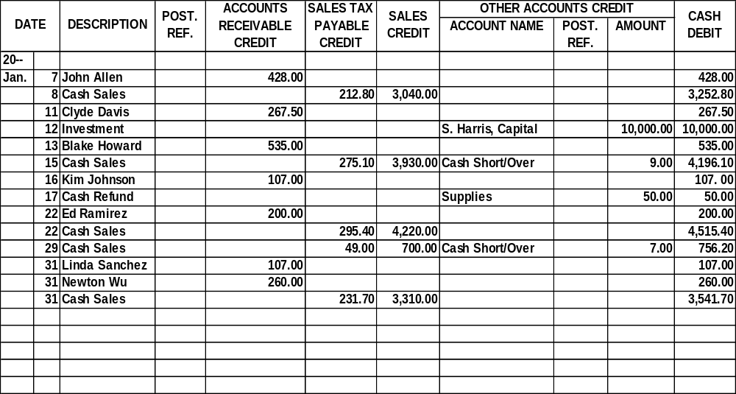
CASH RECEIPTS JOURNAL PAGE 1
The note and the interest are recorded in the Other Accounts Credit section.
31
Collection of
Notes Receivable
400.00
note/J. Wells
Interest Income
18.00
418.00
Page
293

Slide 48
Posting from the Cash Receipts Journal
Page
295

Slide 49
Objective 3
Post from the cash receipts
journal to subsidiary and
general ledgers.
Page
295

Slide 50
Posting the Column Totals
At the end of the month, the cash receipts journal is totaled and the equality of debits and credits is proved.
Page
296

Slide 51
PROOF OF CASH RECEIPTS JOURNAL
Debits
Cash Debit column $28,634.50
Credits
Accounts Receivable Credit column $ 1,904.50
Sales Tax Payable Credit column 1,064.00
Sales Credit column 15,200.00
Other Accounts Credit column 10,466.00
Total credits $28,634.50
Debits and credits are equal.
Page
296

Slide 52
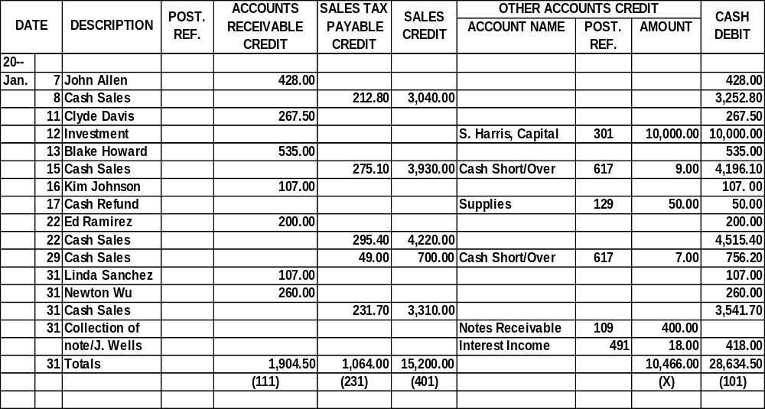
The column totals are posted to the general ledger.
CASH RECEIPTS JOURNAL PAGE 1
Page
296

Slide 53
The amounts in the Other Accounts Credit section are posted.
CASH RECEIPTS JOURNAL PAGE 1
The (X) indicates that the individual amounts are posted, and not the total.
Page
296

Slide 54
Posting to the Accounts Receivable Ledger
Post entries from the Accounts Receivable Credit column to the customers’ accounts in the accounts receivable subsidiary ledger daily.
Page
298

Slide 55
On January 7, $428 was posted to John Allen’s account in the accounts receivable subsidiary ledger.
Page
298

Slide 56
CASH RECEIPTS JOURNAL PAGE 1
SALES
DATE DESCRIPTION POST. ACCOUNTS TAX SALES OTHER ACCOUNTS CREDIT CASH
REF. RECEIVABLE PAYABLE CREDIT ACCOUNT TITLE POST. AMT. DEBIT
CREDIT CREDIT REF.
20--
Jan. 7 John Allen  428.00 428.00
The “CR1” indicates that the transaction appears on page 1 of the cash receipts journal.
Page
298
Name John Allen Terms n/30
Address 1313 Broken Arrow Road, Dallas, Texas 75267-6205
DATE DESCRIPTION POST. DEBIT CREDIT BALANCE
REF.
20--
Jan. 1 Balance  428.00
3 Sales Slip 1101 S1 214.00 642.00
7 CR1 428.00 214.00
31 Sales Slip 1110 S1 267.50 481.50

Slide 57
CASH RECEIPTS JOURNAL PAGE 1
SALES
DATE DESCRIPTION POST. ACCOUNTS TAX SALES OTHER ACCOUNTS CREDIT CASH
REF. RECEIVABLE PAYABLE CREDIT ACCOUNT TITLE POST. AMT. DEBIT
CREDIT CREDIT REF.
20--
Jan. 7 John Allen  428.00 428.00
The amount of $428 is posted to John Allen’s account.
Page
298
Name John Allen Terms n/30
Address 1313 Broken Arrow Road, Dallas, Texas 75267-6205
DATE DESCRIPTION POST. DEBIT CREDIT BALANCE
REF.
20--
Jan. 1 Balance  428.00
3 Sales Slip 1101 S1 214.00 642.00
7 CR1 428.00 214.00
31 Sales Slip 1110 S1 267.50 481.50

Slide 58
CASH RECEIPTS JOURNAL PAGE 1
SALES
DATE DESCRIPTION POST. ACCOUNTS TAX SALES OTHER ACCOUNTS CREDIT CASH
REF. RECEIVABLE PAYABLE CREDIT ACCOUNT TITLE POST. AMT. DEBIT
CREDIT CREDIT REF.
20--
Jan. 7 John Allen  428.00 428.00
The check mark () indicates that the amount was posted to the customer’s account.
Page
298
Name John Allen Terms n/30
Address 1313 Broken Arrow Road, Dallas, Texas 75267-6205
DATE DESCRIPTION POST. DEBIT CREDIT BALANCE
REF.
20--
Jan. 1 Balance  428.00
3 Sales Slip 1101 S1 214.00 642.00
7 CR1 428.00 214.00
31 Sales Slip 1110 S1 267.50 481.50

Slide 59
Advantages of the Cash Receipts Journal
Page
298

Slide 60
The cash receipts journal
Saves time and effort when recording and posting cash receipts
Allows for the division of work among the accounting staff
Strengthens the audit trail by recording all cash receipts transactions in one place
Page
298

Slide 61
R
E
V
I
E
W
Complete the following sentences:
cash receipts journal
The __________________ is a special journal used to record and post transactions involving the receipt of cash.
Cash refers to currency, coins, checks, money orders, and _______________
________.
funds on deposit
in a bank
A cash receipts journal will always include a __________ column.
Cash Debit

Slide 62
R
E
V
I
E
W
Complete the following sentences:
statement of account
A(n) __________________ is a form sent to a firm’s customers showing transactions during the month and the balance owed.
petty cash fund
The ______________ is used to handle payments involving small amounts of money.
promissory note
A(n) ______________ is a written promise to pay a specified amount of money on a specific date.

Slide 63
Thank You
for using
College Accounting, Tenth Edition
Price • Haddock • Brock

