Slide 1
CIS 273 Web Design and Development
Getting Started with HTML
Notes:
Welcome to Web Design and Development. In this lesson will discuss the history of the World Wide Web and how its growth has changed the way we do business, interact socially, study, and more.
Next slide.

Slide 2
Topics
Exploring the history of the World Wide Web
Introducing HTML
Entering elements and attributes
Exploring the structure of an HTML document
Marking the head element
Defining the structure of the page body
Notes:
The following topics will be covered in this lesson:
Exploring the history of the World Wide Web;
Introducing HTML;
Entering elements and attributes;
Exploring the structure of an HTML document;
Marking the head element; and
Defining the structure of the page body.
Next slide.

Slide 3
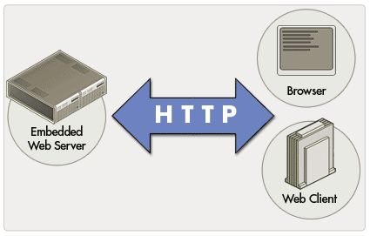
Exploring the History of the World Wide Web
The largest Wide Area Network
Uses hypertext to create links
Web pages are stored on Web Servers
Browsers allow you to view the pages
Notes:
The World Wide Web is the largest Wide Area Network in the world. When you are connected to the WWW or “online” you are potentially connected to every other person and computer who is “online” at the same time. What makes the WWW so easy to navigate are a series of hyperlinks that allow you to move between pages or other web sites with a single click. The use of these hyperlinks, developed by Dr. Timothy Berners-Lee has revolutionized the way we access and share information on a global scale.
Each document or web page is stored on a specialized server known as a “web server”. The pages are viewed through specialized software known as browsers which can be located on a computer, a mobile smart phone, tablets, some gaming systems, and more. The pages are written in a special mark-up language known as HTML, which we will explore in the next slide.
Next slide.

Slide 4
Introducing HTML
Began with SGML
Standardized through W3C
Constantly changing & growing
Notes:
Before we had Hypertext Markup Language or HTML, we had Standardized General Markup Language or SGML which was used by large organizations to simplify placing orders and tracking inventory. The costs were very high to develop and maintain the language but offered the ability to easily create highly specialized ways of “tagging” information.
When HTML first appeared, there were no set standards for authors to use so they were constantly facing incompatibility issues with different browsers. Finally, a group of designers formed the World Wide Web Consortium or W3C that created a uniform language that formed the basis of the language still in use today. Yet as time changed and technology became more sophisticated there were needs to improve HTML and in some cases phase out or deprecate tags. Even when tags are deprecated you may still find them in use in older sites.
Next slide.

Slide 5
XHTML & HTML5
HTML
HTML5
XML
Notes:
At the end of the 1990’s, the W3C released HTML 4.0 and began the task of working on the newest markup language: XHTML. This new version would use the simplicity of HTML and add the flexibility of XML know as Extensible Markup Language – where developers could add content specific tags. This new version was far stricter than previous version of HTML and required some minor adjustments for web developers but overall it was close enough to provide for an easy learning curve.
In the early part of this century, XHTML 1.1 was quickly becoming revamped with newer tags to accommodate social media, multimedia, and still remain flexible to grow along with technology. The biggest hurdle faced was that XHTML 2.0 would not be backwards compatible with earlier versions of HTML making integration a daunting task for companies.
Ian Hickerson proposed a different path in 2004 and eventually the Web Hypertext Application Technology Working Group or WHATWG was formed along with the specifications for HTML5. By 2009 work on XHTML 2.0 ceased and HTML5 moved to the foreground.
Next slide.

Slide 6
HTML & Style Sheets
HTML addresses different parts of the document
Style Sheets address how to display the content
Notes:
The use of HTML identifies where different parts of the document are displayed in the browser. It is the use of a style sheet that determines how it appears in a given device. The style sheet also adds uniformity in the appearance of the content controlling things such as color, heading formats, font styles and can address whole sections of a document contained in its own container known as a div.
Next slide

Slide 7
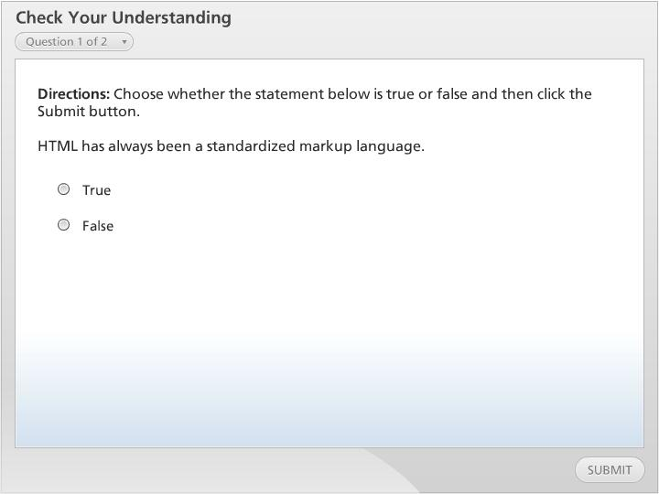



Check Your Understanding

Slide 8
Elements & Attributes
HTML is comprised of elements or tags <element> content here </element> <p> Welcome to My World </p>
Elements can nest inside each other <p> Welcome to <strong> My</strong> World </p>
Attributes specify use, behavior, and sometimes appearance <p id=“opening”> Welcome to <strong> My</strong> World </p>
Notes:
Everything in HTML is written inside of different elements which are also referred to as tags. Some elements have opening and closing tags as shown in this slide. Note the closing tag uses a forward slash before the element name is repeated. In this example we have places “Welcome to My World” inside a paragraph tag which is the letter p inside of the opening and closing brackets.
Elements may also be “nested” inside one another as shown here with “My” inside of the strong tag, making that word appear in bold text.
Attributes addressed use, behavior within a browser, or the appearance of the content. You may use more than one attribute within an element but they must be separated by a comma and the value of the attribute must be inside double quotation marks as well.
Next slide.

Slide 9
Using White Space
Written as a text file, HTML only uses characters and white space
White space is generally ignored in HTML
Use it to help separate out sections of a document
There is nothing macho about a straight left margin!
Notes:
HTML is written as a text file, such as using Notepad or any text editor and does not require that you ever use your “Enter” key. You can just write the code one element after another without any spaces but it would be hard to read or edit.
Browsers will ignore the use of your “Tab” key or consecutive spaces so use that to your advantage – indent code where it makes it easier to read or edit. Use spacing to help you align your content as close to what it will look like on a page as possible.
Next slide.

Slide 10
Structure of the Document
<!DOCTYPE html>
<html>
<head>
<title> document title </title>
</head>
<body> page content
</body>
</html>
Notes:
Your HTML document has several sections that comprise its structure. You begin with a Document Type Definition or DTD that lets the browser know which standard you are using. In HTML5 it’s very simple as shown in the slide.
Next comes the <head> section. This part of the document contains information about the document itself. One of the most important pieces of information is the <title> element. The text inside of this element will appear on the title bar in the browser and form the basis of a bookmark when a visitor adds the page to their bookmarks. It is very important that the title text is meaningful so that when your visitors look for the bookmark they can easily find the correct page. If left out the browser will name the page “untitled document” and if the text is too short such as “price list” the visitor might not recall which price list from which site.
The <body> section contains the content that will appear on the page in the browser.
Please note that each of the structure tags have closing tags associated with them with the exception of the DOCTYPE.
Next slide.

Slide 11
Adding Comments
Comments allow you leave notes to yourself or other designers
They do not show in the browser
They are visible if someone views your code
<!-- comment here --> <! -- note the new prices -->
Notes:
Use comments to help you remember something about the content of the page. You can also use comments to help you remember what you’re placing in a given section of your page. Keep in mind that while the browser does not show the comment to a visitor, they are transparent if the visitor decides to view your code. With that in mind, always keep your comments professional sounding.
You create this “empty tag” with the opening bracket, an exclamation point known as a bang in programming followed by two hyphens. Then you add your comment and close the tag with two hyphens and the closing bracket. Note that there is no forward slash in here.
Next slide.

Slide 12
HTML5 Structural Elements
The structural elements are:
Element | Description
article | Covers a single topic
aside | Tangential to main topic
footer | Content at bottom of the page
header | Content at top of the page
nav | Hyperlinks for navigating the site
section | Major topical area
Notes:
Before you begin to code your pages you should first have a road map or plan of what the page will look like. It’s often a good idea to create a rough sketch or even write the content in a word processing program that is capable of performing spell and grammar checks for you as well. Once you have drawn the page or typed it into a document you can begin to determine what the major content areas are and plan for their proper coding. Keep in mind that not all pages will use each of the structural elements so do not worry if you do not have an <aside> element on the page as one example.
You can also nest structural elements inside of each other so you might have a section with an aside embedded within the section. You can also have multiple structural elements within a single page, such as having more than one article in place.
In HTML 4 the <div> tag was used instead of the HTML5 elements. While you can still use the <div> it is a better practice to use the newer elements because this is the future of the Web.
Next slide.

Slide 13
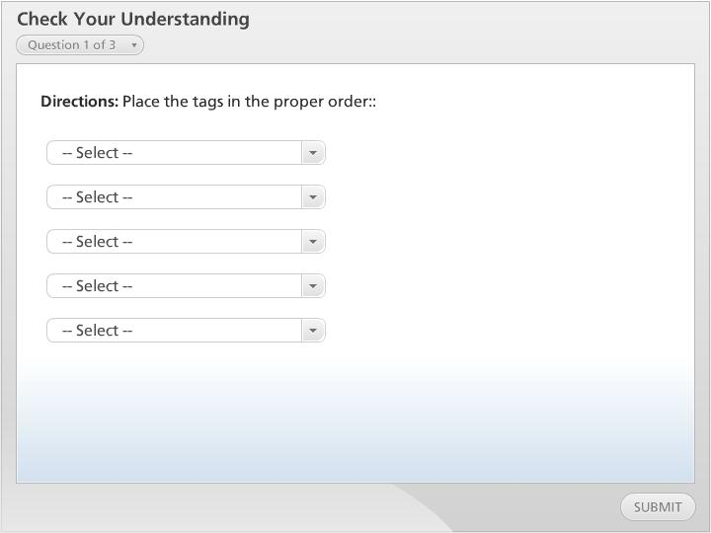
Check Your Understanding

Slide 14
Summary
Exploring the history of the World Wide Web
Introducing HTML
Entering elements and attributes
Exploring the structure of an HTML document
Marking the head element
Defining the structure of the page body
Notes:
We have reached the end of this lesson. Let’s take a look at what we’ve covered.
We started our discussion by examining the history of the World Wide Web.
Then we examined HTML’s history and compared it to XHTML, XML and finally HTML5 and Style Sheets.
Next we examined working with HTML elements and white space. We also looked at how to structure our documents and add comments.
Finally, we looked at HTML5 structural tags.
This completes this lesson.

