Slide 1
Web Design and Development CIS 273
Getting Started with HTML
Notes:
Welcome to Web Design and Development. In this lesson will discuss how to work with some of the basic elements of HTML.
Next slide.

Slide 2
Topics
Working with grouping elements
Marking a list
Applying an external style sheet
Marking text-level elements
Marking a line break
Inserting an inline image
Working with character sets & special characters.
Notes:
The following topics will be covered in this lesson:
Working with grouping elements;
Marking a list;
Applying an external style sheet;
Marking text-level elements;
Marking a line break;
Inserting an inline image; and
Working with character sets and special characters.
Next slide.

Slide 3
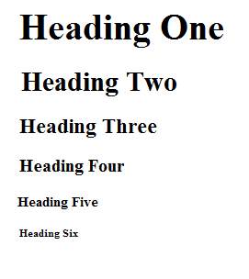

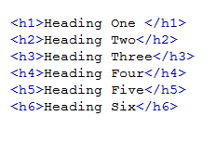
Heading Elements
Notes:
Heading elements help to organize your web page visually. Each heading level, much like the heading styles in a Word document, help your visitor to identify different sections and their relative importance. As shown in our slide, you can see how beginning with <h1> through <h6> the sizes become smaller. It is also important to note that each heading level element adds a double space after the line of text. These are all hard coded and you do not need to tell these elements to be bolded since they already are. You must also remember that software such as a screen reader will not discern any differences between the headings so these are not to be used to format your pages on their own. You should include the headings inside of your <article> elements when organizing your pages.
Next slide.

Slide 4

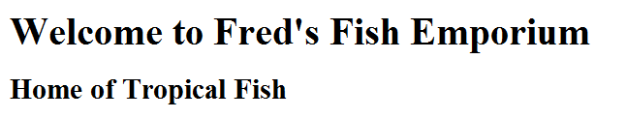
<hgroup> Elements
The <hgroup> in code:
How it appears:
Notes:
The <hgroup> elements allow you to group together headings to indicate that they are acting as a title and subtitle on your page. You can add any of the heading levels to an <hgroup>. This element has an opening and closing tag which you use to surround your heading levels as shown in the slide here.
Next Slide

Slide 5
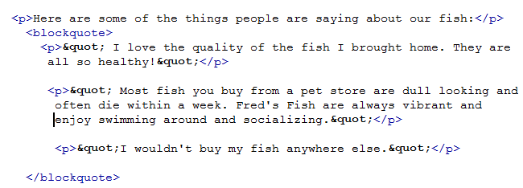
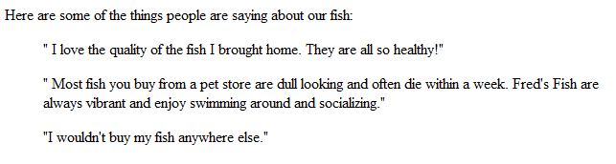
Creating Paragraphs & Blockquotes
Example of the code:
How it appears:
Notes:
Paragraphs are used on a web page in much the same way as they are in a Word document. In HTML5 you must always use the closing <p> tag even if an older browser will still accept only the opening tag. On their own, the paragraphs will use the flush left margin and text will word wrap in the browser based upon the size of the window.
Blockquotes are used to indent text within the page, often for long quotes or offsetting content. You can use a <blockquote> to group several paragraphs as well if the quote is longer than a single paragraph.
Next Slide

Slide 6
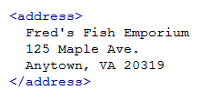
Marking an Address
Most browsers will render the <address> contents in italics:
Notes:
The <address> element is used to surround an address on a web page. The contents of the element are almost always shown in italics in the browser, with added line breaks before and after the information. As you can see from the example above, the contents will appear on a single line even though you have coded them with line breaks. Later, we’ll add the coding to introduce the line breaks.
When the <address> is used inside of the <body> it represents the contact information for the document. When it is used inside of an article it represents the author of the article.
Next Slide

Slide 7
Marking Lists
HTML uses three kinds of lists:
Ordered
Unordered
Description
Ordered lists imply sequence or priority
Unordered lists are often just items
Description lists define terms
Notes:
Lists make it easier to share ideas in an organized manner. The three different kinds of lists in HTML are used for different purposes:
An ordered list, using the element <ol> indicates a sequence or order of priority, while an unordered list using the element <ul> is often used to simply list items without prioritizing them. Both elements use the <li> element to indicate each list item.
A description list uses the element <dl> to surround the list. Inside the term that is being defined is marked with <dt> while the description is marked with <dd>. This kind of list is useful for glossaries, short bios about employees, product descriptions, and so on. In the next two slides we’ll view the code and how the lists appear in a browser.
Next slide.

Slide 8
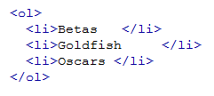
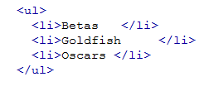
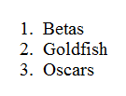
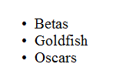
Ordered & Unordered List Examples
Ordered List Example | Unordered List Example
Notes:
Here we see the only difference in the coding is the <ol> for the ordered list versus the <ul> for the unordered list. The browser adds the numbers or bullets by default.
Next slide.

Slide 9
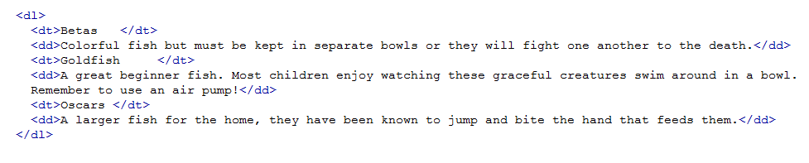
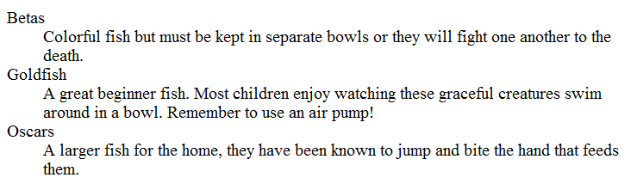
Description List Example
Here’s the code:
How it appears:
Notes:
Here the <dl> surrounds all of the fish that are being described for the customer. Each fish has its own <dt> while each description is surrounded with <dd>.
Next slide.

Slide 10
Nesting Lists
Nested lists create levels with indentation
Can list subtopics or items
Each list must have its own set of opening and closing elements
You can next an unordered list inside an ordered list
Notes:
Using different levels in your lists allows you to create one topic and list subtopics or items underneath. You might want to use this for a single product such as a fish tank with a nested list showing different sizes. Or this could be useful for agendas with a main topic and the subtopics listed below. On the next slide we’ll take a look at an example of a nested list.
Next slide.

Slide 11
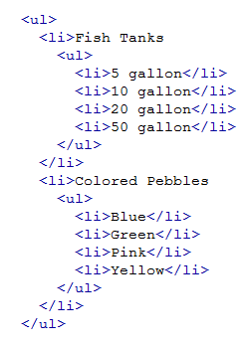
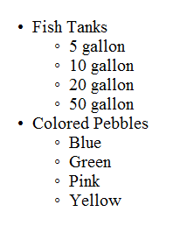
Nested List Example
Notes:
When viewing the code, note the use of indenting to make it easier to check for opening and closing elements.
Next slide.

Slide 12
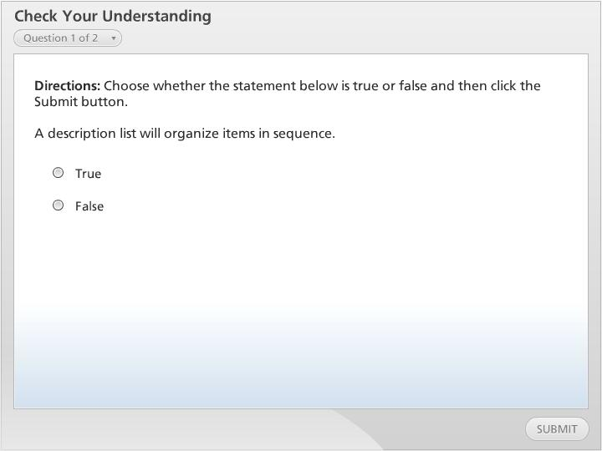



Check Your Understanding

Slide 13
Linking to A Style Sheet
An External Style Sheet keeps formatting consistent
Not all browser work with HTML5 styles
A workaround using JavaScript is often needed to render pages in older browsers
<link href=“stylesheet.css” rel=“stylesheet” type=“text/css”
<script src=“file”> </script>
<script src=“modernizr-1.5.js”><script>
Notes:
Style sheets use Cascading Style Sheet, “CSS” as way to control the format of your pages. CSS allows you to define color, font choices, size, placement, and the like within a given page. When you link to an external style sheet you can easily format all your pages quickly to look consistent with one another. Another useful tool in CSS is that when you change the style in your style sheet, your new style will be applied to all your pages simultaneously saving you time and trouble.
Older browsers may not recognize the newer code elements in HTML5 such as the <section>, <aside>, and <article> and so you will need to apply some JavaScript as a workaround. You do not need to know how to write the code yourself but can easily access a free, open-source document from MIT. You can link to this file as follows: <script src=“modernizr-1.5.js”><script>. Remember to place this in the <head> section of your code.
The href or src portion of the element indicates the file path of where you CSS or JavaScript document is stored and it is important that you add this correctly or neither will be applied.
Next slide

Slide 14
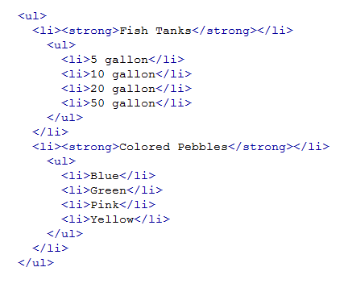
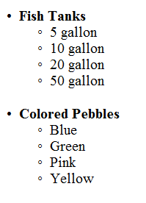
Text Level Elements
Surrounds specific text
Employs opening and closing elements
<b> and <i> should be last resorts
Notes:
The grouping elements we’ve examined so far all apply to large blocks of content and always begin on a new line. Text level elements are applied to specific text within your content. Suppose you want to have something appear as bold? In HTML you would surround that text with the element <strong>, as shown in the example in this slide. Now the top level of our nested list appear as bold making them stand out a little more on the page.
Text level elements can add interest and clarity to your content but can also become confusing if you use too many at a time. Remember when you are designing your pages that on the web less is often more.
Next slide.

Slide 15
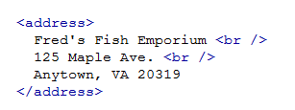
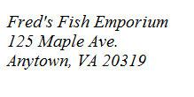
Inserting Line Breaks
<p> appears like a double space
<br /> appears like a single space
Notes:
Remember when we added the <address> element and wrote our code on different lines for each part of the address? Everything appeared on a single line because the browser ignored your white space. In order to separate out each line of the address we need to tell the browser to move to the next line on the page. To do this we use the empty element <br />.
Next slide.

Slide 16

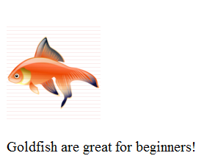
Inserting Inline Images
Adds visual interest
Placed inline with your text
Can be .jpg, .gif, or .png
The alt attribute displays text as well
Notes:
They say a picture is worth one thousand words. This may be a very true statement but on the web a picture will add time to downloading the page so use them judiciously. Web browsers support .jpg, .gif, and .png file types.
The element for inserting images is comprised of several parts utilizing the source attribute indicated as src in the element. This points to the file path of where the image is stored. Another important attribute is the alternative text attribute indicated as alt in the element. This attribute is especially necessary for your pages to be accessible to individuals with visual impairments.
Another two important attributes are the width and height with their related pixel sizes. This tells your browser how much space to allocate for the image while it continues to download other content.
The example above is code pointing to an image for the site using the <figcaption> element to label the image for the visitor.
Next slide.

Slide 17
Character Sets & Special Characters
Character sets include:
Letters
Numbers
Punctuation Marks
Spaces
Special Symbols
Code for a copyright symbol © is entered as: &#169;
Notes:
Character sets are different for each font that you may have used in your word processing documents. Each set includes all the characters necessary to indicate letters, numbers, punctuation marks, and special characters like a dollar sign or copyright symbol. As you are entering your code in your text editor you may notice that you cannot add some symbols that are not already on your keyboard and so you’ll need to rely on the ASCII also known as the American Standard Code for Information Interchange. This is the code for those symbols. When working with ASCII code you will insert the correct number between and ampersand, followed by a pound symbol, the number and finally a semi-colon as shown in this slide for a copyright symbol.
Next slide.

Slide 18
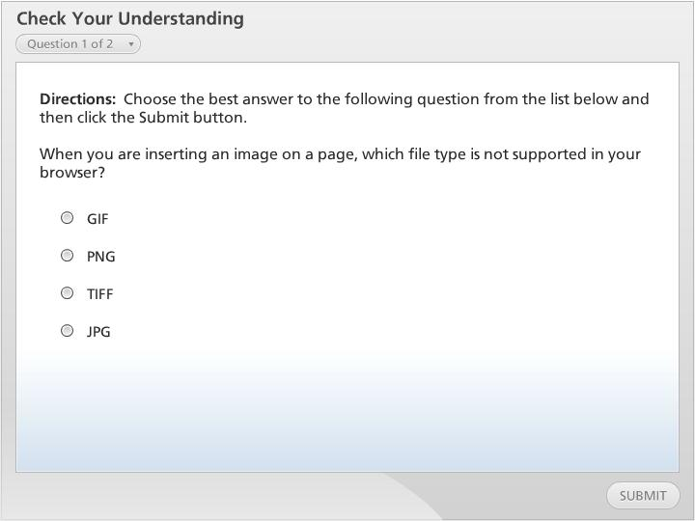
Check Your Understanding

Slide 19
Summary
We have looked at the following:
Working with grouping elements
Marking a list
Applying an external style sheet
Marking text-level elements
Marking a line break
Inserting an inline image
Working with character sets & special characters.
Notes:
We have reached the end of this lesson. Let’s take a look at what we’ve covered.
We started our discussion by examining grouping elements which help to organize content visually on your pages.
Then we examined how to create three different kinds of lists: ordered, unordered, and description.
Next we looked at how to add a style sheet to your pages to control their format as well as the workaround for older browsers with JavaScript.
We looked at how to add line breaks to your pages so that you have the option of using a single space between lines of text.
Then we looked at how to add images to your pages along with a caption.
Finally, we looked at how to add special characters to your pages when they are not available on your keyboard.
This completes this lesson.

